Slide 1


Libyan International Medical University
Faculty of business administration
Building Information System
Name : Abdulrahman Hammuda, Munther Almarimi, Ayub Buwden, Mustafa almatmati
Student ID. : 2278,2275,2276,2281

Slide 2

CONTENT
Introduction
Building Information System
System Development and Organizational Change
Overview of System Development
Alternative System-Building Approaches
Conclusion
References

Slide 3
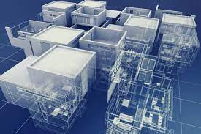
introduction
What is Building Information Management System
(BIM) technology?
BIM allows designers to create 3D models. Once architects design a building, contractors use the same model to construct it; when a building is finished, the owners use BIM to schedule maintenance and complete infrastructure updates.

Slide 4
Building information system
Building a new information system is one kind of planned organizational change. The introduction of a new information system involves much more than new hardware and software.
It also includes,
Changes in jobs,
Skills,
Management and,
Organization.
When we design a new information system, we are redesigning the
organization. System builders must understand how a system will affect specific business processes and the organization as a whole

Slide 5
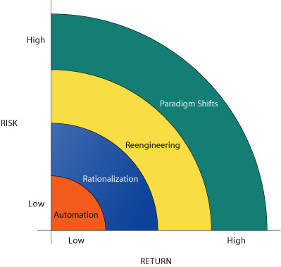
System development and organizational change
Information technology can promote various degrees of organizational change, ranging from steady to far-reaching. The diagram shows four kinds of organizational change :
(1) Automation,
(2) Rationalization,
(3) Business process redesign, and
(4) Paradigm shifts.

Slide 6
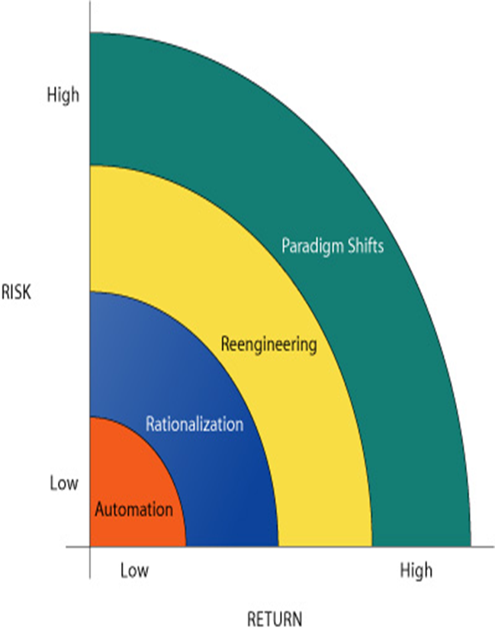
System development and organizational change
The most common form of IT-enabled organizational change is AUTOMATION.
The first applications of information technology involved assisting employees with performing their tasks more efficiently and effectively. Calculating pay checks and pay roll registers are examples of early automation.
Slow-moving and slow-changing strategies

Slide 7
System development and organizational change
RATIONALIZATION of procedures is streamlining of standard operation procedure, eliminating obvious bottleneck, so that automation can be made more efficient
Both Automation and Rationalization can cause some disruption, but it's usually manageable and easily accepted by the people

Slide 8
System development and organizational change
REDESIGNING can cause radical disruption.
Because many companies use it as a guide for downsizing the organization and laying off workers.
Business redesigning causes planners to completely :
Rethink the flow of work.
How the work will be accomplished, and
How costs can be reduced by eliminating unnecessary work and worker

Slide 9
System development and organizational change
PARADIGM SHIFT :
A paradigm shift involves rethinking the nature of the business and the nature of the organization.
This category of Structural Organizational Change is more radical as compared to the Business Procedure Redesign.
It changes the very nature of the business and the structure of the organization itself. (A whole
new products or services that didn't even exist before).

Slide 10

Overview of system development
New information systems are an outgrowth of a process of organizational problem solving. A new information system is built as a solution to some type of problem or set of problems the organization perceives it is facing.
The problem may be one in which managers and employees realize that the organization is not performing as well as expected, or that the organization should take advantage of new opportunities to perform more successfully

Slide 11

Overview of system development
The activities that go into producing an information system solution to an organizational problem or opportunity are called Systems Development. Systems development is a structured kind of problem solved with distinct activities. These activities consist of :
Systems analysis,
Systems design,
Programming,
Testing,
Conversion, and
Production and maintenance.

Slide 12
Alternative system-building approaches
Systems differ in terms of their size and technological complexity and in terms of the organizational problems they are meant to be solved. A number of systems building approaches have been developed to deal with these differences. This section describes these alternative methods:
The traditional systems life cycle,
Prototyping.

Slide 13
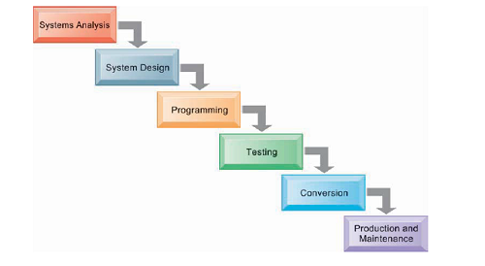
Alternative system-building approaches

Slide 14
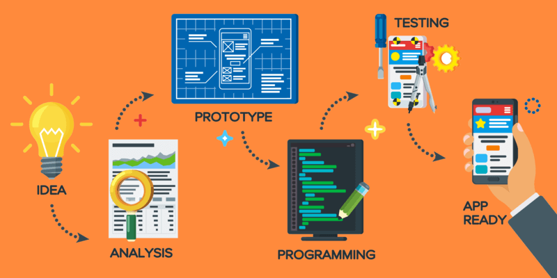
Alternative system-building approaches

Slide 15

Conclusion
Most businesses use technology to enhance Building information systems. An information system is any system that is used to organize data which then is disseminated to appropriate people within the organization. Information systems don't have to consist of computers, networks, and other digital technologies

Slide 16
References
Eastman, Chuck; Tiecholz, Paul; Sacks, Rafael; Liston, Kathleen (2008). https://www.gim-(international.com/content/article/building-information-system#:~:text=A%20BIS%20is%20the%20most,built%20the%20BIS%20are%20twofold.)
Eastman, Chuck; Tiecholz, Paul; Sacks, Rafael; Liston, Kathleen (2011). (https://www.witpress.com/books/978-1-78466-275-2)
Ruffle S. (1986) "Architectural design exposed: from computer-aided-drawing to computer-aided-design" Environments and Planning B: Planning and Design 1986 March 7 pp 515-550.

Slide 17
THANK YOU
FOR
LISTENING

