Slide 1


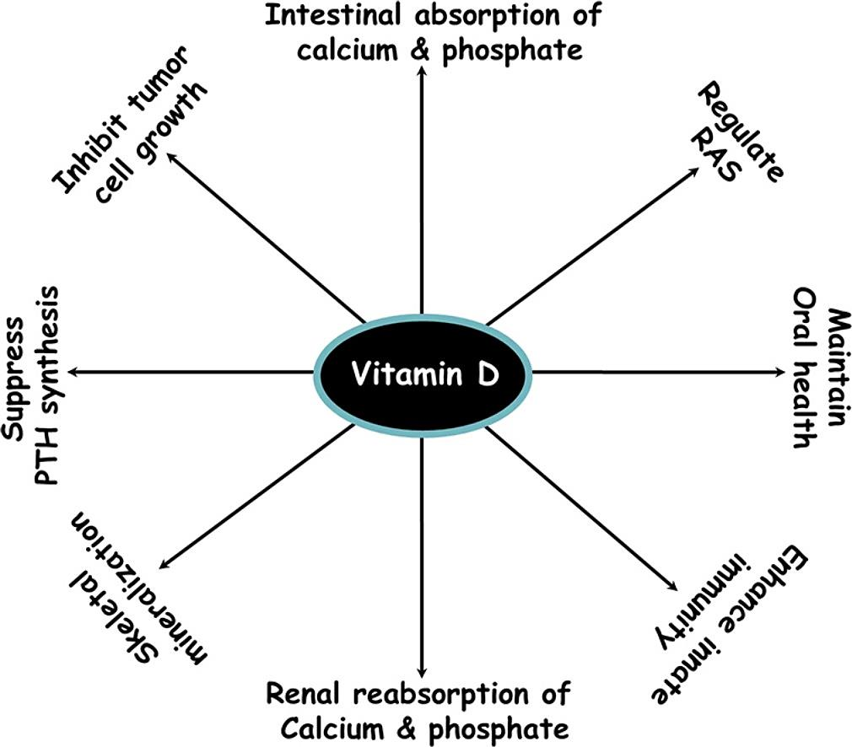
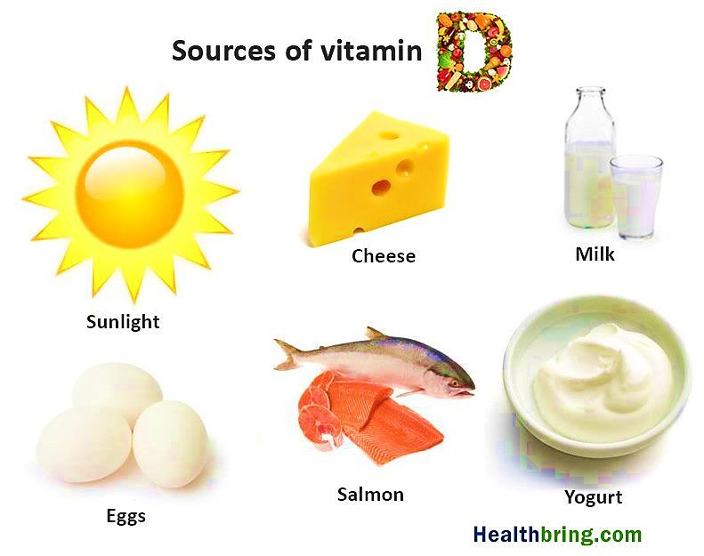
How Does Vitamin D Related to Dental Health
Rokaia Mostafa Aboamoud 2nd year dental student
Libyan International Medical University
Faculty Of Basic medical sciences
introduction
Vitamin D can also reduce the number of matrix metalloproteinase (MMP’S), enzymes associated with periodontal disease. The cells in our immune system and teeth have vitamin D receptors. These receptors bind with the vitamin D we take into our bodies thus increasing the amount of good antimicrobial proteins in the body which fight the bacteria that cause dental caries and periodontal disease.
Vitamin D in relation to Dental health is simple.
A healthy vitamin D level in the body decreases the severity of periodontal disease by supporting stronger healthy bone, reduces bacteria in the mouth and leads to stronger enamel with less decalcification.²
Vitamin D: Essential vitamin for the absorption and metabolism of calcium and phosphorous .
Sunlight promotes sufficient supplementation through the skin when regularly exposed to
normal amounts of sun daily.
Deficiency can lead to poor bone health deformity and weakness.
Vitamin D other rules in the body, including modulation of cell growth , neuromuscular and immune function , and reduction of
inflammation.
There are two main forms of vitamin D are vitamin D3 or cholecalciferol and ergocalciferol or vitamin D2. ¹
Figure2: The roles of vitamin D in the body
Sources of vitamin D
Relation between vitamin D and dental health
Conclusion
Vitamin D plays an important role in oral health by maintaining bone mass, preventing tooth loss, caries, gingivitis and periodontitis, prevention of malignancy, prevention against infection by boosting immunity and having antimicrobial properties.
Enamel is the most mineralized substance in the body made up of calcium and phosphate.
Vitamin D also produces cathelicidin and defenses that have antimicrobial properties helping to reduce the number of bacteria in the mouth and also help absorb calcium and phosphate from the foods we eat.
References
Champe, P.C., Harvey, R.A. & Ferrier, D.R. (2008). Biochemistry. (3rd ed.), Publisher: Lippincott Williams & Wilkins
Suzanne K. Winans, D. (n.d.). Vitamin D and How it Relates to Your Oral Health. [online] Tenino Family Dental Center, Dr. Suzanne Winans. Available at: http://www.teninofamilydental.com/vitamin-d-and-how-it-relates-to-your-oral-health/?fbclid=IwAR0sXR7VMobo7tRopImioOfDBA7TfI02SFfiTr97y0MXpVS05ZvJU2WOAE0
Figure1: Vitamin D sources

