Slide 1


Ethical Behavior and Practice
Libyan International Medical University
Faculty of Business Administration
Student Name: Shahed Elhasia
Student ID: 2186
E-mail: shahed_2186@limu.edu.ly

Slide 2
1
2
3
4
5
Contents:
Ethical Practice.
Introduction.
Ethical Behavior.
Conclusion.
The Ethical Decision-Making Process (ISSUES).
02.

Slide 3
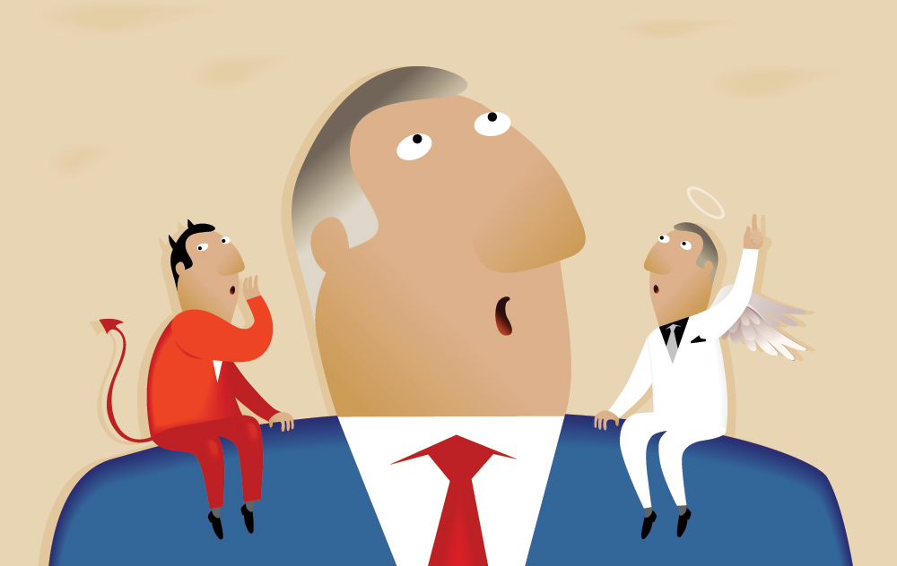
Inroduction:
“The way we make decisions is important for organizations because the wrong decisions or decisions which have been implemented badly can have a significant impact on people’s lives and the reputation of organizations”. (Anonyms, November 18, 2020)
Ethical practice: CIPD Profession Map. (n.d.). Retrieved November 18, 2020, from https://peopleprofession.cipd.org/profession-map/core-behaviours/ethical-practice
03.

Slide 4

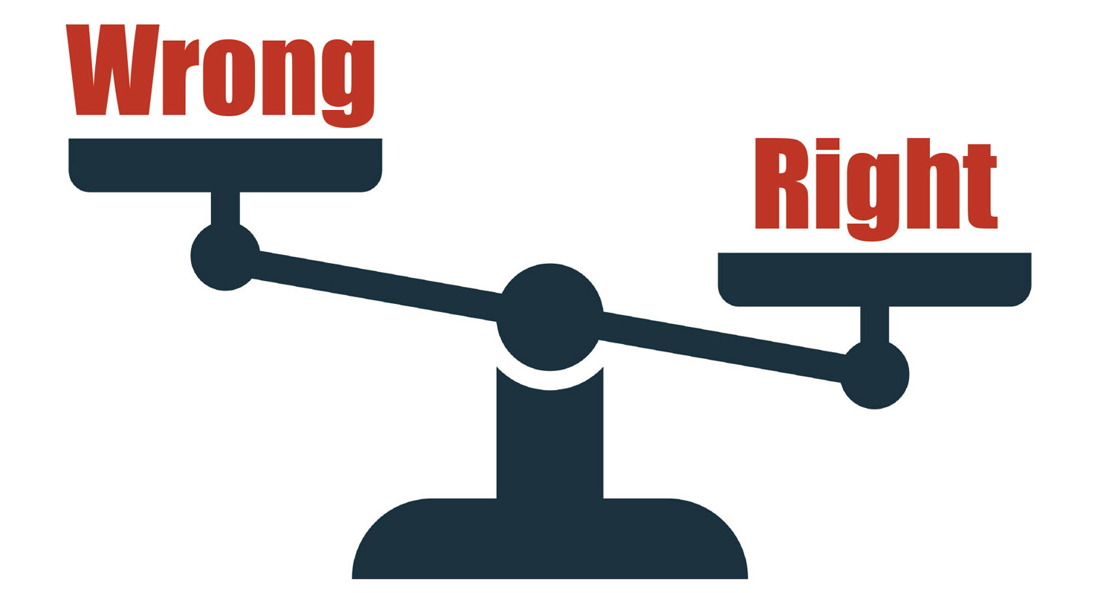
Ethical Behaivor
“A person who demonstrates ethical behavior has evidence of a strong moral code and a consistent set of values. Ethics can be rooted in belief or the pursuit of making the world better”. (Anonyms, November 18, 2020)
A Culture of Ethical Behavior Is Essential to Business. (n.d.). Retrieved November 18, 2020, from https://www.businessnewsdaily.com/9424-business-ethical-behavior.html
04.

Slide 5

Ethical Practice
“A branch of philosophy dealing with values pertaining to human behavior, considering the rightness and
wrongness of actions and the goodness or badness of the motives and ends of such actions”. (Anonyms, November 18, 2020)
Ethics. (n.d.). Retrieved November 18, 2020, from https://medical-dictionary.thefreedictionary.com/Ethical+Practices#:~:text=1.,or%20principles%20governing%20right%20conduct.
05.

Slide 6

The Ethical Desicios-Making Process
“The (ISSUES) concept from McMaster University, Hamilton”.
“Ethical decision making framework, It is applicable at personal, professional and organizational levels both between and within groups”. (Anonyms, November 18, 2020)
Identifying and Analyzing an Ethical Issue. (n.d.). Retrieved November 18, 2020, from https://www.physio-pedia.com/Identifying_and_Analysing_an_Ethical_Issue.
06.

Slide 7
U
I
Identify
Understand
Identify issues and Decision-Making process.
Understand values and duties.
S
E
Evaluate
Study
Evaluate and justify options.
Study the facts.
S
S
Sustain
Select
Sustain and review the plan.
Select reasonable options.
Identifying and Analyzing an Ethical Issue. (n.d.). Retrieved November 18, 2020, from https://www.physio-pedia.com/Identifying_and_Analysing_an_Ethical_Issue.
07.

Slide 8
Conclusion:
“It may be useful to imagine that rigorous ethical decision-making is like building a house. When we encounter ethical dilemmas our first instinct may be to find a quick fix. However, our desire for resolution may cause us to misidentify the key issues or overlook important facts, values or the opinions of other stakeholders”. (Anonyms, November 18, 2020)
Identifying and Analyzing an Ethical Issue. (n.d.). Retrieved November 18, 2020, from https://www.physio-pedia.com/Identifying_and_Analysing_an_Ethical_Issue.
08.

Slide 9
References:
Identifying and Analyzing an Ethical Issue. (n.d.). Retrieved November 18, 2020, from https://www.physio-pedia.com/Identifying_and_Analysing_an_Ethical_Issue.
Ethics. (n.d.). Retrieved November 18, 2020, from https://medical-dictionary.thefreedictionary.com/Ethical+Practices#:~:text=1.,or%20principles%20governing%20right%20conduct.
A Culture of Ethical Behavior Is Essential to Business. (n.d.). Retrieved November 18, 2020, from https://www.businessnewsdaily.com/9424-business-ethical-behavior.html
Ethical practice: CIPD Profession Map. (n.d.). Retrieved November 18, 2020, from https://peopleprofession.cipd.org/profession-map/core-behaviours/ethical-practice
09.

Slide 10
Thank You For Your Attention!
Any questions?

