Slide 1


BREAST CANCER
Libyan International Medical University
Faculty of Basic Medical Science
First Year
Name : Raghad Abd Al-Nasser Abdullah
3242

Slide 2
Objectives
1- Define breast cancer .
2- Discuss signs symptoms of Breast cancer .
3- Risk factor breast Cancer .
4-Treatment Options for Breast Cancer .

Slide 3
Introduction :
The breast is made up of different tissue, ranging from very fatty tissue to very dense tissue.
✓ Breast cancer is the most common malignant tumor among women globally and causes the majority of cancer deaths in women.

Slide 4
definition breast cancer :
Breast cancer is a disease in which cells in the breast grow out of control and There are different kinds of breast cancer ,The kind of breast cancer depends on which cells in the breast turn into cancer and Breast cancer can begin in different parts of the breast.

Slide 5
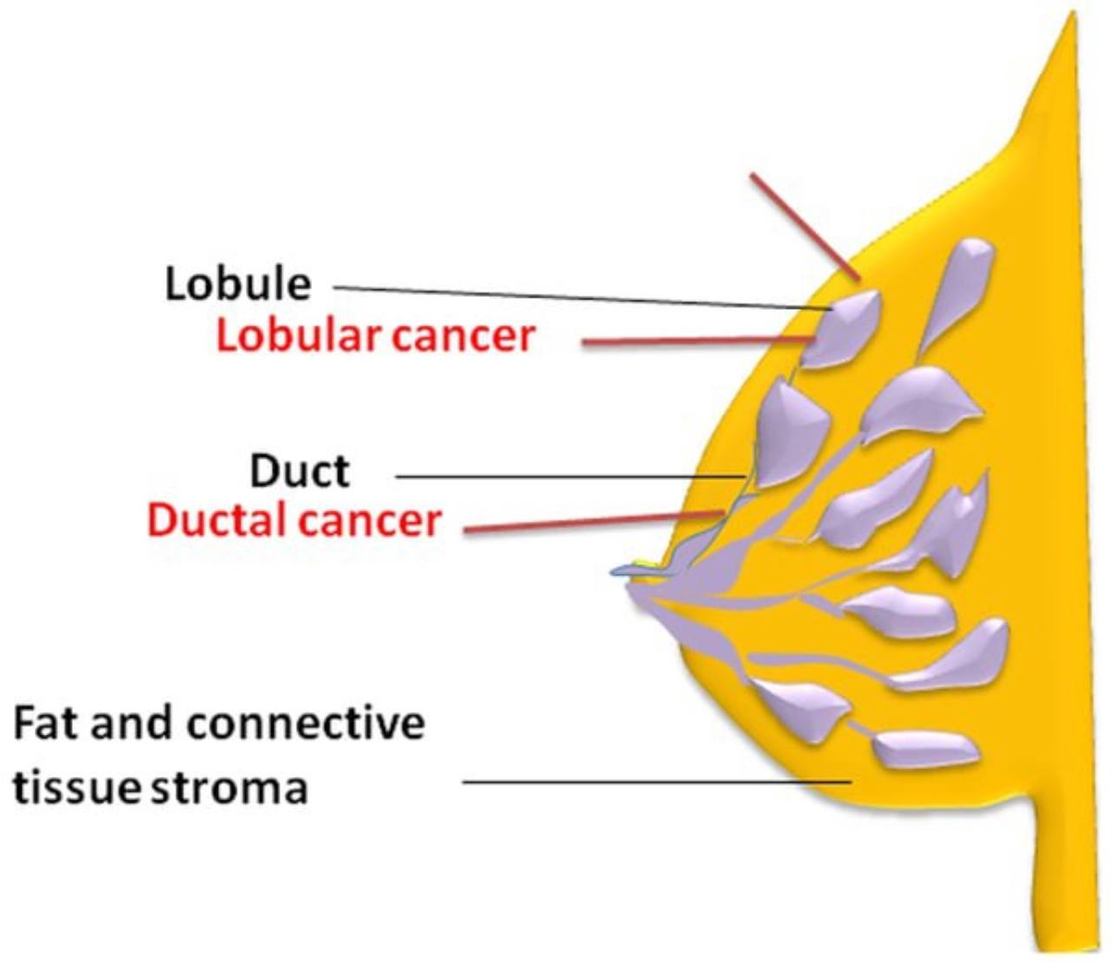
Breast is made up of three main parts :

Slide 6
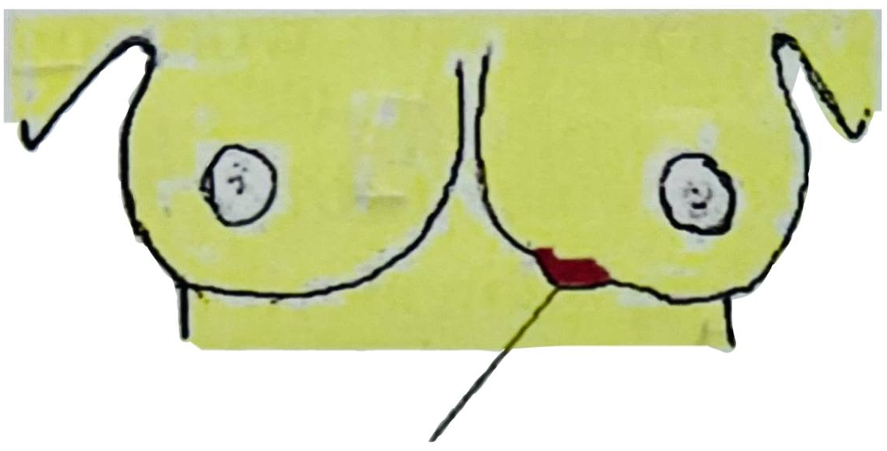
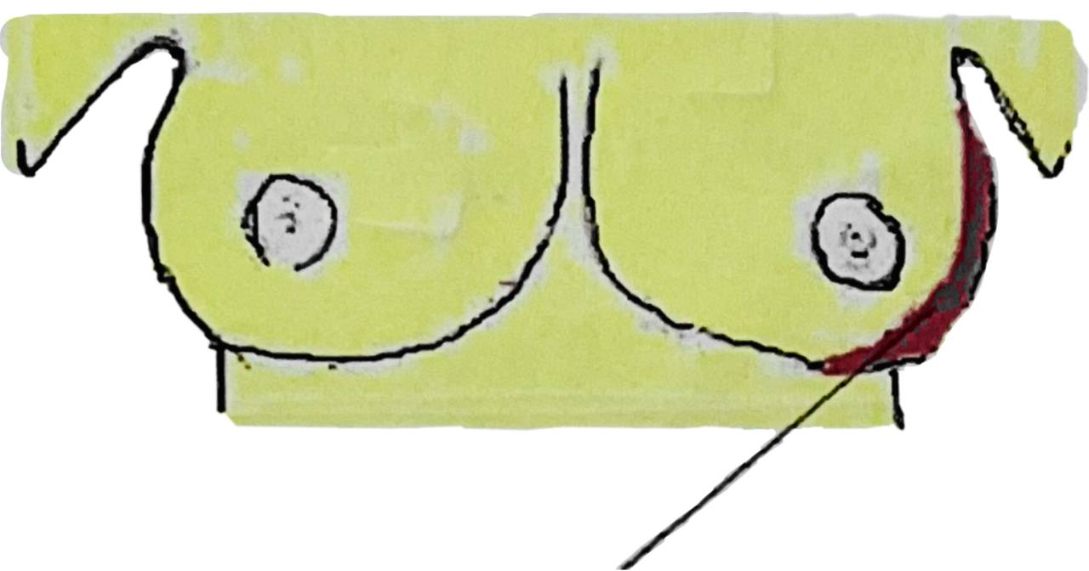
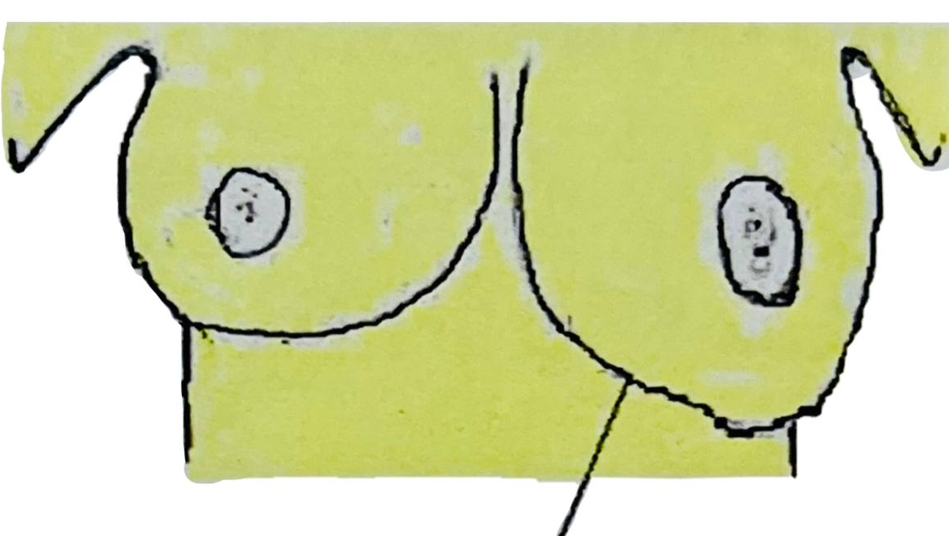
Breast cancer signs & symptoms
A persistent lump / atypical fullness / puckering / hard knot/thickening / dimpling / swelling in breast or in armpit or around collarbone area
A change in skin color of breast / areola / nipple (reddening or darkening )
A change in size / shape of mature breast area

Slide 7
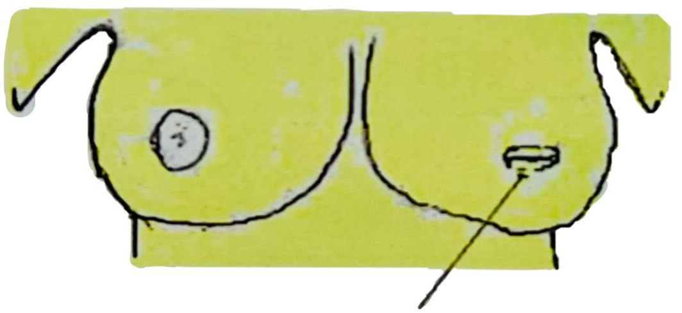
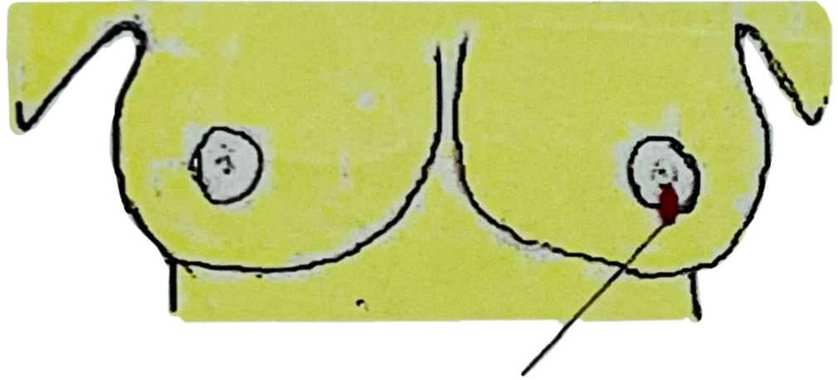
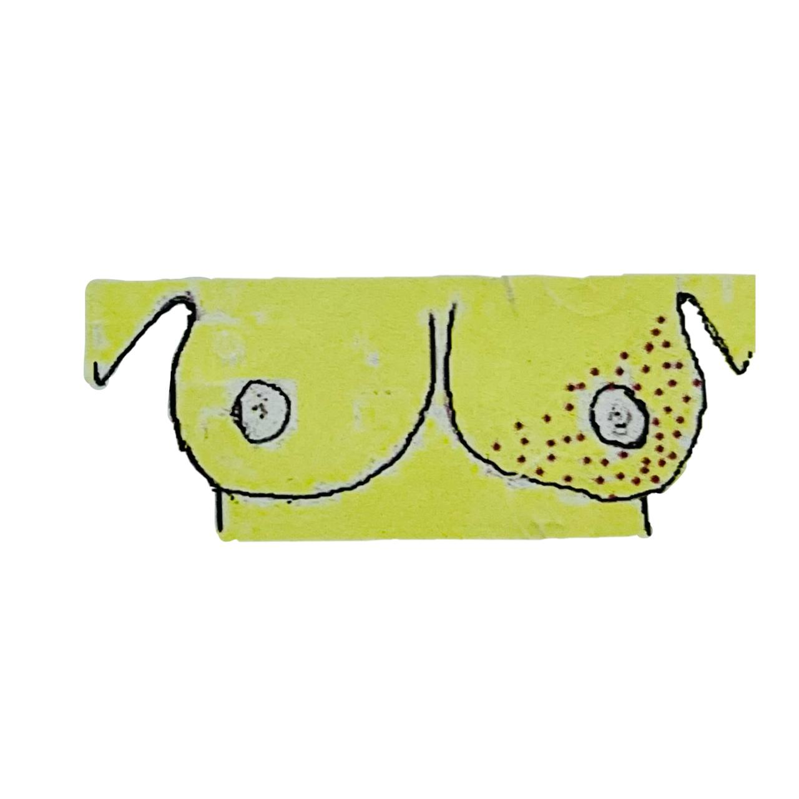
Breast cancer signs & symptoms
A change in nipple (retracted / inverted - pulled in nipple ) or its position
Discharge (liquid ) or blood from one or both nipples that occurs suddenly without squeezing
Itch, constant pain , warmth or rash on - breast area / nipple / armpit

Slide 8
breast cancer TNM staging system
✓ Tumor stage. 'Stage' is a measure of the extent of the tumor at the time of diagnosis and is important for all biological cancers
1) Tumor size (T): Tumor size correlates with prognosis: larger tumors are associated with poorer survival
2) Lymph node status (N): The presence or Absence of axillary lymph node metastases is a major prognostic indicator for patients with breast cancer and requires pathological evaluation of surgically removed lymph nodes
3) Distant metastases (M): distant metastases = poor prognosis.
Bones are the most affected, and in small proportions of patients metastases appear in the lung, liver, central nervous system, skin and adrenal glands.

Slide 9
Risk Factors for Breast Cancer Development
Modifiable | Not Modifiable
Body mass index | age (after 40 years of age)
Diet, environmental and lifestyle factors | genetic BRCA germ line mutations, p53 mutation, amplification of the HER2 gene
Alcohol smoking | Family history specifically First-degree relatives (mother, sister, or daughter)
exogenous estrogen as hormone replacement therapy | Chest radiation
Lack of Exercise (increase the risk) | Race/ethnicity
 | Early menarche
Age at first full-term delivery | Late menopause, and null parity
Lactation (reduce the risk) | Breast density

Slide 10
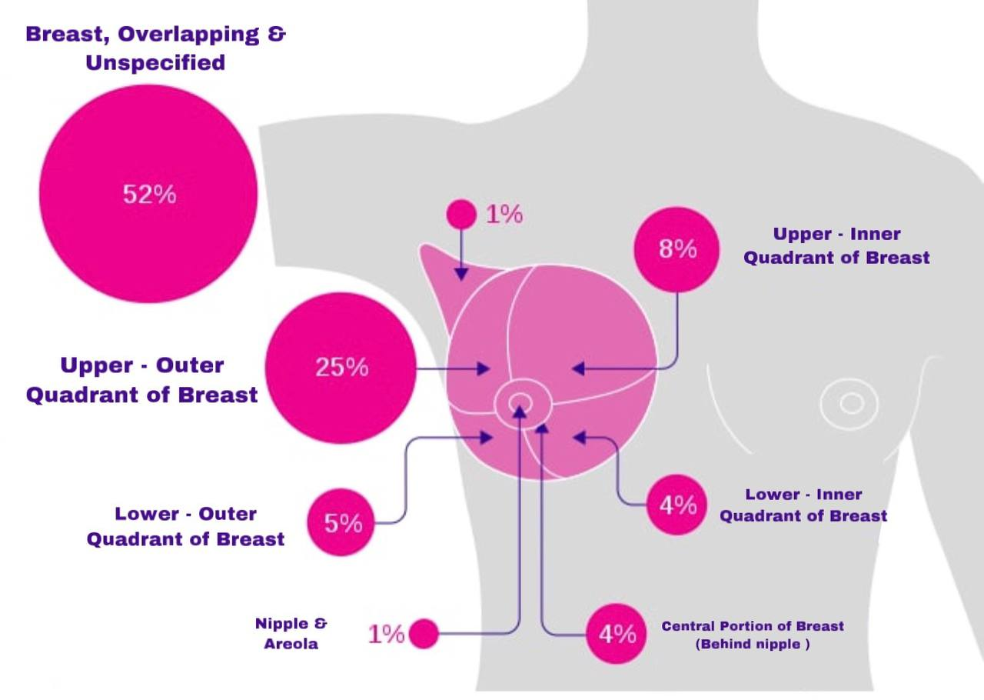
Location:
Location: The most common location for tumors within the breast is in the upper outer quadrant. About 4% of women diagnosed with breast cancer have bilateral primary tumors or sequential lesions in the same breast.

Slide 11

✓ There are many option for breast cancer. ✓ Breast cancer surgery. ✓ Radiation therapy. ✓ Chemotherapy. ✓ Immunotherapy. ✓ Hormone therapy. ✓ bone marrow transplantation.
Treatment :

Slide 12
CONCLUSION:
Breast cancer is the most common type of tumor in women in most parts of the world. Although stabilized in Western countries, its incidence is increasing in other continents. Prevention of breast cancer is difficult because the causes are not well known.

Slide 13
References :
1- Cancer. World Health Organization. https://www.who.int/news-room/fact-sheets/detail/cancer Accessed Feb. 16, 2021.
2- Cancer stat facts: Cancer of any site. National Cancer Institute Surveillance, Epidemiology, and End Results Program. https://seer.cancer.gov/statfacts/html/all.html. Accessed Feb. 16, 2021.
3- Symptoms of cancer. National Cancer Institute. https://www.cancer.gov/about-cancer/diagnosis-staging/symptoms. Accessed Feb. 16, 2021.
4- Rock CL, et al. American Cancer Society guideline for diet and physical activity for cancer prevention. CA: A Cancer Journal for Clinicians. 2020;doi:doi.org/10.3322/caac.21591.

Slide 14
Thank you …

