Slide 1


Libyan International Medical University
Faculty of Business Administration
The Influence of the Demographic and Economic Environments in Marketing
Name : Shahed Wail Alwerfalli
ID : 3298
Email : shahd_ــــــــــــ3298@limu.edu.ly
6/April/2022

Slide 2
Objectives
Understand the Influence of the Demographic Environment in Marketing
Understand the Influence of the Economic Environment in Marketing
2

Slide 3
Table of Content
Demographic Environment
Economic Environment
Conclusion
Reference
3

Slide 4

Demographic Environment
Demographic segmentation is a market segmentation technique where an organization's target market is segmented based on demographic variables such as age, gender, education, income, etc.
4

Slide 5
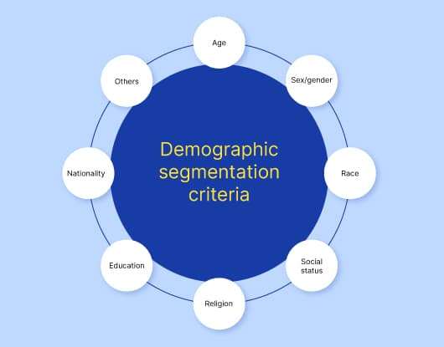
5

Slide 6

Economic Environment
Some of the biggest economic factors that affect marketing are demand and supply.
6

Slide 7
Conclusion
Marketers must observe the demographic environment, such as the changing age structure of populations, the population's geographic shifts, and the population's diversity , Economic changes will affect the demand and supply sides of the market .
7

Slide 8
Reference
Flynn, A. (2019, September 20). How do changes in the demographic and economic environments affect marketing decisions? Greedhead.net. Retrieved April 6, 2022, from https://greedhead.net/how-do-changes-in-the-demographic-and-economic-environments-affect-marketing-decisions/
Ahmed, A. (2019, March 14). Economic factors affecting marketing. Small Business - Chron.com. Retrieved April 6, 2022, from https://smallbusiness.chron.com/economic-factors-affecting-marketing-1699.html
Kelso Andre, M. B. A. (2021, September 21). How changes in the demographic and economic environments affect marketing decisions. LinkedIn. Retrieved April 5, 2022, from https://www.linkedin.com/pulse/how-changes-demographic-economic-environments-affect-marketing-andre
8

Slide 9
Thank You !!
.

