Slide 1


Influenza flu
& pneumonia
Presented by:
Student name : Lotfia farhat
Student number: 3510
Supervised by: Fatma eltarhoni
Y1 / block: PTS
Date: 2022/5/18

Slide 2

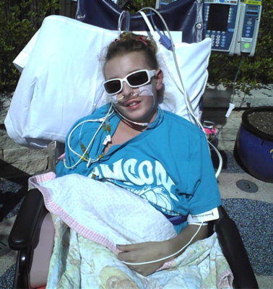

Slide 3
Objective:
1- Definition of influenza ( Flu).
2- Outline the symptoms and complication of flu.
3- Outline differentiate between flu and pneumonia.
4- Discuss the management of pneumonia.

Slide 4
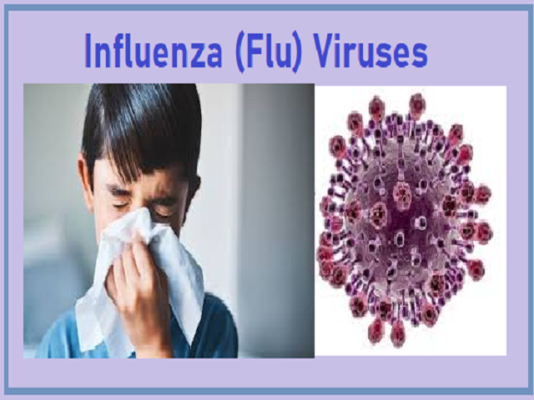
:Influenza
Influenza (flu) is a contagious respiratory illness caused by influenza viruses that infect the nose, throat, and sometimes the lungs.
It is one of the most severe illnesses of the winter season.
Influenza is spread easily from person to person.
There are four types of influenza viruses: A, B, C and D.

Slide 5
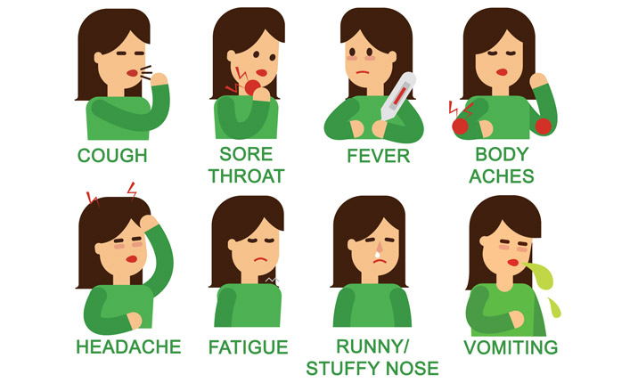
SYMPTOMS OF THE DISEASE
Fever.
Cough.
Sore throat.
Runny nose.
Headache.
Fatigue.
Vomiting and diarrhea.
Muscle or body aches.

Slide 6
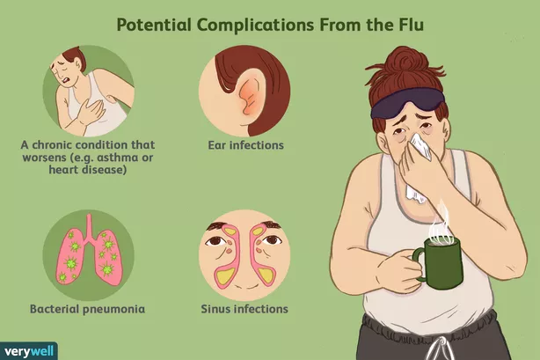
Complication of Flu
Bronchitis.
Asthma flare-ups.
Heart problems.
Ear infections.
Acute respiratory distress syndrome.
Pneumonia.

Slide 7
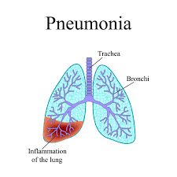
What’s the pneumonia?
Pneumonia is a serious infection or inflammation of the lungs.
The air sacs fill with pus and other liquid, blocking oxygen from reaching the bloodstream. If there is too little oxygen in the blood, the body's cells can’t work properly, which can lead to death.
Influenza is a common cause of pneumonia.

Slide 8
Most cases of flu never lead to pneumonia, but those that do tend to be more severe and deadly.
In fact, flu and pneumonia were the eighth leading cause of death in the United States in 2016.

Slide 9
How do you know if you have pneumonia or the flu?
Because pneumonia is a lung infection, it typically has more respiratory symptoms, while the flu is accompanied by muscular aches, pains and fatigue.
The flu usually comes on suddenly, while pneumonia takes longer to develop and can be a complication from the flu.
The flu is caused by a viral infection, while pneumonia can be caused by either a bacterial infection or viral infection.

Slide 10
The flu is much more contagious than pneumonia.
Both the flu and pneumonia can have complications if you don’t get proper treatment especially for :
older adults and children.
pregnant women.
people with serious health conditions.

Slide 11
Treatment of pneumonia
Treatment of pneumonia depends on what type it is, how serious it is, and the patient’s general health.
Many people can stay home and drink plenty of fluids and get lots of rest and recover in a few weeks. They also need to follow their doctor’s advice, especially involving the use of cough medicines, which often can make the situation worse.

Slide 12

If the pneumonia is caused by bacteria, patients often will receive antibiotic therapy.
or severely ill patients who have to be hospitalized, treatment usually includes intravenous antibiotics, fluids and other medications, as well as breathing treatments and even oxygen therapy.

Slide 13
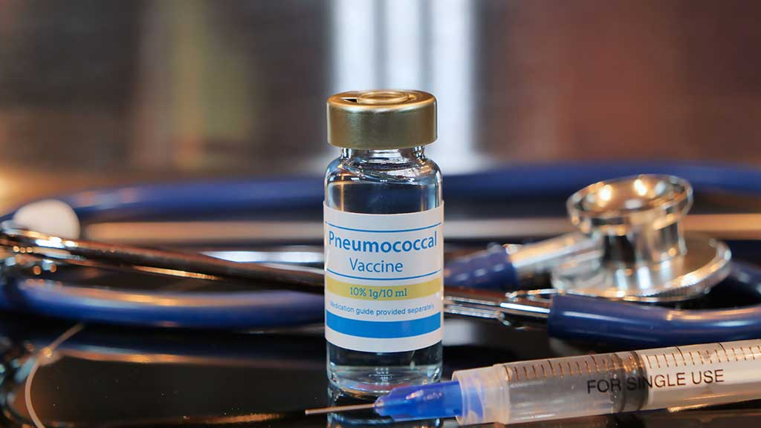
pneumonia vaccination
There are two kinds of pneumonia vaccine:
Pneumococcal conjugate vaccine (PCV13).
PCV13 vaccine is about 75.0% effective against invasive pneumococcal disease (IPD) which can cause meningitis.
for children under 2 and those with certain medical conditions.

Slide 14
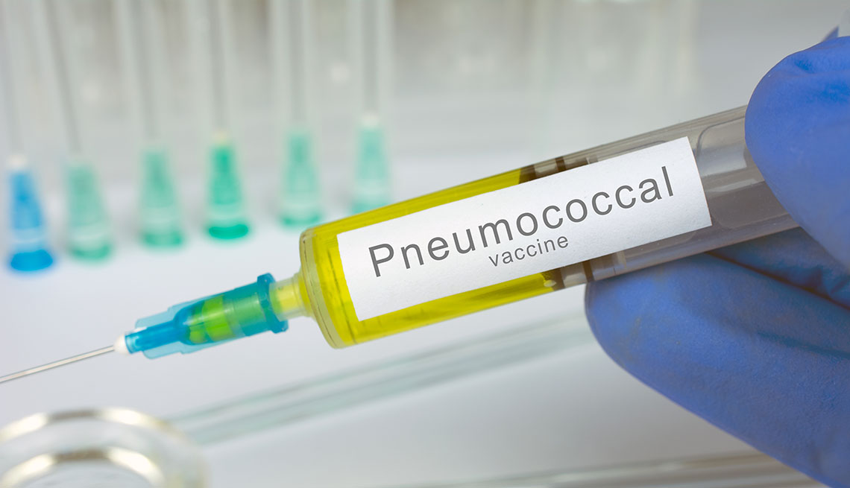
Pneumococcal polysaccharide vaccine (PPSV23).
PPSV23 vaccine is about 60%–80% effective against invasive pneumococcal disease when given to healthy people but less effective in immunocompromised people.
For all adults 65+ years of age, people under 65 years of age with certain medical conditions, or who smoke.

Slide 15
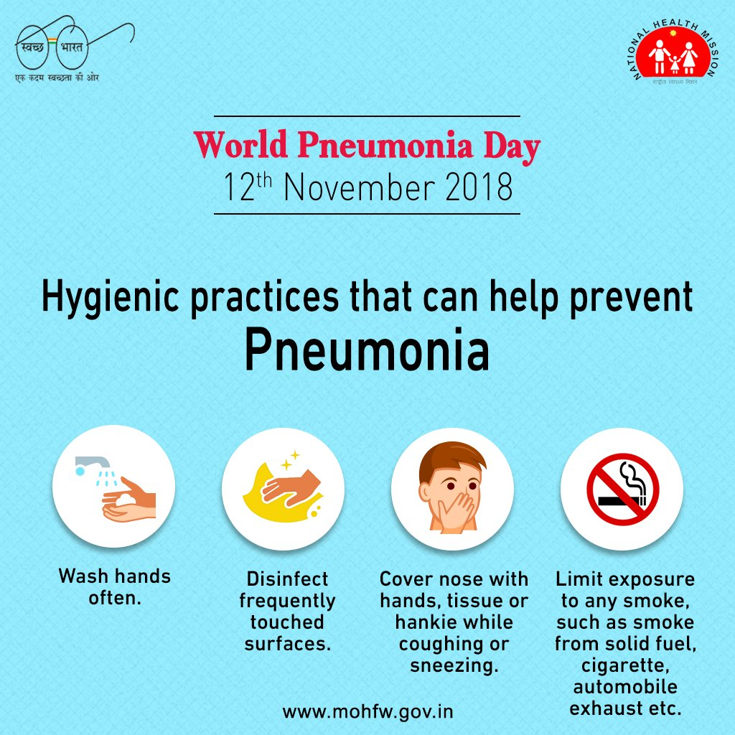
Prevention
Get Vaccinated.
Wash Your Hands.
Don't Smoke.
Be Aware of Your General Health.

Slide 16
REFERENCES
Centers for Disease Control and Prevention. (2021, August 26). Key facts about influenza (flu). Centers for Disease Control and Prevention. Retrieved May 10, 2022, rom https://www.cdc.gov/flu/about/keyfacts.htm
Mayo Foundation for Medical Education and Research. (2021, November 1). Influenza (flu). Mayo Clinic. Retrieved May 10, 2022, from https://www.mayoclinic.org/diseases-conditions/flu/symptoms-causes/syc-20351719
What is the connection between influenza and pneumonia? American Lung Association. (n.d.). Retrieved May 15, 2022, from https://www.lung.org/lung-health-diseases/lung-disease-lookup/pneumonia/what-is-the-connection
Schedule your appointment online. The Difference Between Pneumonia And The Flu | Piedmont Healthcare. (n.d.). Retrieved May 16, 2022, from https://www.piedmont.org/living-better/the-difference-between-pneumonia-and-the-flu
Flu is the most common cause of viral pneumonia in adults. Beebe Healthcare. (n.d.). Retrieved May 15, 2022, from https://www.beebehealthcare.org/health-hub/flu-most-common-cause-viral-pneumonia-adults
Information about pneumonia. Voices For Vaccines. (n.d.). Retrieved May 15, 2022, from https://www.voicesforvaccines.org/vaccine-information/pneumonia/
Preventing pneumonia. American Lung Association. (n.d.). Retrieved May 15, 2022, from https://www.lung.org/lung-health-diseases/lung-disease-lookup/pneumonia/preventing-pneumonia

Slide 17
Thank you
Do you have any question?

