Slide 1
IV Fluid
By : Mahmoud Jamal, Mohamed zidan, milad alhamali.

Slide 2


Objective :
Define IV Fluid.
Outline type of IV Fluids
Outline uses of IV Fluids

Slide 3
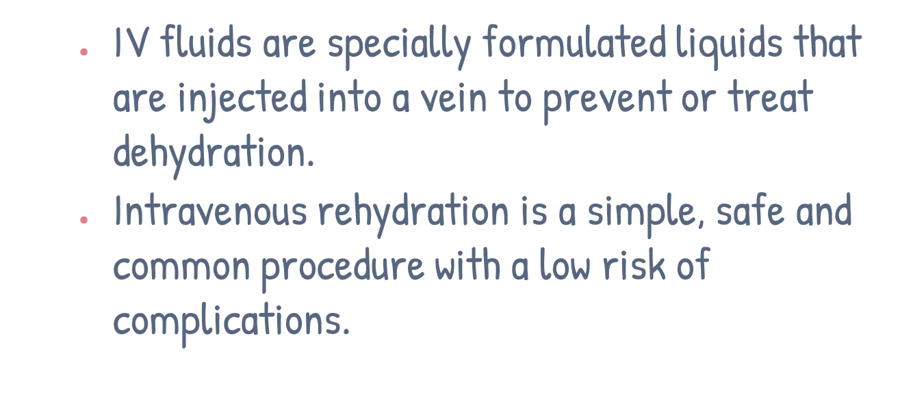
Introduction of IV Fluid :

Slide 4

What are the types of IV fluids?
There are different kinds of IV fluids. Your healthcare provider will decide which type is right for you, depending on why you need them.

Slide 5
Type of IV Fluids
01
02
03
isotonic
hypotonic
hypertonic
has similar concentration of fluid, sugars and salt to blood.
has a lower concentration of fluid, sugars and salt than blood.
has a higher concentration of fluid, sugars and salt than blood.

Slide 6
If a cell is placed in a hypertonic solution, there will be a net flow of water out of the cell, and the cell will lose volume. A solution will be hypertonic to a cell if its solute concentration is higher than that inside the cell, and the solutes cannot cross the membrane.
Three terms hypertonic, hypotonic, and isotonic are used to describe whether a solution will cause water to move into or out of a cell:

Slide 7
If a cell is placed in an isotonic solution, there will be no net flow of water into or out of the cell, and the cell’s volume will remain stable. If the solute concentration outside the cell is the same as inside the cell, and the solutes cannot cross the membrane, then that solution is isotonic to the cell.

Slide 8


USESE OF IV FLUIDS
Isotonic solutions:
-Dehydration, congestive heart failure
Hypertonic solutions:
-Abdominal surgery, lost electrolyte
Hypotonic solutions:
-Headache, hypertensive

Slide 9
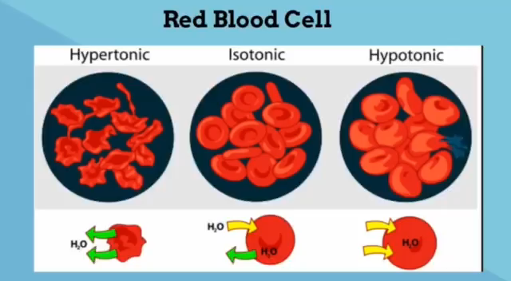
01
Name of The Section
You can enter a subtitle here if you need it

Slide 10
Recap of IV Fluids
1.Isotonic solutions:
Ex : Dehydration.
2.Hypertonic solutions:
Ex : Abdominal surgery.
3.Hypotonic solutions:
Ex : Headache.

Slide 11
Thanks for listening

