Slide 1


The Impact of Sales Strategies on Coca-Cola as a Global Enterprise
Libyan International Medical University
Faculty of Business Adminstration
By Ghadi Ali Dreza 2830
Saturday the 17th of December

Slide 2
TABLE OF CONTENTS
01
02
03
04
Introduction: Defining a Sales Strategy
Coca-Cola’s Sales Strategy
Recommendations
References

Slide 3
01
Introduction

Slide 4
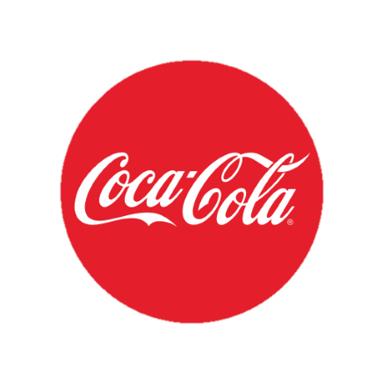
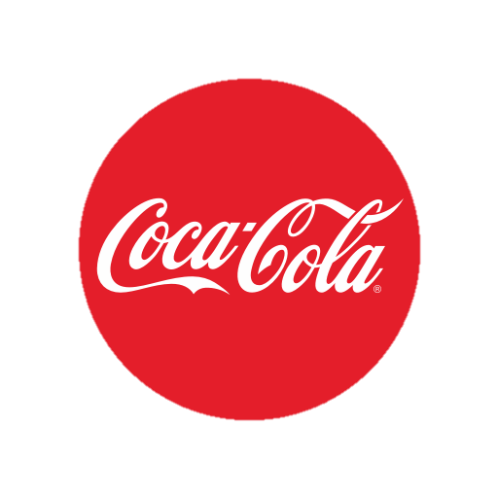
A History Full of Surprises
Coca-Cola was invented in 1886, by Dr. John Pemberton, an Atlanta Pharmacist.
Coca-Cola was originally composed from a caramel-coloured liquid, mixed with some carbonated water.
From then on Coca-Cola became famous, and was initially sold for about (5 cents) per glass .
Frank Robinson, was credited for the name (and was famously know to have crafted the trade-mark logo it-self).
Coca-Cola has established a global presence with over 200 countries world-wide.

Slide 5
What is a Sales Strategy?

Slide 6

A sales strategy is a plan of action designed to find the most effective way to sell a company's product and service

Slide 7
Sales Strategy Takes Into Account Three Things:
01
02
03
Resources Available
The Competition
The Market-Condition
The rivalry between existing companies, services, and or products.
The supplies available for the sales team
It’s a term used to refer to the state of an industry

Slide 8
02
Coca-Colas Sales Strategy

Slide 9
Coca-Cola’s Pricing Strategy
Whenever Coca-Cola infiltrates a new market, they immediately offer there products at lower-costs.
And once Coca-Cola establishes its customer base, it periodically runs sales promotions to encourage sales.
This is how a lot of large-scale brands manipulate prices to enter the new market.

Slide 10

The Four Types of Sales Strategy
Account Based Selling (ABS)
Relationship Sales Strategy
Selling Strategy
Sales Channel Strategy

Slide 11
Account Based Selling: (ABS)
It’s a strategy commonly used by the sales team that focuses on winning high-value accounts, such as (customers/ and businesses) to help reach new levels within the targeted market.
For example, this includes personalising e.g. gifting something special to the target account.
Apart from this, think about customers (Coca-Cola provides a range of flavours that are compatible with everyone- like the Diet Coke).

Slide 12
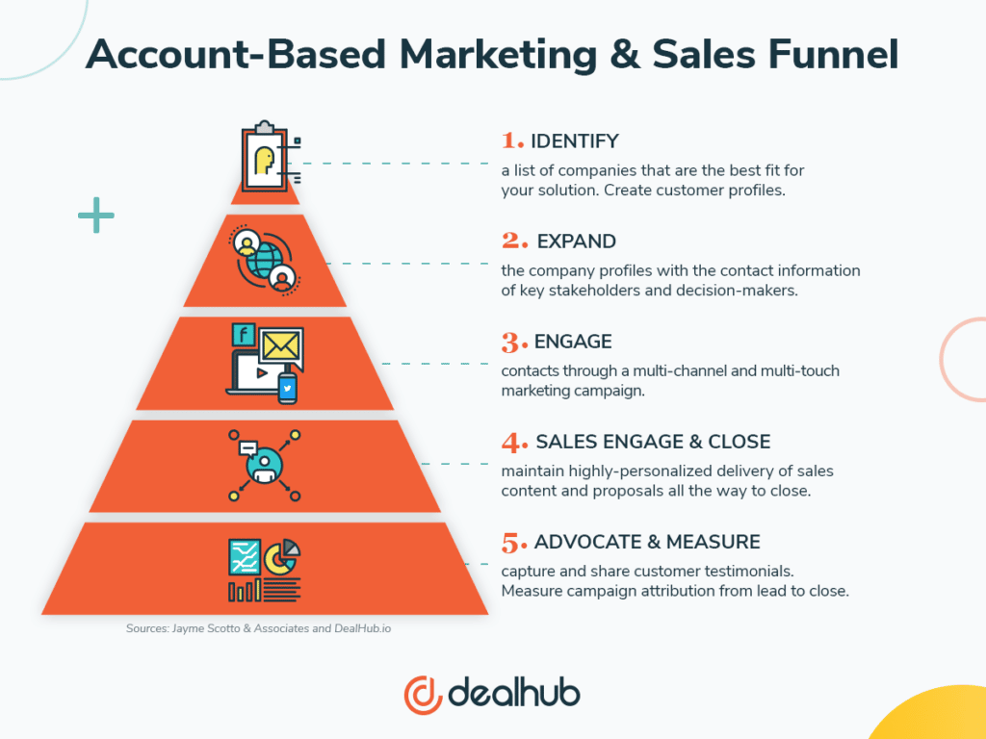

Slide 13
Relationship Sales Strategy:
It’s a mix of tactics and techniques of which are used by a company to build stronger customer relationships.
More like ‘personalising’ the relationship and breaking the ice.
For instance, Coca-Cola provides customers with the freedom of designing their own coke bottle; adding a name or a sentence etc.
This would usually cost $7.00, for each bottle.

Slide 14
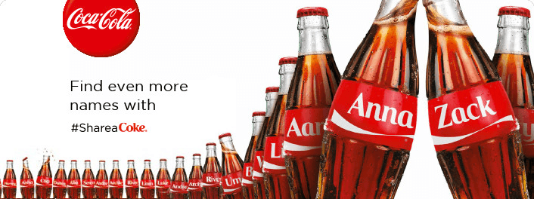
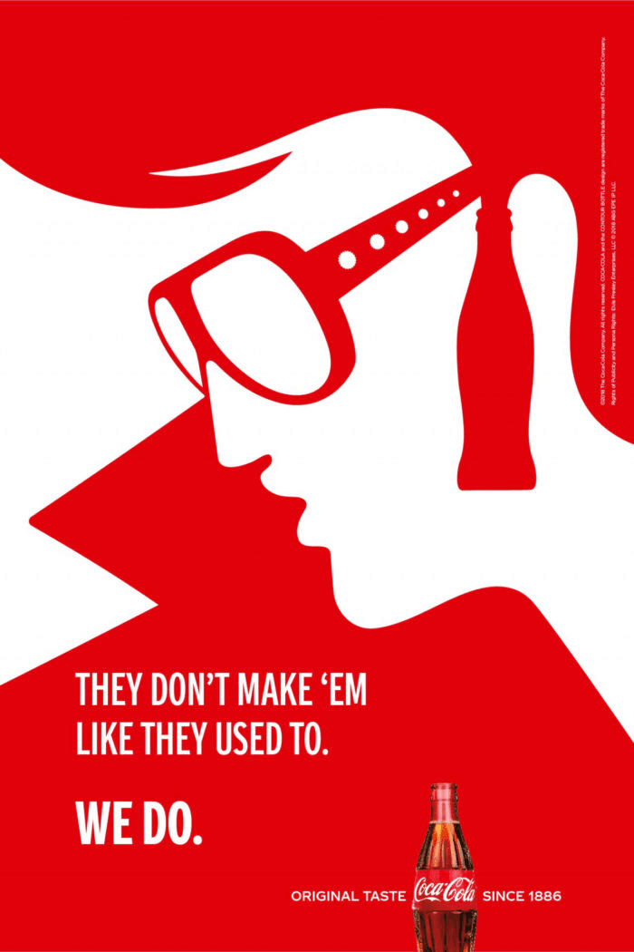
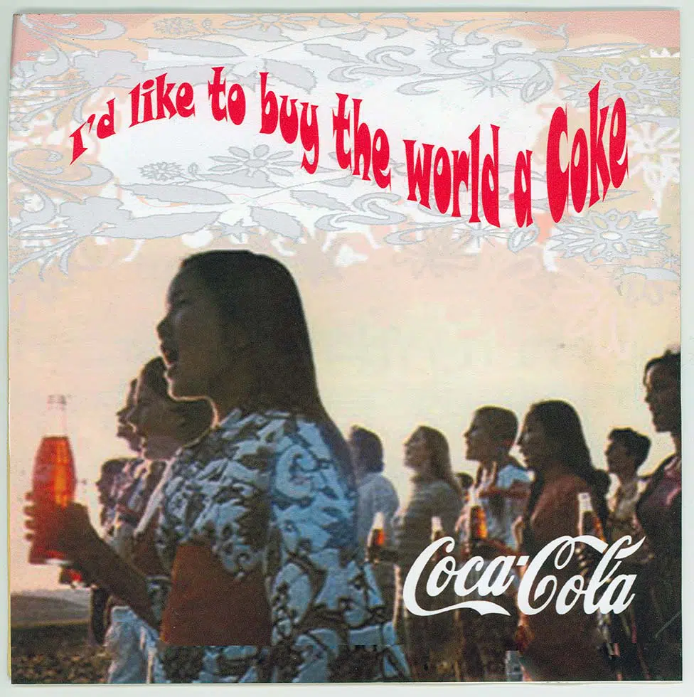

Slide 15
Selling Strategy:
Basically, it’s a sales strategy method used by a company’s sales team to achieve sales targets and direct selling activities.
There are five main selling approaches: Stimuli’s Response, Mental State, Need Satisfaction, Problem Solving, Consultative approach.
An example, would be promotion. Coke aggressively markets its product lines through advertising, across multiple mediums and channel; including TV, online ads, sponsorships, etc.

Slide 16
Sales Channel Strategy:
A sales strategy, simply, is a way in which businesses use the means of direct and indirect channels to sell their products in the proposed market.
For example, Coca-Cola uses a selection of sales channels such as; canning and bottling companies, distributors, wholesalers, and retailers- supermarkets, local shops, cafes, restaurants.

Slide 17
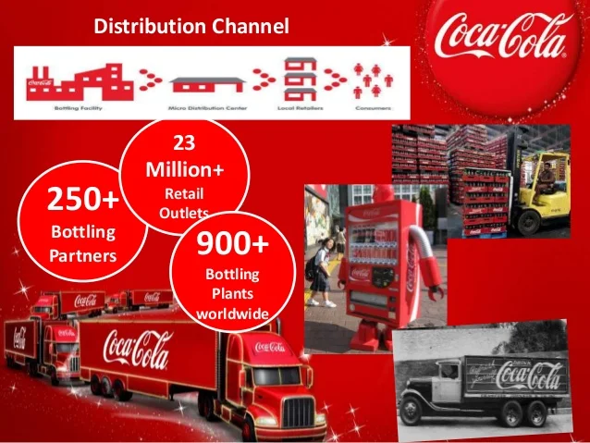

Slide 18
03
Recommendations

Slide 19
Investing in sales promotions: For instance, upon developing a new soft drink, the management should ensure that there is market awareness in relation to the product.
This would contribute towards the consumers purchasing the product.
One of the sales promotion strategies that the management can use is free samples.
Research and Development: This would enable it to effectively add value to its products resulting in increased customer satisfaction.
the firm will be able to penetrate the global market more effectively resulting in an increase in the volume of sales and hence the level of profits.

Slide 20
04
References

Slide 21
RESOURCES
CoSchedule. (2022, December 15). Coke marketing strategy: Their recipe for success (+5 achievable strategies). CoSchedule Blog. Retrieved January 2, 2023, from https://coschedule.com/marketing-strategy/marketing-strategy-examples/coca-cola-marketing-strategy#pricing-strategy
Amin, Z. (2022, September 21). Coca-Cola's 9 marketing strategies to achieve Global Success. Squeeze Growth. Retrieved January 2, 2023, from https://squeezegrowth.com/coca-cola-marketing-strategy/#7_Competitive_Prices_and_Personalization
Gregory Stringer, M. S. (2021, February 9). Case study: Coca Cola Integrated Marketing Communications. LinkedIn. Retrieved January 2, 2023, from https://www.linkedin.com/pulse/case-study-coca-cola-integrated-marketing-gregory-stringer
Personalized 8 fl oz. Glass bottle of Coca-Cola. Coca. (n.d.). Retrieved January 2, 2023, from https://us.coca-cola.com/store/personalized-bottle
Barron, J. (2021, July 12). What is a sales strategy? Playbook and template for success in 2023. Your No. 1 Choice in Premium Sales Intelligence. Retrieved January 2, 2023, from https://www.cognism.com/what-is-a-sales-strategy
Coca Cola Company: Strategic management recommendations: Free essay example. StudyCorgi.com. (2021, October 29). Retrieved January 2, 2023, from https://studycorgi.com/coca-cola-company-strategic-management-recommendations/
Grewal, D., &amp; Levy, M. (2018). Marketing. McGraw-Hill Education.

Slide 22
THANK YOU FOR LISTENING!

