Slide 1


Effect of Tobacco on Pregnancy woman
Name: Marwa Khamis al-elwany
Student number: “ 3605 “
Year 1 , PTS
Date: 2022/6/6

Slide 2
Objectives
Outline Components of tobacco.
Discuss General Effect Of Tobacco.
List Effect of tobacco on pregnant woman.
List Effect of tobacco on fetus.

Slide 3
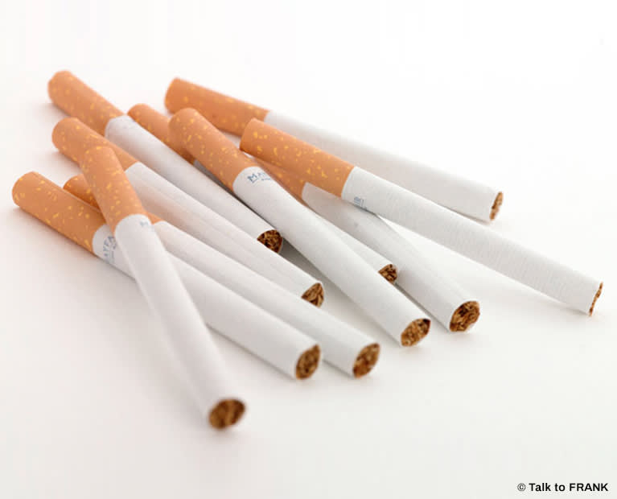
Introduction
For ages, tobacco has been popular and its use is significantly increasing in spite of alarming health hazards.
However, so far a lot has been known about its disadvantages, but still tobacco is grown, developed, advertised, marketed, and sold to earn a big chunk of the financial cake.

Slide 4
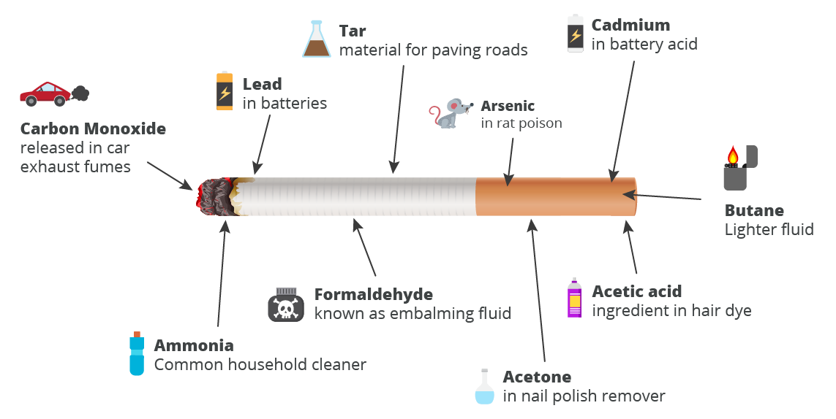
Components of tobacco
Half of these compounds occur naturally in the green tobacco leaf, where the remainder is generated when the tobacco is burned.
The complex mixture of chemicals in tobacco smoke includes :
Tar .
carbon monoxide.
hydrogen cyanide benzene, formaldehyde nicotine, phenol, polycyclic aromatic hydrocarbons (PAHs) and tobacco-specific nitrosamines (TSNAs) .

Slide 5
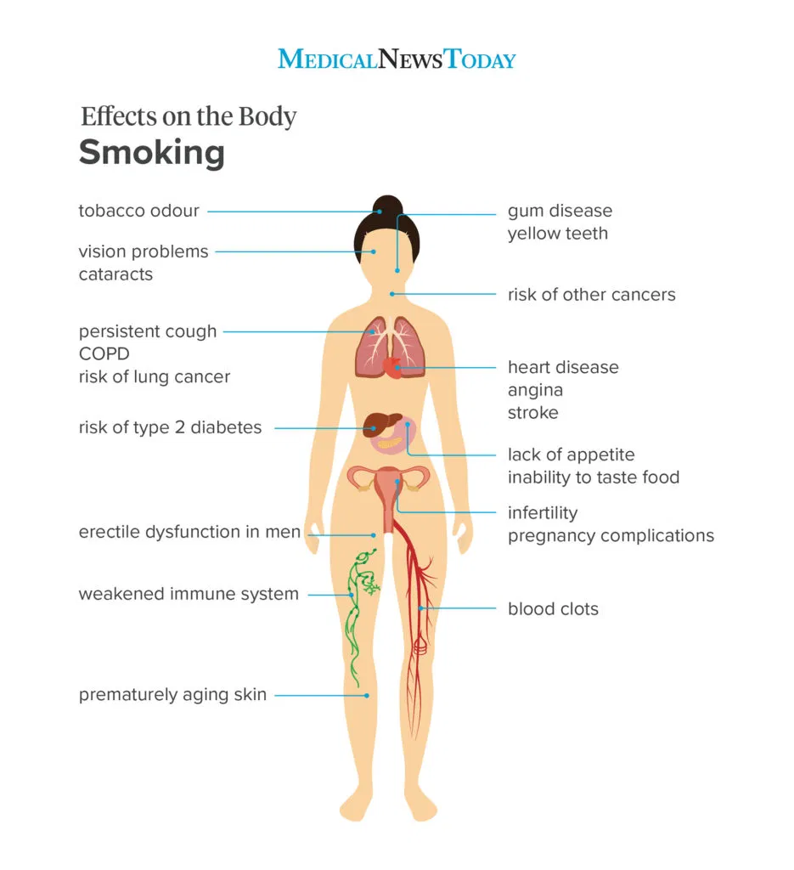
General Effect Of Tobacco
Smoking and Death by heart and respiratory diseases
Cigarette smoking causes more than 480,000 deaths each year in the United States.
Smoking causes about 90% (or 9 out of 10) of all lung cancer deaths.1,2 More women die from lung cancer each year than from breast cancer.
Smoking causes about 80% (or 8 out of 10) of all deaths from chronic obstructive pulmonary disease (COPD).
Cigarette smoking increases risk for death from all causes in men and women.
Smoking causes stroke and coronary heart disease.]

Slide 6
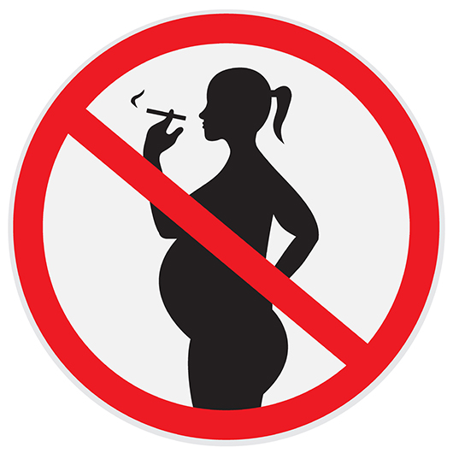
Effect of tobacco on pregnant woman
Increase chance of placental abruption (when it peels away from the wall of your uterus too soon).
placenta previa (when it’s in a position where it could rupture during contractions.
Decrease amount of oxygen in blood .
Cigarette smoking increases risk for death from all causes in men and women.

Slide 7
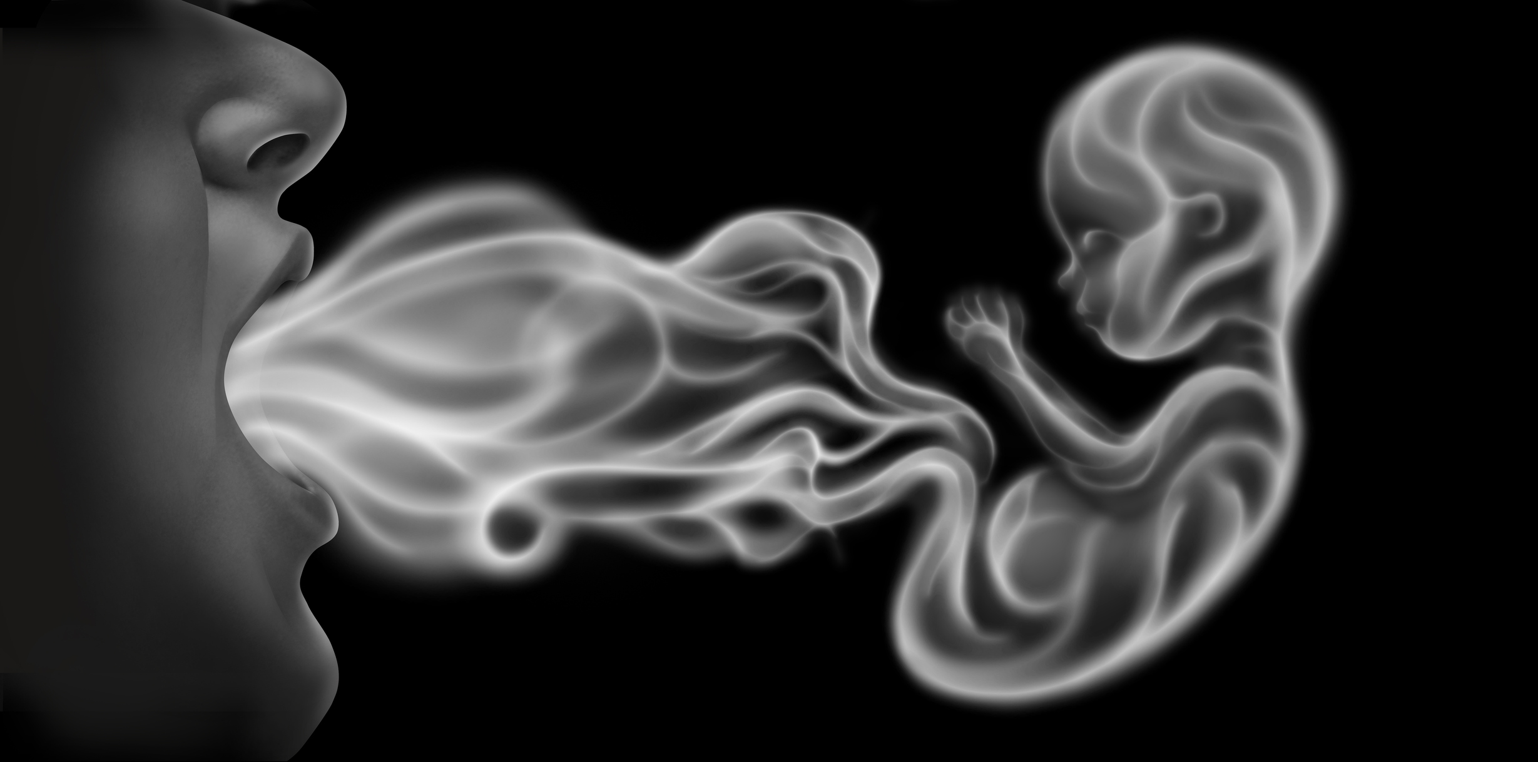
Effect of tobacco on fetus
Decrease heart rate of fetus .
Increase chance of chances of miscarriage and stillbirth.
Increase chance of prematurely or born with low birth weight.
Increases risk of sudden infant death syndrome (SIDS).
New born exposed to secondhand smoke may also develop asthma, allergies, and more frequent lung and ear infections.

Slide 8
Conclusion
Tobacco has an effect on both public and pregnant women , but it’s more worse on pregnant and fetus .
Components included in tobacco are very dangerous and toxic to human being .
Tobacco increases the risk of death more than most diseases .
Tobacco one of the most causes of most fetal diseases world wide .
Tobacco increases the risk of fetus death .
People should be warned about tobacco forms and smoking hazards through social media , schools journals and events.

Slide 9
References
Shanu Mishra and M. B. Mishra,Tobacco: Its historical, cultural, oral, and periodontal health association https://www.ncbi.nlm.nih.gov/pmc/articles/PMC3894096/ , J Int Soc Prev Community Dent. 2013 Jan-Jun; 3(1): 12–18.
Paul F. Engstrom, MD, Margie L. Clapper, PhD, and Robert A. Schnoll, PhD , Physiochemical Composition of Tobacco Smoke , https://www.ncbi.nlm.nih.gov/books/NBK13173/ , Holland-Frei Cancer Medicine. 6th edition , 2003, BC Decker Inc .
Centers for Disease Control and Prevention. https://www.cdc.gov/tobacco/data_statistics/fact_sheets/health_effects/effects_cig_smoking/, Health Effects of Cigarette Smoking.
2020 WebMD, LLC , Smoking During Pregnancy, https://www.webmd.com/baby/smoking-during-pregnancy
Department of heath austuralian govrements , effects of smoking and tobacco , https://www.health.gov.au/health-topics/smoking-and-tobacco/about-smoking-and-tobacco/what-are-the-effects-of-smoking-and-tobacco , 2020

Slide 10
Thank You

