Slide 1

LUNG CANCER
Year1 AMS
Presented by: Essra Adel Dermish
Student No: 3584
1

Slide 2

Objectives
Define Lung Cancer.
Outline Classification of Lung Cancer.
List Most Common Causes of Lung Cancer.
Outline the signs and symptoms of lung cancer.
Outline available therapy's for Lung Carcinoma.
Discuss how to prevent hazards that affect lungs.
2

Slide 3
INTRODUCTION
Lung cancer remains the leading cause of cancer mortality in men and women in the U.S. and worldwide.
About 90% of lung cancer cases are caused by smoking and the use of tobacco products.
However, other factors such as radon gas, asbestos, air pollution exposures, and chronic infections can contribute to lung carcinogenesis.
In addition, multiple inherited and acquired mechanisms of susceptibility to lung cancer have been proposed.
3

Slide 4
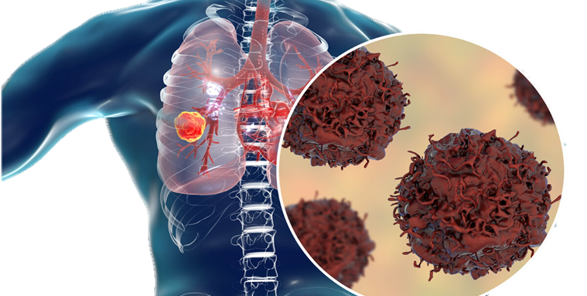
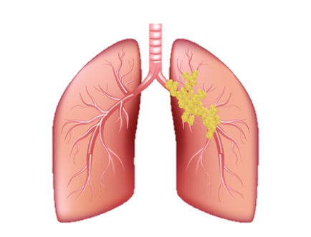
What Is Lung Cancer ?
Lung cancer, also known as lung carcinoma, since about 98–99% of all lung cancers are carcinomas, is a malignant lung tumor characterized by uncontrolled cell growth in tissues of the lung.
4

Slide 5
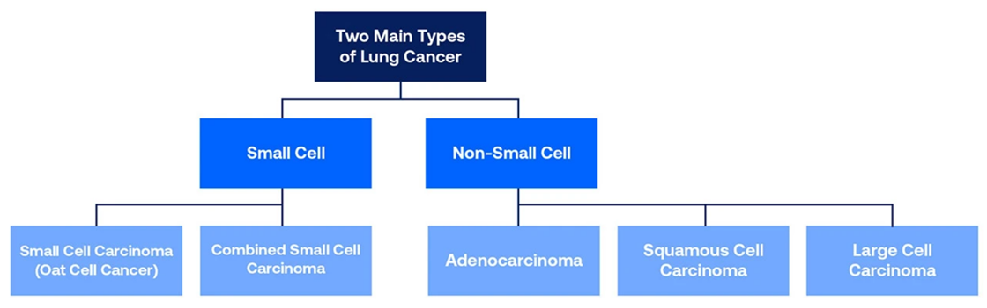
Classification of Lung Cancer
Non-small-cell lung carcinoma
Small-cell lung carcinoma
Adenocarcinoma, Squamous-cell carcinoma, and Large-cell carcinoma.
more common type.
Typically occur close to large airways or anywhere in the lung.
Dense neurosecretory granules (vesicles containing neuroendocrine hormones).
Less Common Type.
Most cases arise in the larger airways (primary and secondary bronchi).
5

Slide 6
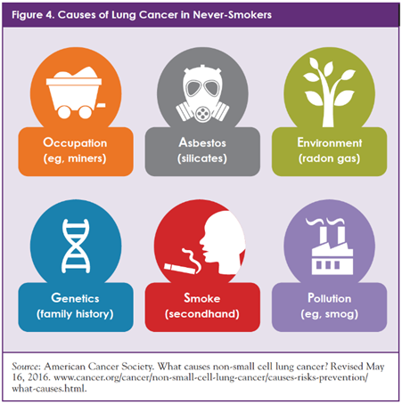
Causes of Lung Cancer
Smoking.
Radon gas.
Asbestos.
Air pollution.
Genetics.
Some metals (aluminum production).
Ionizing radiation (X-ray and gamma).
Some toxic gases (methyl ether (technical grade).
6

Slide 7
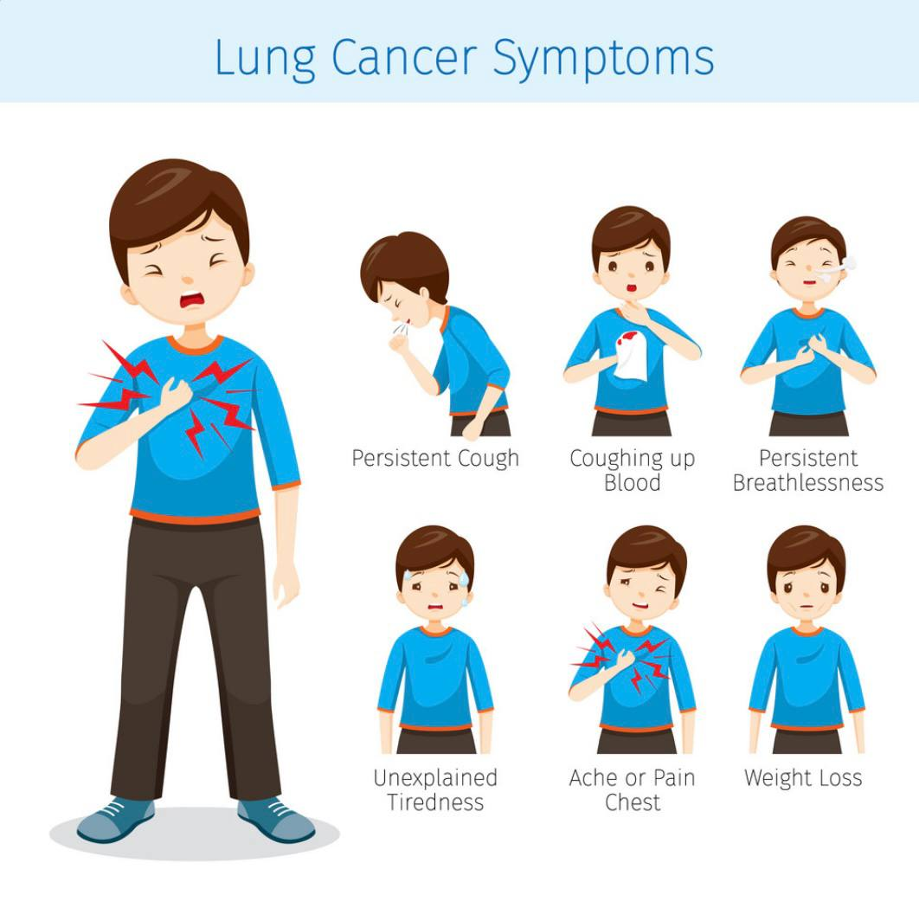
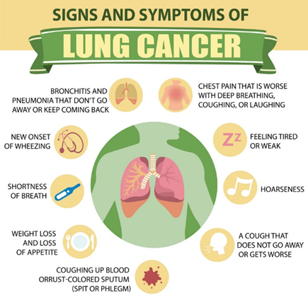
Signs and symptoms
cough that doesn’t go away after 2 or 3 weeks.
a long-standing cough that gets worse.
chest infections that keep coming back.
coughing up blood.
an ache or pain when breathing or coughing.
persistent breathlessness.
persistent tiredness or lack of energy.
loss of appetite or unexplained weight loss.
7

Slide 8
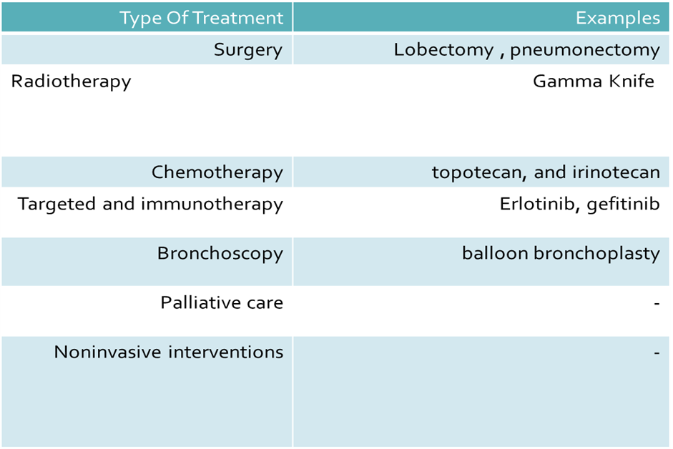
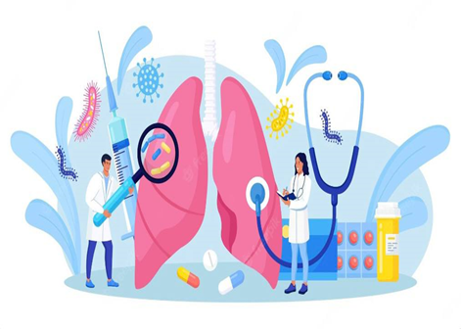
Treatment

Slide 9
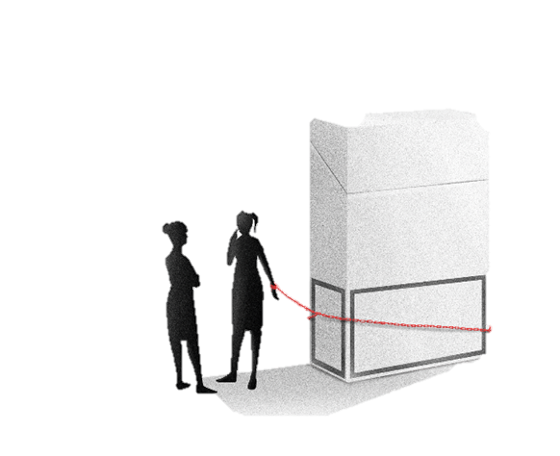
Prevention
Tobacco control
By limiting age of smokers , increase taxes by government .
Screening
Random sampling , affected people or for research .
Other prevention strategies
Some studies have found vitamins A, B, and E may increase the risk of lung cancer in those who have a history of smoking , but some vegetable foods decrease the risk .
Awareness
By data analysis ,social media , schools & TV etc….
9

Slide 10
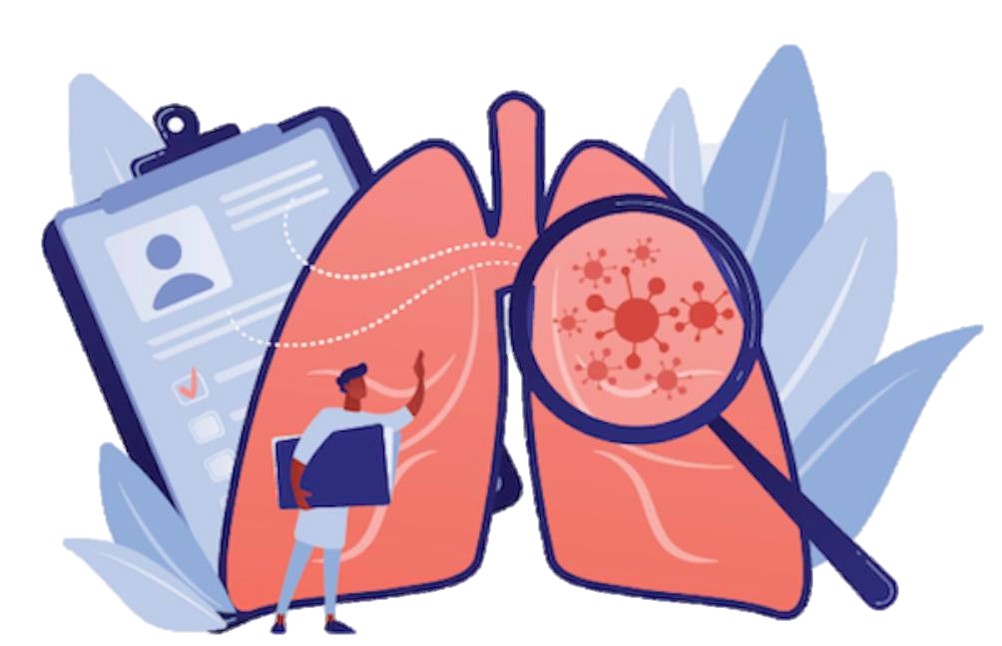
Conclusion
Carcinoma is the most common form of Lung Cancer .
Some types of lung cancer can produce hormones witch is increase some hormonal levels in the body .
Uncontrolled lung tumors can be fetal .
Many available treatments under current using or under research .
Secondhand smokers can be largely affect by any types of smokers.
10

Slide 11
References
"Non-Small Cell Lung Cancer Treatment – Patient Version (PDQ®)". NCI. 12 May 2015. Archived from the original on 29 February 2016. Retrieved 5 March 2016.
National Library of medicine , Medline Plus, Lung Cancer , https://medlineplus.gov/lungcancer.html
NHS, Symptoms - Lung cancer , https://www.nhs.uk/conditions/lung-cancer/symptoms/
Bracken-Clarke D, Kapoor D, Baird AM, Buchanan PJ, Gately K ,Cuffe S, Finn SP (March 2021). "Vaping and lung cancer – A review of current data and recommendations". Lung Cancer. 153: 11–20. doi:10.1016/j.lungcan.2020.12.030. PMID 33429159.
Baldwin DR, Hansell DM, Duffy SW, Field JK (March 2014). "Lung cancer screening with low-dose computed tomography". BMJ. 348: g1970. doi:10.1136/bmj.g1970. PMID 24609921. S2CID 39926785.
Sun Y, Li Z, Li J, Li Z, Han J (March 2016). "A Healthy Dietary Pattern Reduces Lung Cancer Risk: A Systematic Review and Meta-Analysis". Nutrients. 8 (3): 134. doi:10.3390/nu8030134. PMC 4808863. PMID 26959051.
11

Slide 12
Thank You
12

