Slide 1






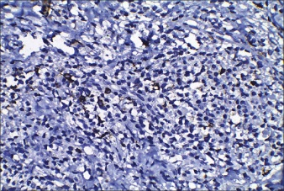
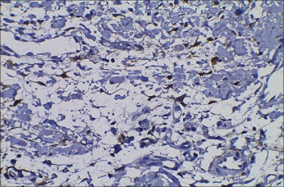

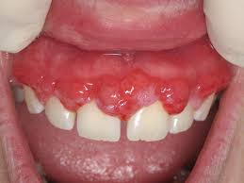

Leukemic gingival enlargement
Esra Adel Elarfi 2943
Libyan International Medical University Faculty of AMS
2nd year medical student
- A 40‑year‑old male patient with low socioeconomic status
The patient’s chief complaints were the swollen gums and difficulty in chewing for the past 2 months
- physical examination, marked pallor of the palpebral conjunctiva and the ventral surface (palm) of hands
- oral examination, and complete blood count of the and of gingival biopsy was taken from the patient .
- Leukemia is a malignancy characterized by proliferation of abnormal white blood cells within the bone marrow , Leukemic cells may also infiltrate into the body tissues, such as skin, spleen, gingiva, lymph nodes and central nervous system.
- The etiology of leukemia is poorly defined.
However, chemical injuries, chromosomal abnormalities, radiation exposure and viral infections are implicated which may result in significant morbidity and mortality.
- leukemia is classified into chronic, sub-acute and acute. Acute leukemia is abrupt in onset and aggressive.
The oral cavity manifests signs of various systemic diseases Typical oral manifestations of acute leukemia include gingival swelling, oral ulceration, spontaneous gingival bleeding, petechial, mucosal pallor, herpetic infections and candidiasis.
- Oral changes maybe the first and only presenting features in leukemia patients, making it imperative for the dentist to diagnose the disease accurately.
-Acute monocyte leukemia is more common in older adults and among men compared to women accounts for 3%–6% of all AML cases
the most common oral sign of leukemia occurring in the post diagnostic period was oral bleeding or petechial.
They also found that patients with acute leukemia who had oral petechial or bleeding tended to have shortened survival time as compared to those patients with acute leukemia who did not have petechial.
- The gingival findings are reported to be partially dependent on the inflammatory condition of the tissues.
-Advanced cases gingival hyperplasia resolves completely or at least partly with effective leukemia chemotherapy .
The flow cytometric immunophenotyping analysis of peripheral blood found CD11b, CD64 and CD33 to be strongly expressed. (Figure 1)
CD14 was assayed and found positive in only 20% of the -monocytoid population ,The expression of CD34 was negative
immunohistochemistry, the gingival specimen showed focal positivity for CD117 whereas CD34 was Found to be negative (Figure 2).
gingival hyperplasia resolves completely or at least partly with effective leukemia chemotherapy Acute leukemia often compels the patient to seek dental care
role of oral hygiene and other factors influencing the resolution of enlargement in leukemia patients needs to be further studied and investigated.
Figure 1
Figure 2
Table 1: Hematological findings at the time of gingival biopsy
 | Patient | normal
WBC (×103 /µL) | 44.78 | 4.00-11.oo
RBC (×103 /µL) | 1.47 | 4.00-600
HGB (g/dL) | 4.9 | 13.5-17.5
HCT (%) | 14.5 | 42-52
PLT (×103 /µL) | 65 | 150-450
1- Kinane D, Marshall G. Peridonatal manifestations of systemic disease. Aust Dent 2001;46(1):2-12. doi:10.1111/j.1834-7819.2001.tb00267..
2- Deschler B, Lübbert M. Acute myeloid leukemia: Epidemiology and etiology. Cancer. 2006;107(9):2099-2107doi:10.1002/cncr.22233.

