Slide 1


Verbal and non-Verbal Messages
Libyan International Medical University
Faculty of Business Administration
Interpersonal Communication (7027)
By :
Khadija Baayou 2847
Mabroka Elallam 2779
Rayan Wanis 3018
Nahawand Alhammali 2752
Submitted To:
Mr. Farag Elmegresi

Slide 2
Table of contents
1
Introduction
2
Principles of verbal messages
3
4
Conclusion
References
Principles of non-verbal messages
Differences between verbal messages and non-verbal
messages.
5
6
2

Slide 3
1
Introduction
3

Slide 4

Introduction
Interpersonal communication is the verbal and non-verbal interaction between two people or more people dependent on each other.
4

Slide 5

Principles of verbal messages
Messages vary in politeness.
Message can be anonymous.
Messages can deceive.
Messages can confirm and disconfirm.
Messages are packaged.
Meanings are in people.
Meanings are denotative and connotative.
5

Slide 6

Principles of non-verbal messages
Non-verbal messages Interact with Verbal Messages :
            There are basic ways that verbal and nonverbal messages interact with each other
            Accent: Nonverbal communication is often used to accent or emphasize some part of the verbal messages.
            Complement: Non-verbal communication may be used to complement, to add nuances of meaning not communicated by your verbal message.
            Contradict. You may deliberately contradict your verbal messages with non-verbal movements.
6

Slide 7
2. Non-verbal Messages Help Manage Impressions :
You form perceptions of other people mostly through their nonverbal communication. Depending on a person’s physical size, skin tone, and clothing. You make assumptions about
who the person is and what they are like.
3. Non-verbal Messages Help Form Relationships :
You spend a lot of your time with your partner without saying anything. You use nonverbal communication to express affection, support, and love, at least in part. At the same time, you use nonverbal signs to express your discontent, wrath, and animosity.
7

Slide 8
4. Non-verbal messages can influence and deceive:
You may influence others not only with your words but also with your nonverbal gestures. And, of course, with the ability to influence comes the ability to fool—to persuade another person into believing something is true when it isn’t, or that something is true when it isn’t.
5. Non-verbal messages are crucial for expressing emotions:
Non-verbal signals express a large part of your emotional experience, even though people frequently explain and reveal feelings vocally.
8

Slide 9
Differences between verbal and non-verbal communication
4
9

Slide 10
 | Verbal communication | Non-verbal communication
Medium of communication | Language, words, phrases, and voice are used as the medium of communication in verbal communication. | Body language, facial expressions, tone, and pauses in speech are used as the medium of communication in non-verbal communication
channel of communication | The human voice, which speaks a single word at a time, is a single channel of communication that used in verbal communication. | Non-verbal communication uses a variety of channels, including the use of your entire body, facial expressions, and voice tone.
Consciousness in communication | Verbal communication is a conscious process. It involves thinking, processing and articulating. | Non-verbal communication happens on an unconscious level. One doesn’t really think about it actively.
Decoding the communication | In verbal communication you will understand what someone is saying if you pay close attention to what they are saying. | Non-verbal communication to understand what the other person is trying to say, you must pay attention to a variety of factors such as the speaker's body language, facial expressions, and tone.
10

Slide 11



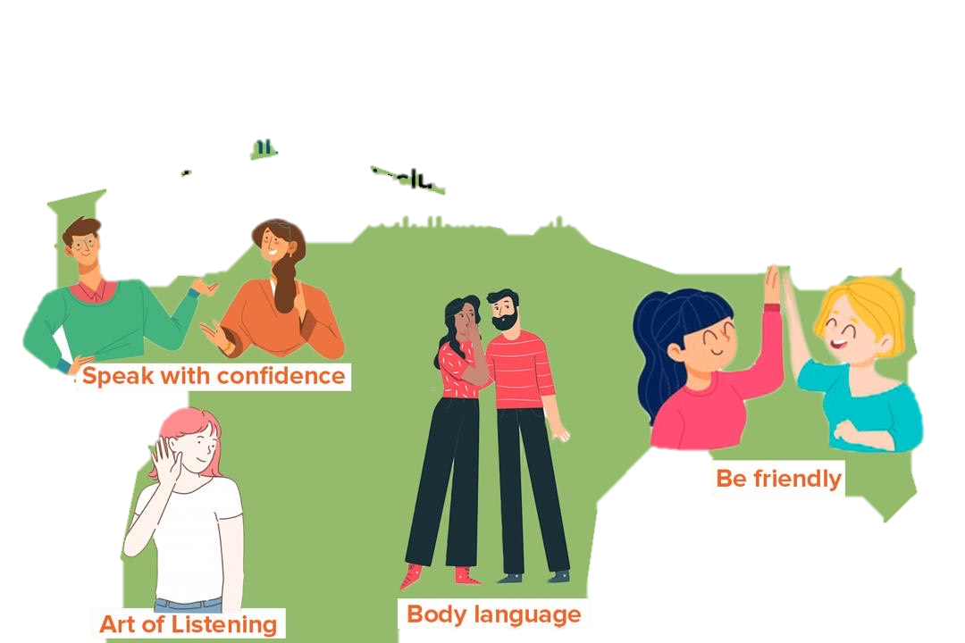
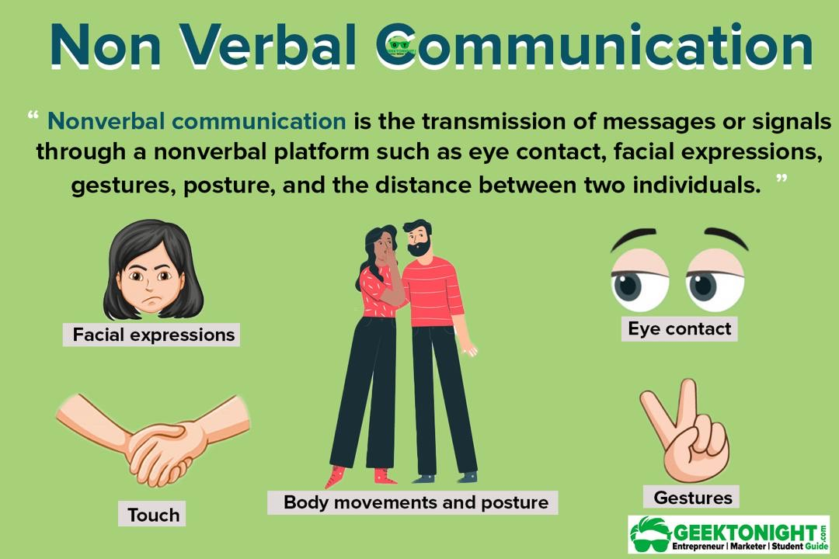




Examples of verbal and non-verbal communication
Verbal communication
Non-verbal communication
11

Slide 12
5
Conclusion
12

Slide 13
Conclusion
Verbal messages are known as communication with words, and non-verbal messages are known as communication without using words.
13

Slide 14
References
DeVito, J. A. (2015). The interpersonal communication book, global edition (14 ed.). Pearson Education.
Kishore, K. (2021, August 3). Difference between verbal and nonverbal communication. Harappa. Retrieved from https://harappa.education/harappa-diaries/verbal-and-nonverbal-communication
14

Slide 15
Thank you for your attention
Do you have any questions?

