Slide 1


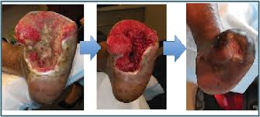
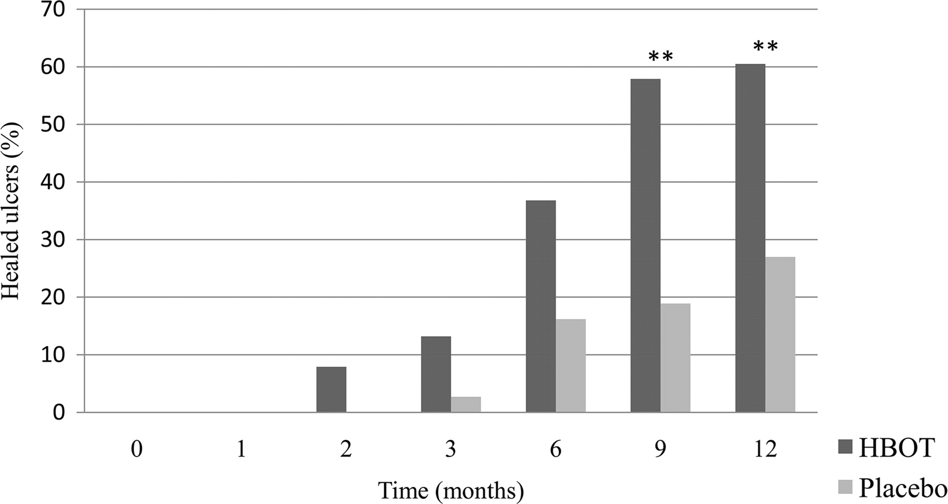


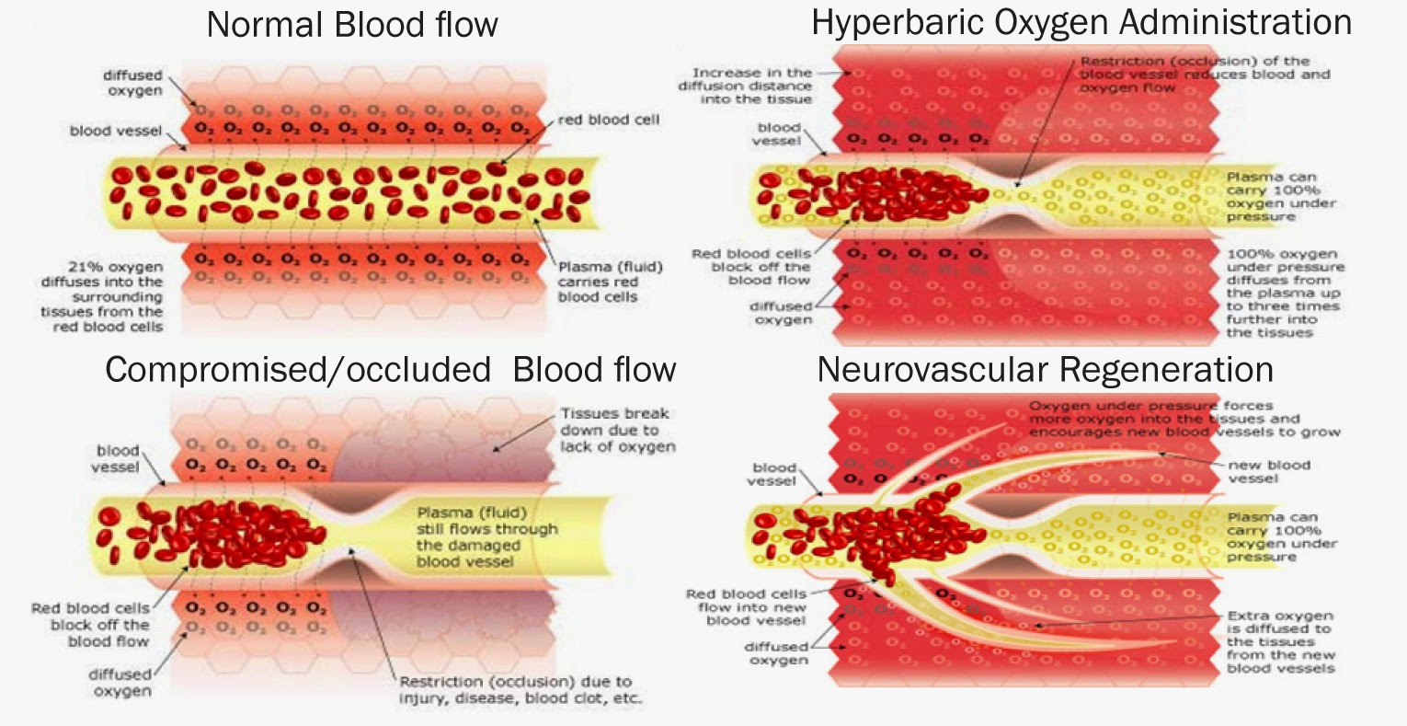
Hyperbaric Oxygen Therapy for the Treatment of Diabetic Foot Ulcers
Ahmed Gaouda / 2nd Year of Faculty of Basic Medical Science
Libyan international Medical University
Introduction
Side effects
❁A diabetic foot ulcers is a frequent complication of diabetes mellitus. Two to ten percent of diabetics have foot ulcer . The risk of developing a diabetic foot ulcer increases with in time. Blood glucose control is an important procedure.
✤ Lung damage, including collapse of the lung
✤ Fluid buildup or bursting (rupture) of the middle ear
✤ Sinus damage
✤ Changes in vision, causing nearsightedness, which
usually goes away days to weeks after the last
treatment
✤ Oxygen poisoning, which can cause lung failure,
fluid in the lungs, or seizures. Seizures from oxygen
poisoning don typically cause brain damage
❁Hyperbaric oxygen therapy (HBOT) is a medical treatment that enhances the body's natural healing processes. The combination of increased atmospheric pressure and increased percentage of oxygen in a total body chamber treats a wide variety of medical conditions.
Types
Monoplace chamber or
Multiplace chambers
Mechanism of action
Therapeutic mechanisms of action for hyperbaric oxygen (HBO2) therapy are based on elevation of both the partial pressure of inspired O2 and of the hydrostatic pressure.
☛ Increased Oxygen Tension
☛ Vasoconstriction
☛ Increased Fibroblast Replicaticn
☛ Increased Collagen Response
☛ Angiogenesis
☛ Enhanced Leukocyte Function
☛ Attenuation of Reperfusion Injury
Conclusion
HBOT does not offer an additional to comprehensive wound care in reducing the indication for amputation or facilitation wound healing in patients with chronic DFUs.
Reference
(1) Canadian Diabetes Association. A step towards good health [Internet]. Toronto (ON): The Association; 2015 [cited 2015 June]. Available from: http://www.diabetes.ca/diabetes-and-you/healthy-living-resources/foot-care/a-step-towards-good-health
(2) American Diabetes Association. Foot complications [Internet]. Alexandria (VA): The Association; c1995–2016 [updated 2015 May 26; cited 2015 Nov 24]. Available from: http://www.diabetes.org/living-with-diabetes/complications/foot-complications/

