Slide 1


Ethical Behavior and It’s Practices
Libyan International Medical University
Faculty of Business Administration
Name: Jude Boughalia
ID: 3766
Email: joud_3766@limu.edu.ly

Slide 2
TABLE OF CONTENTS
01
02
03
Introduction
Importance of Ethical Practices
Consequences of Unethical Business Practices
04
Workplace Ethics
05
Conclusion
06
Reflection
02

Slide 3
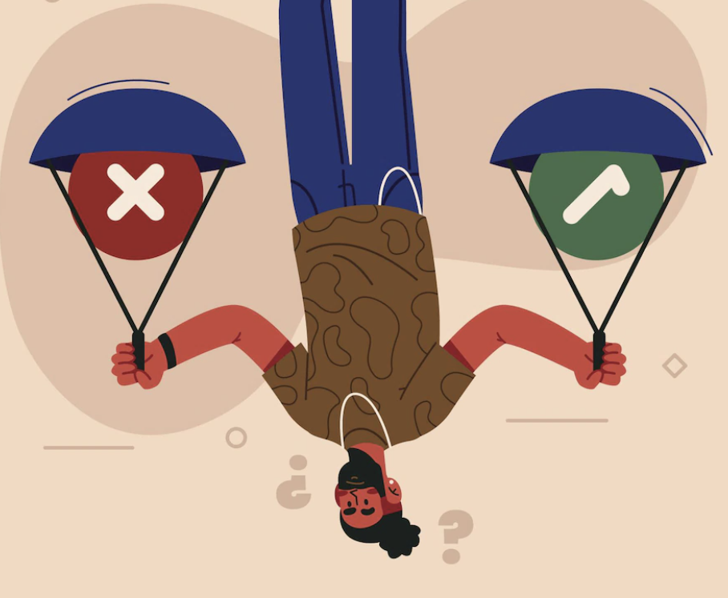
Learning Objectives
01
By the end of this presentation you’ll be able to:
Explain Ethical Behavior and Practices
03

Slide 4
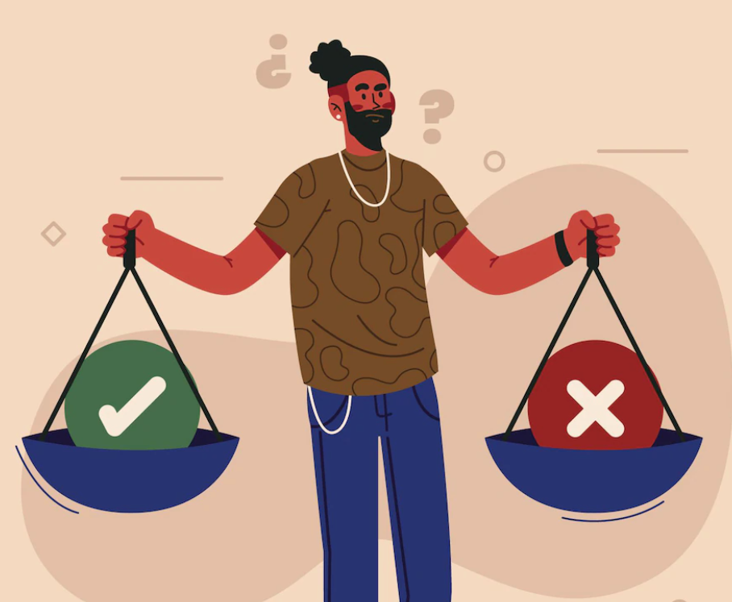
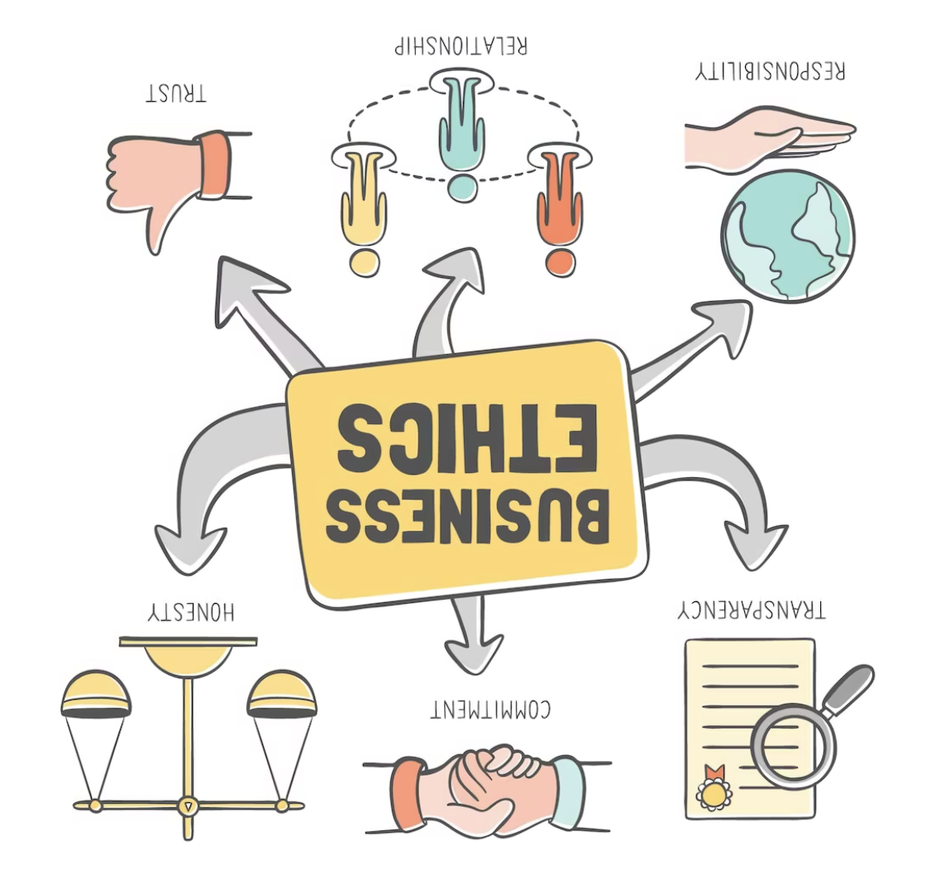
Introduction
Using ethical principles in a specific situation is what is referred to as ethical behavior.
This behavior is defined by certain principles that are maintained in relationships such as:
Honesty
Fairness
Loyalty
04

Slide 5
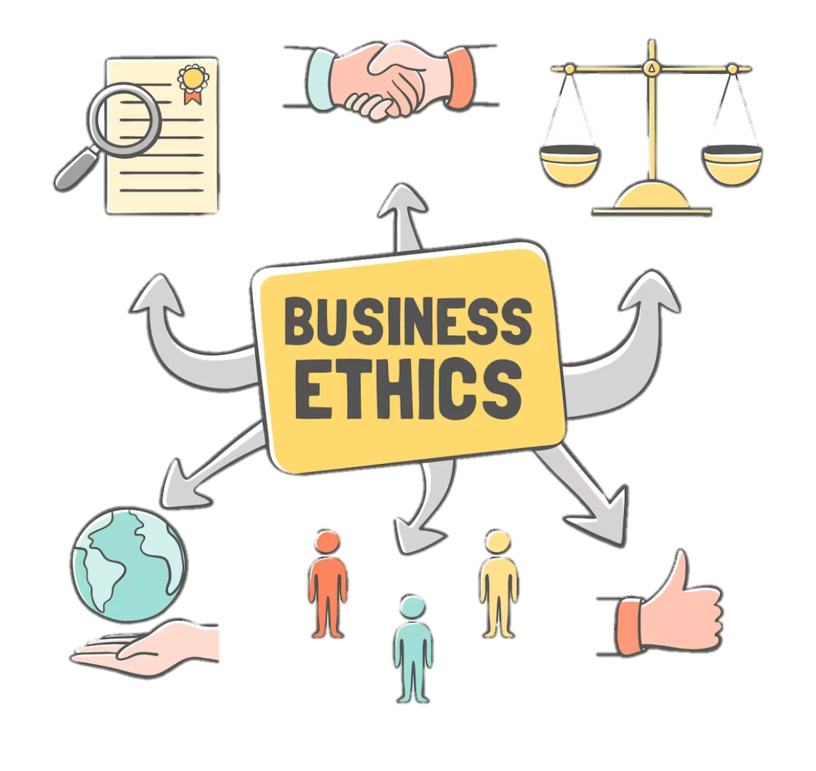
Importance of Ethical Behavior
Every company has it’s own ethical code and rules that controls it’s decisions and activities, Ethical behaviors ensure that employees will achieve the company’s goal by following it’s policies.
05

Slide 6
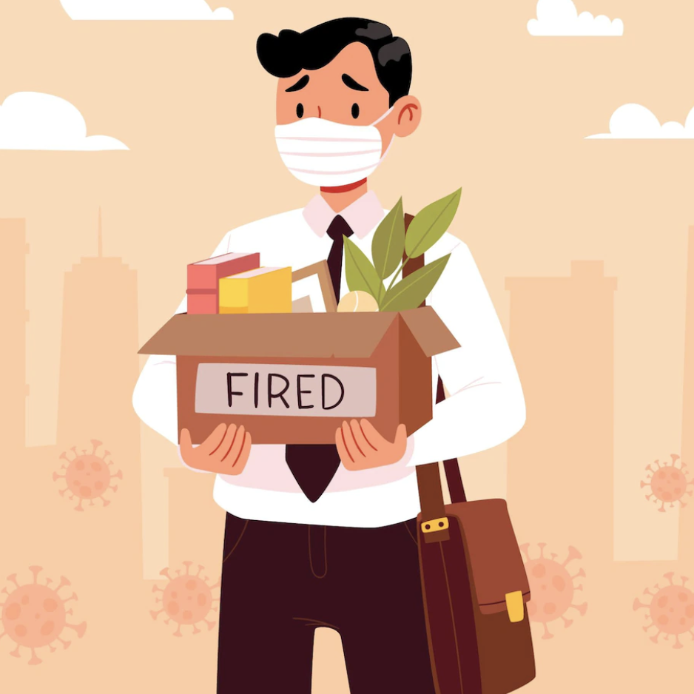
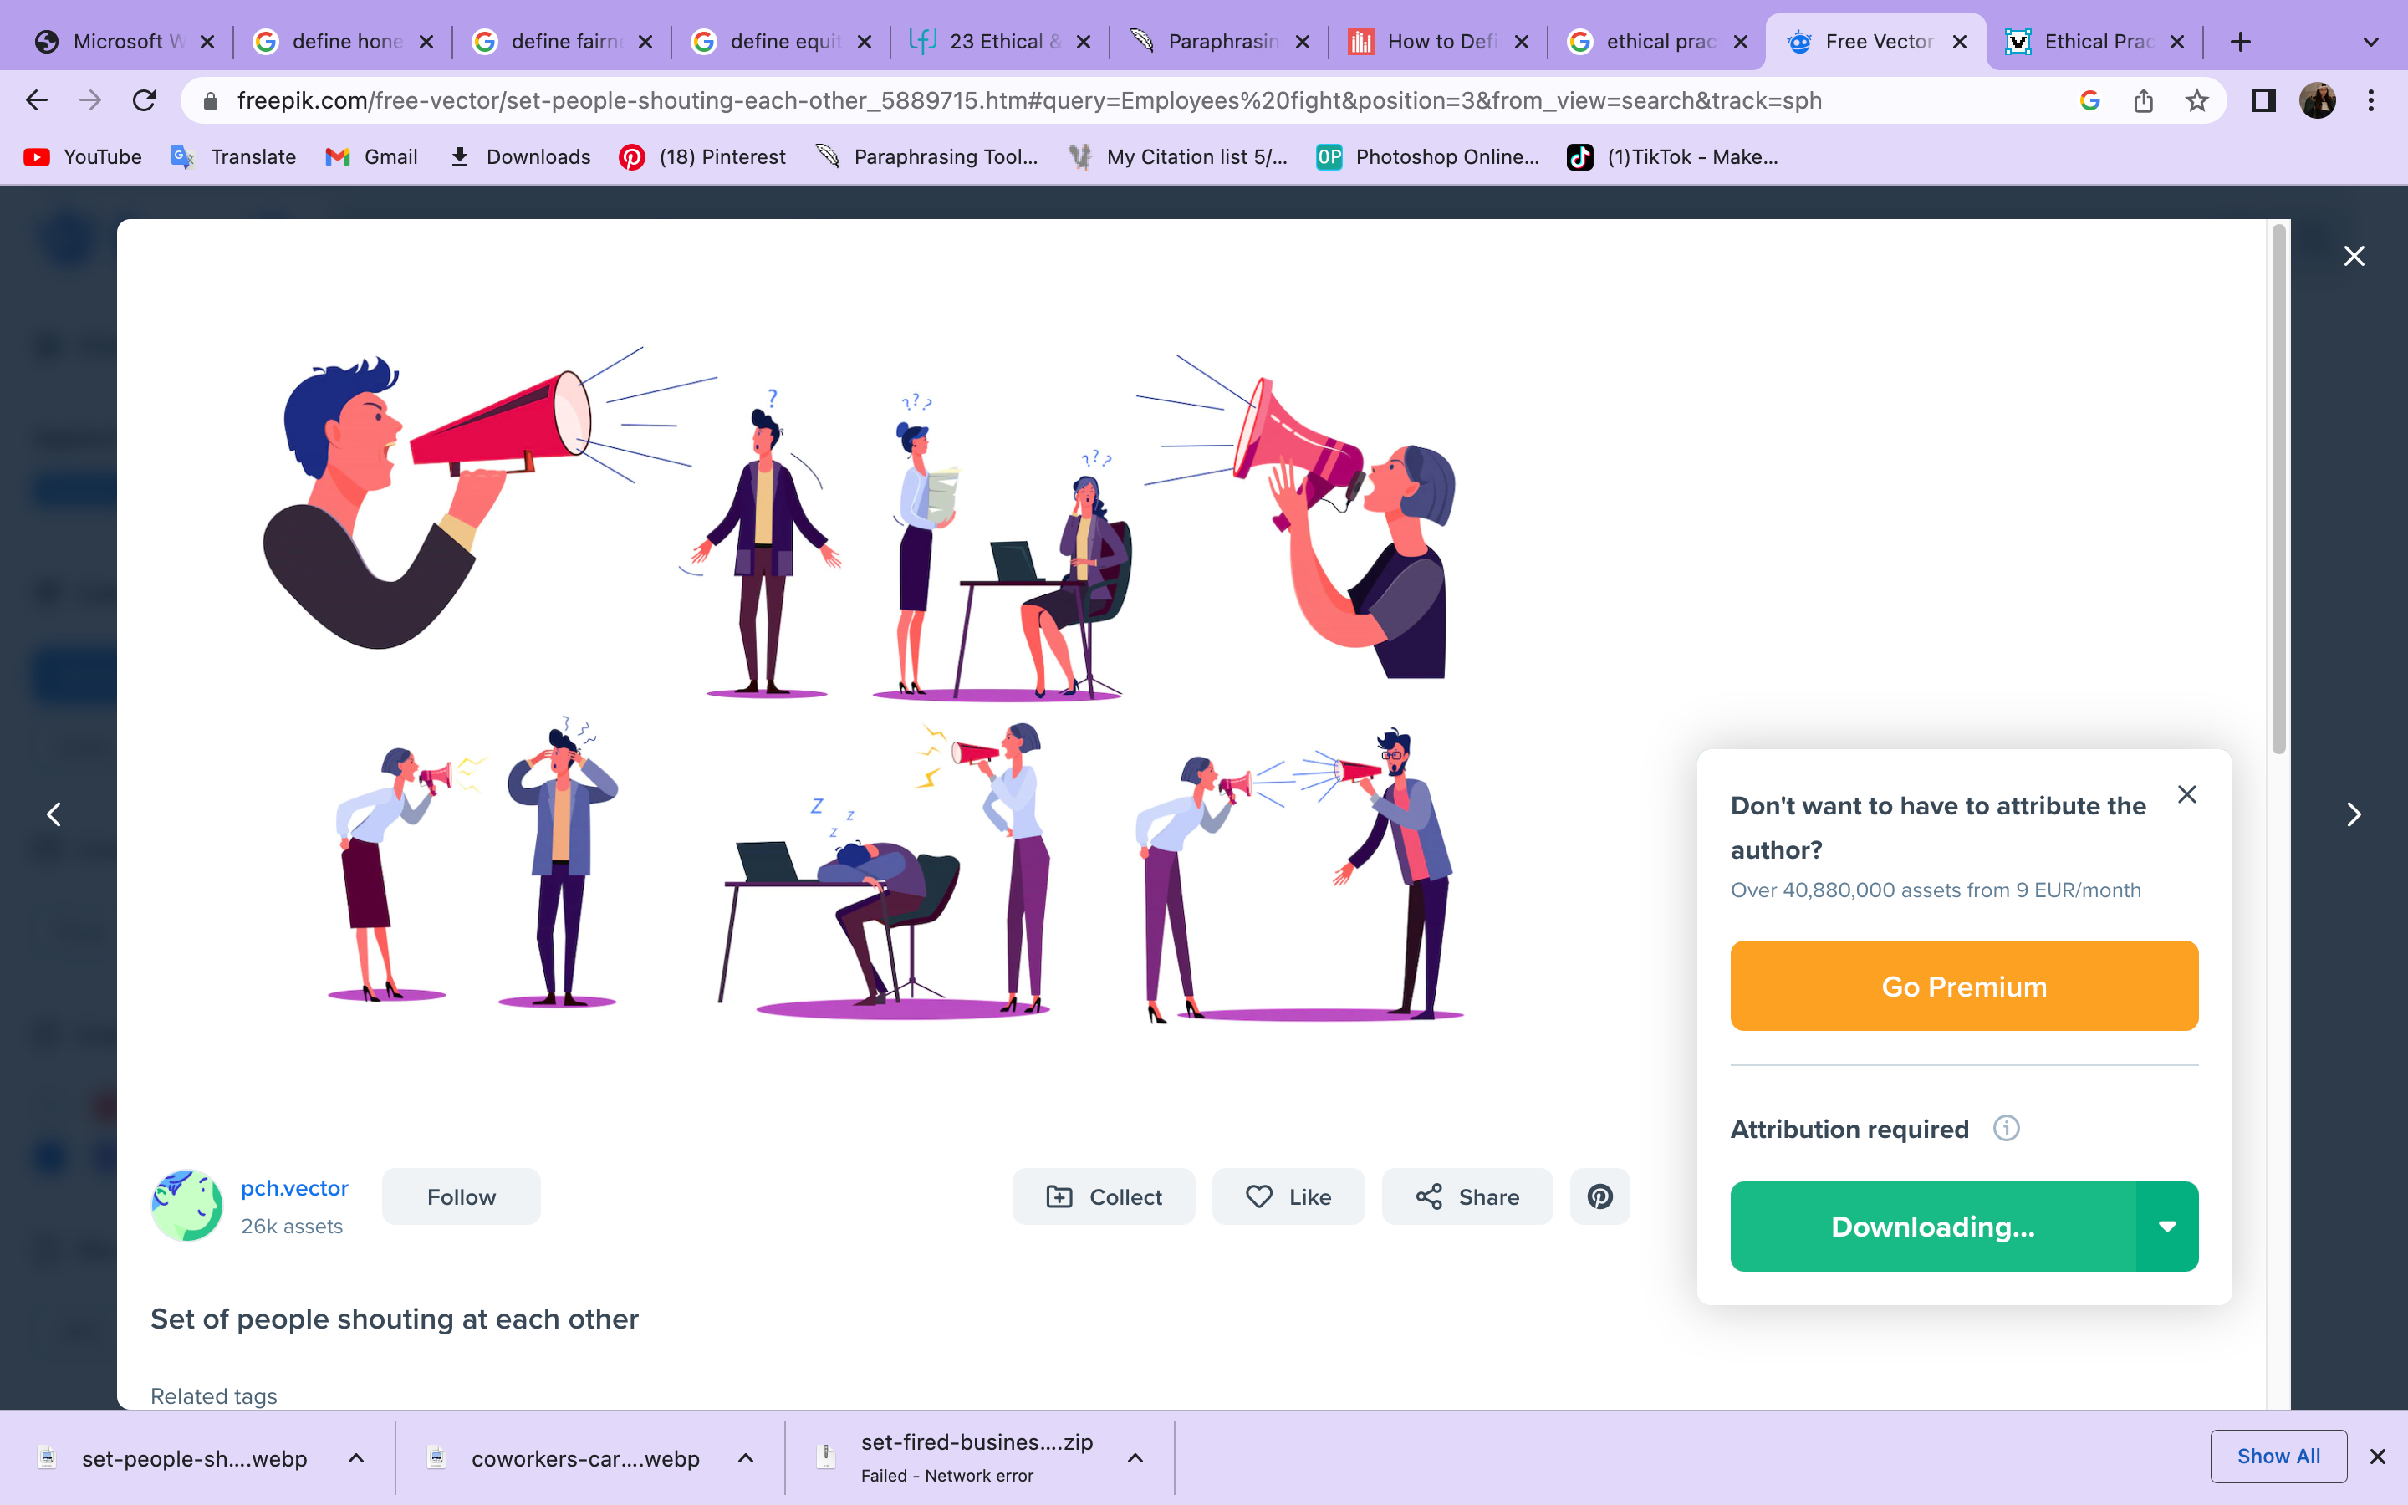
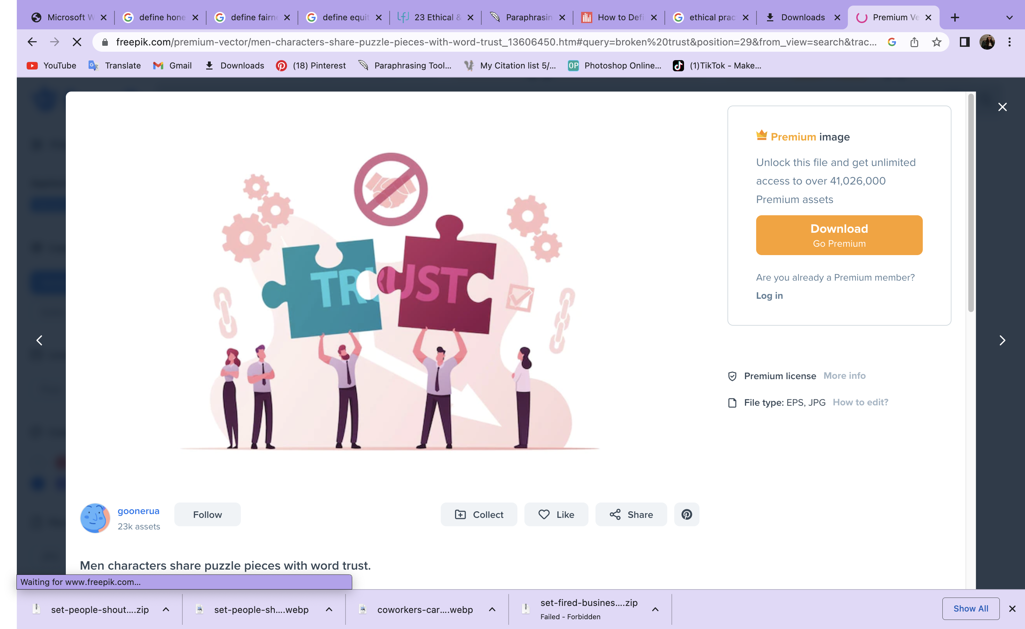
Consequences of Unethical Business Practices
Losing your job and reputation.
Affecting employees’ relationships.
Losing your staff and customers trust.
06

Slide 7
Workplace Ethics
Workplace ethics are the set of principles that should be followed by all the employees and staff in a workplace.
Obey The Company’s Rules
Take Responsibility
Respect Your Colleagues
07

Slide 8

Example
Having a strong sense of responsibility and holding yourself accountable are really important indicators of good work ethic. When an employee shows a sense of responsibility, they show managers that they are dependable and can be relied upon.
08

Slide 9

Conclusion
Implementing ethical behavior in organizations can help to improve employees, job satisfaction, work engagement, trust, and organizational citizenship behaviors.
09

Slide 10

Reflection
In my opinion, it’s Important to use ethical behaviors and practices in the workplace therefore, it builds trust either in the employee to employee relationship or in the employee to customer relationship.
10

Slide 11
References
BSW Field Practicum & Seminar course Manual - Dalhousie University. (n.d.). Retrieved November 8, 2022, from https://cdn.dal.ca/content/dam/dalhousie/pdf/healthprofessions/School%20of%20Social%20Work/Field/BSW-Field-Manual-2021.pdf
How to define ethical behavior & why it's important in the workplace. Work Institute. (2022, July 5). Retrieved November 8, 2022, from https://workinstitute.com/how-to-define-ethical-behavior-why-its-important-in-the-workplace-2/#:~:text=The%20perception%20of%20ethical%20behavior,civic%20virtue%2C%20sportsmanship%20and%20courtesy.
Ethical practice and the role of people professionals: Factsheet: CIPD. CIPD Asia. (n.d.). Retrieved November 8, 2022, from https://www.cipd.asia/knowledge/factsheets/business-ethics#gref
11

Slide 12
THANKS!

