Slide 1


Libyan International Medical University
Faculty of Business Administration
Main Functions of Management
By : Rudena Bettamer
ID: 2886
Student Email: Rudena_2886@limu.edu.ly

Slide 2
Content
INTRODUCTION
MAIN FUNCTIONS OF MANAGEMENT
1. Planning
2. Organizing
3. Leading
4. Controlling
5. Conclusion
6. Reference
2

Slide 3
Introduction
Most positions and departments within a business are tasked with specific duties based on particular knowledge, expertise, or company needs, managers can have a broader and more complex set of responsibilities.
3

Slide 4
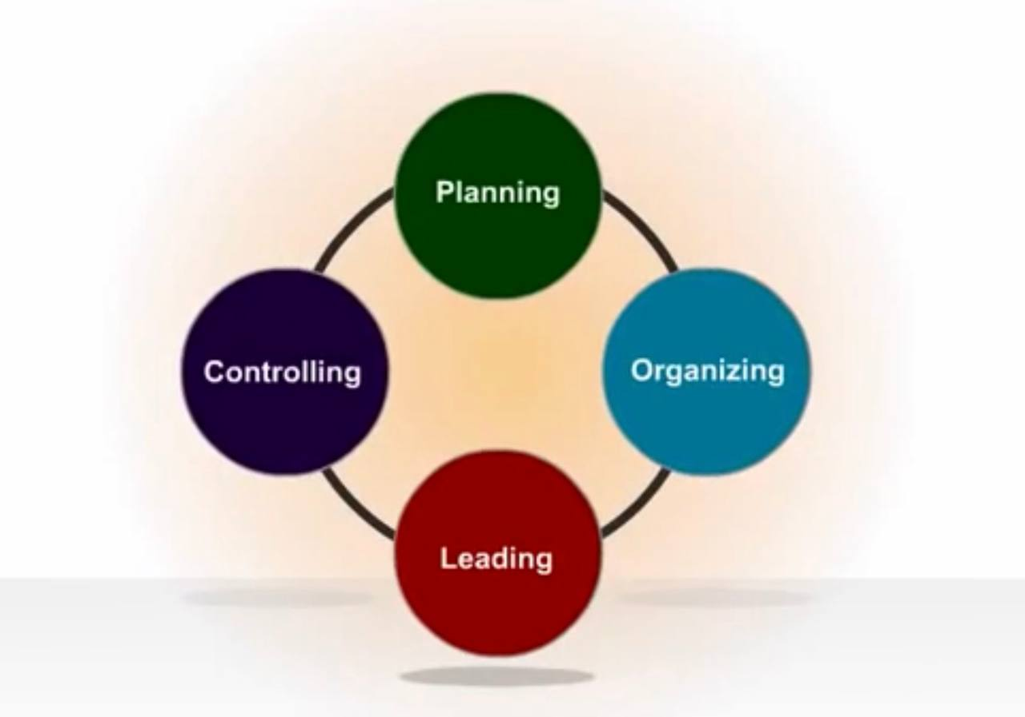
4 Main Functions of Management
4

Slide 5





1. PLANNING
Planning is the preliminary function of management which involves deciding in advance what is to be done in future, when is the right time to do it, how we can do it and who will do it.
5

Slide 6


2. ORGANIZING
Every existing institution has goals that it wants to achieve through the efforts of the workers present in this organization and until it is completed and we can fully invest these efforts and these actions, so they must be organized correctly.
6

Slide 7


3. LEADING
The manager's ability to influence subordinates to work with enthusiasm and confidence to accomplish the tasks assigned to them.
Leadership power sources:
Legal force.
The power of reward and motivation.
7

Slide 8

4. CONTROLLING
To ensure all of the above functions are working toward the success of a company, managers should consistently monitor employee performance, quality of work, and the efficiency and reliability of completed projects.
8

Slide 9
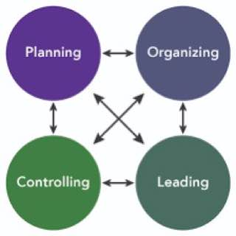
Conclusion
These four functions are among the most important functions of the organization in order for the work to be successful and the goals of the organization to be achieved more broadly.
9

Slide 10
American InterContinental University. (2020, October 22). The four functions of management: What managers need to know. American Intercontinental University - A member of the American InterContinental University System. Retrieved March 22, 2022, from https://www.aiuniv.edu/degrees/business/articles/functions-of-management
REFERENCE
10

Slide 11
THANK YOU

