Slide 1
Lower Gastrointestinal Bleeding
Dr. Nadia farhat ezzawi
Gastroenterology department
BMC

Slide 2
Definition
Lower GIT bleeding is defined as any bleeding in the GI tract distal to ligament of treitz.
Majority of the bleeding is self limiting.
90% of the cases colon is the source of bleeding
Most common cause of significant LGI bleeding is diverticular disease.

Slide 3
Presentation of lower GIT bleeding
Hematochezia:-
Passage of fresh blood through the anus, usually in or with the stool.
Melena :-
Dark sticky feces containing partly digested blood
Occult lower GIT bleeding :- anemia.

Slide 4
Aetiology
1- Hemorrhoids .
2- Diverticulosis.
3- AV-malformation
4- Polyps.
5- IBD.
6- Infectious gastroenteritis .
7- Meckels diverticulum.
8- radiation colitis.
9 – upper source.

Slide 5
Haemorrhoids
Dilated or enlarged veins in the lower portion of the rectum or anus.
Causes :-
Straining and constipation.
Pregnancy.
Obesity.
Prolonged sitting.
Portal hypertension and anorectal varices.
Chronic diarrhea
Familial.

Slide 6
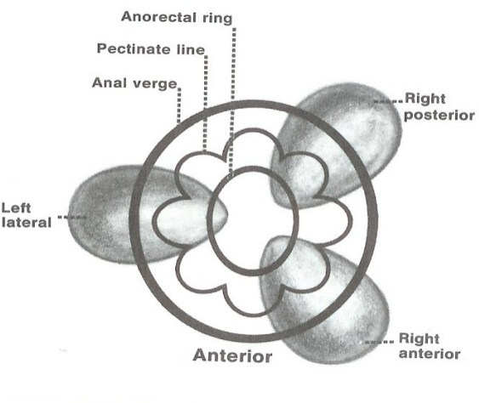
They are commonly seen in left lateral , right anterior and poeterior (3,7,11 o clock) position with patient in lithotomy position.

Slide 7
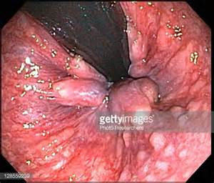
Haemorrhoids
Haemorrhoids
1st degree: never prolapse.
-2nd degree: prolapse during defecation but return spontaneously
-3rd degree: remain prolapsed but can be reduced digitally.
-4th degree: long standing prolapse cannot be reduced

Slide 8
symptoms
Rectal bleeding.
Bright red blood in stool.
Anal pain and itching.
Rectal prolapse.
Thrombosis may result from defecatory straining .

Slide 9
Treatment
Vareis from simple reassurance to operative hemorrhoidectomy.
Complicated haemorrhoids cuase sever bleeding and anemia.
Stabilization of the patient should be performed before surgery.
Fluids , blood transfusion, antibiotics.
surgery

Slide 10
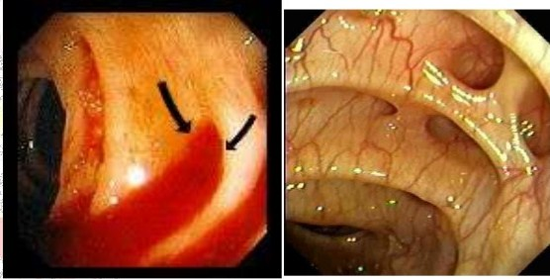
diverticulitis
Diverticulosis
is a condition in which there are small pouches or pockets in the wall or lining of any portion of the digestive tract.
inflammation or infection of diverticulae called (Diverticulitis).

Slide 11
Risk factors
Rare < 40 yrs
Chronic lack of dietary fiber or genetic.
obesity.
smoking.
family history.
and NSAID use.

Slide 12
Clinical Features
asymptomatic and are only found incidentally during routine colonoscopy or CT imaging.
intermittent lower abdominal pain , colicky in nature.
Rectal bleeding..
management
Patients with diverticular bleeds can often be managed conservatively as most cases will be self-limiting, Any significant bleeding will need appropriate resuscitation, including the use of blood products, and stabilisation.

Slide 13
Endoscopic therapy:
Diathermy/laser phtocoagulation.
Vasoconstrictive agents (control bleeding).
Surgical intervention*
is required in those with perforation with faecal peritonitis or overwhelming sepsis.

Slide 14
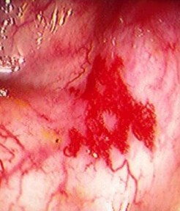
Angiodysplasia
Submucosal vascular malformation.
It is caused by arteriovenous malformations between previously healthy blood vessels, most commonly in the caecum and ascending colon.

Slide 15
Angiodysplasia can be divided into
acquired or congenital:
Acquired angiodysplasia – begins as reduced submucosal venous drainage in the colon due to chronic and intermittent contraction of the colon, giving rise to dilated and tortuous veins. This results in the loss of pre-capillary sphincter competency and in turn causes the formation of small arterio-venous communications characterized by a small tuft of dilated vessels.
Congenital angiodysplasia – such as hereditary haemorrhagic telangectasia (/Rendu-Osler-Weber syndrome) or Heyde’s syndrome.

Slide 16
Clinical Features
Asymptomatic – only diagnosed incidentally during colonoscopy (around 10% cases)
Painless occult PR bleeding (majority of case)
Acute haemorrhage (10-15% of cases)
lower GI lesions (more common in angiodysplasia) are more likely to present as haematochezia. Signs on examination are usually minimal.

Slide 17
investigations
Colonoscopy depending on the suspected site of bleeding.
Small bowel bleeds : wireless capsule endoscopy may help detection of site of dysplasia.
in the setting of an overt angiodysplastic bleed, mesenteric angiography is recommended

Slide 18
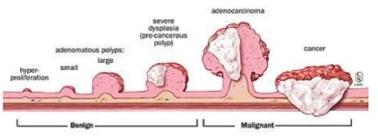
Neoplasia of LGI tract
It may present as polyp , ulcer or mass.
Sloughing off of the lesion may present as lower GI bleeding.
Proper evaluation , investigation , biopsy , staging of the neoplasia is to be done for management.

Slide 19
Colitis
Infective / inflammatory colitis present as LGI bleeding , mostly hematochezia, pus may also present.
IBD usually confirmed by biopsies on colonoscopy.
Infectious colitis; in addition to colonoscopy ; stool testing for C.difficile toxins is fequently the first line diagnostic approach.

Slide 20
Approuch to patient with Lower GIT Bleeding
History and examination:-
a prior history of peptic ulcer disease, diverticulosis, aortic vascular surgery, radiation therapy, use of medications such as non-steroidal anti-inflammatory and anti-coagulants, or recent endoscopy with biopsy may indicate the origin of bleeding.
Diagnostic and resuscitative manuevers must occur simultaneously if hemodynamic instability is present.
Digital rectal examination with stool guaiac is a routine part of the physical examination

Slide 21
Insert NGT to R/O upper source of bleeding .
complete blood count: -
type of anemia and cross match, platelet count
coagulation parameters.
  LFTs, albumin, BUN and creatinine.
Uss abdomin.
Sigmoidoscopy/anoscopy to rule out anorectal sources of hemorrhage.
Colonoscopy permits examination of the entire colon and potential therapeutic interventions in LGIB.

Slide 22
When colonoscopy is non diagnostic ; selective angiography is indicated.
Consult general surgeon if the cause is surgical (hemorrhoids, fissure , mickles diverticulum) , or the patient continues to actively bleed

Slide 23
summary
mortality rates for lower gastrointestinal bleedings are less than 5%.
screening anoscopy/sigmoidoscopy After resuscitation is indicated to rule out the presence of anorectal pathology.
Unclear diagnosis with active bleeding needs surgical intervention.

Slide 24
Thank you

