Slide 1


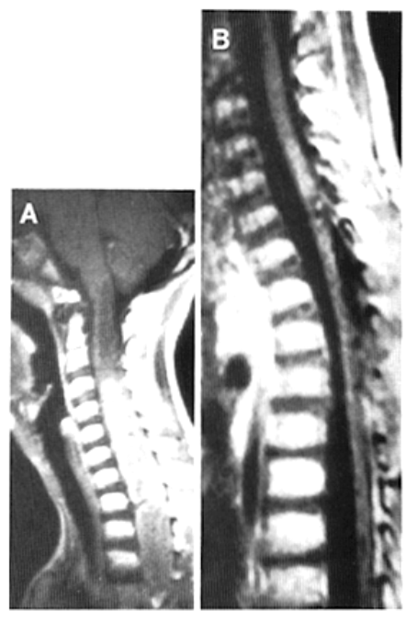
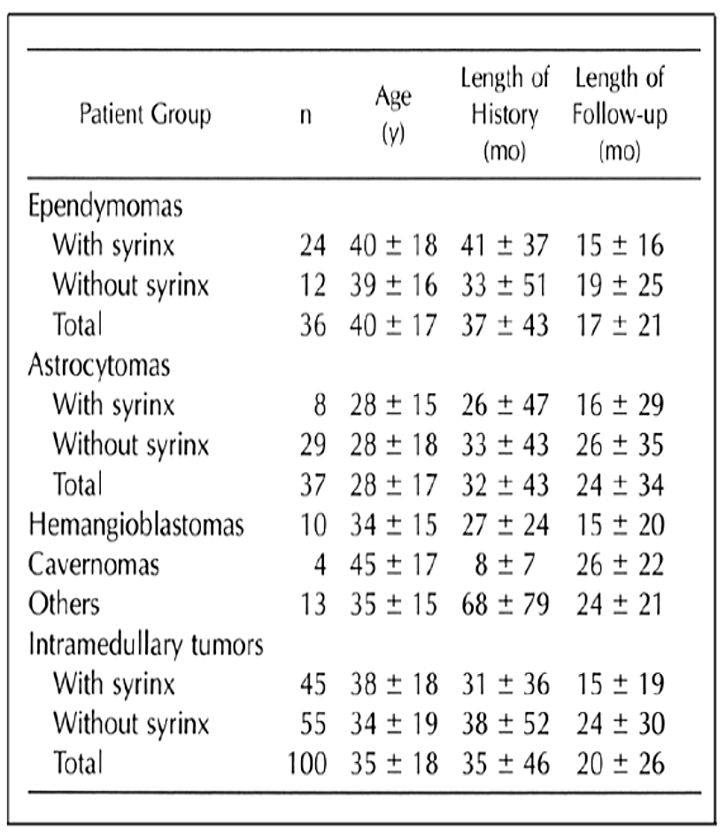
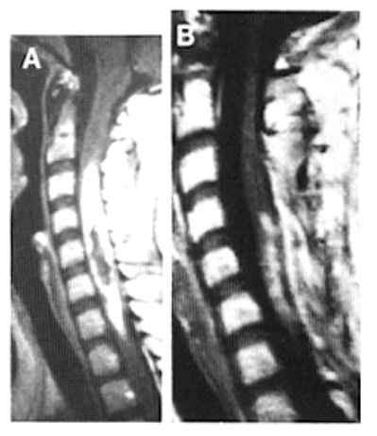
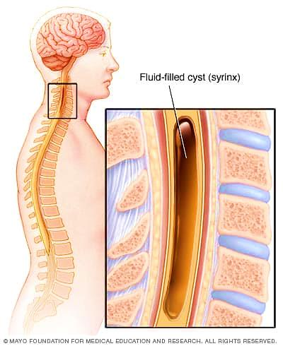
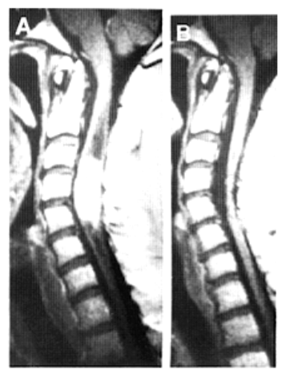
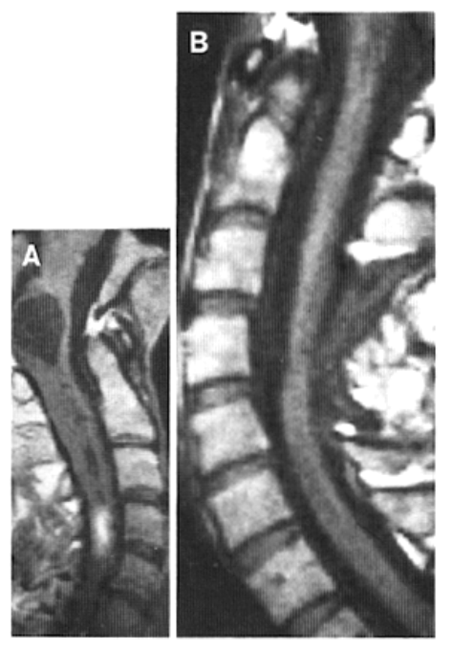
Syringomyelia in Association with Intramedullary Spinal Cord Tumors
Zeizi Ahemed Abdalla 2nd Year Medical Student
Faculty of Basic Medical Science
Libyan International Medical University
Introduction
Forty percent showed syringes above and below the tumors.
In four patients, the syringes extended up into the medulla oblongata.
Syringes were found more often in adults than children (50.1 and 21.1%, respectively).¹
Figure 3:
Preoperative MRI scan (A) of a 10-year-old boy with an astrocytoma extending from C5-T9 and a syrinx above the tumor. scan MRI after 3 months (B) shows no residual tumor.¹
Intramedullary Spinal Cord Tumors
( IMSCTs )
Primary spine tumors are rare neoplasms that can lead to significant patient
morbidity and mortality.
Intramedullary spinal cord tumors (IMSCTs) are the rarest of these neoplasms and can potentially lead to severe neurologic deterioration, decreased function, poor quality of life, or death.²
Syringomyelia
Tumor-associated fluid-filled cavity within the spinal cord as syringomyelia or syrinx.
Syrinx occurs with 25 to 58% of patients with IMSCT, and in this association, syringes appear more commonly in the lower cervical and upper thoracic region.
They occur most frequently with ependymomas, followed by hemangioblastomas and cavernomas.²
.
Figure 4: MRI scan (A) of a 17-year-old girl with an astrocytoma extending from C3-C7 without a syrinx.
MRI scan after 2
years (B) demonstrates tumor regrowth.¹
Table 1 gives an overview of mean ages and lengths of histories and follow-ups
Ependymomas (Fig. 1), hemangioblastomas (Fig. 2), and cavernomas showed the highest proportion of syrinx formation. Astrocytomas (Figs. 3 and 4) were accompanied by syringomyelia less often.¹
Figure 1: Preoperative MRI scan (A) of a 42-year-old man with an ependymoma extending from C3-C5 accompanied by a syrinx above and below them solid tumor. MRI scan 3 months after surgery (B) shows no evidence of residual tumor.¹
If a syrinx accompanies the tumor, this should be interpreted as a favorable prognostic sign, because it indicates a displacing rather than an infiltrating tumor and thus suggests resectability of the mass.¹
.
Conclusion
In conclusion intramedullary tumors should be operated on as soon as neurological symptoms have appeared.
Waiting for further neurological
progression dramatically raises the risk of surgery.
Intramedullary Tumors in Relation to Accompanying Syringomyelia
Figure 2: MRI scan (A) of a 47-year-old woman with a hemangioblastoma extending from C4-C5 with an associated syrinx above and below the solid tumor part. MRI scan 6 months after surgery (B) shows no residual tumor.¹
During the period from 1977 to 1992, a total of 100 intramedullary tumors in 94 patients were operated on in the Department of Neurosurgery at the Nordstadt Hospital in Hannover, Germany.
Of 100 intramedullary tumors, 45 presented with associated syringes.
Forty-nine percent were above tumor level and 11% below tumor level.
References
1.Samii, M. and Klekamp, J. (1994). Surgical Results of 100 Intramedullary Tumors in Relation to Accompanying Syringomyelia. Neurosurgery, 35(5), pp.865-873.
2.Samartzis, D., Gillis, C., Shih, P., O'Toole, J. and Fessler, R. (2015). Intramedullary Spinal Cord Tumors: Part I—Epidemiology, Pathophysiology, and Diagnosis. Global Spine Journal, 5(5), pp.425-435.

