Slide 1
Management of Thoracic Trauma
Omar Mangoush

Slide 2
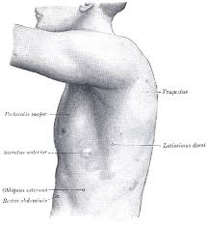
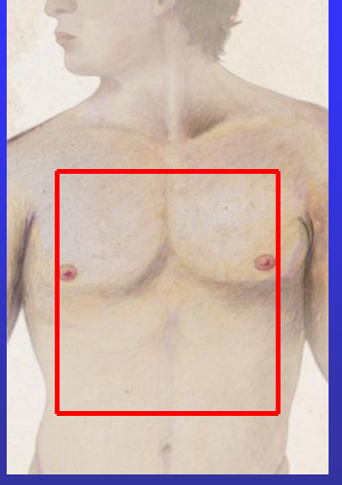
Mode of Trauma
Penetrating → Intervention
  Low energy
  High energy: cavitation
  Crossing mediastinum
  None Crossing mediastinum
Blunt → CT

Slide 3
Initial Assessment
ABC
Hypoventilation & Hypoxia are killers
Injuries may develop over time and may become life threatening
Reassessment important especially if the condition is deteriorate

Slide 4
Primary Survey Secondary Survey
Tension pneumothorax
Open pneumothorax
Massive haemothorax
Cardiac tamponade
Facture ribs & flail chest
Simple pneumothorax
Simple haemothorax
Lung contusion
Blunt myocardial injury
Blunt aortic injury
Notes:
Secondary survey: fully examined, front and back. Special attention is paid to identifying any missed injuries or progression of previously identified injuries. The examination is also directed by findings on the chest X-ray

Slide 5
Fracture Ribs, Clavical & Sternum
Not much of a problem, but associated injuries to soft tissue do matter (major vessels, lung, liver, spleen)
Analgesia
O₂
Look for associated soft tissues injuries
Physiotherapy
IF PATIENT IS STABLE, DO NOT INSERT ICD
DO CXR FIRST
Notes:
Clinical suspicion with pain site, tenderness, bony crepitus, ecchymosis and muscle spasm over the rib
Analgesia: parenteral, intercostal block, epidural or paravertebral
Admit if elderly patient, multiple rib fracture
Physio

Slide 6
Flail Chest
Associated lung contusion & pain
Cover with bulky dressing
30-40% will need mechanical ventilation
Notes:
Main problem is Associated lung contusion & pain rather than mechanical ventilation

Slide 7
Pneumothorax
Type:
  Closed
  Open
  Tension
Treatment:
  Observation
  Needle thoracostomy
  ICD thoracostomy
IF PATIENT IS STABLE, DO NOT INSERT ICD
DO CXR FIRST

Slide 8
Simple Pneumothorax
Small ones, visible only on CT → observe
Most of them need ICD
Multiple trauma, ventilation or travel → ICD

Slide 9
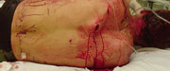
Open Pneumothorax
Notes:
Once the size of the hole is more than 0.75 times the size of the trachea, air preferentially enters through the thoracic cavity.
sucking wound. Occlusive dressing and chest drain. If needed, intubation and ventilation.

Slide 10
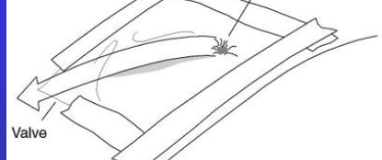

Slide 11
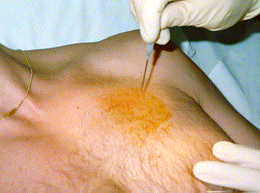
Tension Pneumothorax
DO NOT SEND PATIENT ANYWHERE
DO NEEDLE THORACOSTOMY FIRST
Notes:
- By nature the patient will be unstable, do not send the patient anywhere, needle thoracostomy first

Slide 12
Haemothorax
ICD thoracostomy
  1000 - 1500 ml immediate or 100-200 ml/h for 3h → Thoracotomy
  Dark blood <> Bright red blood
Retained blood (CT) → empyema
IF PATIENT IS STABLE, DO NOT INSERT ICD
DO CXR FIRST
Notes:
CXR:
Supine, haziness
Erect: obliteration of CP angle (300-500)
USS
CT

Slide 13
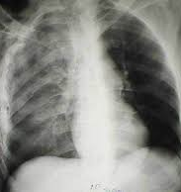
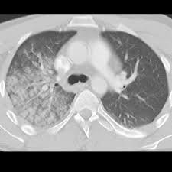
Lung Contusion
IF PATIENT IS STABLE, DO NOT INSERT ICD
DO CXR FIRST
Notes:
Alveolar infiltration → ARDS → pneumonia
CT more sensitive than CXR
No air bronchogram
Ass with flail chest
Appear within 6-24hours
No need for ICD. Good physio and broncheal toilet
Blunt trauma → 20% lung contusion → 50% mechanical ventilation → 10-25% death

Slide 14
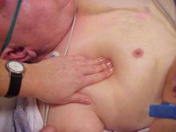
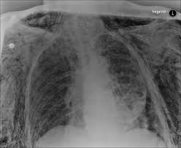
Subcutaneous Emphysema

Slide 15
Tracheobronchial Injury
Pneumothorax
  Massive air leak & collapsed lung
  ICD thoracostomy
No pneumothorax
      Late diagnosis
Bronchoscopic guided intubation, if indicated
Primary surgical repair

Slide 16
Oesophageal Perforation
Associated with penetrating injuries (crossing mediastinum)
Initial CXR could be normal
Water soluble contrast oesophagram
Mortality is high if diagnosed late
Broad spectrum antibiotics and primary surgical repair
Notes:
Lethal because there is no serosal cover
Cause chemical and bacterial mediastinitis

Slide 17
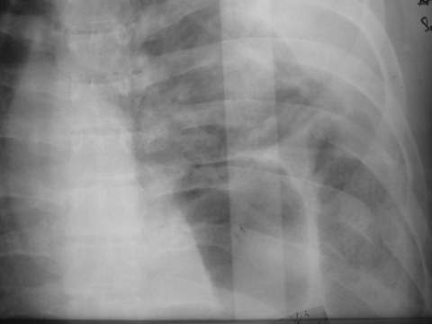
Diaphragmatic Rupture
Blunt abdominal trauma
High index of suspicion
Auscultation of chest
CXR, CT
Mainly left
Laparotomy <> thoracotomy
IF PATIENT IS STABLE, DO NOT INSERT ICD
DO CXR FIRST

Slide 18
Myocardial Contusion
Associated with fracture sternum
Serial ECG
  Frequent ectopics
  Heart block
  ST elevation
Serial Troponin
If negative, discharge; otherwise admit and echocardiogram
Notes:
The point of diagnostic testing is not to diagnose the presence of myocardial contusion but to define a low risk population that can be safely discharged from the emergency department

Slide 19
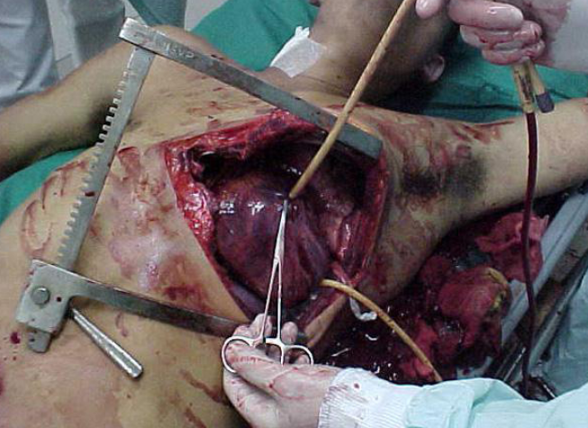
Myocardial Rupture & Penetrating Injuries
Arrest or Shock with no response to resuscitation
Exsanguination <> tamponade
ED thoracotomy
Finger occlusion, Foley catheter or vascular clamp
Notes:
- Exsanguination usually die before reaching ED
- Tamponade give some degree of protection and buy some time

Slide 20
Cardiac Tamponade
Beck’s triad
  Hypotension
  Raised JVP
  Muffled heart sounds
Bedside echo
Pericardiocentesis <> thoracotomy
Notes:
Other signs:
Pulsus paradoxicus
Kussmaul’s sign
Water bottle on CXR

Slide 21
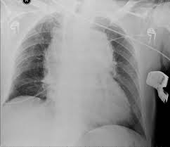
Aortic Injury
Associated with deceleration injury
High index of suspicion
CXR, CT, TOE
If BP is high, control it with Labetalol or Ismolol
Surgical repair or TEVAR
Notes:
Prognosis:
15% of RTA death
90% die at scene
50% of ER cases die within 24h without diagnosis or Rx
CXR: Low sensitivity, but 98% negative predictive value
Wide mediastinum (>8cm)
Blurring of aortic knuckle and loss of aortic outline
NG shift to right
Depression of left main bronchus
Fracture first 3 ribs and sternum
TEVAR: thoracic endovascular aortic repair
- Surgical repair:
Haemodynamic instability
Large-volume haemorrhage from chest tubes
Contrast extravasation on CT or rapidly expanding mediastinal haematoma
Penetrating aortic injury

Slide 22
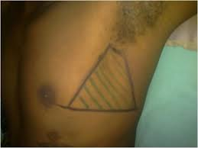
ICD Insertion
Safe triangle: anterior axillary line, posterior axillary line & nipple
Generous skin cut
No trocar, use finger & Robert to guide the drain
IF PATIENT IS STABLE, DO NOT INSERT ICD
DO CXR FIRST
Notes:
- Generous skin opening
- Do not use trocar
Palpate with finger
Guide drain with Robert

Slide 23
Emergency Department Thoracotomy
Indications:
  Witnessed cardiac arrest
    CPR <15 min in penetrating trauma
    CPR < 5 min in blunt trauma
  Retractable shock
Rational:
  Release of cardiac tamponade
  Perform open CPR
  Repair cardiac injuries
  Apply clamp into thoracic aorta
  Apply clamp into lung hilum
Outcome:
Survival 5-50%
Notes:
Drastic, but it can safe life

Slide 24
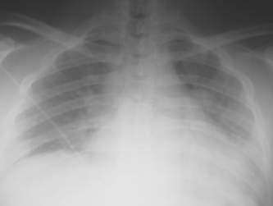
General Consideration
AUSCULTATE
High flow O2
RSI if indicated
Poor quality CXR → CT
  Stable →CT, unstable →Resus + OR
Analgesia
Bronchial lavage
Physiotherapy

Slide 25
Message to Take Home
IF PATIENT IS STABLE, DO NOT INSERT ICD. DO CXR FIRST
DO NOT SEND UNSTABLE PATIENT TO RADIOLOGY DEPRTMENT
ED THORACOTOMY CAN SAFE LIFE
CONTINUE TO MONITOR PATIENT AFTER INITIAL EVALUATION & INTERVENTION. DOES THIS PATIENT NEEDS AN ICU BED?
ANALGESIA & CHEST PHYSIOTHERPAY

