Slide 1







Libyan International Medical University
Faculty of Business Administration
The Ethical Issues in the Context of Privatization and Deregulation
NAME: Abdelmoula Sowan
ID:4015
Email: abdualmula-4015@limu.edu.ly

Slide 2

Table
of Contents
  Introduction
  Privatization
  Deregulation
  Danger of Deregulation
  Disadvantage of Privatization
  Advantages of Privatization
2

Slide 3

Introduction:
In the subject of public administration, there are numerous challenges in attempting to manage politics-free government and public affairs.
3

Slide 4


  Privatization:
When a public service is sold, the government permits businesses to take over the operation. A government contract may allow a private corporation to acquire ownership of a good or service in this way.
4

Slide 5


Deregulation:
Deregulation is the process of getting rid of or cutting back on government rules, usually in the business world. It is the abolition of economic regulation by the government.
the removal of constraints or regulations, particularly in a certain industry.
5

Slide 6


The danger of deregulation:
The risk of deregulation is that without sufficient oversight of intricate technological procedures, the general population will be at the whim of the market. The majority of companies are well-operated, with an emphasis on emissions and safety. However, it is evident that some are badly run and prioritize short-term profit over health and safety.
6

Slide 7
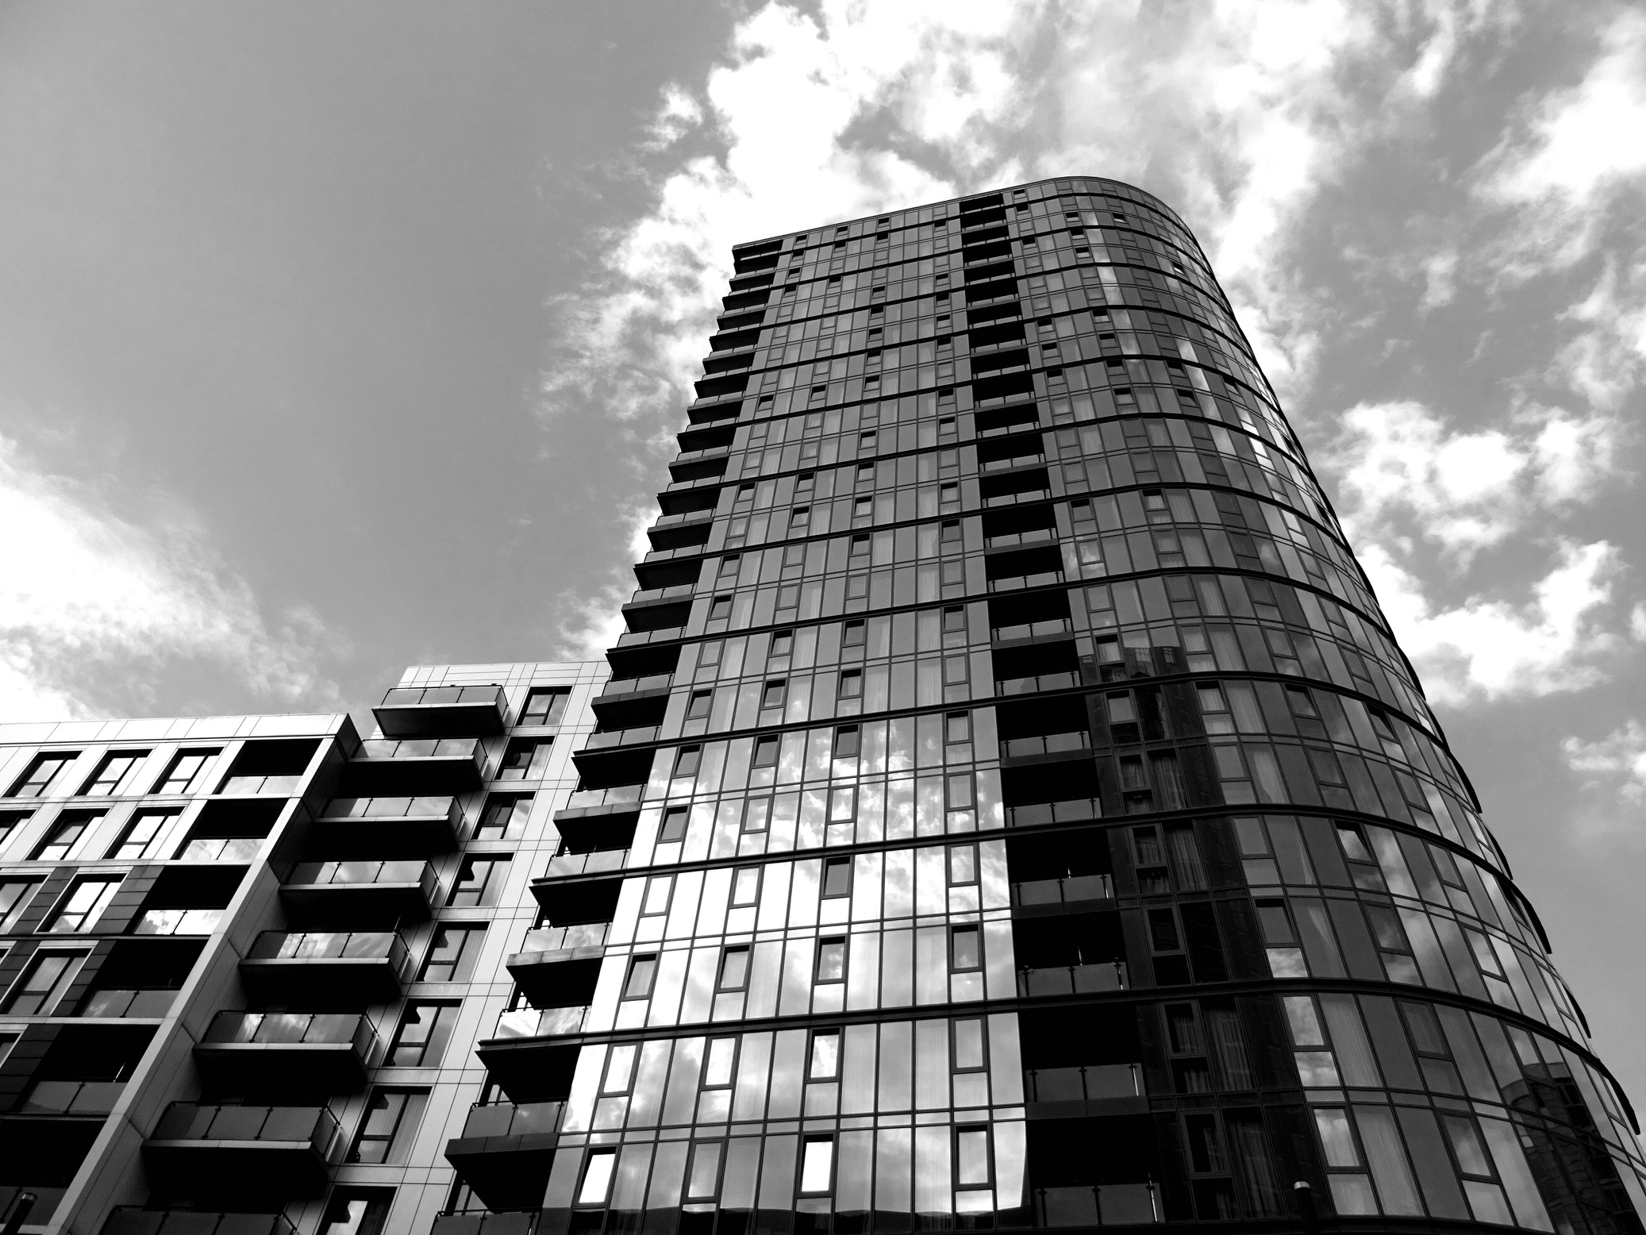

Disadvantage of Privatization :
Costs you more money
Privatization is Risky
Privatization creates a divided society
If private businesses are in charge of our public services and they are too large to fail, then when something goes wrong, it is the public that must clean up the mess.
When public services are privatized, you pay more both directly and indirectly as a taxpayer.
To ensure that everyone's basic needs are met and that we may all participate in the community, public services are crucial.
7

Slide 8
Advantages of Privatization:
1-IMPROVE SERVICE QUALITY:
According to a number of surveys, public officials thought that privatization had improved the quality of services.
8

Slide 9
2-INCREASE EFFICIENCY AND INNOVATION:
Through the use of more flexible hiring techniques, job categories, streamlined operational processes, and streamlined procurement, private management can dramatically reduce operating costs.
9

Slide 10

Conclusion:
In other words, whether or not a stable, competitive environment has been formed first, privatization is preferable to none.
Regulation, or governing and managing an industry through legislation, is the primary means through which the government keeps an eye on business.
10

Slide 11

Reflection:
In my opinion, privatization is crucial to get a lot of money and being financially independent, but it has disadvantages for example it makes you cost a lot of money.
Deregulation is the removal of constraints or regulations, particularly in a certain industry.
11

Slide 12
References:
Megginson and Netter, From state to market: A survey of empirical studies on privatization, Journal of Economic Literature 39(2), June 2001, 321–389.
Kemp, Roger L. (2007). Privatization: The Provision of Public Services by the Private Sector. Jefferson City, NC and London: McFarland & Co., Inc., Publishers. ISBN 978-0-7864-3250-9.
12

Slide 13


