Slide 1




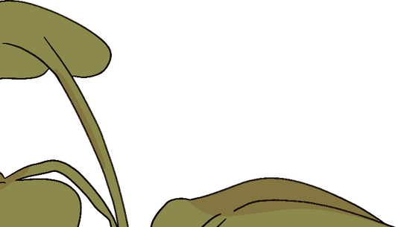
OBESITY IN
CHILDHOOD
Name : Areej Anbig Student Number: 3388
Date:4/6/2022

Slide 2
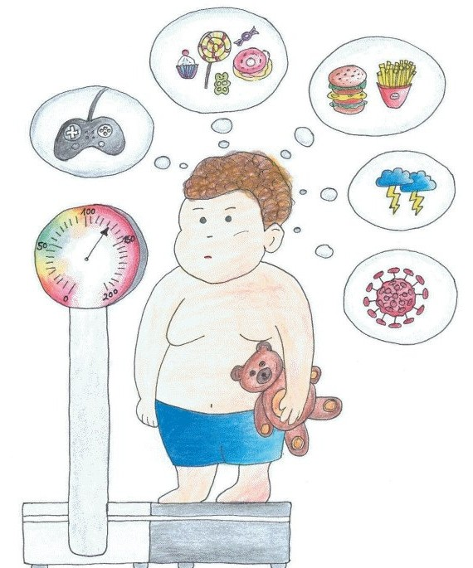




OBJECTIVES
Define childhood obesity
List causes of childhood obesity
List complication of childhood obesity
Describe risk factors of childhood obesity
Describe prevention of obesity in children

Slide 3


INTRODUCTION

Slide 4

Definition:
Obesity is a Medical Term that refers to Abnormal or Excessive Fat accumulation that presents a Risk to Health.

Slide 5

Percentile range Of BMI
<5% 5%to<85% 85%<95%
95%or over
"Normal" weight
Underweight
Overweight
Obese

Slide 6


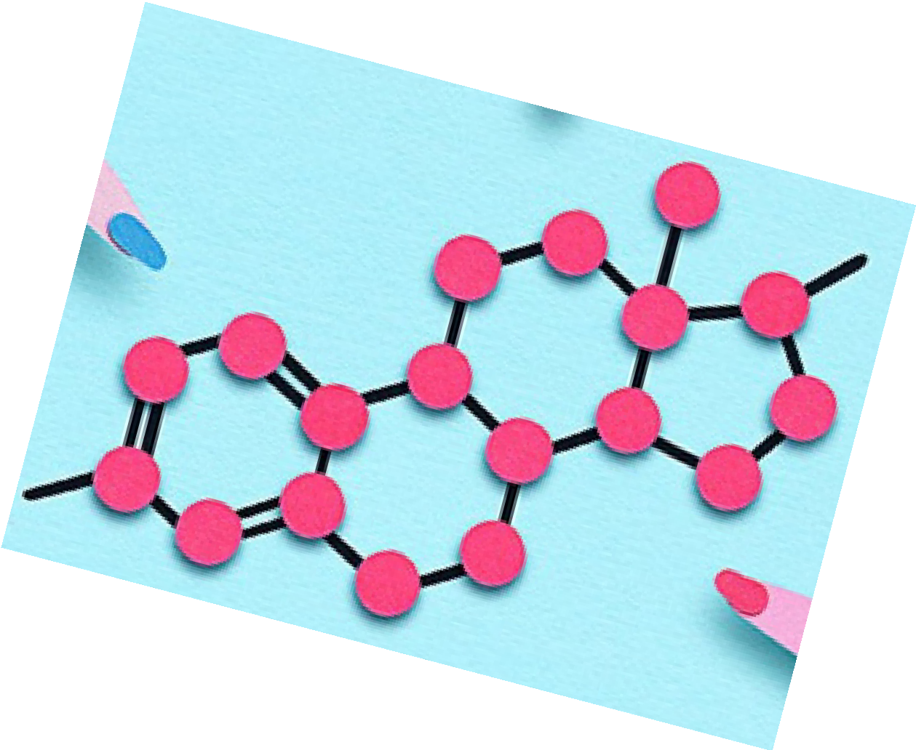
CAUSES
Little activity
Many calories from
food and drinks
Genetic
Hormonal

Slide 7

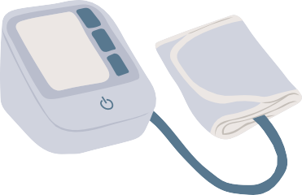


CHILDHOOD OBESITY OFTEN CAUSES
COMPLICATIONS
TYPE 2 DIABETES
LIVER DISEASE
Physical
Emotional
Social
ASTHMA
HIGH CHOLESTEROL
HIGH BLOOD PRESSURE
FEET PROBLEMS
EMOTIONAL /MENTAL HEALTH SLEEP APNOEA

Slide 8

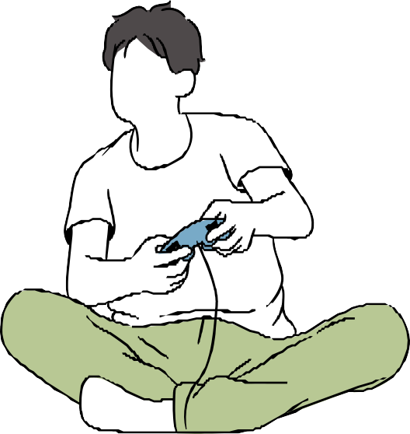
diet
Regularly eating high-calorie foods, such as fast foods, baked goods and vending machine snacks, can cause your child to gain weight
RISK FACTORS
Lack of exercise
Children who don't
exercise much are more likely to gain weight because they don't burn as many calories.

Slide 9
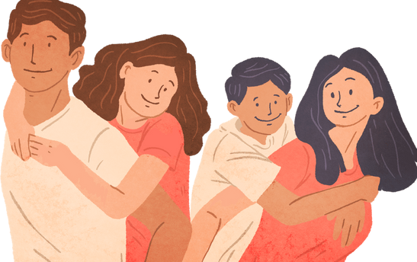
FAMILY FACTORS
If your child comes from a family of overweight people, he or she may be more likely to put on weight.

Slide 10
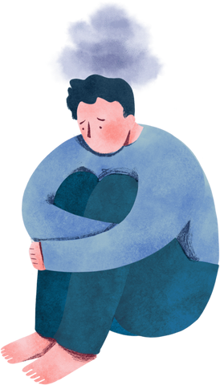
PSYCHOLOGICAL FACTORS
CERTAIN MEDICATIONS
Some prescription drugs can increase the risk of developing obesity
Personal, parental and family stress can increase a child's risk of obesity

Slide 11

PREVENTING
Eat the Rainbow
Move More
Children need at least 60 minutes of physical activity every day
Having a healthy diet can help children get the nutrients they need for healthy growth and development, and help them reach a healthy weight

Slide 12
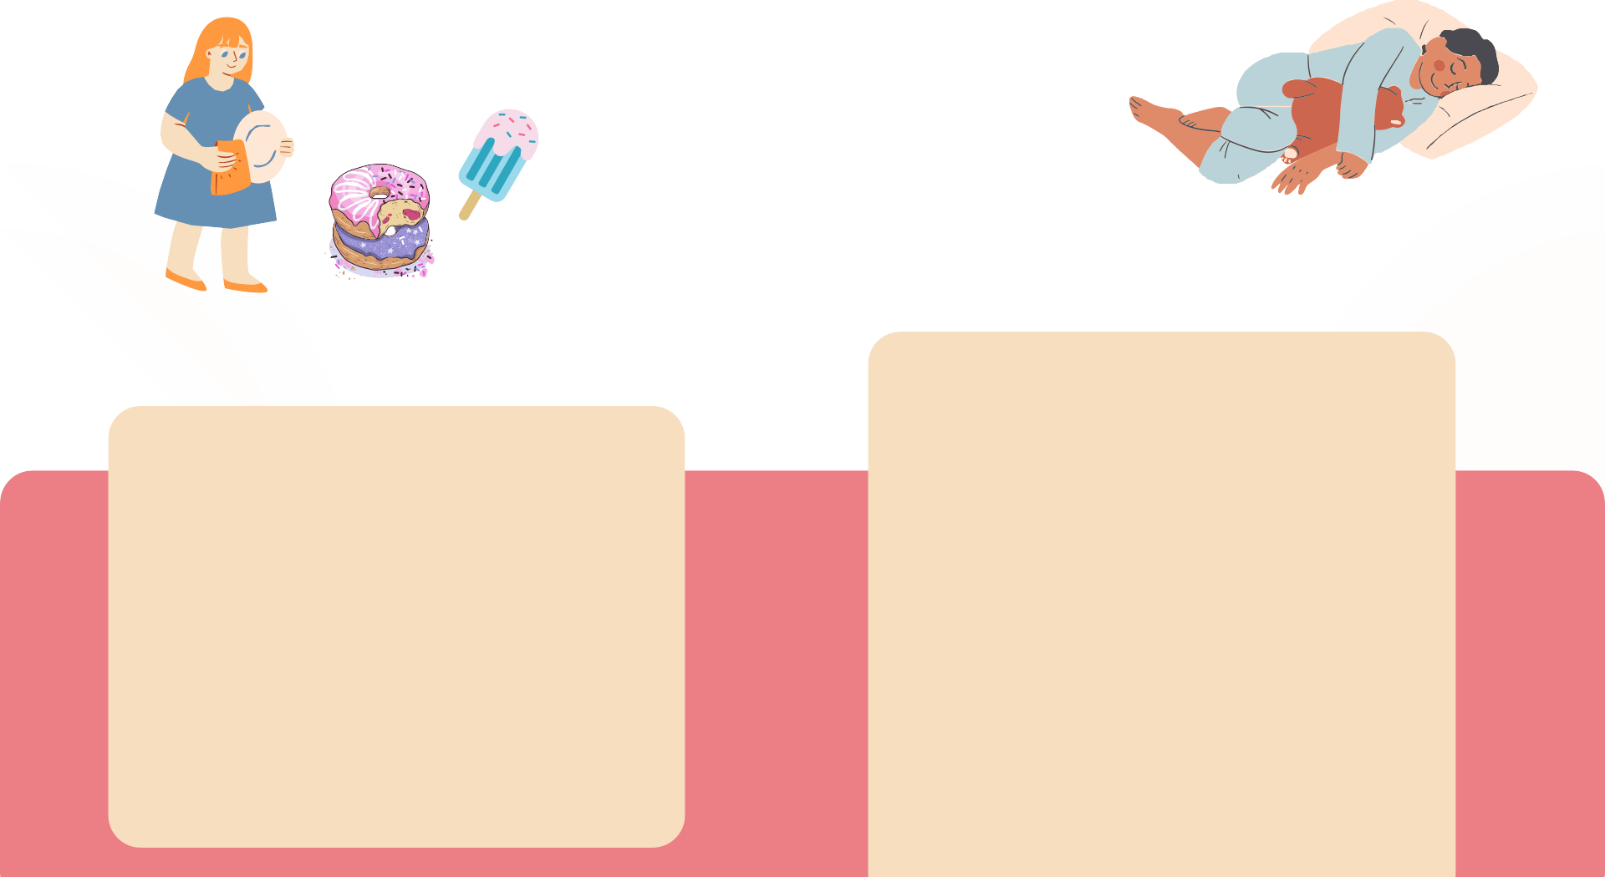

SLEEP WELL
SLOW DOWN ON SUGAR
A good way to slow down on sugar is by avoiding sugary drinks
Too little sleep is associated with obesity partly because inadequate sleep can make us eat more and be less physically active

Slide 13
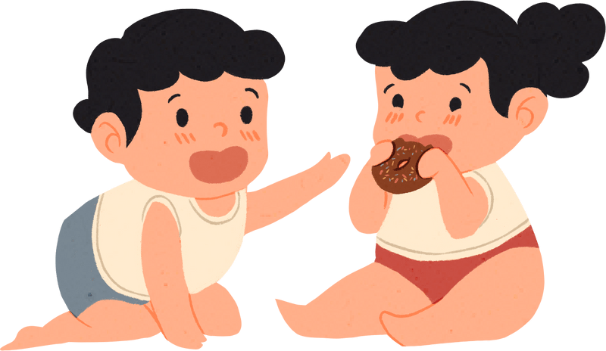
CONCLUSION

Slide 14
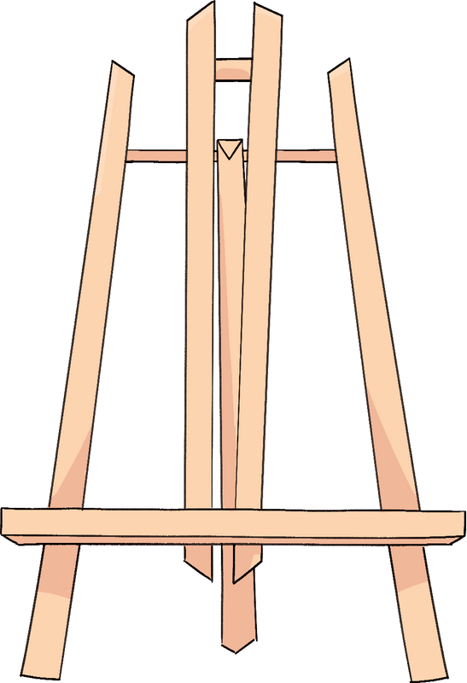

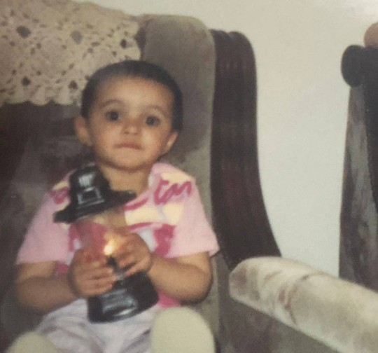

REFERENCES
Joshua,J. Seema,K. Stephen,M. Richard,O. Childhood obesity - Symptoms and causes .Dec.05,2020
Karnik S, Kanekar A. Childhood obesity: a global public health crisis. Int J Prev Med. 2012.
Ruth,P. Ann,O. Jenelle,G. Ken,R. Captian,H. Terry,O. Preventing childhood obesity . Feb .11,2022
Shira,Eytan. MD .Childhood obesity : Sings, Causes, Treatment and Pravention . Mar 28,2022

Slide 15
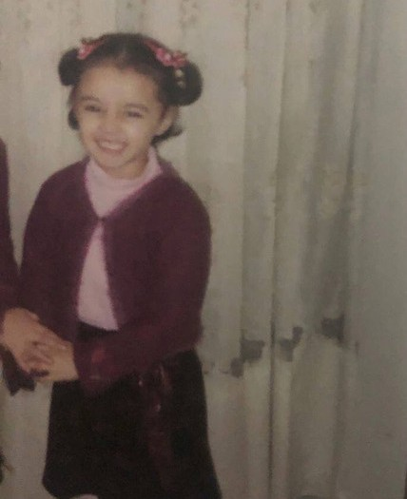
THANK YOU FOR LISTENING

