Slide 1

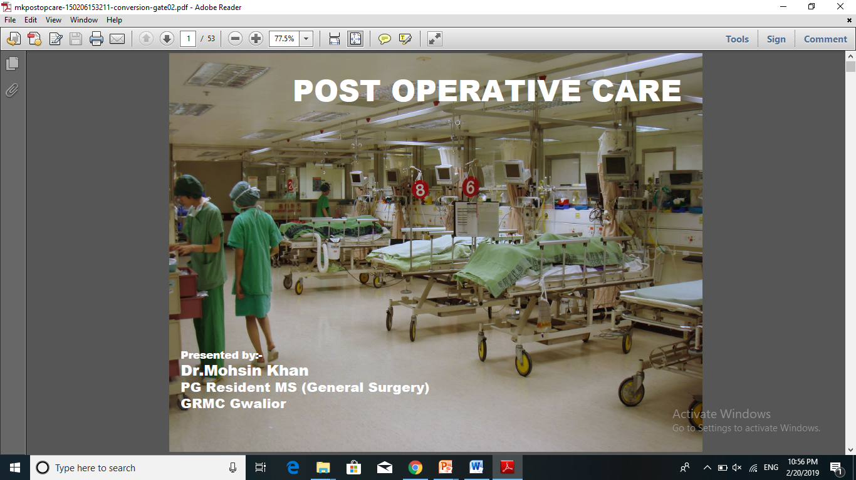
Postoperative care
Haitham R. Elmehdawi

Slide 2
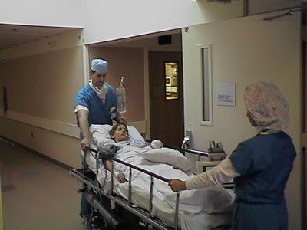
Postoperative care
The post operative period begins from
the time the patient leaves the operating room and ends with the follow up visit by the surgeon.
The post operative care is provided by -
PACU
SICU

Slide 3
Postoperative care
purposes
Successful and faster recovery
To Reduce mortality rate
To reduce patient hospital stay and the cost

Slide 4
Postoperative care
Phases
PHASE (3)
CONVALESCENT AFTER DISCHARGE
PHASE (2)
INTERMEDIATE HOSPITAL STAY
PHASE (1)
IMMEDIATE POST ANAESTHETIC

Slide 5
Postoperative care
Aim of phase 1 & 2
Homeostasis
Treatment of pain
Prevention & early detection of complications

Slide 6
Postoperative care
IMMEDIATE
POST OPERATIVE
PERIOD
Homeostasis
Treatment of pain
Prevention & early detection of complications

Slide 7
Postoperative care
Phases 1
Transferring of the patient from the OR to the PACU is the responsibility of the anesthesiologist.
During transport the anesthesiologist remains at the head part of the patient and a surgical team member remains at the opposite side.
Transporting the patient involves the special consideration of the incision site, potential vascular changes and exposure.

Slide 8
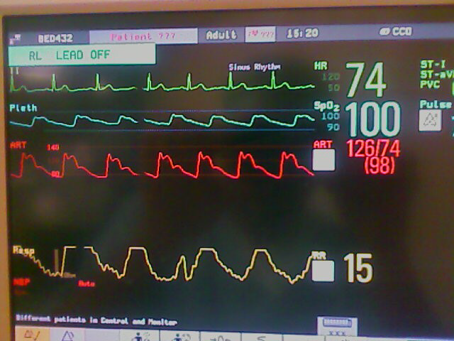
Postoperative care
Phases 1
All vitals Monitoring
Vital sign every 15-30 min.
(pulse, BP, R.R , Temp)
C.V.P
ECG
Fluid balance ( intake and output)
Needs urinary catheter.

Slide 9
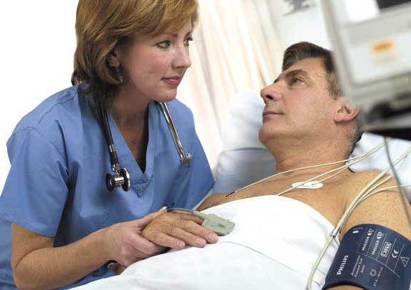
Postoperative care
Phases 1
Other types of monitoring :
Arterial pulses after vascular surgery.
Level of consciousness after neurosurgery.
The ability to respond to commands

Slide 10
Postoperative care
Phases 1
Maintain fluid balance
input & output

Slide 11

External Balance
Neutral balance: input = output
Positive balance: input > output
Negative balance: input < output

Slide 12
Postoperative care
Input :
NPO
IV Fluid
blood
Liquids.
Soft diet.
Normal or special diet
Fluid intake 1500ml
Food intake 1000ml
Oxidation of nutrients 300ml
Total input 2500 – 3000 ml /day
IV Fluid = maintenance + Loss + on going loss

Slide 13
Postoperative care
Output
Sensible
Urine 1500ml
Sweat 100ml
Insensible
Skin (evaporation) 500ml
Lungs 400ml
Feces 200ml
Total output 2500 – 3000 ml /day
+
bleeding , vomiting , Surgical drains , fistula

Slide 14
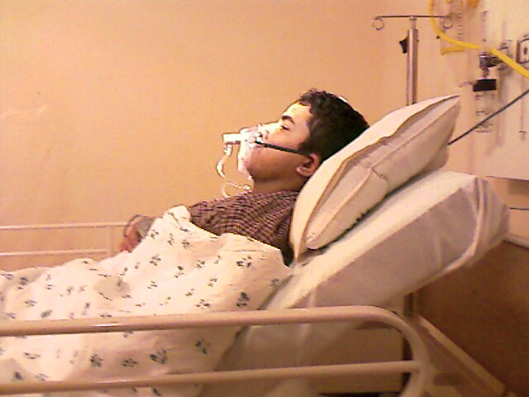
Postoperative care
Position in Bed and mobilization:
Maintain airway
By proper positioning of patient’s head.
By clearing airway.
O2 mask.
Ventilator.
Tracheal suction.
Chest physiotherapy
Turning in bed usually every 30 min. until full mobilization.
◦ Special position required sometimes.
◦ DVT prevention mechanically ( intermittent calf
compression).

Slide 15
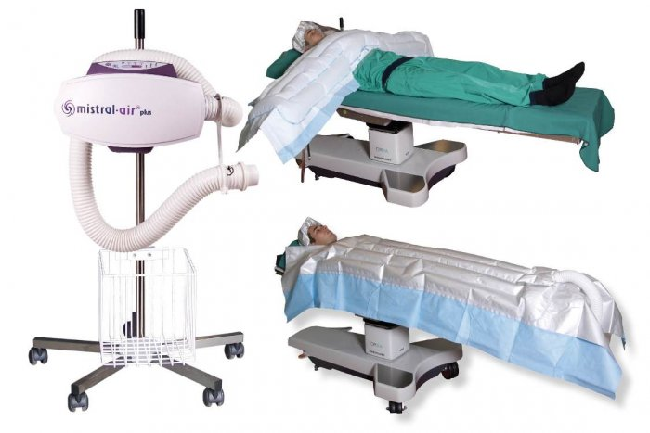
Postoperative care
Keep the patient warm.
Use warmer(Bair Hugger) blankets
Use warm lights

Slide 16
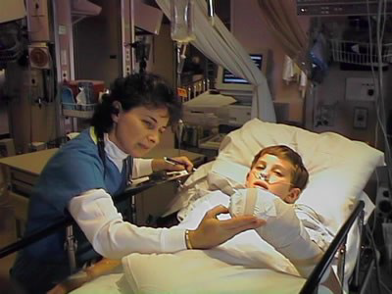
Postoperative care
Look for Hemorrhage
It is a serious complication of surgery
that resulting death.
It can occur in immediate post operatively or up to several days after surgery.
If left untreated, it cause shock .

Slide 17
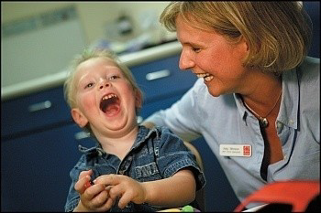
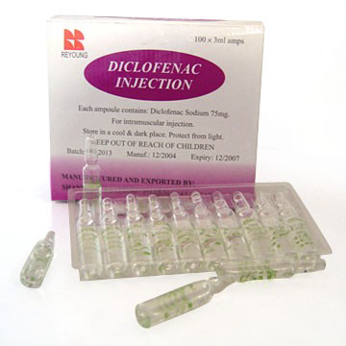
Postoperative care
Relieving pain & anxiety
NSAIDS.
Administer opioid analgesia.
Epidural analgesia.
Psychological support to relieve fear + To give support

Slide 18

Postoperative care
Controlling nausea & vomiting
These are common problem in post operative period.
Medication can be administered
Example:
Injection Metaclopramide

Slide 19
Postoperative care
General and specific Medication:
◦ Antibiotics.
◦ Pain killers.
◦ Sedatives.
◦ H2 Blockers specially in ICU patients.
◦ Anti-Coagulants.
◦ Anti Diabetics.
◦ Anti Hypertensive.

Slide 20
Postoperative care
A patient remains in the post op unit, until the patient has fully
recovered from anesthesia.
Following measures are used to determine the patient
ready for discharge from post operative unit.
Stable vital signs
Orientation to Person , Place ,Time .
Adequate oxygen saturation level.
Urine out put at least 30ml/hour
Minimal pain.
Adequate respiratory function.

Slide 21
Postoperative care
THE INTERMEDIATE
POST OPERATIVE
PERIOD

Slide 22
Postoperative care
Care of the wound
Dressing can be removed 3-4 days after operation.
Wet dressing should be removed earlier and changed.
Symptoms and signs of infection should be looked for, which if present compression, removal of few stitches and daily dressing with swab for C & S.
Tensile strength of wound minimal during first 5 days, then rapid between 5th -20th day then slowly again (full strength takes 1-2 years).
Good nutrition.

Slide 23
Postoperative care
Post-Operative Care of GIT
NPO until peristalsis returns.
Paralytic ileus usually takes about 24hs.
NGT is necessary after esophageal and gastric surgery.
NGT is NOT necessary after cholecystectomy, pelvic operation or colonic resections.
Gastrostomy and jujenostomy tubes feeding can start on 2nd Post-Op. day because absorption from small bowel is not affected by laparotomy.
Enteral feeding is better than parenteral feeding.
Gradual return of oral feeding from liquids to normal diet.

Slide 24
Postoperative care
Post-Operative pulmonary Care
Post-Op. atelectasis is enhanced by shallow breathing, pain, obesity and abdominal distension (restriction of diaphragmatic movements)
Post-Op. physiotherapy especially deep inspiration helps to decrease atelectasis. Also O2 mask and periodic hyperinflation using spirometer.
Early mobilization helps a lot.
Antibiotics and treatment of heart failure Post-Op.

Slide 25

Postoperative care

