Slide 1


The Contested Theories in Interpreting International Relations
Libyan International Medical University Faculty of Business Administration
Name: Munsif AL Msallati ID:2707 Email: MUNSIF ALMASALATI 2707@limu.edu.ly Date:22-12-2021

Slide 2
Table of contents:
1-Introduction.
2-Theories of International Relations.
3-Realism.
4-Liberalism.
5-Conclusion.
6-References.
01

Slide 3
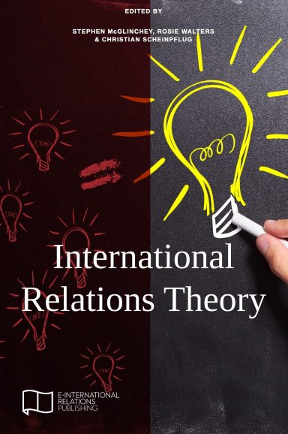
Introduction:
Theories of International Relations allow us to understand and try to make sense of the world around us through various lenses, each of which represents a different theoretical perspective.
02

Slide 4
Theories of International Relations:
Most theories of international relations are based on the idea that states always act in accordance with their National Interest, or the interests of that particular state.
03

Slide 5
Realism:
states work only to increase their own power relative to that of other states.
A state’s primary interest is self-preservation. Therefore, the state must seek power and must always protect itself.
04

Slide 6
Liberalism:
Liberalism emphasizes that the broad ties among states have both made it difficult to define national interest and decreased the usefulness of military power.
Example: Relations among the major Western powers fit a model of complex interdependence very well. The United States has significant disagreements with its European and Asian allies over trade and policy, but it is hard to imagine a circumstance in which the United States would use military power against any of these allies. Instead, the United States relies on economic pressure and incentives to achieve its policy aims.
05

Slide 7
Conclusion:
International relations are an exceptionally important aspect of citizenship in a global society.
06

Slide 8
References:
Germain, R. D., & Kenny, M. (1998). Engaging Gramsci: international relations theory and the new Gramscians. Review of international studies, 24(1), 3-21.
Bieler, A., & Morton, A. D. (2004). A critical theory route to hegemony, world order and historical change: neo-Gramscian perspectives in International Relations. Capital & class, 28(1), 85-113.

Slide 9
Thank you!

