Slide 1


The Difference Between Parametric and Non-parametric
Libyan International Medical University
Faculty of Business Administrator
Name : Ahmed Khalid ELThanie
ID : 2976
Email : ahmed_2976@limu.edu.ly

Slide 2
TABLE OF CONTENTS
01
04
Differences Between Parametric and non- parametric
Introduction
02
05
Reflection
Definition
03
06
conclusion
Examples of Population

Slide 3
Introduction
01

Slide 4
Introduction to Population
Population study is a scientific investigation of population dynamics such as population number, structure, growth, distribution, and dispersal. Contrary to popular belief, family planning research focuses on contraception, side effects.

Slide 5
02
Definition

Slide 6
Definition of Population
Population research is a scientific inquiry aimed at understanding the population dynamics for the size, structure, growth, distribution, and dispersal of a population. In contrast, the family planning research inquires upon contraception, side effect.

Slide 7
03
Examples of Population

Slide 8
Examples of Population
Population dynamics.
Population/Demography.
Family Planning.

Slide 9
04
Differences Between Parametric and non- parametric

Slide 10
Differences Between Parametric and non- parametric
In parametric statistics, the information about the distribution of the population is known and is based on a fixed set of parameters. In nonparametric statistics, the information about the distribution of a population is unknown, and the parameters are not fixed, which makes is necessary to test the hypothesis for the population.

Slide 11
05
Reflection

Slide 12
Reflection
Population : A research population is generally a large collection of individuals or objects that is the main focus of a scientific query. It is for the benefit of the population that researches are done.
Differences Between Parametric and non- parametric : Next slide -----→

Slide 13
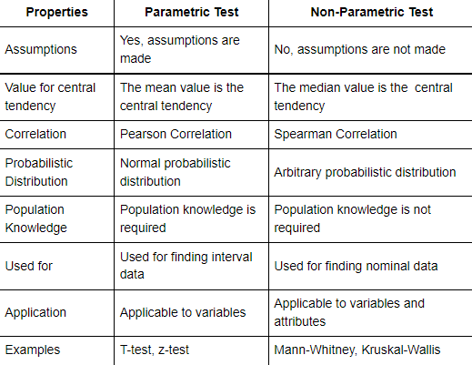

Slide 14
06
conclusion

Slide 15
conclusion
Population : When you are attempting to study a population, you have to collect information from everyone in that group. This makes it extremely difficult to study populations.
Differences Between Parametric and non- parametric : The key difference between parametric and nonparametric test is that the parametric test relies on statistical distributions in data whereas nonparametric do not depend on any distribution. Non-parametric does not make any assumptions and measures the central tendency with the median value.

Slide 16
References
IBM Docs. (n.d.). Www.ibm.com. Retrieved May 11, 2022, from https://www.ibm.com/docs/en/db2woc?topic=procedures-statistics-parametric-nonparametric%23%3a%7e%3atext%3dIn+parametric+statistics%2c+the+information+about+the+distribution%2cnecessary+to+test+the+hypothesis+for+the+population.&msclkid=0d36a153d12d11ec81d1301ef1db3ee2
Market Positioning Strategies. (n.d.). https://www.learnmarketing.net/positioning.htm

