Slide 1


The Various Ways of Improving Verbal Messages
By :Mahmoud Fathi Gargoum
Mahmoud_2859@limu.edu.ly
2859
1
Notes:
Links:
https://www.pexels.com/photo/two-imac-s-with-keyboard-and-phones-on-desk-326503/

Slide 2

CONTENT
Introduction
5 tips to Improve Verbal Communication Skills
Conclusion
References
2

Slide 3
INTRODUCTION
Strong verbal communication skills are valuable in both your personal and professional life.
When speaking confidently, you are much more likely to command the respect of others and build rapport that can help you in your business .
3
Notes:
Links:
https://www.pexels.com/photo/group-of-people-using-laptops-1560932/

Slide 4

The following 5 tips will help you improve your verbal communication skills, whether in person or over the phone :
4

Slide 5

1. Think before you speak
You can eliminate many of the awkward pauses that occur by taking a minute to organize your thoughts in your mind before you speak .
5

Slide 6

2. Be clear and concise
Avoid using complex sentences, and try to state your argument in direct language.
The most effective way to get your point across is to make it in a clear and concise manner.
6

Slide 7

3. Speak with confidence
There are several factors that can improve your confidence like your body language, the tone of your voice ,and your ability to make direct eye contact with your audience.
7

Slide 8
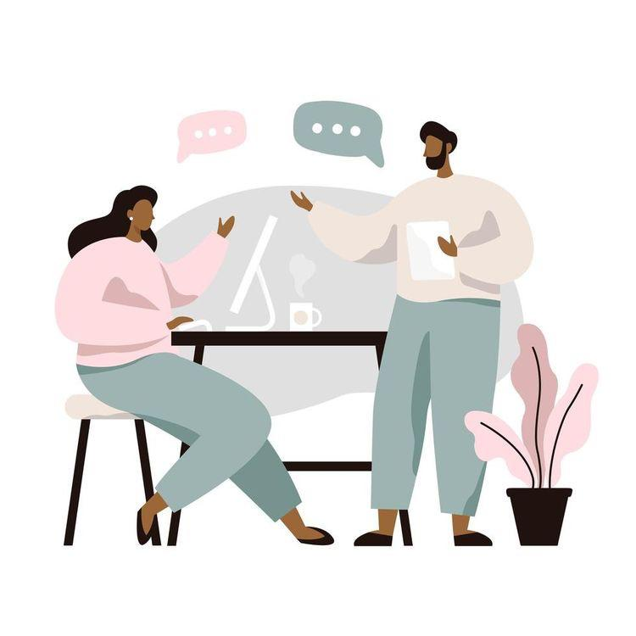
4. Vary your vocal tone
use voice inflection to add emphasis to important points, and vary the pitch of your voice to express emotion , This will help keep your audience engaged in your message.
8

Slide 9
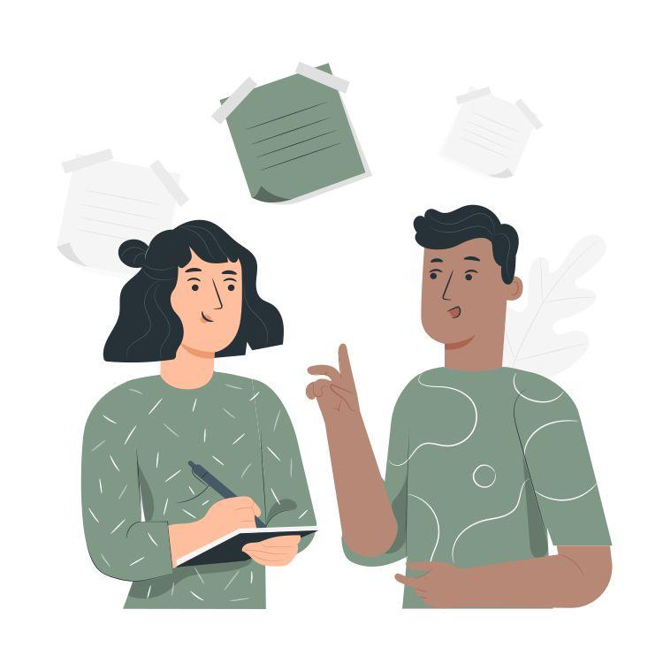
5. Be an active listener
It shows the people you are speaking with that you genuinely care about their ideas, and it helps ensure you understand their needs.
9

Slide 10
CONCLUSION
Developing strong verbal communication skills is essential in building a successful career, and it enhance mutual understanding, trust, decision-making, and problem-solving between yourself and others
10
Notes:
Linkjs:
https://www.pexels.com/photo/woman-holding-a-laptop-4347368/
https://www.pexels.com/photo/man-in-black-suit-jacket-holding-silver-laptop-computer-3777564/

Slide 11
REFERENCES
7 Tips to Improve Verbal Communication Skills | Call Tracking and Analytics. (n.d.). CallRail. Retrieved November 10, 2021, from https://www.callrail.com/blog/7-tips-to-improve-verbal-communication-skills/
1
Kashyap, S. (2021, September 30). 9 Effective Communication Strategies to Connect Better with Your Team. ProofHub. Retrieved November 10, 2021, from https://www.proofhub.com/articles/communication-strategies
2
11

Slide 12
THANK YOU!
12
Notes:
Links:
https://www.pexels.com/photo/two-imac-s-with-keyboard-and-phones-on-desk-326503/

