Slide 1


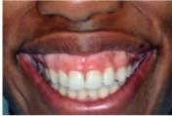

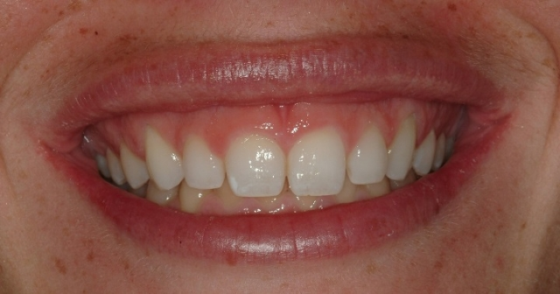
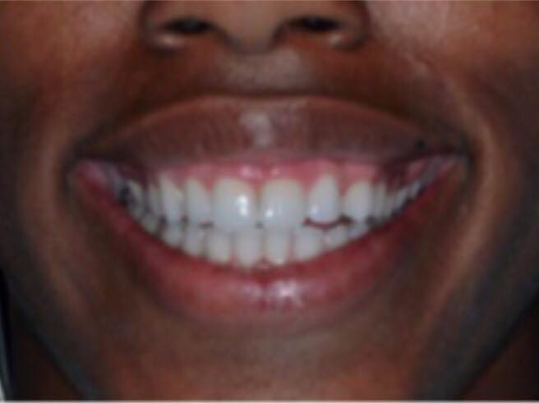
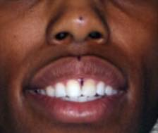
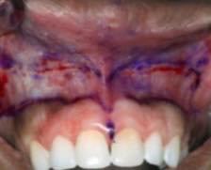
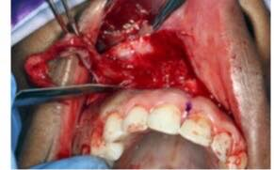
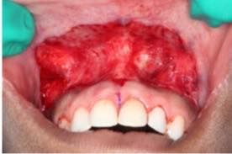
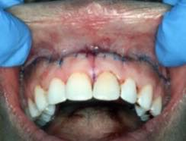
Surgical lip repositioning as treatment of gummy smile
Supervised by Dr. Mahmoud Elmansoury
Ruba Dabous 2nd year dentistry student
Libyan international medical university
Introduction
Gummy smile also known as excessive gingival display (EGD) is condition characterized by excessive exposure of maxillary gingival during smile (fig 1) .
EGD could have an adverse emotional and psychosocial impact.
The extent and etiology of gingival display dictate which treatment is indicated.
The most common causes of gummy smile :
-Gingival Short teeth .
-Skeletal Vertical maxillary excess (VME) .
- Hypermobile upper lip .
The procedure was first introduced in 1973 and resulted in reduced morbidity compared with orthognathic surgery while resulting in predictable improvement.
Lip repositioning (LRP) reduces gingival display by restricting the pull of elevator lip muscles and shortening the vestibule, thereby decreasing the range of motion of the lips and decreasing the amount of gingival display.
Conclusion
Gummy smile is a common unaesthetic clinical condition with an adverse emotional and psychosocial impact.
The main causes of gummy smile :
-Gingival .
-Skeletal.
- Hypermobile upper lip
The extent and etiology of gummy smile dictate which treatment is indicated .
The surgical lip repositioning is decreases the vertical maxillary excess and hypermobile upper lip .
Both patients achieved acceptable esthetic results that were stable at 12 and 24 months.( Fig 8)
Fig 2
Case management
The facial & dental midline were marked using a surgical marker at three locations nose , philtrum and interdental papilla between the central incisors (
fig 3)
Under local anesthesia, incisions were outlined using a surgical marker on the alveolar mucosa extending from the mucogingival junction (MGJ) to 12 mm apically and expanding to the distal of the second premolars bilaterally
(Fig4).then, a partial thickness incision was made in the previously marked areas, exposing the underlying connective tissue (CT) (Figs. 5 and 6). The apical mucosa was approximated to reduce the vestibular depth and sutured to the MGJ using interrupted 6-0 sutures.‡ To ensure bilateral nsymmetry, the sutures were started at the midline, followed by the distal aspects of the premolars, and finally closing the incisions primarily (Fig. 7). The patients received nonsteroidal anti-inflammatory drugs for 7 days and an antimicrobial rinse.§ Post-surgical instructions were given with emphasis on minimizing lip movement for at least 4 weeks.
The patients were followed up at 1, 2, and 4 weeks and 6, 12, and 24 months.
Gummy smile fig1
Treatment
Esthetic crown lengthening .
Injection of botulinum toxin type A .
Orthognathic surgery .
Surgical lip repositioning .
Fig 8
References
Case Presentation
Fig 3
Fig 4
Fig 5
-Rubinstein A, Kostianovsky A. Cosmetic surgery for the malformation of the laugh: Original technique (in Spanish). Prensa Med Argent 1973;60:952.
- Simon Z, Rosenblatt A, Dorfman W. Eliminating a gummy
smile with surgical lip repositioning. Cosmet Dent 2007;23:
100-108.
-Silva CO, Ribeiro-Júnior NV, Campos TV, Rodrigues JG, Tatakis DN.
Excessive gingival display: Treatment by a modified lip repositioning
technique. J Clin Periodontol 2013;40:260-265.
The esthetic results of lip repositioning ( LRP) surgery on identical 27-year-old twin
sisters exhibiting severe vertical maxillary excess (VME) and hypermobile upper lip. Both patients were given the option of orthognathic surgery to correct their VME or LRP to reduce their gummy smile and improve esthetics (fig 2).
Both elected LRP to
address their gummy smile and avoid higher morbidity and costs associated with orthognathic surgery.
Fig 6
Fig 7

