Slide 1
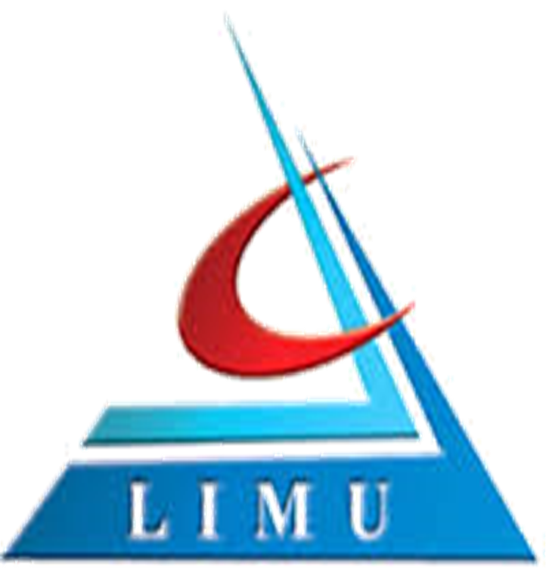

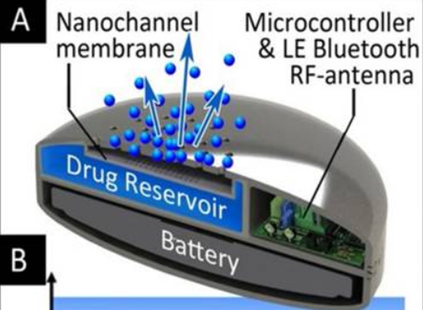
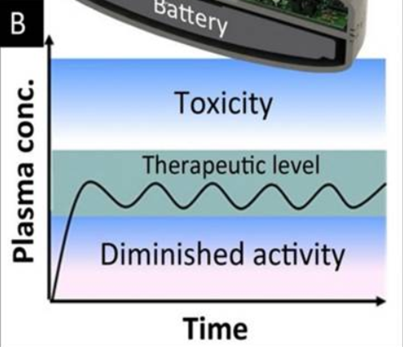
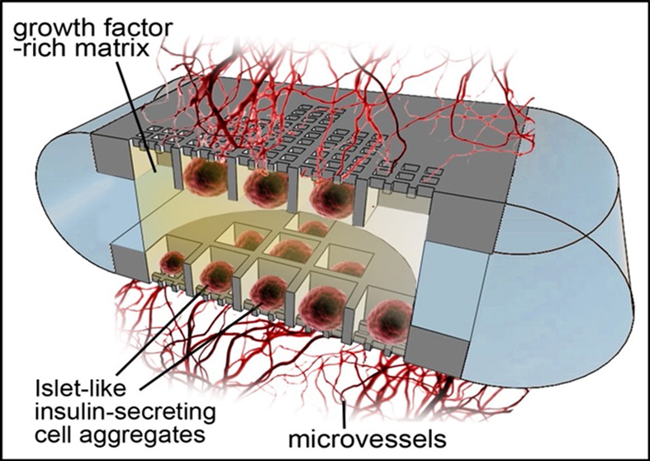
Can nano-based immune technology be used to reduces organ transplant rejection?
By: Mohamed K. Darz
Faculty Of Basic Medical Sciences Libyan International Medical University
Nano-immune technology
Methodology
What Is porous slilcon?
An new methodology applied in the study of immunology is nanotechnology-based systems can be modified to target specific cells of the immune system and deliver chemotherapeutic or immuno-modulatory agents that can prime and activate innate and antigen-specific memory immune responses. [1]
1. Localized, sustained, and controlled delivery of drugs and bioactive agents:
i) Liposomes, Nanochannel Membranes and other Nanocarriers:
a) lipid-based formulations such as emulsions ,liposomes ,and polymeric micelles have demonstrated reliable alternatives to transport water-insoluble therapeutics.
b) the role of nanoparticles in the disruption of signaling pathways in T cell activation and donor antibody functions.
c) The central innovation of this sustained delivery technology, is the use of microfabricated nanochannel membranes which, like an hourglass, passively control the release of molecules.
porous silicon has been widely investigated for its biodegradability and biocompatibility. Features such as high surface area and tunable shape and size have led to porous silicon being used for a variety of biomedical applications (e.g. tissue engineering , biosensors , optics).
Recently, multistage nanovectors such as disk-shaped porous silicon were developed to strategically overcome the body’s biological barriers through unique size and shape tailoring. Furthermore, modification of the pore size resulted in prolonged release of a fluorescent payload, and increased loading concentration as pore size increased.
Applications
*in medicine:
i) the localized, sustained, and controlled delivery of drugs and bioactive factors.
ii) the imaging of clinically relevant biomarkers and functional parameters for diagnosis and treatment.
*applications of nanotechnology in organ transplantation:
i) Delivery of Immunosuppressant
and other Drugs(nanoparticles+Liposomes &
Peptide Amphiphiles).
ii) Donor Specific Tolerance & Rejection(nanobodies).
iii) Imaging, Diagnostics and other uses(Nanoparticles e.g.,
gold, iron oxide,quantum dots).
ii) Implantable Devices and Biocapsules:
Nanotechnology-based, tunable implant devices have the potential to adjust drug release based on the circadian rhythms of inflammatory markers. The synchronization of drug delivery to bio-cycles using these devices represents an additional step toward individualized medicine.
Conclusion
Nanotechnology exhibits new ways to attack the variable obstacles that organ and cell transplantations present. The induction of nanotechnology has showed successes including the recent use of nano-composite polymer as scaffolding for the synthesis of a successfully implanted artificial trachea. New developments in nano-materials such as the inclusion of bioactive properties, able to enhance cell growth and function, offer a promising future for today’s transplant therapies and could improve the prognosis of transplant patients.
Challenges of transplantation
Figure 2
Figure 3
iii) Nanoglands and Nanoparticles in Transplant:
Nanotechnology-based encapsulation systems such as Nanogland have successfully supported the engraftment of pancreatic islets in animal models [6]. These encapsulation systems protect the transplanted cells from immune attack and provide a physiological environment promoting cell survival and vascularization.
improved surgical procedures and the use of powerful immunosuppressive drugs, cell and organ (i.e., kidney, heart, liver, pancreas) transplantations have become the standard of care for millions of patients with end stage organ failure [2]. Unfortunately, organ shortages, graft failure, and life-long administration of immunosuppressant continue to pose as critical obstacles limiting successful transplantation. While immunosuppressant therapy has proven paramount to transplantation success, strenuous requirements or life-long systemic use, often lead to poor patient compliance causing eventual morbidity and mortality.
References
Figure 4
1- Michael et al. "Application Of Nanotechnologies For Improved Immune Response Against Infectious Diseases In The Developing World". Advanced Drug Delivery Reviews, vol 62, no. 4-5, 2010, pp. 378-393. Elsevier BV, doi:10.1016/j.addr.2009.11.011.
2-NHS Organ Donation Register | Organ Donation - English. (2019). Statistics about organ donation. [online] Available at: http://www.organdonation.nhs.uk/statistics/ [Accessed 28 Jan. 2019].
3- "Erratum Regarding “US Renal Data System 2014 Annual Data Report: Epidemiology Of Kidney Disease In The United States” (Am J Kidney Dis. 2015;66[1][Suppl 1]:S1-S305)". Vol 66, no. 3, 2015, p. 545. Elsevier BV, doi:10.1053/j.ajkd.2015.07.013.
Figure 1
2. Imaging and functional parameters for diagnosis
*Nanotechnology has made substantial progress in the world of medical imaging. Similar to their ability to deliver therapeutics, nanoparticles can be used to deliver contrast agents to assist in delineating anatomy and physiology for medical imaging.
*With respect to the transplant field, nanoparticle approaches for imaging have predominately been used to monitor transplanted grafts], track distribution (dispersion) of administered stem cells ,gauge viability of implanted cells within scaffolds or within tissues ,and to evaluate drug release from scaffolds [7].

