Slide 1


Libyan International Medical university
Basic Medical science
Year 1, AMS
Immunization
Presented by: Salha Swedik
Student no: 3527
5/6/2022

Slide 2
Objectives
Immunization saves lives
Identify Immunization and how does it work
Purposes of Vaccines
Childhood diseases
Do adults need vaccinations too?

Slide 3
Immunization saves lives
01. What is Immunization?
It’s a process of administering a vaccine to create resistance against specific disease

Slide 4
0.2 How does Immunization works?
the immune system creates antibodies to fight the virus and clear it

Slide 5
2. Purpose of vaccines
The first vaccine discovered was the smallpox vaccine. Smallpox was a deadly illness. It killed 300 million to 500 million people around the world in the last century. After the vaccine was given to people, the disease was eventually erased. It’s the only disease to be completely destroyed. There are now others close to that point, including polio

Slide 6
A vaccine (or immunization) is a way to build your body’s natural immunity to a disease before you get sick. This keeps you from getting and spreading the diseases

Slide 7
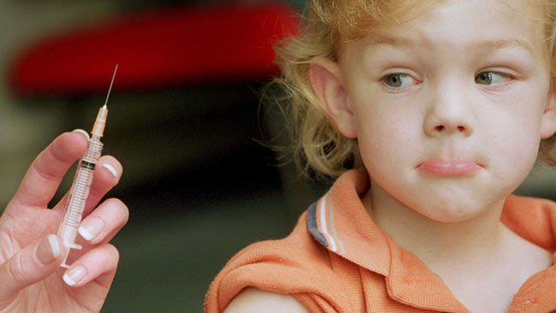

Slide 8
Immunisation protects against many serious childhood diseases, including:
whooping cough (pertussis)
measles
German measles (rubella)
meningococcal C
pneumococcal disease
chickenpox (varicella)
tetanus
mumps
polio
diphtheria
rotavirus
hepatitis.

Slide 9
Do Adults need vaccination too ?
All adults need immunizations : to help them prevent getting and spreading serious diseases that could result in poor health, missed work, medical bills, and not being able to care for family

Slide 10
Conclusion
Vaccines are among the greatest advances in global health and development. For over two centuries, vaccines have safely reduced the scourge of diseases like polio, measles and smallpox, helping children grow up healthy and happy. They save more than five lives every minute – preventing up to three million deaths a year, even before the arrival of COVID-19.
Thanks to immunization efforts worldwide, children are able to walk, play, dance and learn. Vaccinated children do better at school. Today, vaccines are estimated to be one of the most cost-effective means of advancing global welfare

Slide 11
THANK YOU

Slide 12
Reference
Healthcare, M., 2022. Importance of Immunization - Midland Healthcare. [online] Midland Healthcare. Available at: <https://midlandhealthcare.org/importance-of-immunization/> [Accessed 6 June 2022].
Unicef.org. 2022. Immunization. [online] Available at: <https://www.unicef.org/immunization> [Accessed 6 June 2022].
staff, f. and Rice, A., 2022. The Importance of Vaccinations - familydoctor.org. [online] familydoctor.org. Available at: <https://familydoctor.org/the-importance-of-vaccinations/> [Accessed 6 June 2022].

