Slide 1
Thermal Injuries:
د. سمير المرغني- دكتوراة في البصمة الوراثية-بريطانيا
استاذ مساعد-كلية الطب -جامعة بنغازي
رئيس قسم الطب الشرعي والسموم-كلية الطب-جامعة اجدابيا
والجامعة الدولية الليبية للعلوم الطبية

Slide 2
Introduction
Heat, cold and electricity are some of the ‘physical agents’ that can cause non-kinetic injuries to the body.

Slide 3
Severity of burn
■ first degree – erythema and blistering (vesiculation);
■ second degree – burning of the full-thickness of
the epidermis and exposure of the dermis;
■ third degree – destruction down to subdermal
tissues, sometimes with carbonization and exposure of muscle and bone.

Slide 4
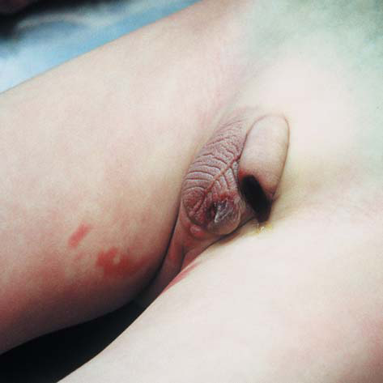
First- and second-degree burns on the right thigh and scrotum of a 5-year-old diabetic child, who had been treated by a quack, who had promised the parents to cure the child by hot baths. Death was caused by the untreated diabetes.

Slide 5
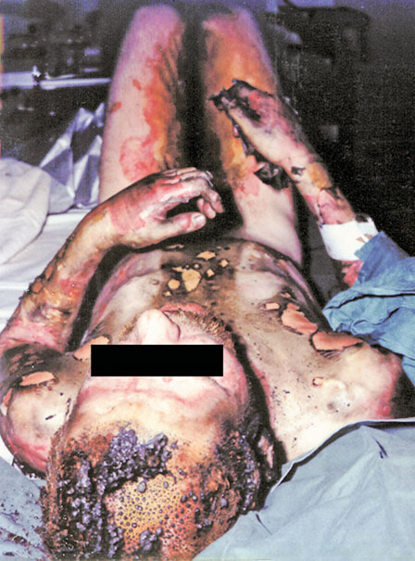
The extensiveness of burns on a body recovered
from a fire may be varied. This individual had second and third
إخماد degree burns after dousing himself with petrol before setting
himself on fire (self-immolation). Note the molten and singed hair المنصهر.

Slide 6
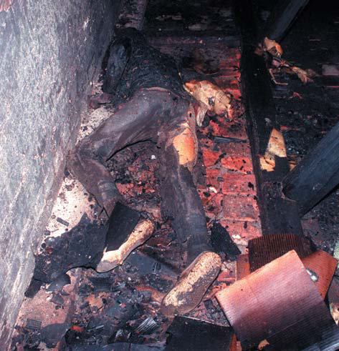
Dead bodies in fires pose a problem for pathologists
and investigators. Death was shown to have occurred after the
fire began from soot in the lungs and carboxyhaemoglobin in the
blood. There were no ante-mortem burns and there was a high
blood-alcohol concentration.

Slide 7
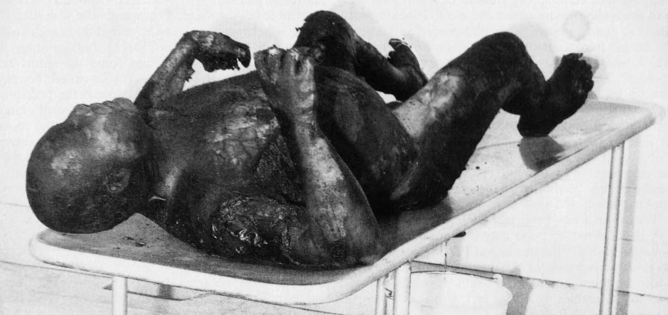
Heat flexures of the limbs, part way towards the ‘pugilistic attitude’ formed when the arms are raised higher. The elbows, knees and wrists are strongly flexed because muscle contraction is stronger in the flexor groups. The victim was the captain of a Russian ship who set fire to his cabin during a bout of heavy drinking.

Slide 8
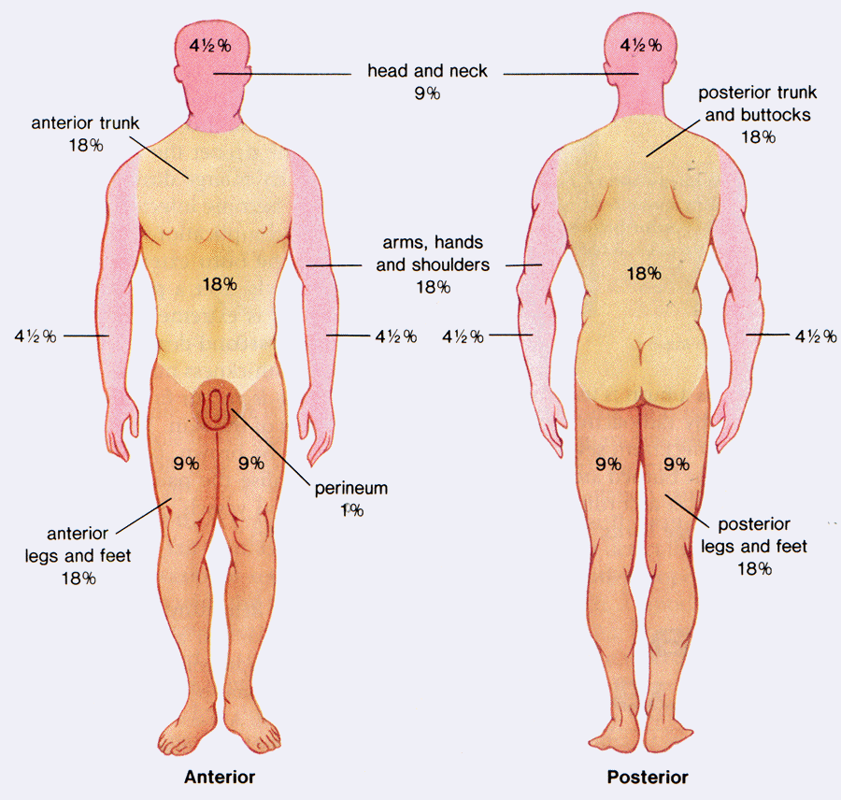
M.L. aspects of thermal injuries
Factors affecting degree of burn
A) Extent of burnt area:
is determined by rule of nine of Wallace.
B) Depth of burn:
The 3rd degree burn is the most serious one.
C) Site of burn.
Neck, abdominal wall or genitalia are more
dangerous than those of the extremities.

Slide 9
The ‘Rule of Nines’ for calculating the area burned.
It does not apply to infants whose body proportions are different
from adults. About 60 per cent surface burns can be survived by
children and young people up to 20 years of age but this rapidly
decreases with advancing age.

Slide 10
Scalds
The general features of scalds are similar to those of burns, with erythema and blistering, but charring of the skin is only found when the liquid is extremely hot, such as with molten metal.

Slide 11
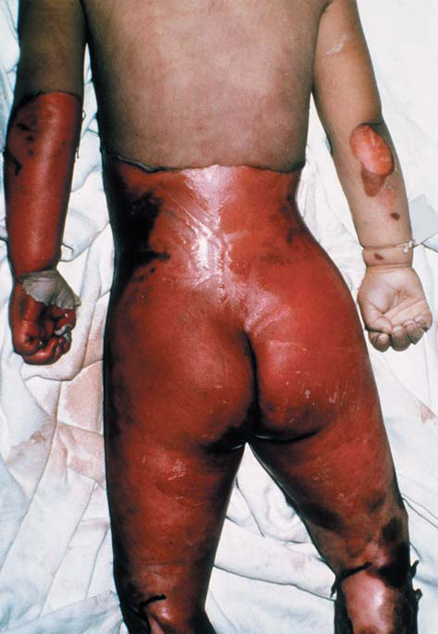
Scalds or wet burns in a child accidentally left in a
hot bath while her mother went to answer the telephone. This
illustrates that time, as well as temperature, is a factor in causing heat damage to skin. The child died some days later from an intercurrent chest infection.

Slide 12
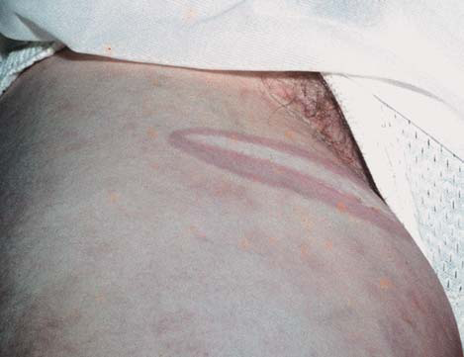
A burn on the inner sides of each upper thigh in a
young woman. These are suggestive of the application of a hot-water
bottle in an attempt at resuscitation after a criminal abortion. The
victim died of air embolism following the use of a Higginson syringe.

Slide 13
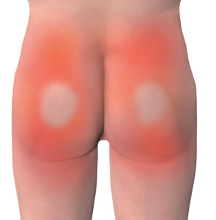
Pattern of scalding from forced immersion in a
hot bath. Note the clear demarcation between scalded and uninjured skin representing the fluid level of the bath. Sparing of skin on the buttocks reflects firm contact between those
parts and the base of the bath.

Slide 14
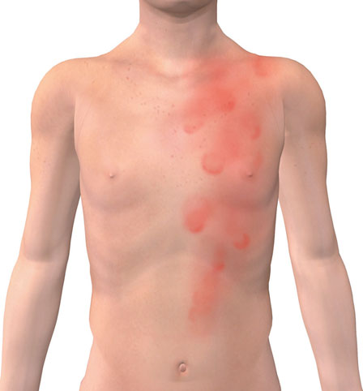
Pattern of scalding from running water

Slide 15
Pathophysiological consequences of thermal injury
Burned/scalded tissue elicits an acute inflammatory
response, leading to increased capillary permeability
at the injured site; tissue fluid loss associated with
thermal injury can be severe enough to cause dehydration,
electrolyte disturbance and hypovolaemic
shock and, if the burn area exceeds 20% of the total
body surface area, the release of systemic inflammatory
mediators which may lead to acute lung injury
and multiple organ dysfunction/failure. Burned skin
provides no protection against infection, increasing
the risk of sepsis in survivors.

Slide 16
Exposure to heat/hyperthermia
Hyperthermia – a condition where the core body
temperature is greater than 40°C (100°F) – occurs
when heat is no longer effectively dissipated, leading
to excessive heat retention. Its development is
more likely in those who have taken substances
(e.g. drugs, including cocaine and amphetamine)
that elevate metabolic rate/heat production or reduce
sweating, or in those with medical conditions
(e.g. hyperthyroidism). Autopsy findings in ‘heat illness’,
including ‘heat stroke’, are non-specific but
can include pulmonary and/or cerebral oedema,
visceral surface petechiae and features in keeping
with ‘shock’ and multiple organ failure in those who
survive for a short period.

Slide 17
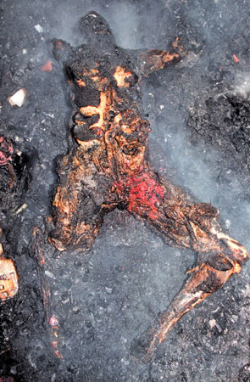
Charred body at the scene of a fire showing the ‘pugilist attitude’ and post-mortem skin splits on the chest. Extreme care must be taken to preserve the teeth in such cases, in order to assist identification of the deceased.

Slide 18
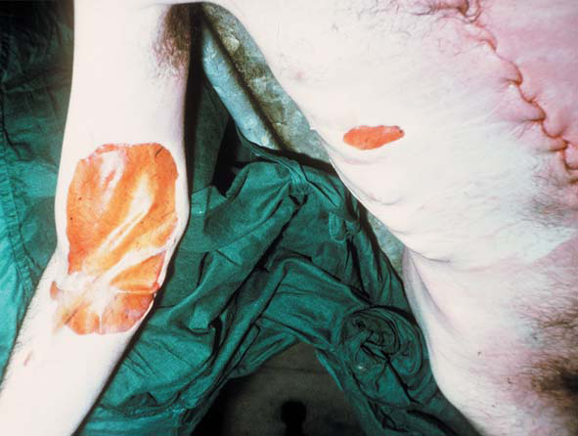
Post-mortem burn on the arm and chest caused by a hot-water bottle being left over the heart in an attempt at resuscitation. The lesion is
sharp-edged, there is no erythematous margin, and the surface is brown and leathery from post-mortem drying.

Slide 19
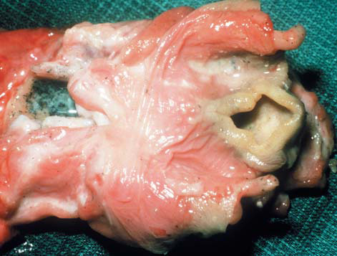
Larynx of a house-fire victim showing heat
blanching of the epiglottis and glottal entrance from breathing hot gas. The lower cut end of the trachea shows copious soot-containing
mucus, also indicating respiration during the fire.

Slide 20
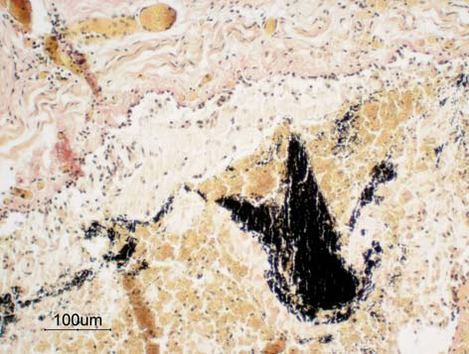
A small bronchus from a fire victim, showing
histological evidence of soot deposition, together with desquamation of the epithelium and plugging with cellular debris. (Van Gieson;
original magnification 10.)

Slide 21
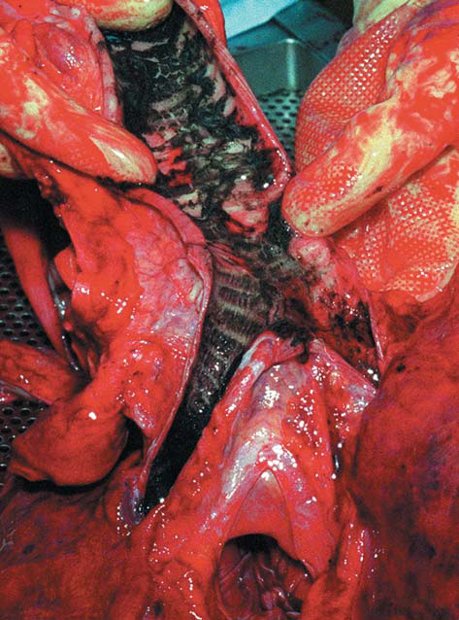
Soot in the tracheal mucus, a sign of breathing while
the fire was in progress. Though soot can passively reach the glottis
after death if the mouth is open, it cannot reach the lower air
passages in any significant quantity. Histology of the smaller
bronchi offers complete proof of active respiration.

Slide 22
Pathological investigation of bodies recovered from fires:
When a fire results in a fatality, there should be a
low threshold for treating the death with caution,
in view of the potential for there to have been an
attempt made to conceal a homicide by ‘burning
the evidence’. The need for safety of investigators
after events such as gas explosions, is a very
important consideration in the examination of fire scene.

Slide 23
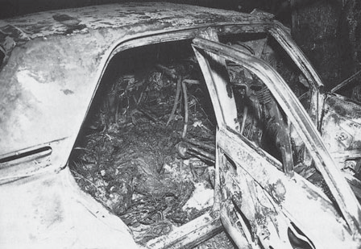
The finding of a body in a burnt-out car should
always be treated with suspicion. Carboxyhaemoglobin levels
may be low in rapid fl ash petrol fires leading to difficulties in
assessing vitality at the time of the fire.

Slide 24
The pathological investigation of bodies recovered
from fires should attempt to:
■ confirm the identity of the deceased;
■ determine whether the deceased was alive at some
time during the fire (or was dead before it started);
■ determine why the deceased was in the fire (and
why they could not get out of it);
■ determine the cause of death; and
■ determine (or give an opinion as to) the manner
of death.

Slide 25
Visual identification from facial features may be
possible if there has been limited fire damage to the
body, but heat damage can cause major distortion of
such features even in the absence of direct burns.
Personal effects may assist identification, as
will unique medical features and factors such as
the presence of scars and tattoos, but where there
is severe charring of the body more robust means
of identification must be relied on such as dental
examination and comparison of the dentition with
available ante-mortem records or DNA analysis.

Slide 26
Post-mortem radiography should usually be performed before dissection, with particular emphasis on radiographs to assist identification (dentition, surgical
prostheses, etc.), to identify fractures (including healing fractures with callus) and to exclude projectiles such as bullets and shrapnel.

Slide 27
Determination of ‘vitality’ (the fact that someone
was alive) during the fire at post-mortem examination
may be possible by the finding of soot
in the airways, oesophagus and/or stomach – the
implication that respiration was required to inhale
the soot. The presence of soot below the level of
the vocal cords, often accompanied by thermal injury
of the epithelial lining of the airways, is particularly
useful, and may be confirmed under the
microscope

Slide 28
Blood samples can be taken for a rapid assessment of carboxyhaemoglobin, as a convenient marker of the inhalation of the combustion products of fire i.e. the inhalation of carbon monoxide, a product of incomplete combustion.
While carboxyhaemoglobin levels are commonly elevated in fire deaths (a level of over 50 per cent

Slide 29
Failure to escape from fire
Deceased was already dead before the start of the fi re
● Deceased was intoxicated (alcohol and/or drugs)
● Deceased was elderly and/or disabled
● Deceased was immobile
● Deceased was rapidly overcome by fumes/smoke because of ‘poor
physiological reserve’ (e.g. ischaemic heart disease or chronic
obstructive airways disease)
● Deceased had insufficient time to escape the fire owing to the nature
of the fire itself (an explosion or ‘fl ash fire’)
● There was panic/confusion
● Escape routes were obstructed (deliberately or accidentally)
● Deceased was in an unfamiliar environment (and did not know where
the escape route was)

Slide 30
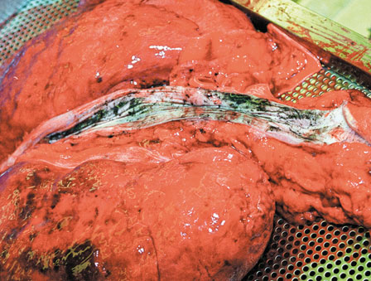
Soot staining can be seen in the oesophagus in this body recovered from a house fire. Such staining indicates that the deceased was alive – and able to swallow – at the time of the fire.

Slide 31
Deaths occurring during a fire
The majority of burnt bodies recovered from fires will not have died from the direct effect of burns, but from exposure to the products of combustion (smoke, carbon monoxide, cyanide and a cocktail of toxic combustion by-products) and/or the inhalation of hot air/gases

Slide 32
Interference with respiration (owing to a reduction in environmental oxygen and/or the production of carbon monoxide and other toxic substances)
● Inhalation heat injury leading to laryngospasm, bronchospasm and so-called ‘vagal inhibition’ and cardiac arrest
● Exposure to extreme heat and shock
● Trauma
● Exacerbation of pre-existing natural disease or burns

Slide 33
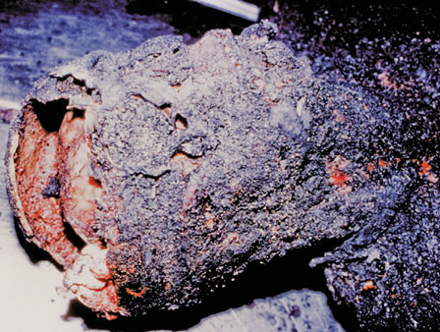
Post-mortem fire-related skull fractures in a severely charred body. There is a reddish-brown heat haematoma/extradural haemorrhage on the inner surface of the carbonized cranial vault.

Slide 34
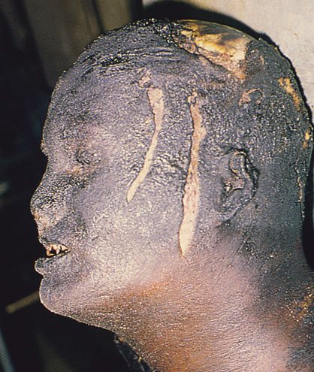
Post-mortem artefactual skin splitting in charred skin. No haemorrhage can be seen in the depths of the splits and they should not be confused with ante-mortem injuries.

Slide 35
Cold injury (hypothermia)
Cold injury (hypothermia) has both clinical and
forensic aspects, as many people suffer from and
die of hypothermia even in temperate climates in
winter. In marine disasters, hypothermia may be
as common a cause of death as drowning.

Slide 36
Mild cases
– shivering
– feeling cold
– lethargy
– cold, pale skin
● Moderate cases
– violent, uncontrollable shivering
– cognitive impairment
– confusion
– loss of judgment and reasoning
– loss of coordination, including difficulty moving around or stumbling
– memory loss
– drowsiness
– slurred speech
– apathy
– slow, shallow breathing
– weak pulse

Slide 37
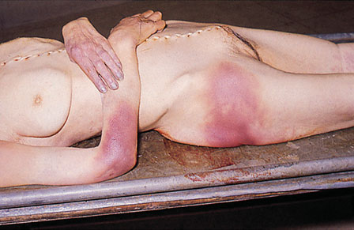
Pinkish discoloration over the large joints in fatal hypothermia.

Slide 38
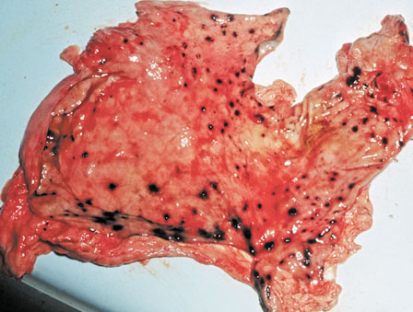
Numerous superficial haemorrhagic gastric
erosions of the lining of the stomach in hypothermia. These are often called ‘Wischnewsky’ spots.

Slide 39
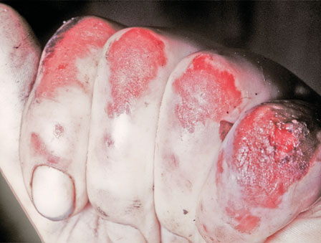
Frostbite of the knuckles.

Slide 40
● Severe cases
– loss of control of hands, feet and limbs
– uncontrollable shivering that suddenly stops
– unconsciousness
– shallow or no breathing, weak
– irregular or no pulse
– stiff muscles
– dilated pupils

Slide 41
The body may rapidly lose temperature when immersed in cold water, as water has a cooling effect that is 20–30 times that of dry air. Hypothermia may confer a protective effect on survival following cold water immersion, but survival may be accompanied by severe hypoxic brain injury.

Slide 42
Generally, the elderly, children and trauma
patients are susceptible to hypothermia. Hypothermia can be classified into mild (core temperature 32–35°C compared with a normal of 37.5°C), moderate (30–32°C), or
severe (< 30°C).

Slide 43
Other gastrointestinal lesions sometimes found in deaths caused by hypothermia include haemorrhagic erosions and infarction in the small bowel (because of red blood cell ‘sludging’ and submucosal thrombosis), and haemorrhagic pancreatitis with fat necrosis. Cold injury to the extremities may be severe enough to cause frost bite, which reflects tissue injury that varies in severity from erythema to infarction and necrosis following microvascular injury and thrombosis

Slide 44
The phenomenon of ‘hide and die syndrome’
describes the finding of a body that appears to be hidden, for example under furniture or in the corner of a room, etc.,

Slide 45
Electrical injury
Injury and death from the passage of an electric current through the body is common in both industrial
and domestic circumstances. The essential factor in
causing harm is the current (i.e. an electron flow)
which is measured in milliamperes (mA). This in
turn is determined by the resistance of the tissues
in ohms () and the voltage of the power supply in
volts (V).

Slide 46
Almost all cases of electrocution, fatal or otherwise, originate from the public power supply, which is delivered throughout the world at either 110 V or 240 V. It is rare for death to occur at less than 100 V.

Slide 47
Usually, the entry point is a hand that touches an electrical appliance or live conductor, and the exit is to earth (or ‘ground’), often via the other hand or the feet.

Slide 48
In either case, the current will cross the thorax, which is the most dangerous area for a shock because of the risks of cardiac arrest or respiratory paralysis.

Slide 49
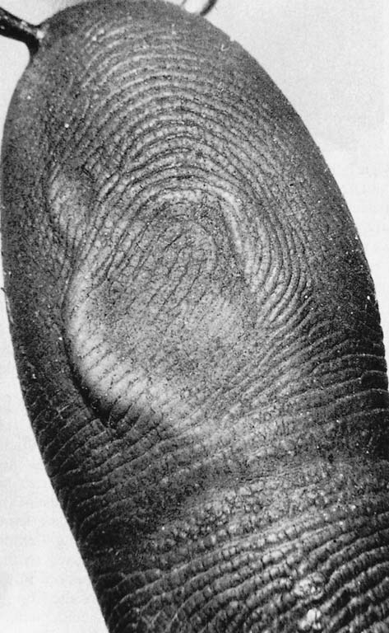
Firm contact electric marks on a fingertip. Two
blisters have been formed by the heat of local skin resistance; they have collapsed on cooling.

Slide 50
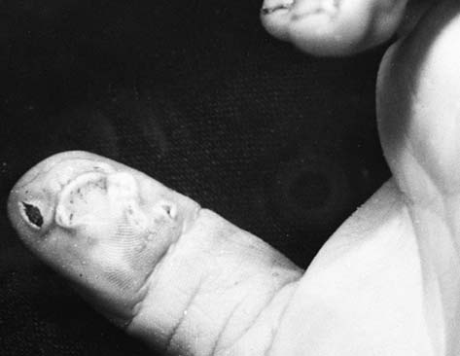
Firm contact blister and adjacent spark burn from 240 V mains supply. The victim was holding a faulty electric drill.
There were no other marks on the body.

Slide 51
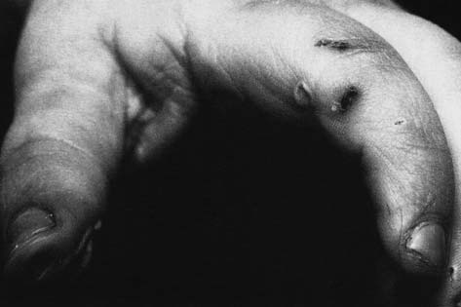
Collapsed blisters and a spark burn from holding a faulty power tool.

Slide 52
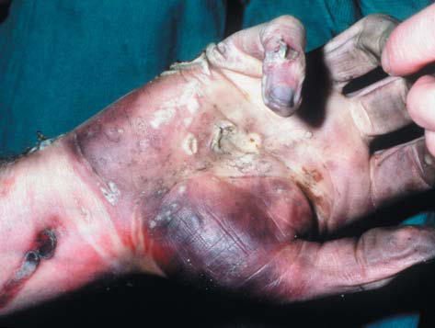
Multiple electrical burns on a hand, with blisters showing the typical pale raised margins and areas of peeling epidermis. There is a blackening from metallization as the current
was passing for several hours; the victim was an electrician who fell into an air-conditioning plant.

Slide 53
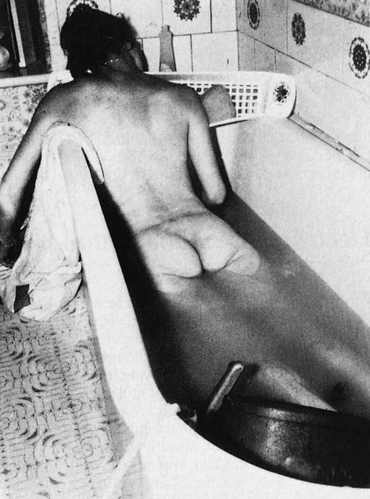
Homicidal electrocution in the bath. An electric heater was dropped into the water with the wire to the earth terminal deliberately disconnected. The 240 V supply entered the body diffusely through the water and completed the circuit by earthing through contact with the breasts against the metal taps,
leaving electrical marks on the skin.

Slide 54
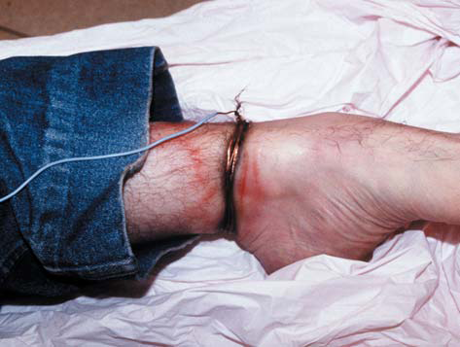
Suicide by electricity. Both wrists were wired in this fashion to a 240 V supply socket, the circuit being completed from arm to arm across the chest.

Slide 55
When a live metal conductor is gripped by
the hand, pain and muscle twitching will occur if
the current reaches about 10 mA. If the current in the
arm exceeds about 30 mA, the muscles will go into
spasm, which cannot be voluntarily released because
the flexor muscles are stronger than the extensors:
the result is for the hand to grip or to hold on. This
‘hold-on’ effect is very dangerous as it may allow the
circuit to be maintained for long enough to cause cardiac arrhythmia, whereas the normal response would have been to let go so as to stop the pain.

Slide 56
If the current across the chest is 50 mA or more, even for only a few seconds, fatal ventricular fibrillation is likely to occur, and alternating current (AC, common in domestic supplies) is much more dangerous than direct current (DC) at precipitating cardiac
arrhythmia

Slide 57
The tissue resistance is important. Thick dry skin, such as the palm of the hand or sole of the foot, may have a resistance of 1 million ohms, but when wet, this may fall to a few hundred ohms and the current, given a fixed supply voltage, will be markedly

Slide 58
The mode of death in most cases of electrocution
is ventricular fibrillation caused by the direct effects
of the current on the myocardium and cardiac conducting
system. These changes can be reversed
when the current ceases, which may explain some
of the remarkable recoveries following prolonged
cardiac massage after receipt of an electric shock.
The victims of such an arrhythmia will be pale,
whereas those who die as a result of peripheral respiratory
paralysis are usually cyanosed. Even rarer
are the instances in which the current has entered
the head and caused primary brain-stemparalysis,
which has resulted in failure of respiration.

Slide 59
The electrical lesion
Unless the circumstances are accurately known, it can be difficult to know whether a dead victim has been in contact with electricity

Slide 60
Usually, however, there is a discrete focal point of entry and, as the electrical current is concentrated at that point, enough energy can be released to cause a thermal lesion. The entry points may be multiple and obvious, or they may be single and very inconspicuous.

Slide 61
The focal electrical lesion is usually a blister,
which occurs when the conductor is in firm contact with the skin and which usually collapses soon after infliction, forming a raised rim with a concave centre. Characteristically, the skin is pale, often white, and there is an areola of pallor

Slide 62
local vasoconstriction), sometimes accompanied by
a hyperaemic rim. The blister may vary from a few
millimetres to several centimetres. The skin often
peels off the large blisters leaving a red base. The
other type of electrical mark is a ‘spark burn’, where
there is an air gap between metal and skin. Here, a
central nodule of fused keratin, brown or yellow in
colour, is surrounded by the typical areola of pale
skin. Both types of lesion often lie adjacent to each
other. In high-voltage burns, multiple sparks may
crackle onto the victim and cause large areas of
damage, sometimes called ‘crocodile skin’ because
of its appearance

Slide 63
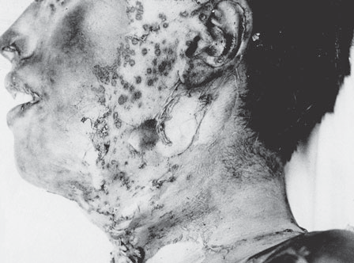
Multiple burns from high-voltage (multi-kilovolt) electrical supply lines. The ‘crocodile skin’ is caused by arcing of the current over a considerable distance.

Slide 64
Death from lightning
Hundreds of deaths occur each year from atmospheric
lightning, especially in tropical countries.
A lightning strike from cloud to earth may involve
property, animals or humans. Huge electrical forces
are involved, producing millions of amperes and
phenomenal voltages. Some of the lesions caused
to those who are struck directly or simply caught
close to the lightning strike are electrical, but other
will be from burns and yet others result from the
‘explosive effects’ of a compression wave of heated
air leading to ‘burst eardrums’, pulmonary blast injury
and muscle necrosis/myoglobinuria.

Slide 65
All kinds of bizarre appearances may be found, especially partial or complete stripping of clothing from the victim, which may arouse suspicions of foul play.
Severe burns, fractures and gross lacerations can occur, along with the well-known magnetization or even fusion of metallic objects in the clothing. The usual textbook description is of ‘fern or branch-like’ patterns on the skin – the so-called Lichtenberg

Slide 66
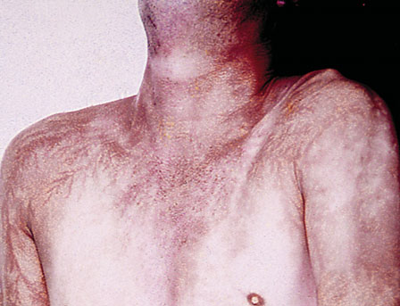
The ‘Lichtenberg figure’ and lightening fatalities. Note the fern-like branching pattern of skin discoloration on the chest

Slide 67
Thermal injury
It's injury caused by application of exposure to extreme heat or cold
❖ Classification of thermal injury
1. Due to heat
A- General effects of exposure to heat
1- Heat stroke (Heat hyperpyrexia)
2- Heat exhaustion (Heat collapse)
3- Heat cramps (Miner's cramps)
B- Local application of heat
1-Dry heat >>> Burn
2- Moist heat >>> Scald

Slide 68
2. Due to cold
A- General effects of exposure to cold
1- Hypothermia
B- Local application of cold
1- Dry cold >>> Frost bite
2- Moist cold >>> Trench foot (Immersion foot or hand)
❖ General effects of exposure to cold
Hypothermia
❖ Manifestation
Mild degree:-CNS depression, increased metabolic rate, increased pulse,
Shivering, Dysarthria
Moderate degree:-Further CNS and vital sign depression, Loss of shivering,
Arrhythmias, Inability to rewarm spontaneously
Severe degree:-Comatose and areflexes, profoundly depressed vitals

Slide 69
MEDICOLEGAL IMPORTANTS OF HYPOTHERMIA
Death due to cold exposure in most of cases are accidental in nature
2- Suicidal and Homicidal death due to cold exposure NOT common
3- Cold water more penetrating than cold air SO more fatality
4- Alcoholic, ill health or malnutrition condition reduce resistance of person
to cold

Slide 70
Frost bite
It occur due to exposure to dry cold, as in case of mountaineers
Usually affect distal part (fingers, toes more affect than tip of nose & ear
lobule). Atmospheric temperature below zero
Trench foot OR immersion foot or hand
Necrosis of finger, toe or hand & feet may occur at low temperature below 5Ċ, if the
limbs are wet due to immersion

Slide 71
General effects of exposure to heat
A- HEAT EXHAUSION
It's due to salt-deficiency & dehydration
Signs & symptoms
1- Rapid weak pulse & low BP
2- Pale cold skin with profuse sweating (temperature normal or slightly rise)
3- Vomiting
4- Cramps
5- NO loss of consciousness, NO rise of temperature, NO convulsion
6- Hypokalemia, high hemoglobulin, high blood urea
7- Oligouria with high specific gravity
TTT with Intravenous fluid

Slide 72
B- Heat cramps
This is condition characterized by several painful paroxysmal cramps in the
muscle of extremities and abdomen, due to exposure to hard work in high
temperature lead to rapid dehydration of the body by excessive loss of salt
and water (this may occur alone or in the presence of heat exhaustion)
TTT with Intravenous fluid
C- HEAT HYPERPYREXIA (HEAT STROKE)
Occur when head is exposed directly to sunlight or heat, this will affect the
heat regulation center, SO the mechanisms which control the body
temperature become disrupted (SWEATING), SO temperature rise
Heat stroke is a medical emergency and death rate is high
Signs & symptoms
1- Sudden rise of temperature
2- Flushed dry skin (NO sweating)
3- No vomiting, No cramps, No dehydration
4- Convulsion, Coma
TTT >>> cooling of the body

Slide 73
B- Local application of heat
BURN
• Classification according to depth
1. First degree
**Affect superficial layer of skin
**Painfull
**Healing of this burn dose not leave scar
**It appears as blister surrounded by red, hyperemic skin.
2. Second degree
**There is destruction of full thickness of skin
**Most Painfull
**Healing of this burn leave scar, which produce disfigurement or impaired
function according to site & size
**It appear as shriveled area of coagulated tissue surrounded by burn of first
degree
3. Third degree
Characterized by gross destruction of subcutaneous tissue, muscles
Painless due to destruction of nerve endings
Healing of this burn leave scar which produce disfigurement or impaired
function according to site & size

Slide 74
❖ FACTORS AFFECTING THE PROGNOSIS OF BURNS
1- THE EXTENT of burn (MOST important factor)
Can be estimated by (RULE OF 9)
A- Head & Neck = 9%
B- Chest (Front=9%, Back= 9%)
C- Abdomen (Front=9%, Back= 9%)
D- Lower limb
- Right (Front=9%, Back= 9%)
- Left (Front=9%, Back= 9%)
E- Upper limb (Right=9%, Left= 9%)
F- Perineum and external genitalia = 1%

Slide 75
2- THE DEGREE (DEPTH) of burn
3- THE SITE of burn
Burn of the face, neck or abdomen more dangerous than burn of the limb
4- THE AGE of victim
Infant and old persons more affected than young adult
5- GENERAL HEALTH of victim
Persons with chronic disease more affected than healthy persons
AGE OF THE BURN
1- 2-3hrs vesication
2- 36-72hrs disappearance of inflammatory zone, presence of pus
3- 1 week separation of superficial slough
4- 2week separation of deeper slough
5- after 2week appearance of red granulation surface without slough

Slide 76
❖ CAUSES OF DEATH FROM BURNS
▪ IMMEDIATE CAUSES
1- Asphyxia
2- Primary (Neurogenic) shock
3- Associated mechanical injuries
▪ DELAYED CAUSES
1- Secondary (Hypovolumic) shock
2- Toxemia
3- Infection
4- Acute edema glottis
▪ LATE CAUSES
1- Jaundice
2- Infection
3- Deep vein thrombosis
4-Curling's ulcer, Marjolin's ulcer
Curling's ulcer is an acute peptic ulcer of the duodenum resulting as a
complication from severe burns (occur after 7-10days of burn)
Marjolin's ulcer: - these are the ulcer malignant changes in burnt area.

Slide 77
POSTMORTEM PICTURE OF DEATH DUE TO BURN
1- The body show ante-mortem burn of different degree, and may be take
pugilistic (boxer's) attitude
2- Generalized redness of the body due to carboxy-hemoglobulin in the blood
3- Soot in the airway
4- Hemoconcentration
5- Generalized visceral congestion
6-Skull fracture due to severe burn

Slide 78
Thermal fracture Traumatic fracture
The scalp Show ante-mortem burn Show ante-mortem wounds
The brain Small and shrunken Edematous
The extradural hematoma Dose not fill space between skull & brain
Fill space between skull & brain
The fracture No displacement of bone May show displacement of bone

Slide 79
SUREST SIGNS OF ANTEMORTEM BURNS INJURY AND DEATH
1- Soot or carbon practicles in respiratory tract
2- In absence of soot, concentration of carboxy hemoglobin in blood beyond 5%,
antemortem vital reaction IN and AROUND burnt margin.

Slide 80
DIFFERENCE BETWEEN ANTEMORTEM & POSTMORTEM BUR
Antemortem burn Postmortem burn
Hyperemia Present IN and around the burn Absent
Vesicles Tense, filled with serum rich by albumin, chloride & polymorphs If present, NOT tense, filled with Fluid poor in protein & NO chloride or polymorphs Floor of ruptured vesicles Red Yellow
Signs of inflammation & repair Present Absent
Soot in airway May be present Absent
CO in the blood May be present Absent
Hemoconcentration Present Absent
Healing May be present Absent
Sepsis May be present Absent
Other causes of death Absent Present

Slide 81
DIFFERENCE BETWEEN DRY BURNS, SCALDS & CORROSIV
BURN
DRY BURN SCALDS CORROSIVE
Causes Dry heat E.g. flame Moist heat E.g. hot liquid or vapour Corrosive
Direction of spread From below to upward From above to downward From above to downward
Degree All degree may seen 1st degree only All degree
Vesicles Around the burnt area After sometime All over burnt area within few minute Absent
Cloths Burnt Not affected Eaten up and discolored
Healing According to degree of burn No permanent scar Heal with thick scar
Singeing of hair Present Absent Absent
Soot in airway May be present Absent Absent
Co in blood May be present Absent Absent
Nature of affection Usually accidental Usually accidental Usually accidental

Slide 82
BURN DUE TO ELECTROCAUSION
❖ NATURE
Accidental death is the most common
Homicidal & Suicidal very rare
❖ FACTORS AFFECTING THE SEVERITY OF BURN OF
ELECTROCUTION
1-STRENGHT OF CURRENT (Most important factor)
The severity of the injury is directly proportional to the strenght of current
2- TYPE OF CURRENT
Alternating current more dangerous than the continued one
3- DURATION OF CONTACT
The severity of the injury is directly proportional to the duration of the contact
4- DIRECTION OF ELECTRICAL BURN
In upper parts of the body more dangerous than the lower parts of body
5- RESISTANCE OF THE BODY
In high voltage burn, multiple sparks may crackle onto the victim and cause
multifocal spark lesion called CROCODILE SKIN APPEARANCE

Slide 83
CAUSE OF DEATH FROM ELECTROCUTION
1- Ventricular fibrillation (main cause of death)
2- Peripheral asphyxia
Due to muscular spasm, this restricts respiratory movement
3-Central asphyxia
Occur when current pass through the respiratory center
4- Cerebral anoxia
Due to prolonged ventricular fibrillation, this may cause brain damage due to
inadequate blood supply

Slide 84
Lightning
It's electric discharge coming down from the clouds to earth. Its direct current
It also produce wound of entry (usually head) and wound of exit (usually foot).
It passes through blood vessels and skin in tree like fashion (called
lightning print OR ARBORESCENT MARKINGS) sometimes can be absent
IN general lightning cause any type of injury.

