Slide 1

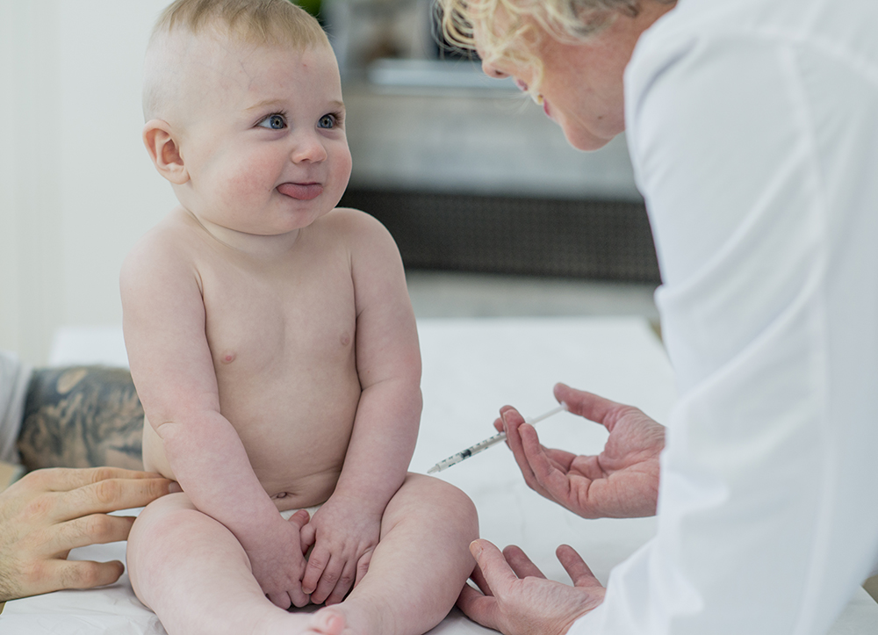

Immunization Vaccines
Presented by :Faraj Ben Gharbia 3572 / 1st year AMS
May 12th 2022

Slide 2
Objectives
Define vaccines.
List types of vaccine with example to each one.
Explain the mechanism of action of active and inactive vaccine.
Compare between Live and Inactive vaccine.
Describe the side effects of vaccination.
2

Slide 3
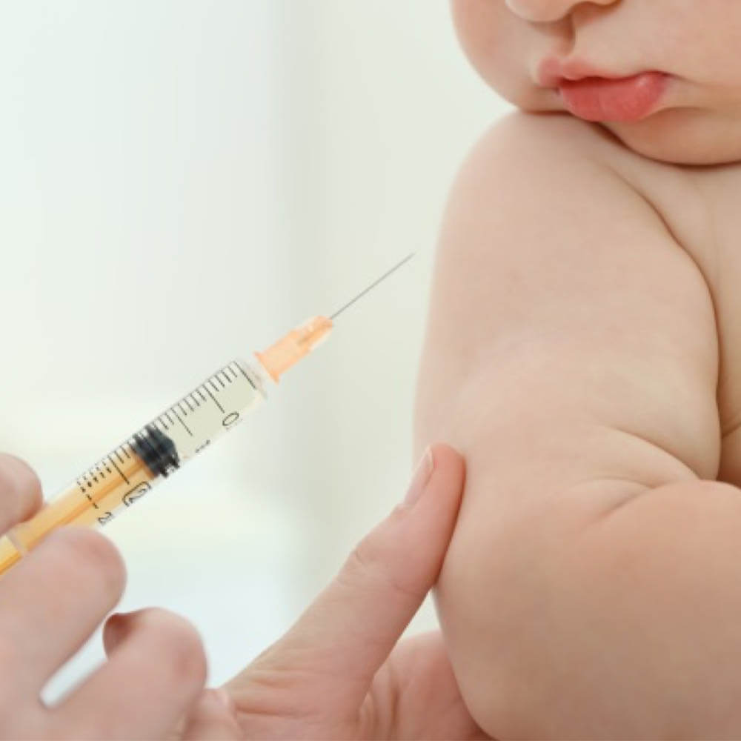
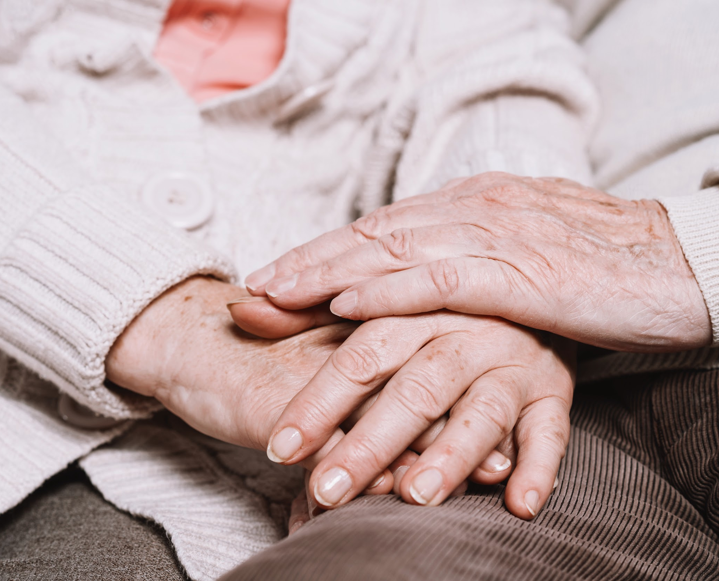
INTRODUCTION
Immunization is a global health and development success story, saving millions of lives every year. Vaccines reduce risks of getting a disease by working with your body’s natural defences to build protection. When you get a vaccine, your immune system responds.
3

Slide 4
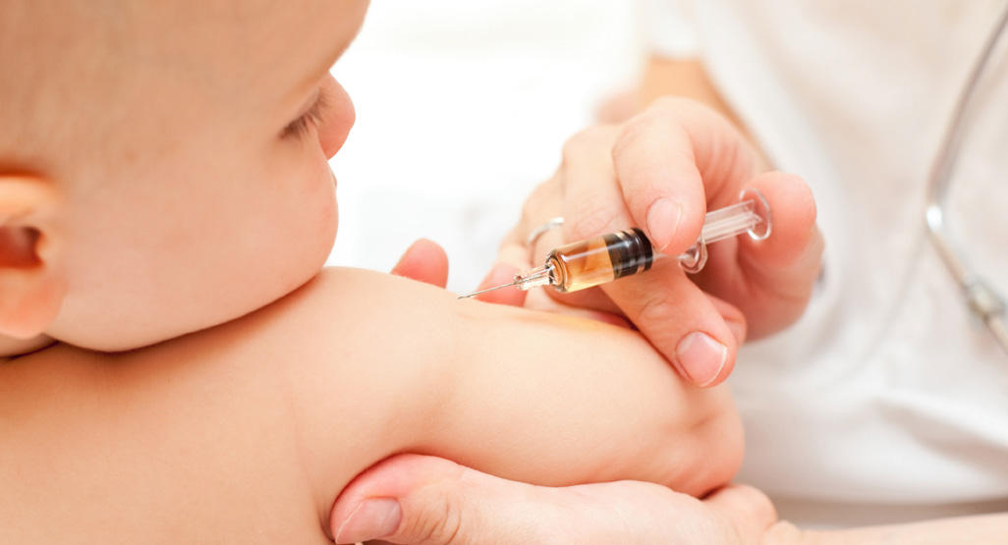
Vaccines are substances that prepare the immune system to fight a disease-causing germ or other pathogen by imitating an infection.
What is Vaccine?

Slide 5
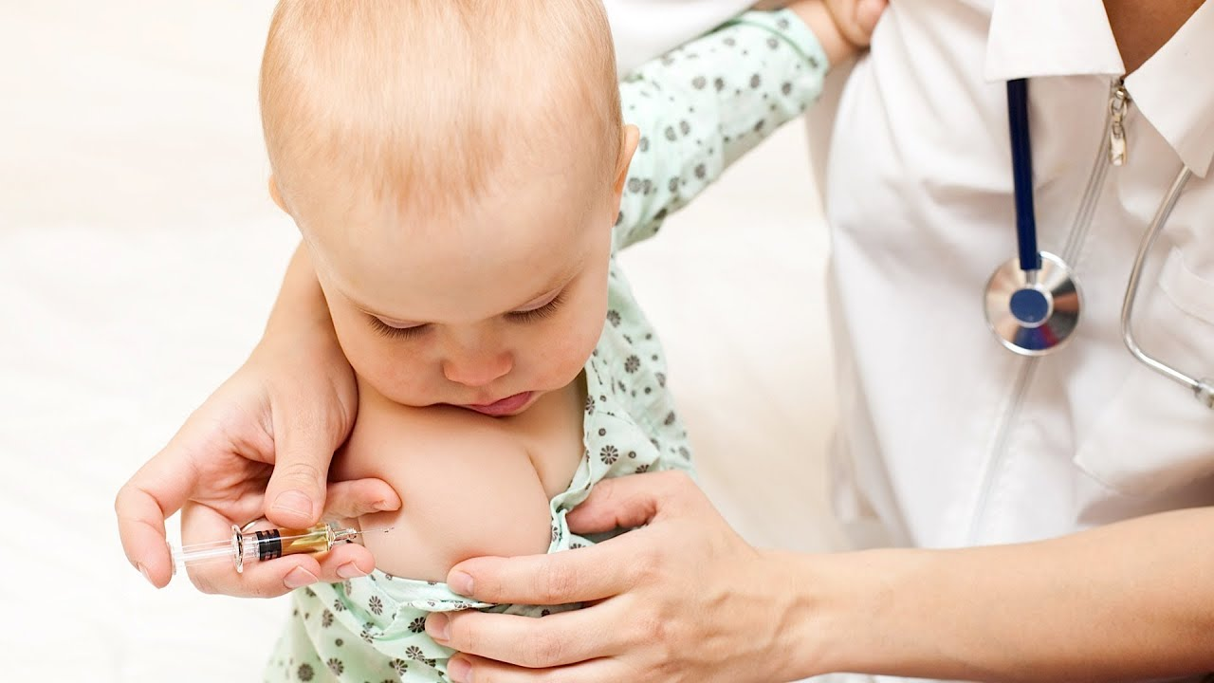
Types of Vaccine
5

Slide 6
Types of Vaccine
Several types of vaccines, including:
Inactivated vaccines (HepatitisA , Flu)
Live-attenuated vaccines (Chickenpox , Yellow fever)
Messenger RNA (mRNA) vaccines( COVID-19)
6

Slide 7
Types of Vaccine
Several types of vaccines, including:
Subunit, recombinant, polysaccharide, and conjugate vaccines ( Hepatitis B ,Whooping cough Pneumococcal disease .,Meningococcal disease,Diphtheria,COVID-19)
Toxoid vaccines (Diphtheria)
Viral vector vaccines (COVID-19)
7

Slide 8
The mechanism of inactivated Vaccine :
The specific virus or bacteria is killed with heat or chemicals, and its dead cells are introduced into the body to stimuli immune system.
The mechanism of live attenuated Vaccine :
A weaker, asymptomatic form of the virus or bacteria is introduced into the body. Because it is weakened, the pathogen will not spread and cause diseases, but the immune system will still learn to recognize its antigens and know to fight in the future.
8

Slide 9
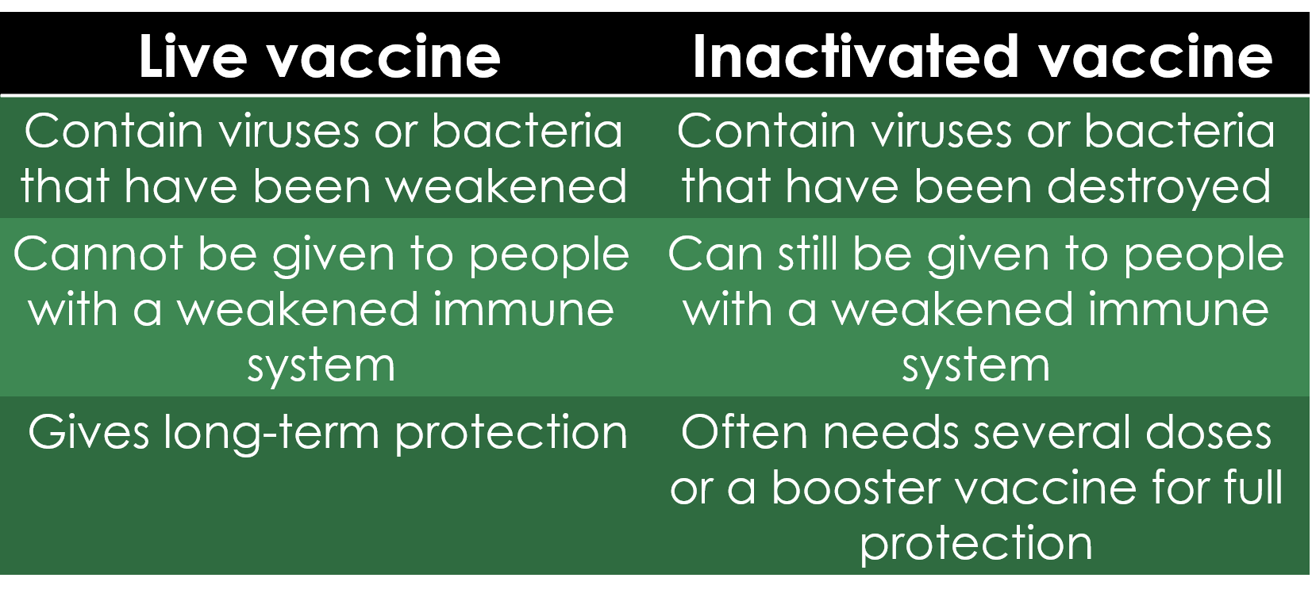

Slide 10
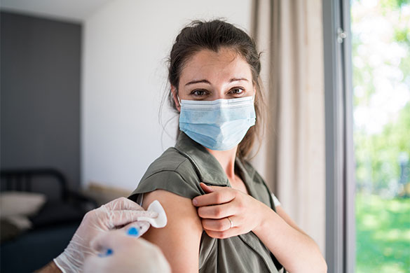
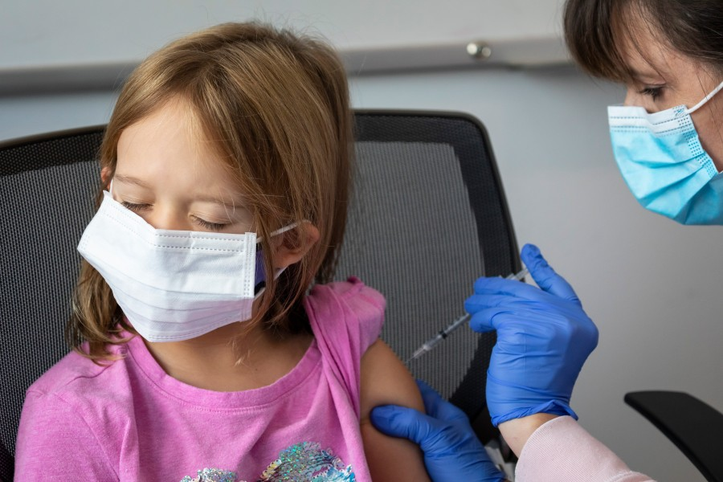
Side effects
1) The area where the needle goes in looking red, swollen and feeling a bit sore for 2 to 3 days.
2) Babies or young children feeling a bit unwell or developing a high temperature for 1or 2 days.
10

Slide 11
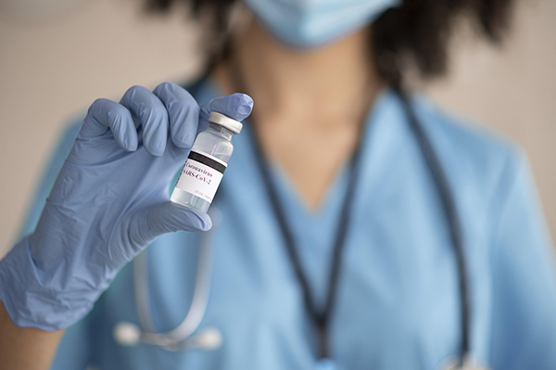
CONCLUSIONS
Vaccines have helped dramatically reduce the number of deaths caused by infectious diseases. The continued vaccination of children will help protect them from life-threatening diseases and keep them healthy.
11

Slide 12

Explainer: What is a vaccine?. (2022). Retrieved 3 June 2022, from https://www.sciencenewsforstudents.org/article/explainer-what-vaccine.
(2022). Retrieved 3 June 2022, from https://www.hhs.gov/immunization/basics/types/index.html.
Writers, S. (2022). How Vaccines Work | PublicHealth.org. Retrieved 3 June 2022, from https://www.publichealth.org/public-awareness/understanding-vaccines/vaccines-work/.
Why vaccination is safe and important. (2022). Retrieved 3 June 2022, from https://www.nhs.uk/conditions/vaccinations/why-vaccination-is-safe-and-important/.
References:
12

Slide 13
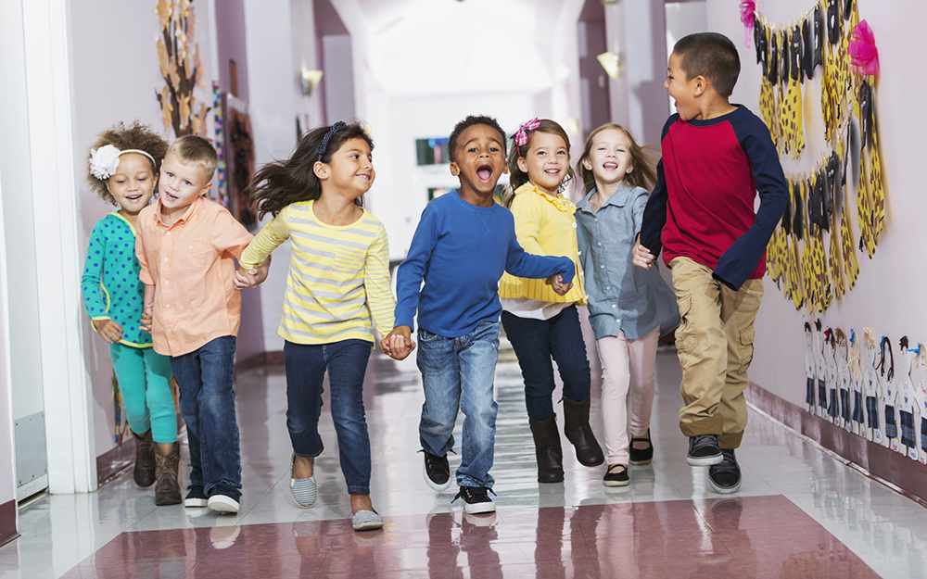

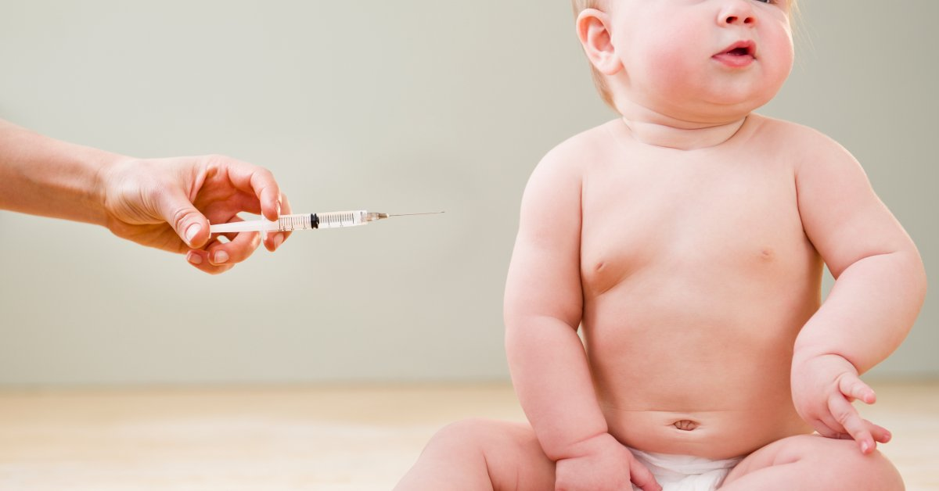
THANK YOU
12

