Slide 1
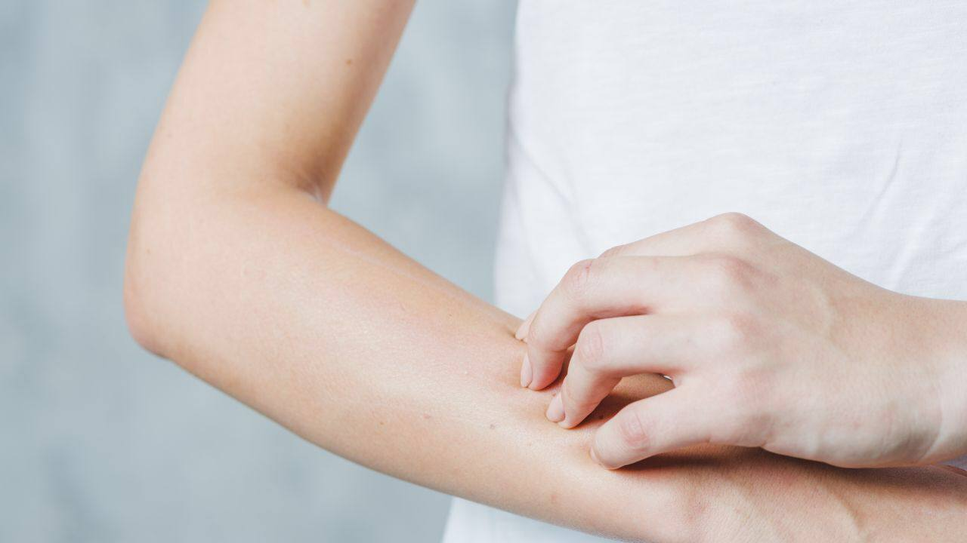


Scabies Infectious disease prevention
Presented by: Malak Shahout
number stu: 2540
Block :PTS
2022/5/24
1

Slide 2
Objective
Define Scabies
Signs and symptom of scabies
Causes of scabies
Prevention of scabies
2

Slide 3
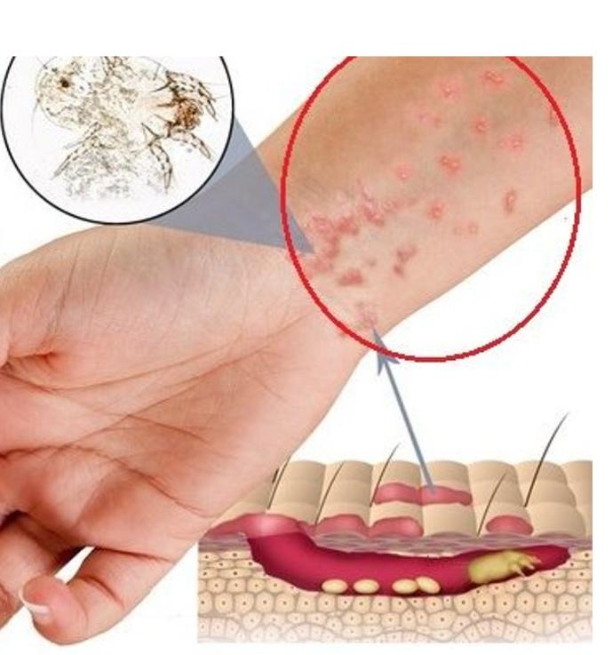
Introduction
3

Slide 4
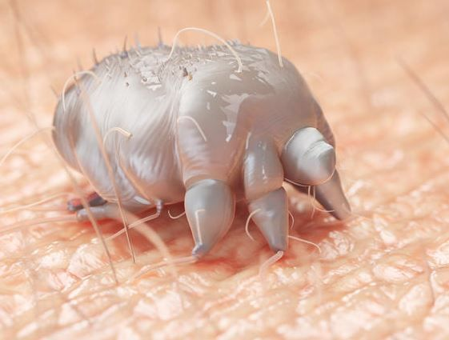
Scabies
Scabies is a contagious intensely itchy skin condition caused by a burrowing mite.
The scientific name for scabies would be Sarcoptes scabiei.
Another name for scabies or Sarcoptic mange.
Scabies have been affecting people for
the last 2,500 years.
4

Slide 5

Scabies is estimated to affect over 300 million people each year throughout the world
5

Slide 6

It can affect people of all ages, race,and gender
6

Slide 7

Scabies commonly occurs in people in crowded living conditions, such as those found in
- prisons
7

Slide 8


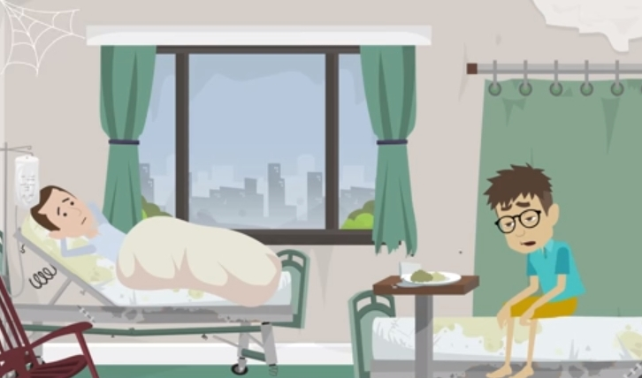
Child care group
Family home
hospitals or nursing homes
8

Slide 9
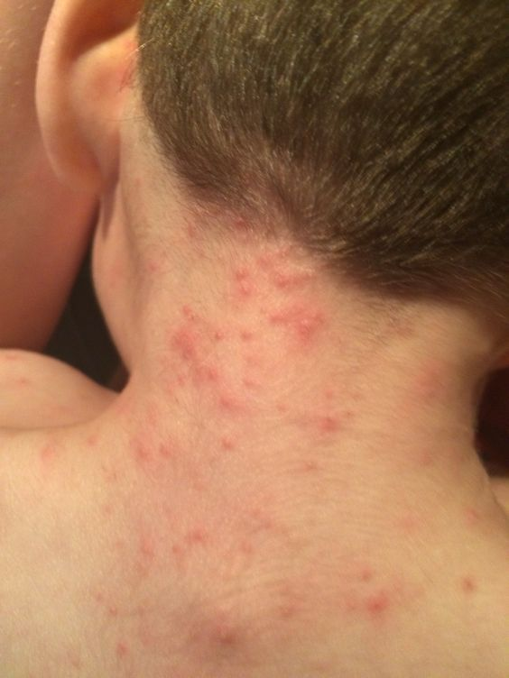
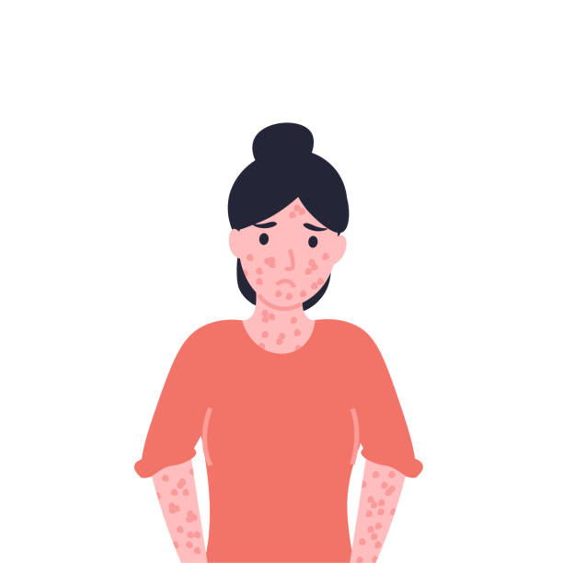
Signs & symptoms of scabies.
Itching, mainly at night
Rash
Sores
Thick crusts on the skin
9

Slide 10
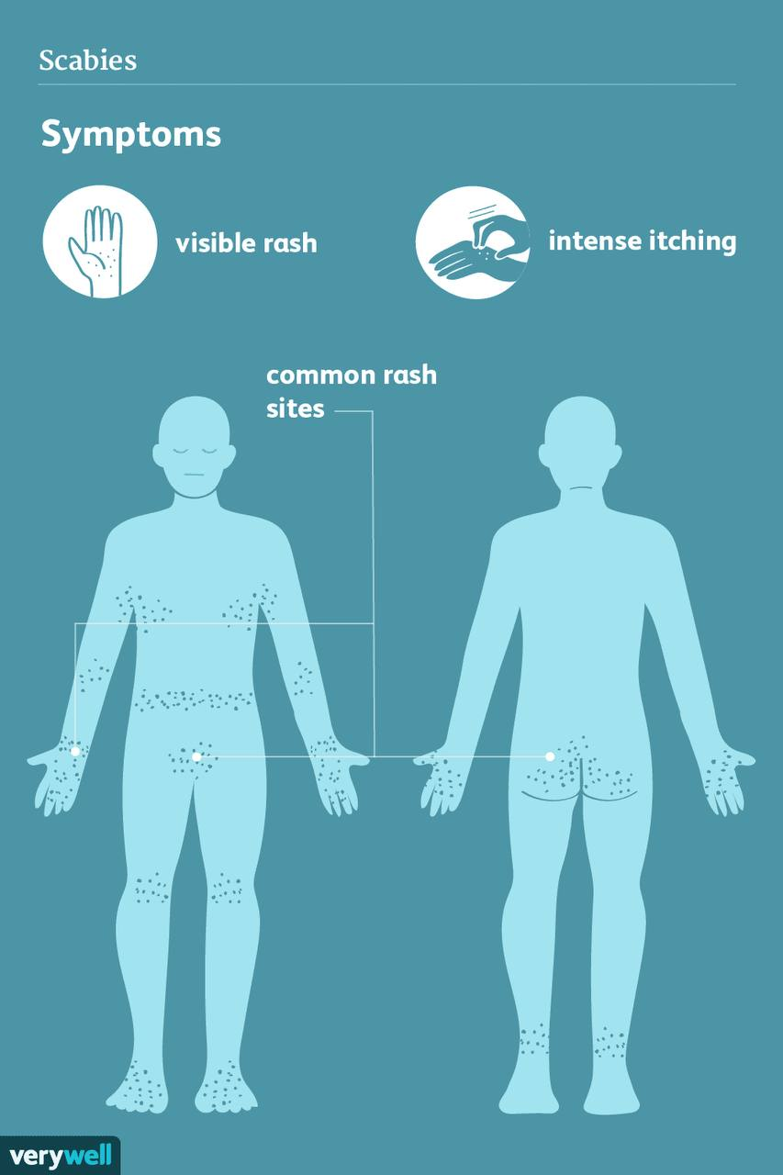
10

Slide 11
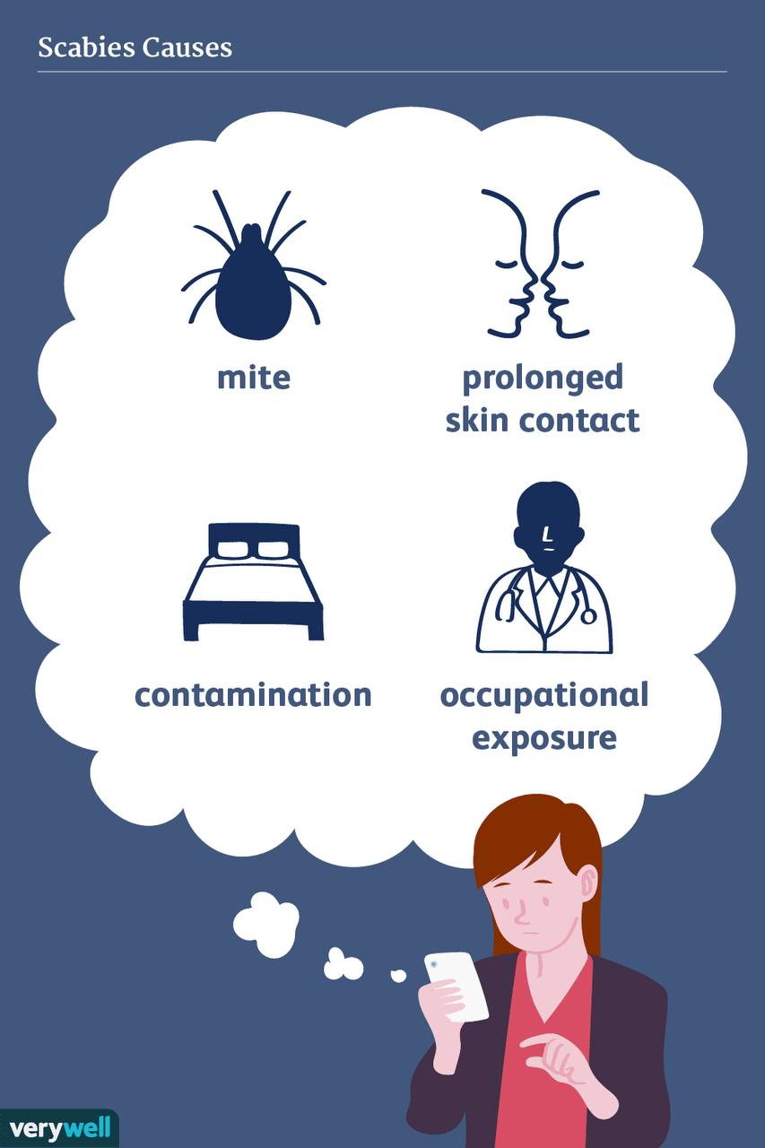
11

Slide 12
Prevention
Stay away from skin-to-skin contact with an infected individual
Avoid prolonged contact with a surface containing mites
Wash or isolate any materials infected with scabies thoroughly
be aware of your environmental risks for scabies
12

Slide 13
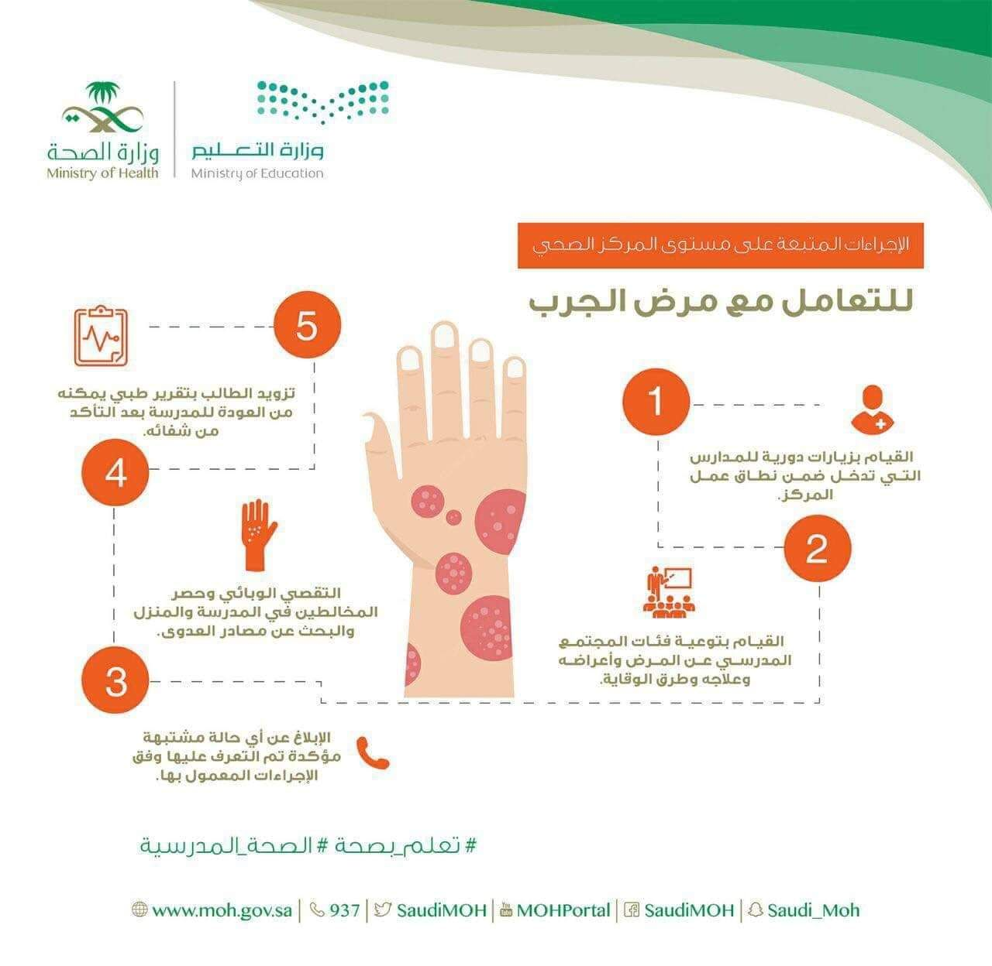
/
Steps taken to combat Scabies
Prepare students and members with medical certificate used to get back to community after relief from the disease
Routine visits to schools in the region of the health center
Quarantine and remove any affected members and look for source of disease
Give Awareness Rounds to all community members in school about the Disease and how to prevent it
Inform and Report any Suspected Cases
13

Slide 14
Conclusion
As scabies spread moderately contagious, early diagnosis and treatment can prevent it from spreading further and causing any more trouble.
In case you had scabies previously the symptoms usually develop within a few days after exposure. For first-time occurrences, six weeks are required for the symptoms to appear.
14

Slide 15
References
Downs AMR, Harvey I, Kennedy CTC. The epidemiology of head lice and scabies in the UK. Epidemiol Infect 1999;122:471-477
Walton SF, Holt DC, Currie BJ, Kemp DJ. Scabies: new future for a neglected disease. Adv Parasitol 2004;57:309-376
Arlian LG, Runyan RA, Achar S, Estes SA. Survival and infectivity of Sarcoptes scabiei var. canis and var. hominis. J Am Acad Dermatol 1984;11:210-215
Mahe A, Faye O, N'Diaye HT, et al. Definition of an algorithm for the management of common skin diseases at primary health care level in sub-Saharan Africa. Trans R Soc Trop Med Hyg 2005;99:39-47
15

Slide 16
Thank you!
16

