Slide 1
Cardiovascular Examination
Dr. Zaki Bettamer
zikoecho@yahoo.com
26/12/2016

Slide 2
Basic concepts
Try to secure, if possible, a well-lighted quiet room.
Perform examination from the patients right side.
Set pt. at 45% and expose pericardium

Slide 3
Approach
Introduce your self to the patient , shake hands with him & take his permission for examination.
Observe the patient position whether he is setting, lying, or leaning forward & whether he is in pain or distress or he looks comfortable.

Slide 4
General examination
1. General appearance .dyspnic,tachypnic ,disterssed ,in pain ,on O2 therapy …
2. Vital signs:
pulse
Rate,rhythm,character,volume,
synchronizing,radiofemoral delay.
Blood pressure
Temperature
Respiratory rate

Slide 5
Examination of the Pulse
Arteries:
Carotid
Brachial
Radial
Femoral
Popliteal
Posterior tibial
Dorsalis pedis
Characters:
Rate
Rhythm
Volume
Synchronicity
Vessele wall
Radiofemoral delay
Other pulses & carotid bruit

Slide 6
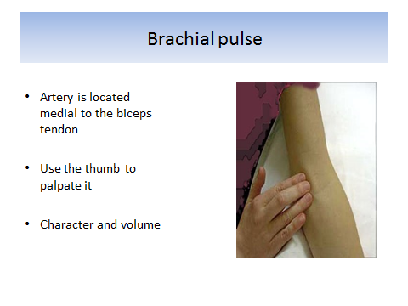

Slide 7
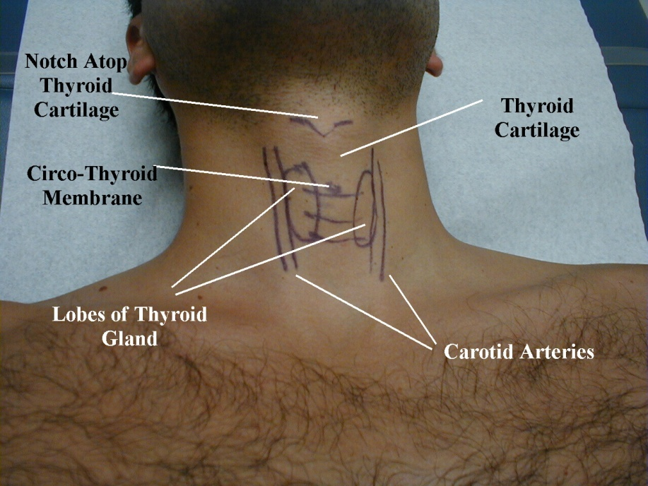
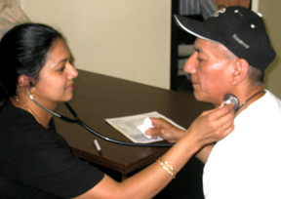
Carotid artery

Slide 8
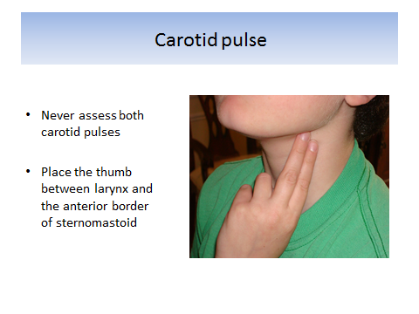

Slide 9
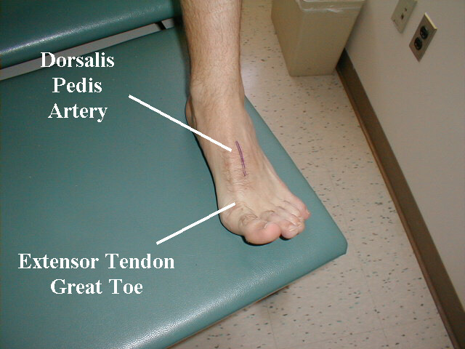
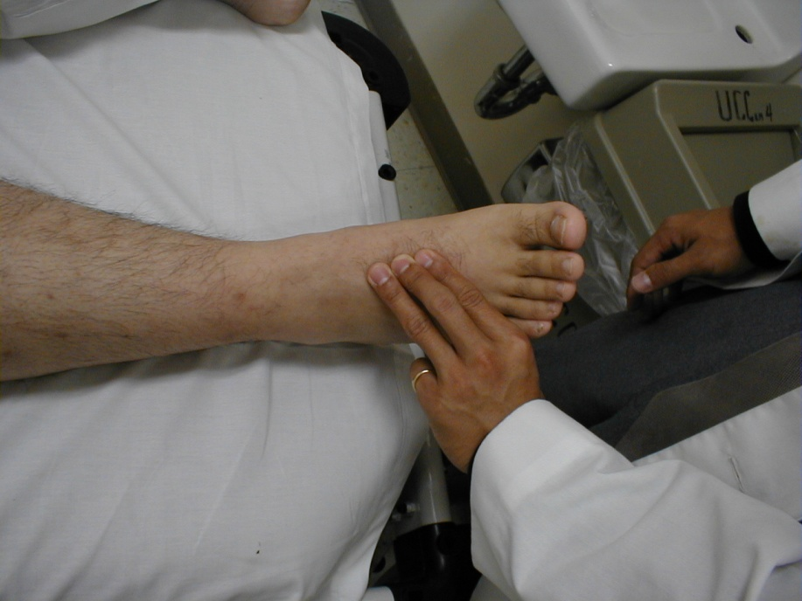
Dorsalis pedis

Slide 10
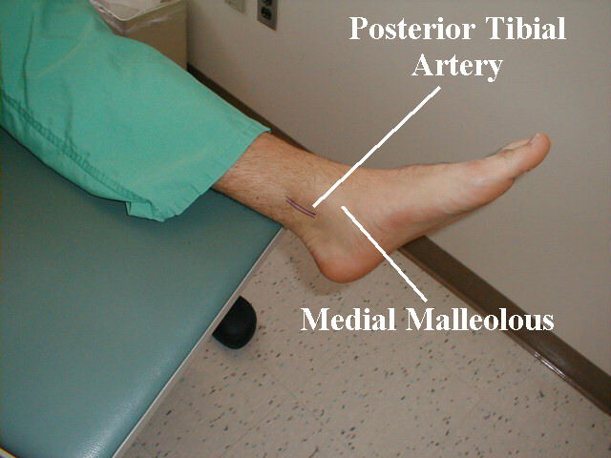
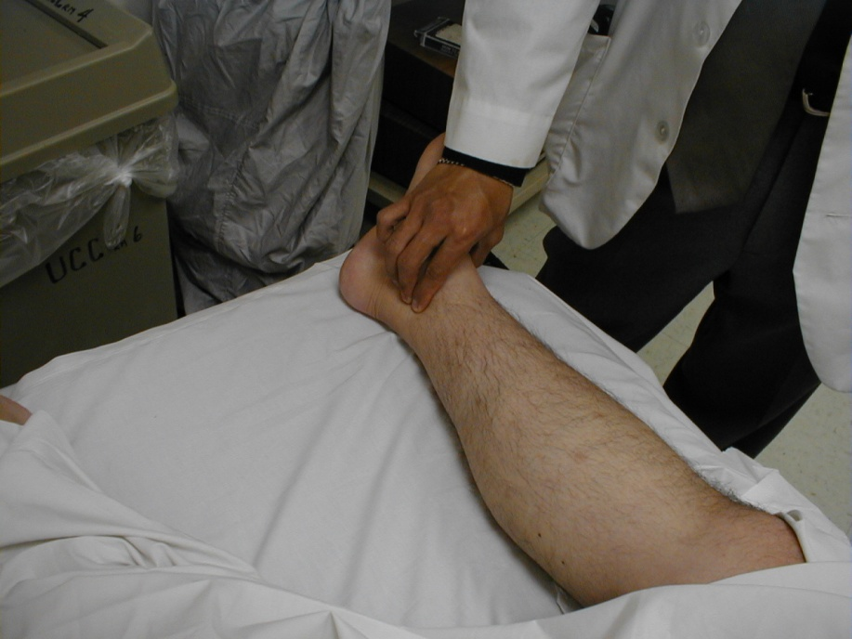
Posterior tibial

Slide 11
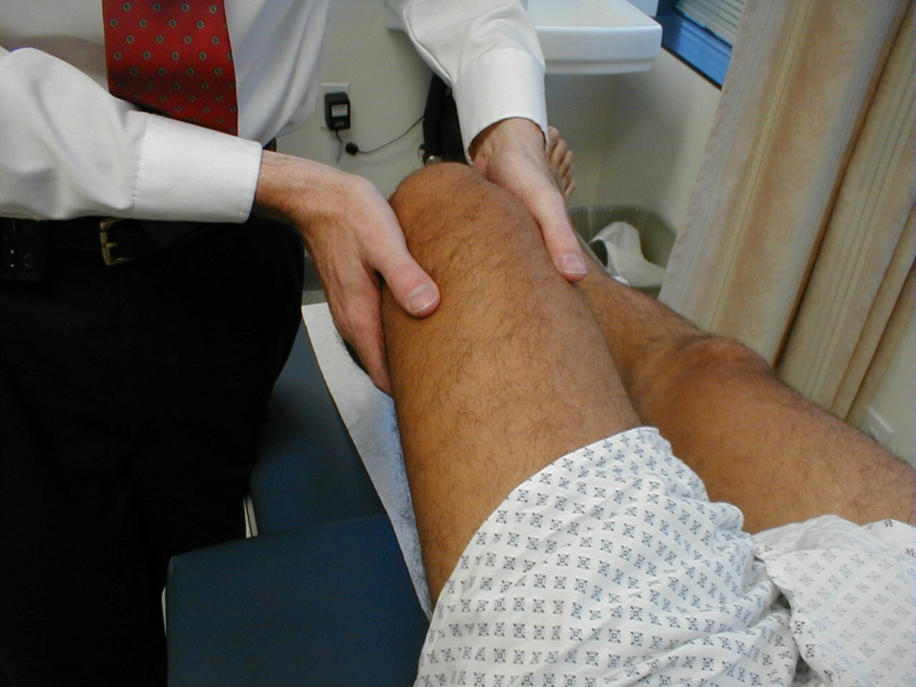
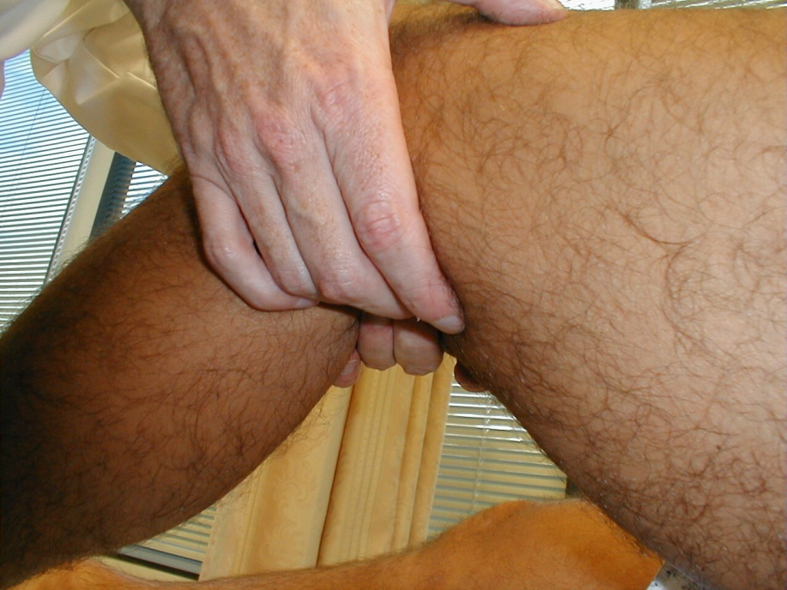
Poplitial artery

Slide 12
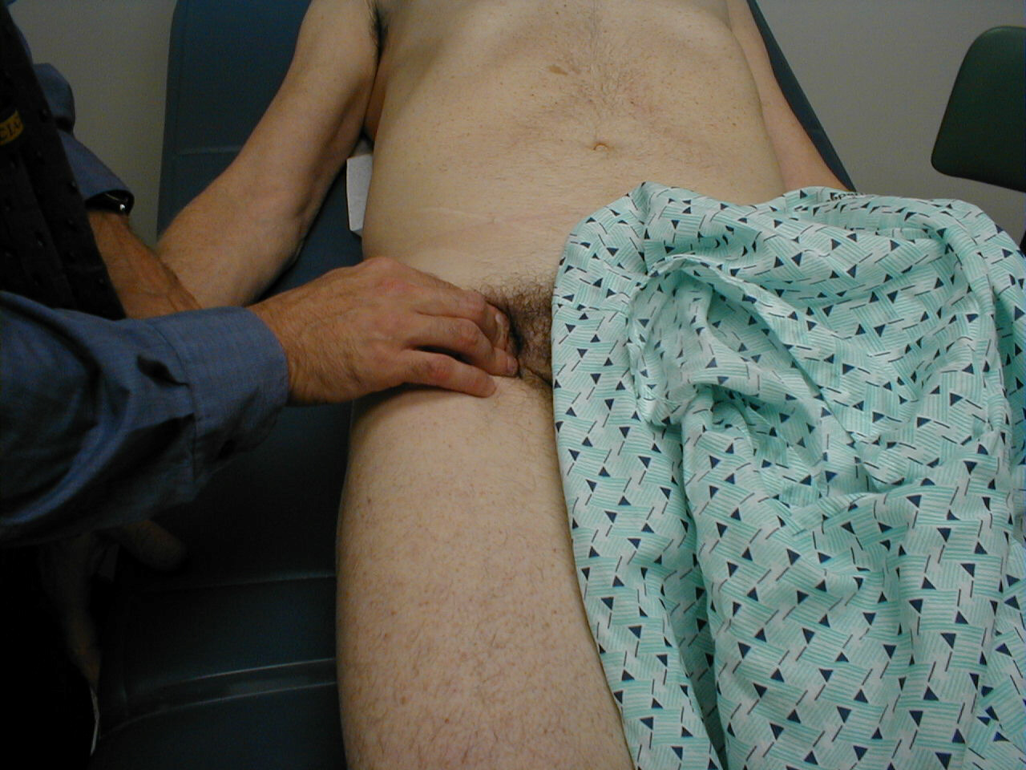
Femoral artery

Slide 13
Types of pulses
Slow rising pulse (delayed up strokes / parvus et tardus) = aortic stenosis
Pulsus bisferience = AR + AS
Pulsus paradocsus = acute sever asthma or cardiac tamponade
Pulsus alternans = LVF
Collapsing pulse= hyperdynamic circulation

Slide 14
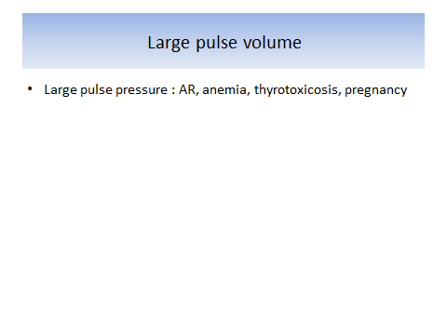
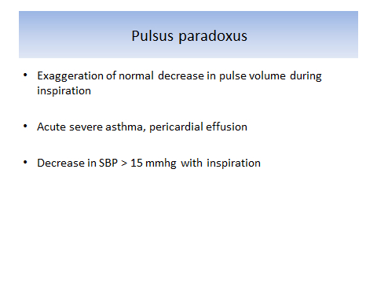

Slide 15
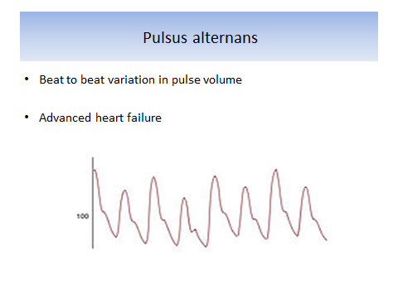

Slide 16
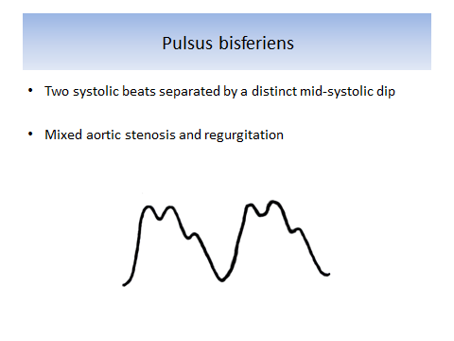

Slide 17
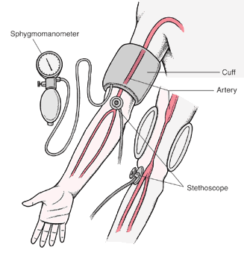
Blood pressure measuring
130/80
130/80/0

Slide 18
General examination
3. Hands: (cold, warm, clubbing, cyanosis, sweating,splinter hge)

Slide 19
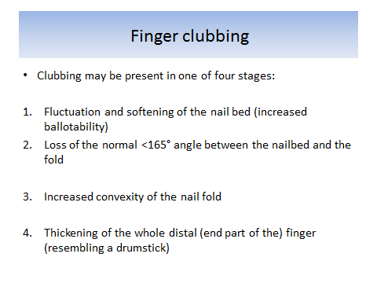

Slide 20
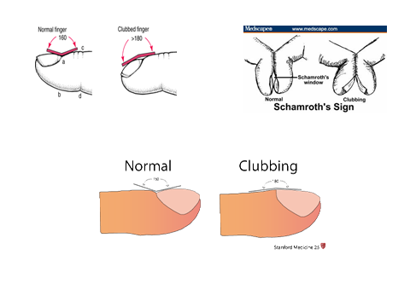

Slide 21
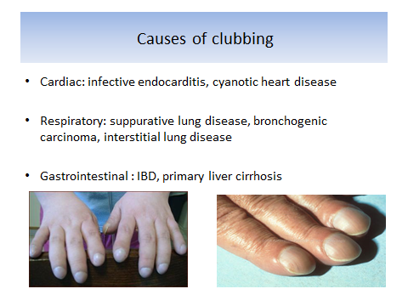

Slide 22
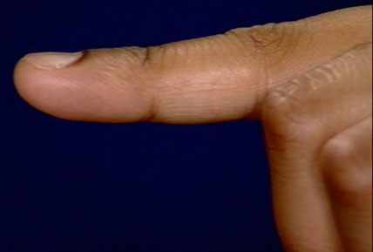
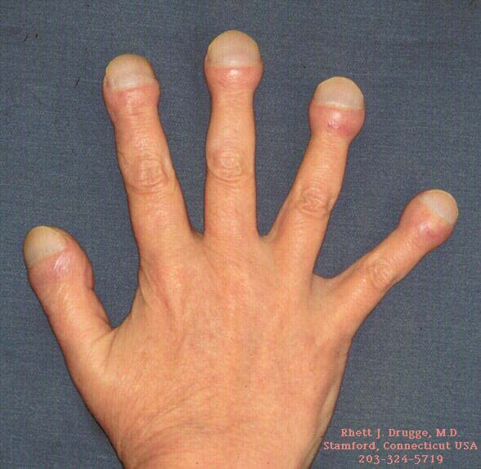
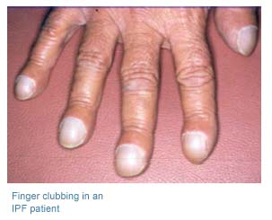
Clubbing

Slide 23
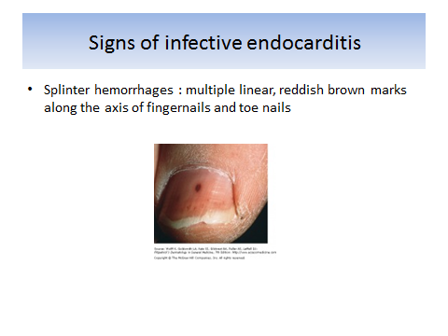

Slide 24
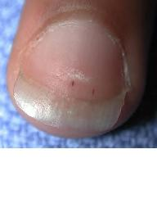
Splinter hemorrhage
Infective endocarditis
Vasculitis
Trauma

Slide 25
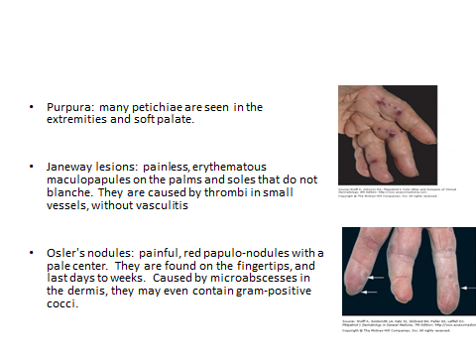

Slide 26
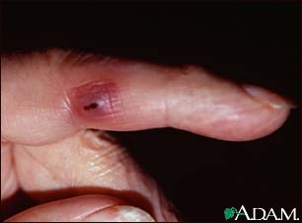
Janeway spots

Slide 27
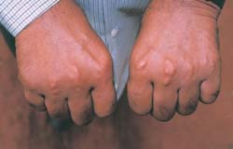
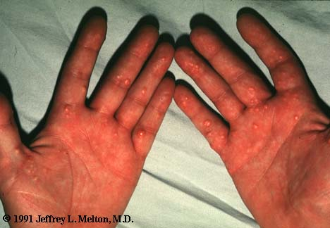
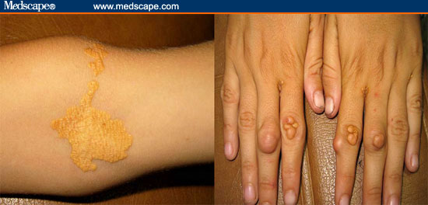
Xanthomas

Slide 28
Types of xanthomas
Xanthomas: tumor-like collections of foamy histiocyts within the dermis... characterized histologically by dermal accumulation of benign appearing histiocytes with abundant, finely vacuolated (foamy) cytoplasm...
1) tuberous: occur as yellow nodules at the flexors
2) tendon
3) plane: are linear yellow lesions in the skin folds, especially the palmar creases...
4) eruptive: occur as sudden showers of yellow papules that wax and wane according to variation in plasma triglyceride and lipid content...they occur on the buttocks, posterior thighs, knees, and elbows
5) xanthelasma

Slide 29
4. Eyes (corneal arcus,pallor,xanthelasma)

Slide 30
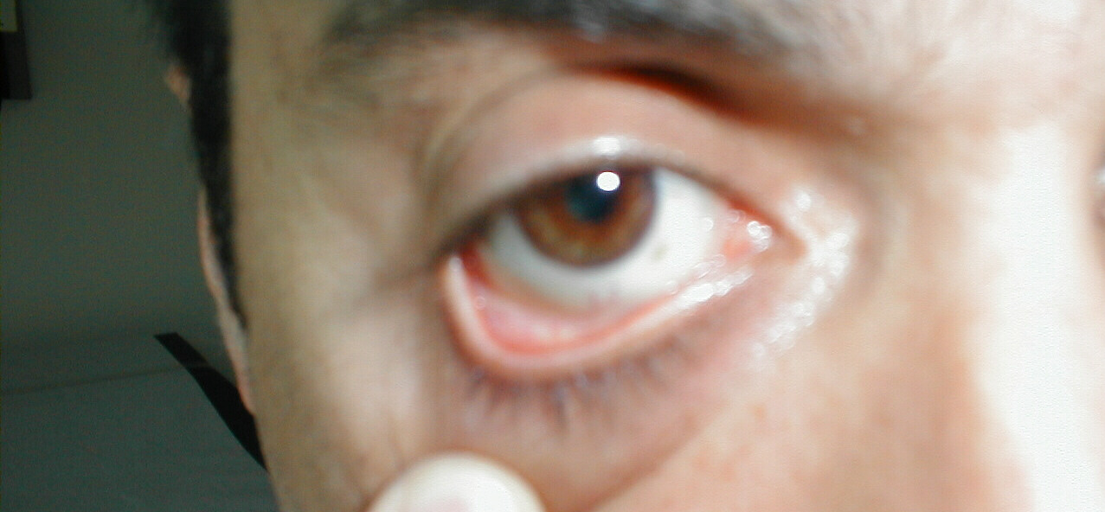
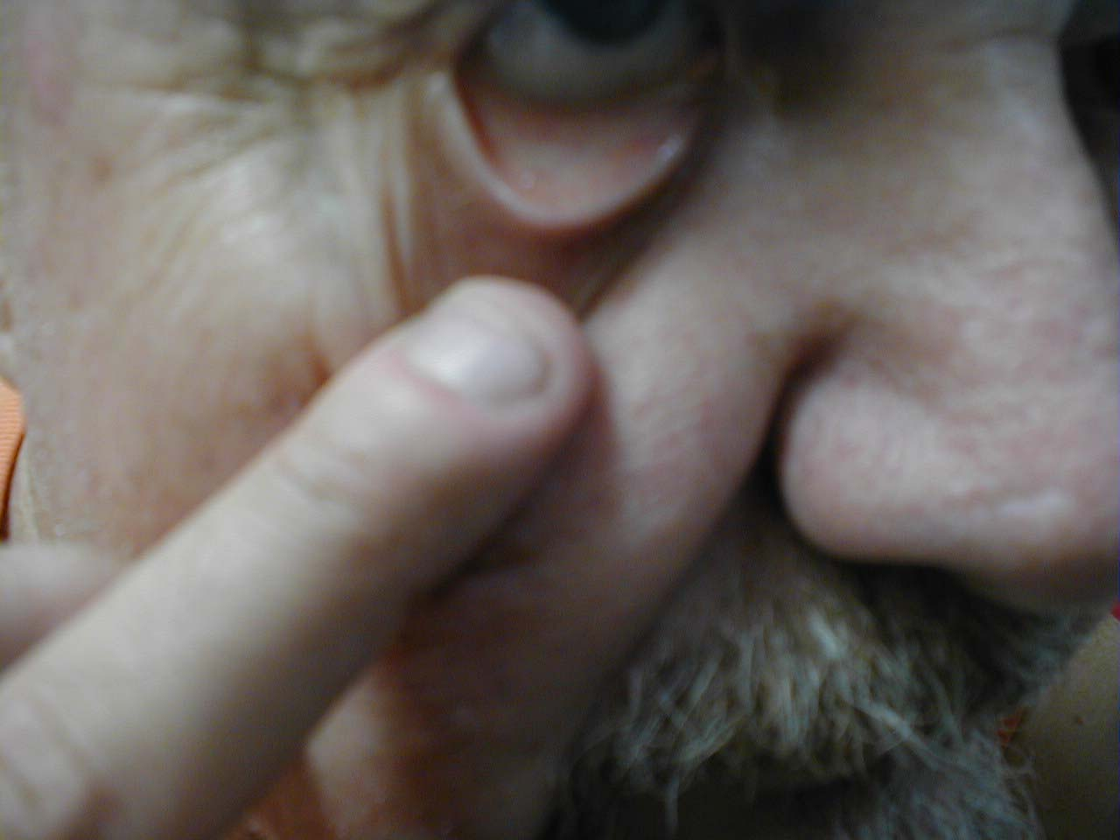
Pallor

Slide 31
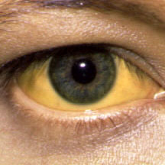
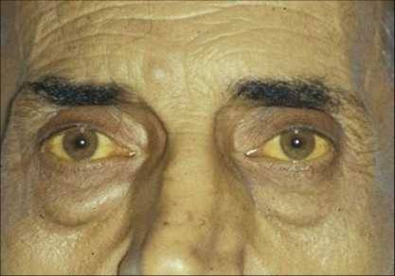
jaundice

Slide 32
Causes of jaundice
1) Unconjugated hyperbilirubinemia (Achloruric jaundice): a) hemolytic b) non-hemolytic (Gilbert`s syndrome)
2) Conjugated hyperbilirubinemia: a) Hepatic (hepatitis) b) Posthepatic (cholestatic) intra-hepatic cholestasis extra-hepatic cholestasis (obstructive)

Slide 33
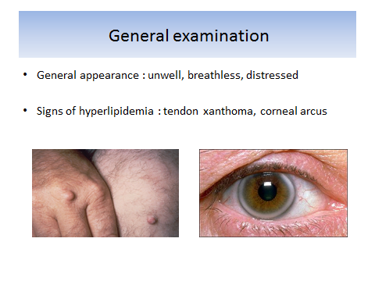
Clinical signs

Slide 34
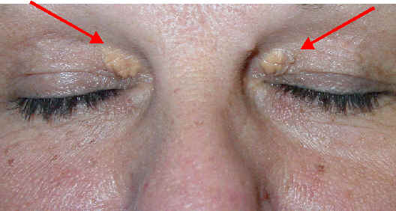
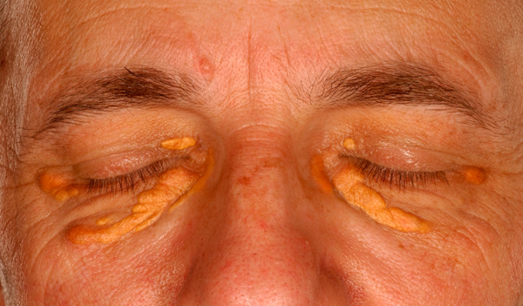
Xanthelasma

Slide 35
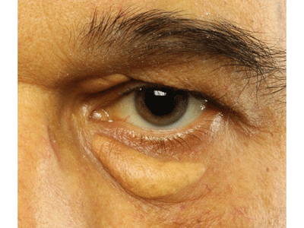
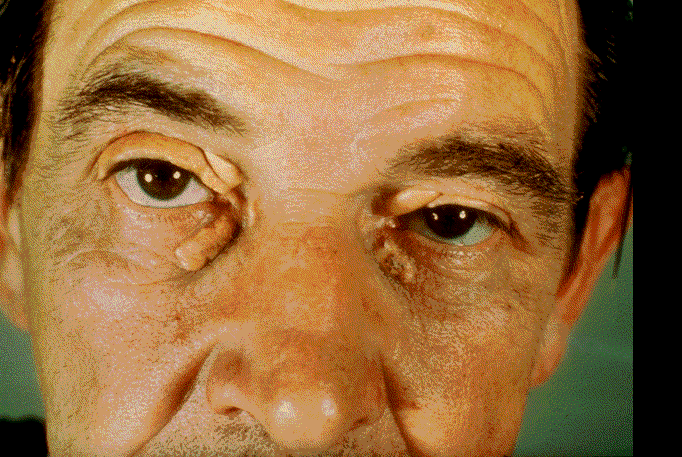
Xanthelasma

Slide 36
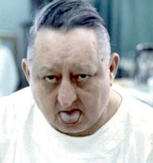
Central cyanosis

Slide 37
5. Neck:
Neck veins.
Pulsations (arterial vs. venous).
Carotid arteries.character,bruit
Trachea, thyroid gland.

Slide 38
JVP
JVP Pulsation
2 per cardiac cycle
Not palpable
Varies depending on position
Enhances with hepatojugular reflex
Carotid Pulsation
1 per cardiac cycle
Palpable
Position independent
Does not enhance with hepatojugualr reflex

Slide 39
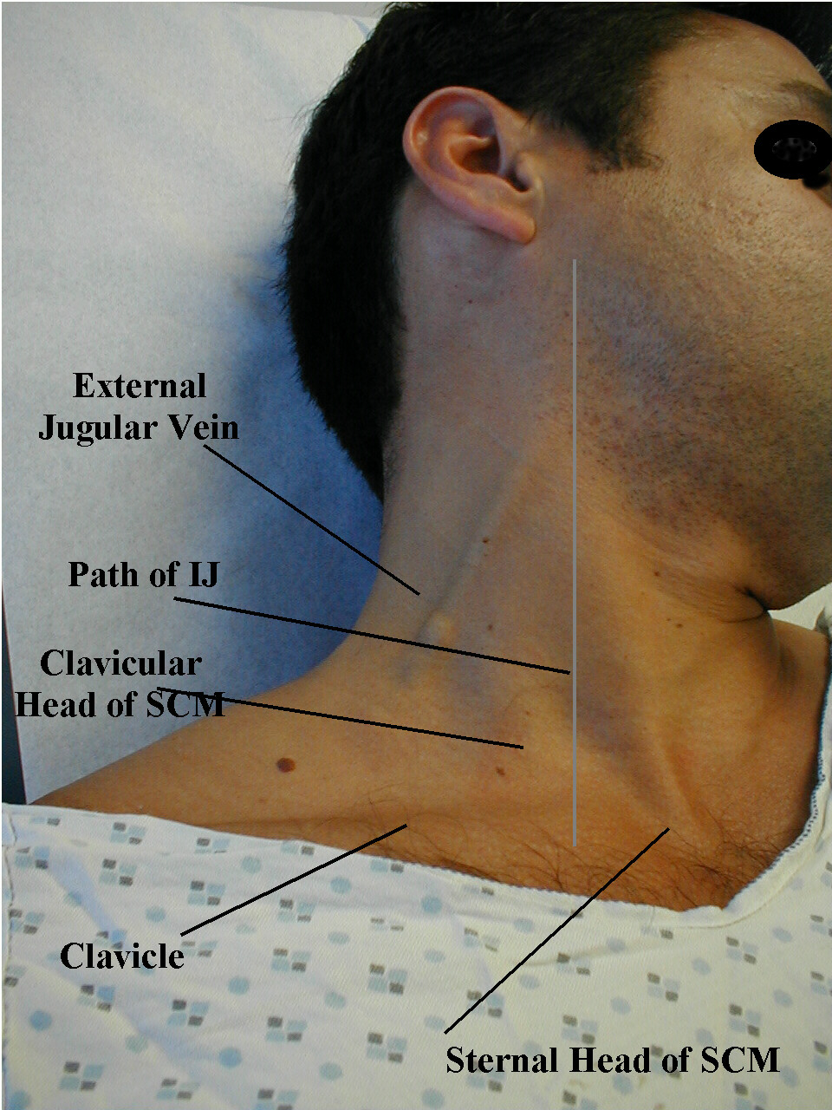

Slide 40

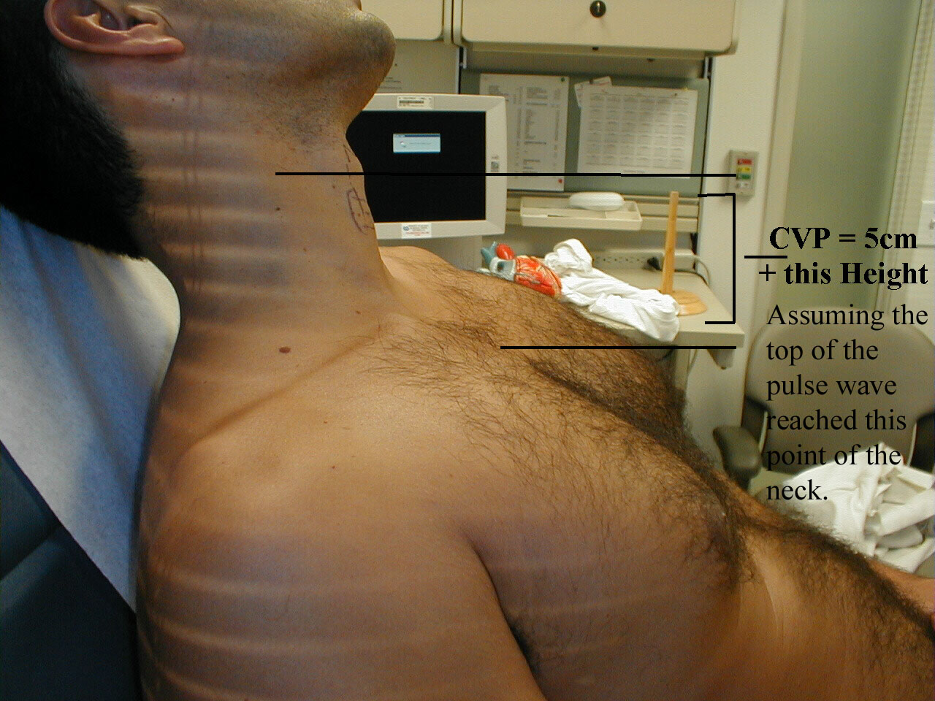
JVP estimation

Slide 41
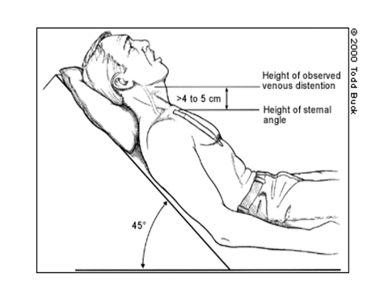

Slide 42
Causes of raised JVP
Right sided heart failure
Pulmonary embolism
Pericardial effusion (Prominent “y” descent)
Constrictive pericarditis (Kussmaul`s sign)
Superior venacava obstruction (non-pulsatile)

Slide 43

Jugular venous pulse
A
A
C
C
V
Y
X
SYSTOLE
DIASTOLE

Slide 44
Abnormal waves
Prominent “y” descent : pericardial effusion
Absent “a” : atrial fibrillation
Giant “a” : tricuspid stenosis & pul.HTN
Giant “v” : tricuspid regurge
Cannon waves: complete heart block

Slide 45
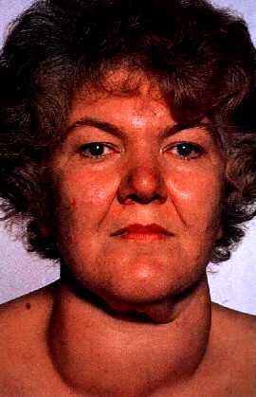
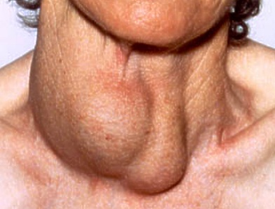
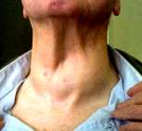
Goiter

Slide 46
6. Lower Limbs ( signs of PVD, edema, pulsations dorsalis pedes, post.tibialis A).
7. Abdomen: feel for palpable hepatomegaly and check if it is pulsatile (tricuspid regurge). Look for ascites ,splenomegaly(IE), and an aortic aneurysm.

Slide 47
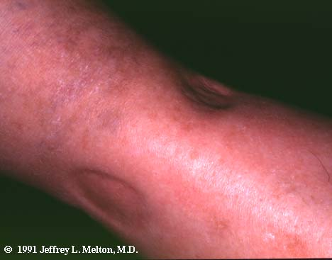
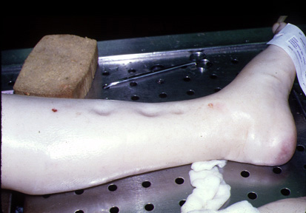
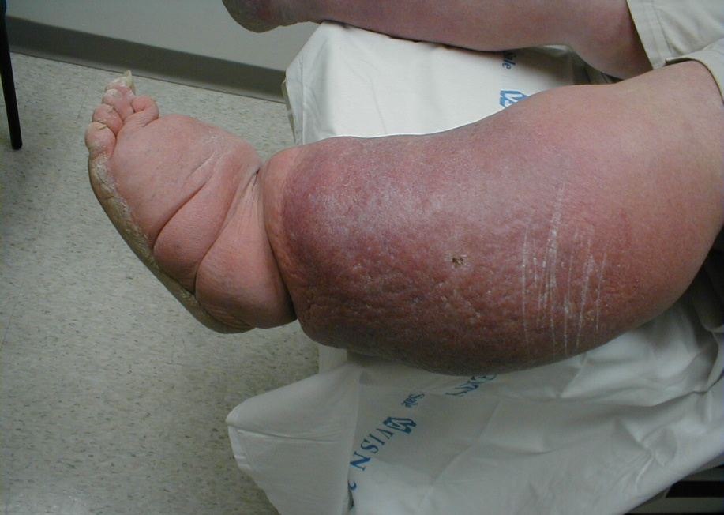
Oedema

Slide 48
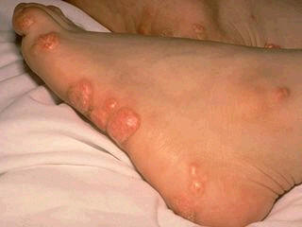
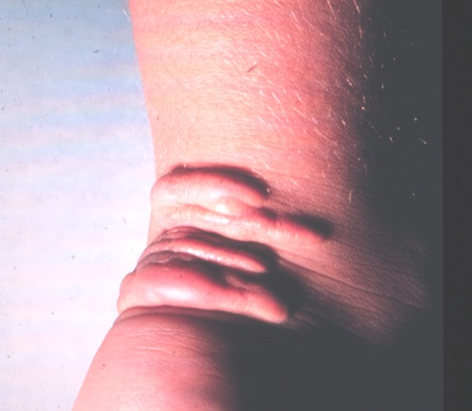
Xanthomas

Slide 49
EXAMINATION OF PRECORDIUM

Slide 50
PREPARING FOR EXAMINATION
Position: semi-sitting (45° angle)
Exposure: anterior chest
Patient’s right side
Warm your hand and your stethoscope

Slide 51
STEPS OF EXAMINATION
Inspection
Palpation
Percussion
Auscultation

Slide 52
INSPECTION
Chest deformity
Scars
Pulsations

Slide 53
INSPECTION- Chest deformity
Pectus excavatum (funnel chest)
Localised depression of lower length of sternum or the whole sternum.
Causes
Developmental defect
Marfan’s syndrome
May displace the heart and affect palpation and auscultation.

Slide 54


Pectus excavatum

Slide 55
INSPECTION- Chest deformity
Pectus carinatum (pigeon chest)
Localised prominence of sternum and adjacent costal cartilages.
Causes
Chromic respiratory or cardiac disease in childhood (precordial bulge)
Rickets
Rarely developmental

Slide 56


Pectus carinatum

Slide 57
INSPECTION- Scars
Sternotomy
Lateral thoracotomy
Infraclavicular

Slide 58
INSPECTION- Scars
Sternotomy
Indicates open heart surgery
Valve replacement
Open mitral valvotomy
Coronary artery bypass grafting (CABG)
Thymic excision (thymomectomy)

Slide 59


Slide 60
INSPECTION- Scars
Lateral thoracotomy
Closed mitral valvotomy (Left Submammary scar)
Lung surgery (eg pneumonectomy)
Oesophageal surgery

Slide 61


Slide 62


Slide 63


INSPECTION- Scars
Infraclavicular incision
Pacemaker implantation

Slide 64
INSPECTION- Pulsations
Apex beat
Visible or not
Precordial hyperactivity
Epigastric pulsations
Right ventricular hypertrophy
Abdominal aorta (aneurysm)
Pulsatile hepatomegaly (TR)
Thin person

Slide 65
INSPECTION- Pulsations
Second left intercostal space
Pulmonary artery dilatation
Pulmonary hypertension
Second right intercostal space
Aneurysm of ascending aorta or arch of aorta
Third left intercostal space
Right ventricular hypertrophy

Slide 66
PALPATION
Apex beat
Heaves
Thrills

Slide 67



PALPATION

Slide 68
PALPATION- apex beat
Lowermost and outermost point of cardiac impulse ( point of maximum impulse, PMI).
Palpated by the palm of the right hand.

Slide 69
PALPATION- apex beat

Slide 70

PALPATION- apex beat
If you cannot feel it in the supine position, ask the patient to roll to the partial left lateral decubitus position, and palpate again.

Slide 71
PALPATION- apex beat
Determine:
Location
Size
Character

Slide 72
PALPATION- apex beat
Normal apex beat:
Location: the 5th left intercostal space at or medial to the midclavicular line.
Size: less than 2 cm
Character: short and “kicking”

Slide 73

PALPATION- apex beat

Slide 74
PALPATION- apex beat
Impalpable apex beat
Obesity
Hyperinflation (Emphysema,asthma)
Pleural/pericardial effusion
Pneumothorax
Behind a rib
Dextrocardia

Slide 75
PALPATION- apex beat
Displaced apex beat
LV dilatation
Large pleural effusion
Tension pneumothorax
Pneumonectomy
Lung collapse
away from the affected side
towards the affected side

Slide 76
PALPATION- apex beat
Abnormal characters
Tapping: Mitral stenosis (palpable S1)
Double impulse: Hypertrophic cardiomyopathy
Forceful and sustained (heaving):LVH (Aortic stenosis, hypertension)
Forceful and ill-sustained (thrusting): aortic regurgitation
Diffuse or dyskinetic (>2.5cm): LV dysfunction, large anterior MI

Slide 77

PALPATION- Left parasternal heave
By heel of the hand or whole palmar surface of the hand

Slide 78
PALPATION- Left parasternal heave
Causes:
Right ventricular hypertrophy or dialatation
Severe left atrial enlargement
(RV pushed anteriorly)

Slide 79
PALPATION-Thrills
Thrill=palpable murmur
Feel for thrills with flat hand, over: apex, left sternal edge, base of heart .
If present use carotid pulse or apec beat to determine timing of thrill
Systolic thrill
Apex: mitral regurgitation
Tricuspid/lower left paraternal: VSD
Aortic area: aortic stenosis
Diastolic thrill: very rare
Apex : mitral stenosis
Parasternal : aoertic regurgitation

Slide 80
AUSCULTATION
Heart sounds
Added sounds
Murmurs

Slide 81

AUSCULTATION-areas
Aortic area
2nd right intercostal space
Pulmonary area
2nd left intercostal space
Mitral area
5th left intercostal space at midclavicular line or at apex beat
Tricuspid area
4th or 5th left intercostal space

Slide 82


AUSCULTATION-stethoscope
Bell
For low-pitched sounds
S3, S4
Murmur of MS
Diaphragm
For high-pitched sounds
S1, S2
Murmurs of valvular regurgitation

Slide 83

AUSCULTATION-usual sequence
Listen to the mitral area with diaphragm

Slide 84

AUSCULTATION-usual sequence
Listen to the tricuspid area with diaphragm

Slide 85

AUSCULTATION-usual sequence
Listen to the pulmonaryl area with diaphragm

Slide 86

AUSCULTATION-usual sequence
Listen to the aortic area with diaphragm

Slide 87
AUSCULTATION
In each area
Identify S1 and S2
Assess their intensity and regularity
Listen for any added sounds or murmurs in systole and diastole

Slide 88

AUSCULTATION-usual sequence
Roll the patient on to his left lateral position, listen with the diaphragm and the bell component of the murmur of mitral stenosis.

Slide 89

AUSCULTATION-usual sequence
Ask the patient to lean forward, take a deep breath, exhale and to hold their breath for a short period of time and listen with diaphragm to the murmur of aortic regurgitation in the 3rd left intercostal space

Slide 90

AUSCULTATION-usual sequence
Listen to the mitral area with the Bell for S3 and S4

Slide 91

AUSCULTATION-usual sequence
Listen to the tricuspid area with the Bell for S3 and S4

Slide 92
AUSCULTATION-additional areas
Over axilla if you find a systolic murmur at mitral area
Over both carotids if you find systolic murmur over aortic (or pulmonary) areas

Slide 93
AUSCULTATION-Heart sounds
First heart sound (S1)
Closure of mitral (and tricuspid) valves
Best heared at mitral and tricuspid areas
Occurs just before the carotide pulse
Second heart sound (S2)
Closure of aortic (A2) and pulmonary (P2) valves
Best heared at aortic and pulmonary areas

Slide 94
AUSCULTATION-Heart sounds
Loud S1:
Mitral stenosis (rarely tricuspid stenosis)
Atrial myxoma
Increased cardiac output
Short PR interval
Soft S1
Mitral valve fibrosis or calcification
Mitral regurgitation
Heart failure
Prolonged PR interval
Variable intensity
Atrial fibrillation
Complete heart block

Slide 95
AUSCULTATION-Heart sounds
Loud S2
Systemic hypertension (loud A2)
Pulmonary hypertension (P2)
Soft S2
Heart failure
Calcified aortic valve
Aortic regurgitation

Slide 96
AUSCULTATION-Heart sounds
Spiltting of S2
Normally A2 occurs before P2 producing spiltting of S2
With inspiration P2 is delayed further increasing the spiltting of S2

Slide 97
AUSCULTATION-Heart sounds
Wide splitting of S2
RBBB
Mitral regurgitation
Pulmonary stenosis
Pulmonary hypertension
Ventricular septal defects
Fixed splitting of S2
Atrial septal defect
Reverse splitting of S2 ( splitting increase with expiration)
Aortic stenosis
hypertrophic cardiomyopathy
LBBB
Ventricular pacemaker

Slide 98
AUSCULTATION-Heart sounds
Third heart sound (S3)
Rapid filling of ventricles during diastole
Best heared at mitral area with the bell
Occurs in diastole just after S2
Causes
Normal findings in younger patients
Volume overload
Severe TR, MR
LV dusfunction, dilatation or aneurysm
Dilated cardiomyopathy
Hyperdynamic states
Fever
Pregnancy
Thyrotoxicosis

Slide 99
AUSCULTATION-Heart sounds
Fourth heart sound (S4)
Due to vigorous atrial contraction to pump blood into a stiff ventricle
Best heared at mitral area with the bell
Occurs in diastole just before the S1
Causes (never normal)
Pressure overload
LVH
Hypertrophic cardiomyopathy
Severe aortic stenosis

Slide 100
AUSCULTATION- Added Sounds
Opening snap
Mitral (or tricuspid) stenosis
Clicks
Ejection clicks (early systolic)
Bicuspid aortic valve
Congenital pulmonary stenosis
Midsystolic clicks
Mitral valve prolapse
Metallic sounds
Prosthetic heart valve

Slide 101
AUSCULTATION-Murmurs
Timing
Intensity
Location of maximum intensity
Radiation
Pitch
Quality (character)
Behavior with special maneuvers

Slide 102
AUSCULTATION-Murmurs
Timing
Systolic
Diastolic
Continuous

Slide 103
AUSCULTATION-Murmurs
Systolic murmurs
Ejection systolic (mid-systolic)
AS
HCM
PS
Late systolic murmurs
MVP
Pansystolic murmurs
MR
TR
VSD

Slide 104
AUSCULTATION-Murmurs
Diastolic murmurs
Early diastolic
AR
PR
Mid-diastolic
MS
TS
Atrial myxoma

Slide 105
AUSCULTATION-Murmurs
Continuous murmurs
PDA
AV fistula

Slide 106
AUSCULTATION-Murmurs
Intensity
Grade I - So faint and heard only with special effort
Grade II – Soft
Grade III - Prominent but not loud
Grade IV - Loud usually with palpable thrill
Grade V - Very loud with thrill
Grade VI - Heard without stethoscope on the chest wall

Slide 107
AUSCULTATION-Murmurs
Intensity
Grade I - Very soft, even cardiologists face difficulties detecting it (by expert in optimum conditions)
Grade II – Murmur easily heard by cardiologist but difficult for others (by non-expert in optimum conditions)
Grade III - Easily heard by anybody
Grade IV - Very easily heard, very loud associated with thrills
Grade V – Loud. Can be heard by putting ear on the chest
Grade VI - Very loud. Can be heard even without placing ears or stethescope on the chest wall

Slide 108
AUSCULTATION-Murmurs
Location of maximum intensity
Mitral
Tricuspid
Pulmonary
Aortic
2nd aortic

Slide 109
AUSCULTATION-Murmurs
Radiation
To left axilla: MR
To neck (along carotids): AS
To right parasternal area: VSD

Slide 110
AUSCULTATION-Murmurs
Pitch
Low-pitched
Low velocity or low pressure gradient
High-pitched
High velocity or high pressure gradient

Slide 111
AUSCULTATION-Murmurs
Quality (character)
Harsh
Blowing
Musical
Rumbling

Slide 112
AUSCULTATION-Murmurs
Behavior with special maneuvers
Respiration
Right sided murmurs (tricuspid and pulmonary) increase with inspiration
Left-sided murmurs (aortic, mitral) increase with expiration
Valsalve maneuver
Increase murmurs of MVP and HCM and decrease all other murmurs

Slide 113
AUSCULTATION-Murmurs
Behavior with special maneuvers
Handgrip
Increase murmurs of MR and AR
Dercrease murmurs of AS, MVP and HCM
Squatting
Decrease murmurs of MVP and HCM and increase all other murmurs
Left recumbent position
Increase murmur of MS
Leaning forward
Increase murmur of AR

Slide 114
AUSCULTATION-Murmurs
Mitral regurgitation
Timing Pansystolic
Intensity 3/6
Location of max. intensity Mitral
Radiation Left axilla
Pitch High-pitched
Quality Blowing
Behavior with special maneuvers increase with expiration and handgrip

Slide 115
AUSCULTATION-Murmurs
Tricuspid regurgitation
Timing Pansystolic
Intensity 3/6
Location of max. intensity Tricuspid
Radiation None
Pitch High-pitched
Quality Blowing
Behavior with special maneuvers Increase with inspiration

Slide 116
AUSCULTATION-Murmurs
Ventricular septal defect (VSD)
Timing Pansystolic
Intensity 3/6
Location of max. intensity Tricuspid
Radiation Right parasternal
Pitch High-pitched
Quality Blowing
Behavior with special maneuvers Increase with exercise

Slide 117
AUSCULTATION-Murmurs
Mitral stenosis
Timing Mid-diastolic
Intensity 3/6
Location of max. intensity Mitral
Radiation None
Pitch Low-pitched
Quality Rumbling
Behavior with special maneuvers Increase with expiration and left lateral position

Slide 118
AUSCULTATION-Murmurs
Aortic stenosis
Timing Ejection systolic(midsystolic)
Intensity 3/6
Location of max. intensity Aortic
Radiation Neck
Pitch Medium-pitched
Quality Harsh
Behavior with special maneuvers decrease with handgrip

Slide 119
AUSCULTATION-Murmurs
Aortic regurgitation
Timing early diastolic
Intensity 3/6
Location of max. intensity 2nd aortic
Radiation None
Pitch High-pitched
Quality Rough
Behavior with special maneuvers increase with expiration and leaning forward

Slide 120
Summary
Inspect: precordium for chest wall abnormalities, scars and pulsations
Palpate for apex beat, determine its presence, location and character
Palpate for parasternal heave
Palpate for thrills at apex, parasternal areaand base

Slide 121
Summary
Auscultate with diaphragm at mitral → tricuspid → pulmonary → aortic areas
Identify S1 and S2 their intensity, regularity and splitting
Identify any murmur and describe it
If a murmur is present auscultate over its radiation area
Auscultate with diaphragm and bell at mitral area in left lateral position for murmur of MS
Auscultate with diaphragm over 2nd aortic area with the patient leaning forward and hlding breath in expiration for murmur of AR

Slide 122
THANK YOU

