Slide 1


1
Libyan International
Medical University
Faculty of
Business Administration
Systems
Design and Capacity
Module: Operations Management
Instructor: Dr. Zuhair F. Busneina
Presented & prepared by:
Shahed Bushiha (2354)
Boushra Hweidi (2674)
Saad Elmesmary (2279)
Derar Gargoum (2727)
Definitions.
Manufacturing And Service Systems.
Contents
Difference Between Design And System Capacity.
Capacity Planning.
Process Of Capacity Planning.
Importance Of Capacity Design.
Conclusion.
References.
Notes:
Download more minimal templates here: https://crmrkt.com/GK9Dwa

Slide 2

2
DEFINITIONS
Definitions.
Manufacturing And Service Systems.
Difference Between Design And System Capacity.
Capacity is the maximum level of output that a company can sustain to make a product or provide a service.
The capacity of the manufacturing unit can be expressed in number of units of output per period.
Planning for capacity requires management to accept limitations on the production process.
Contents
Capacity Planning.
Process Of Capacity Planning.
Importance Of Capacity Design.
Conclusion.
References.
Notes:
Download more minimal templates here: https://crmrkt.com/GK9Dwa

Slide 3
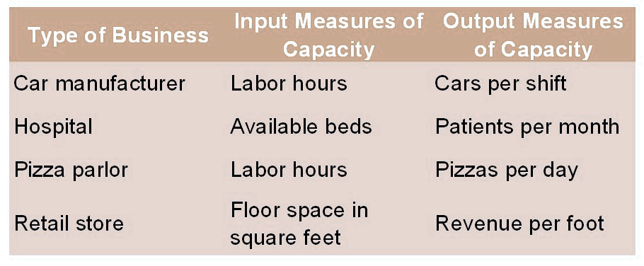
DEFINITIONS
3
MEASURING CAPACITY EXAMPLES
Capacity is the maximum level of output that a company can sustain to make a product or provide a service.
The capacity of the manufacturing unit can be expressed in number of units of output per period.
Planning for capacity requires management to accept limitations on the production process.

Slide 4
4
MEASURING CAPACITY EXAMPLES
Manufacturing And Service Systems
Manufacturing Systems
Service Systems
Produce standardized products in large quantities. This plant and machinery have limited capacity and contribute to the fixed costs which must be borne by the products produced.
The materials input to a manufacturing system are raw materials and energy.
Services are produced and consumed in the presence of the customer and there is little or no opportunity to store value, as in the case of finished goods inventory.
Service systems present uncertainty in terms of both capacity and costs.
Notes:
Download more minimal templates here: https://crmrkt.com/GK9Dwa

Slide 5
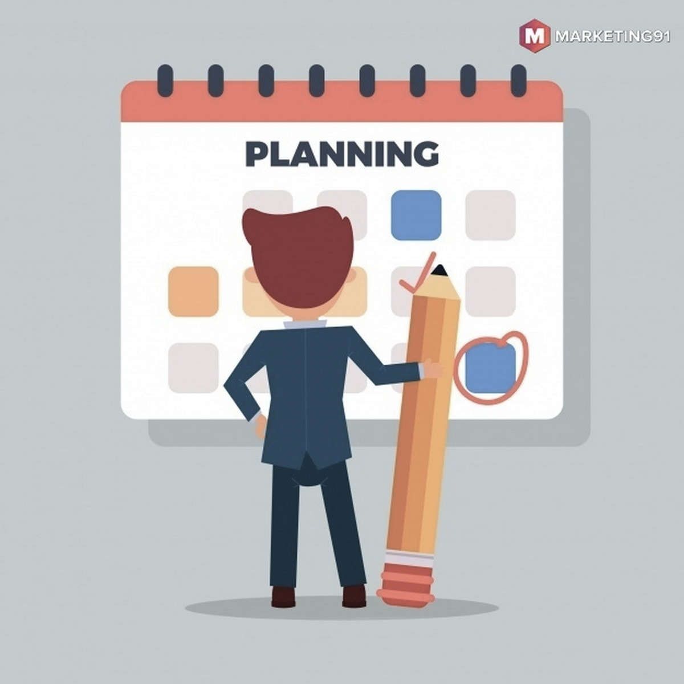
PROCESS OF CAPACITY PLANNING
Manufacturing And Service Systems
5
Capacity planning is concerned with identifying the needs of an organization and deciding how to meet those needs, also determining:
Long-term capacity.
Short-term capacity.
Manufacturing Systems
Service Systems
Produce standardized products in large quantities. This plant and machinery have limited capacity and contribute to the fixed costs which must be born by the products produced.
The materials input to a manufacturing system are raw materials and energy.
Services are produced and consumed in the presence of the customer and there is little or no opportunity to store value, as in the case of finished goods inventory.
Service systems present uncertainty in terms of both capacity and costs.
Notes:
Download more minimal templates here: https://crmrkt.com/GK9Dwa

Slide 6
PROCESS OF CAPACITY PLANNING
6
Capacity planning is concerned with identifying the needs of an organization and deciding how to meet those needs, also determining:
Long-term capacity.
Short-term capacity.
PROCESS OF CAPACITY PLANNING
CONT…
Long-term:
Short-term:
Long-term capacity planning is concerned with accommodating major changes affecting the general level of production in the long run.
The goal of short-term capacity planning is to handle unexpected shifts in demand in an efficient economic manner.

Slide 7
PROCESS OF CAPACITY PLANNING
CONT…
7
LONG-TERM CAPACITY STRATEGIES
Long-range capacity decisions will be affected by the following parameters:
Long-term:
Phasing in capacity
Long-term capacity planning is concerned with accommodating major changes affecting the general level of production in the long run.
Short-term :
The goal of short-term capacity planning is to handle unexpected shifts in demand in an efficient economic manner.
Multiple Products
Phasing out capacity

Slide 8
LONG-TERM CAPACITY STRATEGIES
Phasing in capacity
Multiple Products
Phasing out capacity
8
PROCESS OF CAPACITY PLANNING
CONT…
Long-range capacity decisions will be affected by the following parameters:
Long-term capacity:
Long-term capacity planning is concerned with accommodating major changes affecting the general level of production in the long run.
Short-term capacity:
The goal of short-term capacity planning is to handle unexpected shifts in demand in an efficient economic manner.
Multiple Products
Company’s produce more than one product using the same facilities in order to increase the profit and reduce risk.
CONT…

Slide 9
9
Multiple Products
CONT…
Companies produce more than one product using the same facilities in order to increase the profit and reduce risk.
Notes:
Download more minimal templates here: https://crmrkt.com/GK9Dwa

Slide 10
LONG-TERM CAPACITY STRATEGIES
Phasing in capacity
Multiple Products
Phasing out capacity
10
Long-range capacity decisions will be affected by the following parameters:

Slide 11
11
Phasing in capacity
In high technology industries, and in industries where obsolescence is high. Products must be brought to market quickly.
CONT…
Notes:
Download more minimal templates here: https://crmrkt.com/GK9Dwa

Slide 12
LONG-TERM CAPACITY STRATEGIES
Phasing in capacity
Multiple Products
Phasing out capacity
12
Long-range capacity decisions will be affected by the following parameters:

Slide 13
13
Phasing out capacity
The outdated manufacturing facilities cause excessive plant closures and down time. The impact of closures is not limited to only fixed costs of plant and machinery. The phasing out here is done with humanistic way without affecting the community.
CONT…
Notes:
Download more minimal templates here: https://crmrkt.com/GK9Dwa

Slide 14
LONG-TERM CAPACITY STRATEGIES
Phasing in capacity
Multiple Products
Phasing out capacity
14
Long-range capacity decisions will be affected by the following parameters:
The Short-term Capacity Strategies
Employee training
Backlog
Employment level (hiring or firing)
Subcontracting
Inventories
Process design
The short-term capacity strategies

Slide 15
The Short-term Capacity Strategies
Backlog
Employment level (hiring or firing)
Subcontracting
Inventories
Process design
15
Inventories:
Stock finished goods for the duration of slack periods to meet the demand during peak period.
Backlog:
During peak periods, the willing customers are requested to wait, and their orders are fulfilled after a peak demand period.
Employment level:
Hire additional employees at some stage in peak demand duration and layoff employees as demand decreases.
Employee training:
Develop multi skilled employees through training so that they can be rotated amongst distinctive jobs.
Subcontracting: During peak periods, employ the capacity of other companies temporarily to make the factor components or products.
Process design:
Change job contents by redesigning the job.
Employee training
CONT…
The short-term capacity strategies

Slide 16
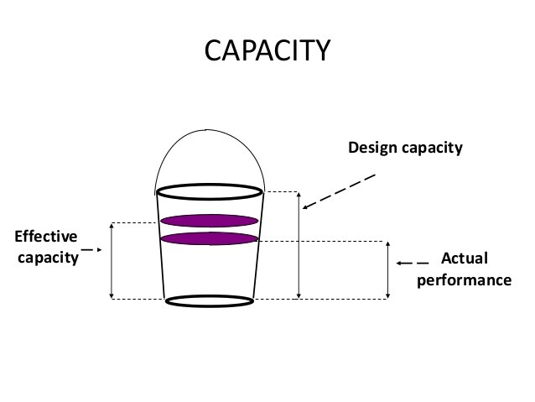
DESIGN & SYSTEM CAPACITY
16
Inventories:
Stock finished goods for the duration of slack periods to meet the demand during peak period.
Backlog:
During peak periods, the willing customers are requested to wait, and their orders are fulfilled after a peak demand period.
Employment level:
Hire additional employees at some stage in peak demand duration and layoff employees as demand decreases.
Employee training:
Develop multi skilled employees through training so that they can be rotated amongst distinctive jobs.
Subcontracting: During peak periods, employ the capacity of other companies temporarily to make the factor components or products.
Process design:
Change job contents by redesigning the job.
Design capacity : maximum output rate or service capacity an operation, process, or facility is designed for.
Effective capacity : Design capacity minus allowances such as personal time, maintenance, and scrap.
Actual output : rate of output achieved, cannot exceed effective capacity.
CONT…
Notes:
Download more minimal templates here: https://crmrkt.com/GK9Dwa

Slide 17
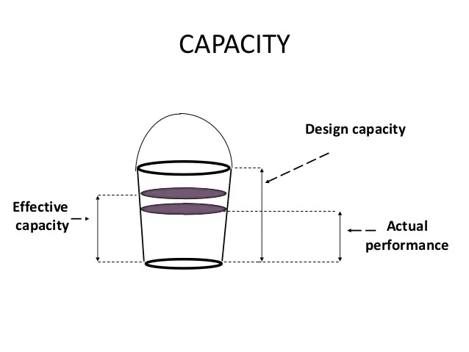
17
3
DESIGN & SYSTEM CAPACITY
Inventories:
Stock finished goods for the duration of slack periods to meet the demand during peak period.
Backlog:
During peak periods, the willing customers are requested to wait, and their orders are fulfilled after a peak demand period.
Employment level:
Hire additional employees at some stage in peak demand duration and layoff employees as demand decreases.
Employee training:
Develop multi skilled employees through training so that they can be rotated amongst distinctive jobs.
Subcontracting: During peak periods, employ the capacity of other companies temporarily to make the factor components or products.
Process design:
Change job contents by redesigning the job.
Design capacity : maximum output rate or service capacity an operation, process, or facility is designed for.
Effective capacity : Design capacity minus allowances such as personal time, maintenance, and scrap.
Actual output : rate of output achieved, cannot exceed effective capacity.
CONT…
EXAMPLES…
Production :
The batch production line of a bakery can produce 12,000 loaves of bread an hour on a fully staffed shift.
Machines :
A robot can sort 10,300 recycling items an hour under ideal conditions such as a high density of objects the robot is able to recognize.
Notes:
Download more minimal templates here: https://crmrkt.com/GK9Dwa

Slide 18
EXAMPLES…
18
Production :
The batch production line of a bakery can produce 12,000 loaves of bread an hour on a fully staffed shift.
Machines :
A robot can sort 10,300 recycling items an hour under ideal conditions such as a high density of objects the robot is able to recognize.
SERVICE CAPACITY
Service capacity is the maximum level of value-added activity over a period that the service process can consistently achieve.
Examples:
The number of calls a customer service agent can handle during a shift
The number of meals served by a restaurant during the lunch time period
The number of repair calls made by a computer service engineer in a day

Slide 19
SERVICE CAPACITY
19
CAPACITY PLANNING
Capacity planning is the process of determining the production capacity needed by an organization to meet changing demands for its products.
Planning for capacity breaks down into three steps:
Service capacity is the maximum level of value-added activity over a period that the service process can consistently achieve.
Examples:
Analyzing Current Capacity
The number of calls a customer service agent can handle during a shift
The number of meals served by a restaurant during the lunch time period
The number of repair calls made by a computer service engineer in a day
Determining Capacity Requirements
Planning For The Future

Slide 20
CAPACITY PLANNING
Analyzing Current Capacity
Determining Capacity Requirements
Planning For The Future
SERVICE CAPACITY
20
Capacity planning is the process of determining the production capacity needed by an organization to meet changing demands for its products.
Planning for capacity breaks down into three steps:
Service capacity is the maximum level of value-added activity over a period that the service process can consistently achieve.
Examples:
The number of calls a customer service agent can handle during a shift
The number of meals served by a restaurant during the lunch time period
The number of repair calls made by a computer service engineer in a day
Capacity decisions have a meaningful impact on an organization's ability to meet future product and service needs; capacity effectively restricts the pace of production that may be produced.
Operating costs are influenced by capacity decisions. In an ideal world, capacity and demand requirements will be matched, resulting in lower operational costs.
Capacity is usually a major determinant of initial cost. Typically, the greater the capacity of a productive unit, the greater its cost.
IMPORTANCE OF CAPACITY DESIGN

Slide 21
21
Capacity decisions have a meaningful impact on an organization's ability to meet future product and service needs; capacity effectively restricts the pace of production that may be produced.
Operating costs are influenced by capacity decisions. In an ideal world, capacity and demand requirements will be matched, resulting in lower operational costs.
Capacity is usually a major determinant of initial cost. Typically, the greater the capacity of a productive unit, the greater its cost.
IMPORTANCE OF
CAPACITY DESIGN
Capacity decisions sometimes entail long-term resource commitments and the knowledge that, once adopted, it may be difficult or impossible to change those decisions without incurring significant expenses.
Capacity decisions can have an impact on a company's competitiveness.
Capacity has an impact on management ease; having adequate capacity makes management easier than having insufficient capacity.
CONT…
Notes:
Download more minimal templates here: https://crmrkt.com/GK9Dwa

Slide 22
Capacity decisions have a meaningful impact on an organization's ability to meet future product and service needs; capacity effectively restricts the pace of production that may be produced.
Operating costs are influenced by capacity decisions. In an ideal world, capacity and demand requirements will be matched, resulting in lower operational costs.
Capacity is usually a major determinant of initial cost. Typically, the greater the capacity of a productive unit, the greater its cost.
IMPORTANCE OF CAPACITY DESIGN
22
To sum up, capacity planning helps determine how services are offered, and the appropriate time frames and staff required to meet current demand and cover all operational costs.
This is an important consideration when establishing yearly budgets to effectively allocate money for expenses.
Capacity decisions sometimes entail long-term resource commitments and the knowledge that, once adopted, it may be difficult or impossible to change those decisions without incurring significant expenses.
Capacity decisions can have an impact on a company's competitiveness.
Capacity has an impact on management ease; having adequate capacity makes management easier than having insufficient capacity.
CONT…
Conclusion
Notes:
Download more minimal templates here: https://crmrkt.com/GK9Dwa

Slide 23
23
3
To sum up, capacity planning helps determine how services are offered, and the appropriate time frames and staff required to meet current demand and cover all operational costs.
This is an important consideration when establishing yearly budgets to effectively allocate money for expenses.
Capacity decisions sometimes entail long-term resource commitments and the knowledge that, once adopted, it may be difficult or impossible to change those decisions without incurring significant expenses.
Capacity decisions can have an impact on a company's competitiveness.
Capacity has an impact on management ease; having adequate capacity makes management easier than having insufficient capacity.
CONT…
Conclusion
12
References
S Anil Kumar, and N Suresh. Operations Managment. New Dehli [U.A.] New Age Internat. Limited Publ, 2009.
Caggiano, Alessandra. “Manufacturing System.” CIRP Encyclopedia of Production Engineering, 2014, pp. 830–836, link.springer.com/referenceworkentry/10.1007%2F978-3-642-20617-7_6562, 10.1007/978-3-642-20617-7_6562.
Greasley, Andrew. “Long-Term Capacity Planning.” SAGE Knowledge, SAGE Publications Ltd, 2008, sk.sagepub.com/books/operations-management/n6.xml#:~:text=Term%20Capacity%20Planning-. Accessed 1 Jan. 2022.
“Capacity Planning for Service Organizations: The Value of Scaling Your Business.” Www.wolterskluwer.com, www.wolterskluwer.com/en/expert-insights/the-value-of-capacity-planning-process.
“Capacity Planning - Organization, System, Examples, Definition, System, Long-Term Capacity Planning.” Referenceforbusiness.com, 2014, www.referenceforbusiness.com/management/Bun-Comp/Capacity-Planning.html.
“Capacity Planning - Organization, System, Examples, Definition, System, Long-Term Capacity Planning.” Www.referenceforbusiness.com, www.referenceforbusiness.com/management/Bun-Comp/Capacity-Planning.html#:~:text=In%20the%20short%20term%2C%20capacity. Accessed 1 Jan. 2022.
Notes:
Download more minimal templates here: https://crmrkt.com/GK9Dwa

Slide 24
References
24
S Anil Kumar, and N Suresh. Operations Managment. New Dehli [U.A.] New Age Internat. Limited Publ, 2009.
Caggiano, Alessandra. “Manufacturing System.” CIRP Encyclopedia of Production Engineering, 2014, pp. 830–836, link.springer.com/referenceworkentry/10.1007%2F978-3-642-20617-7_6562, 10.1007/978-3-642-20617-7_6562.
Greasley, Andrew. “Long-Term Capacity Planning.” SAGE Knowledge, SAGE Publications Ltd, 2008, sk.sagepub.com/books/operations-management/n6.xml#:~:text=Term%20Capacity%20Planning-. Accessed 1 Jan. 2022.
“Capacity Planning for Service Organizations: The Value of Scaling Your Business.” Www.wolterskluwer.com, www.wolterskluwer.com/en/expert-insights/the-value-of-capacity-planning-process.
“Capacity Planning - Organization, System, Examples, Definition, System, Long-Term Capacity Planning.” Referenceforbusiness.com, 2014, www.referenceforbusiness.com/management/Bun-Comp/Capacity-Planning.html.
“Capacity Planning - Organization, System, Examples, Definition, System, Long-Term Capacity Planning.” Www.referenceforbusiness.com, www.referenceforbusiness.com/management/Bun-Comp/Capacity-Planning.html#:~:text=In%20the%20short%20term%2C%20capacity. Accessed 1 Jan. 2022.
THANK YOU

Slide 25
25
THANK YOU
Notes:
Download more minimal templates here: https://crmrkt.com/GK9Dwa

