Slide 1


Types of Managers
Libyan International Medical University
Faculty of Business Administration
Name: Jude Boughalia 3766
Email: joud_3766@limu.edu.ly

Slide 2
Table of Contents
01
02
03
Introduction
Types of Managers
Conclusion
02

Slide 3
Introduction
Managers are found at multiple levels in an organization. They may lead an entire organization as Rose Marie Bravo did at Burberry; or they may head functions, departments, or units.
03

Slide 4

Types of Managers
The three main types of managers:
general managers.
functional managers.
frontline managers.
04

Slide 5
General Managers
They are responsible for the overall performance of an organization or one of its major self-contained subunits or divisions. In small companies, the general manager may be one of the top executives. They ensure strategic goals are met by setting operational policies, creating and maintaining budgets, managing employees, and more.
05

Slide 6
Functional Managers
They are responsible for a task, activity, or operation such as accounting, marketing, sales, R&D, production, information technology, or logistics. The functional manager is the person who has management authority within a business unit/department with direct supervision over one or more resources on the project/program team.
06

Slide 7
Frontline Managers
manage employees who are themselves not managers. They are found at the lowest level of the management hierarchy. Front-line employees are an essential part of customer service. They greet customers, handle issues and answer questions. By creating positive interactions, they may increase the number of sales and improve customer satisfaction.
07

Slide 8
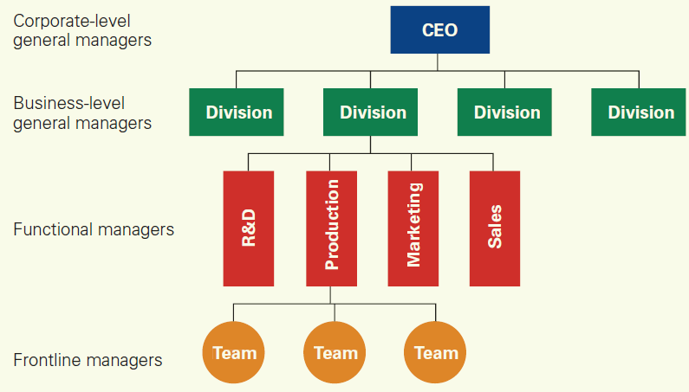
08

Slide 9
In Conclusion
There are different types of managers, each and every one of them is as important as the others and has its own tasks that is different from the others.
09

Slide 10
References
Types of managers in principles of management tutorial 06 April 2022 - learn types of managers in principles of management tutorial (9218): Wisdom Jobs India. Wisdom Jobs. (n.d.). Retrieved April 5, 2022, from https://www.wisdomjobs.com/e-university/principles-of-management-tutorial-293/types-of-managers-9218.html
Banton, C. (2022, February 8). General manager (GM). Investopedia. Retrieved April 5, 2022, from https://www.investopedia.com/terms/g/general-manager.asp#:~:text=A%20general%20manager%20(GM)%20is,one%20of%20the%20top%20executives.
Functional manager. IST Project Management Office. (2017, February 9). Retrieved April 5, 2022, from https://uwaterloo.ca/ist-project-management-office/methodologies/roles-and-responsibilities/functional-manager#:~:text=The%20functional%20manager%20is%20the,%2Fprogram%20deliverable(s).

Slide 11
Thanks!

