Slide 1



Relation between Obesity and Diabetes
Name Najwa Zuwawa
ID. 2851
MSS Group 6

Slide 2
Objectives
Define obesity and Diabetes
Outline Types of Diabetes
Explain Relation between Obesity and Diabetes
Demonstrate Body Mass Index
Clarify Complication of Diabetes

Slide 3
Introduction
Obesity is caused by the accumulation of excess body fat. It impairs health to a great extent especially by raising the risk of other chronic illnesses such as heart disease and diabetes.

Slide 4
Obesity
Obesity is a complex disorder involving an excessive amount of body fat. Obesity isn't just a cosmetic concern. It increases your risk of diseases and health problems, such as heart disease, diabetes and high blood pressure.

Slide 5
Diabetes
Diabetes is a group of disorders characterized by chronic high blood glucose levels (hyperglycemia) due to the body's failure to produce any or enough insulin to regulate high glucose levels.

Slide 6
Types of Diabetes
There are two main types of diabetes. Type 1 diabetes, which often occurs in children or adolescents, is caused by the body's inability to make insulin.
type 2 diabetes, which occurs as a result of the body's inability to react properly to insulin (insulin resist

Slide 7
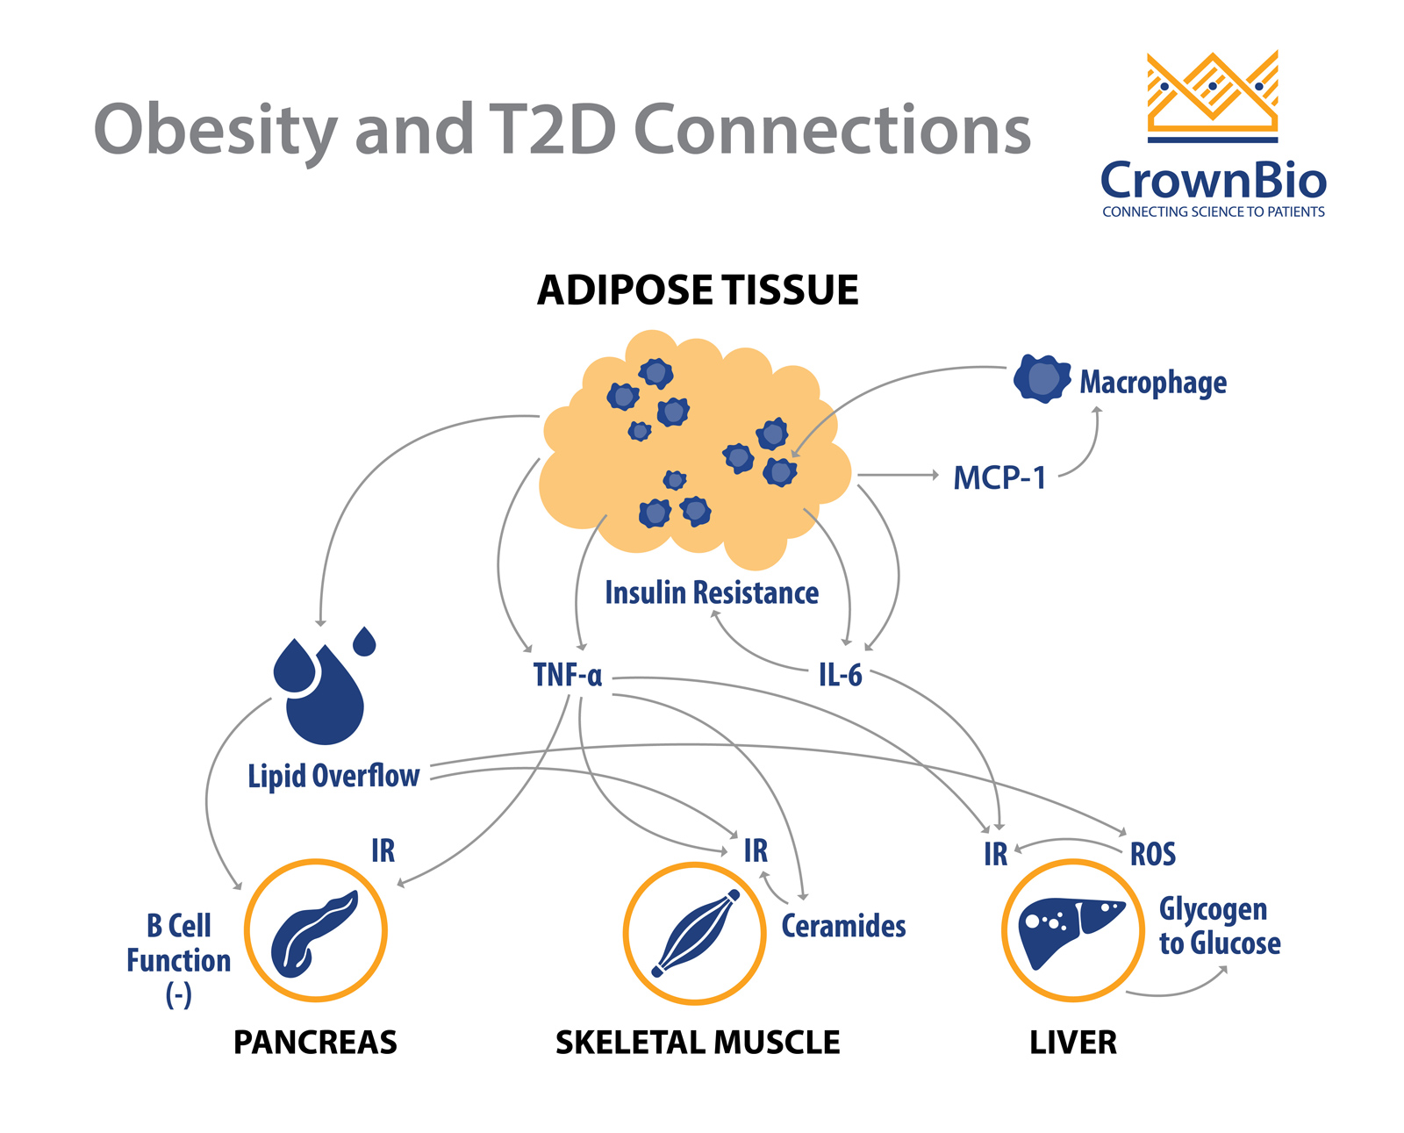
Relation between Obesity and Diabetes
Being overweight increases the chances of developing the common type of diabetes, type 2 diabetes. In this disease, the body makes enough insulin but the cells in the body have become resistant to the salutary action of insulin.

Slide 8
How does Weight Relate to Diabetes?
There are many risk factors for type 2 diabetes such as age, race, pregnancy, stress, certain medications, genetics or family history, high cholesterol and obesity.
People who are overweight or have obesity have added pressure on their body's ability to use insulin to properly control blood sugar levels, and are therefore more likely to develop diabetes
UNDERWEIGHT
NORMAL
OVERWEIGHT
OBESE
<18,5
18,5 - 24,9
25 - 29,9
30 - 34,9

Slide 9
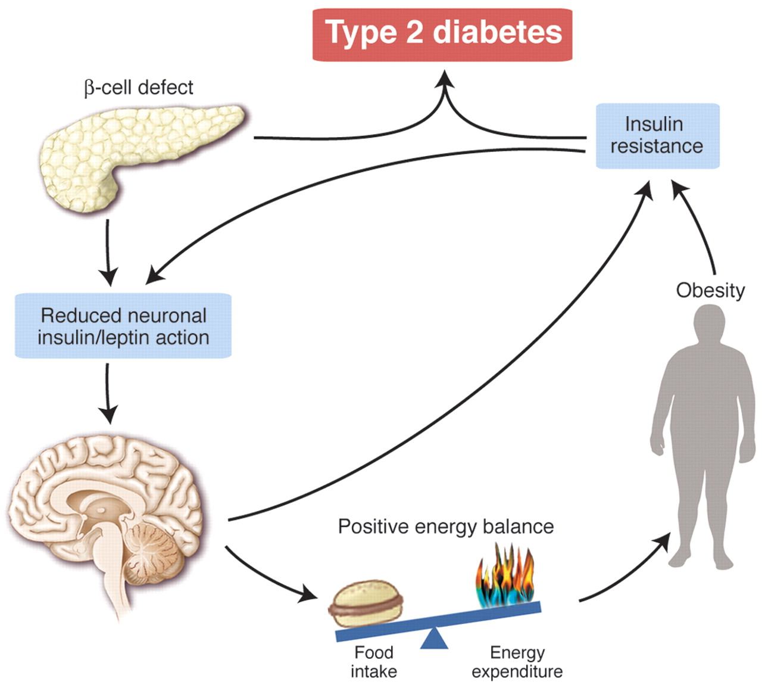
How does Weight Relate to Diabetes

Slide 10
Body Mass Index
Weight status | BMI
Underweight | Below 18.5
Normal | 18.5 - 24.9
Overweight | 25.0 - 29.9
Obese class 1 | 30.0 – 34.9
Obese class 2 | 35.0 - 39.9
Extreme Obesity class 3 | Above 40
However, the best predictor of type 2 diabetes is overweight or obesity. Almost 90% of people living with type 2 diabetes are overweight or have obesity.

Slide 11
Complication of Diabetes
Being overweight increases the chances of developing the common type of diabetes, type 2 diabetes. In this disease, the body makes enough insulin but the cells in the body have become resistant to the salutary action of insulin.

Slide 12
Summary
Obesity is a chronic metabolic disease affecting adults and children worldwide. It has become one of the leading cause of death.
Obesity is known to be the main risk factor for a number of non-communicable diseases, in particular type 2 diabetes.

Slide 13
References
Mokdad A, Ford E, Bowman B, Dietz W, Vinicor F, Bales V et al. Prevalence of Obesity, Diabetes, and Obesity-Related Health Risk Factors, 2001. 2022.
Understanding obesity and type 2 diabetes [Internet]. Obesity Action Coalition. 2012 [cited 2022 May 31]. Available from: https://www.obesityaction.org/get-educated/public-resources/brochures-guides/understanding-obesity-and-type-2-diabetes-brochure/

Slide 14
THANK YOU

