Slide 1
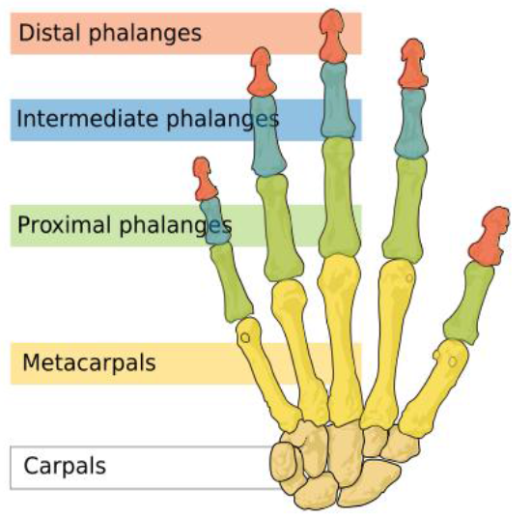
Hand examination

Slide 2
Finger joints

Slide 3
Hand examination
1- Introduce yourself to the patient.
2- Explain the procedure to the patient.
3- Ask patient to roll up his/her sleeves and Place both arms out in front, elbows bent 90º, palms down, fingers straight on the below.
4- Examine patient in good light and warm surrounding.

Slide 4
Inspection
a- Compare the two sides.
b- Look for the normal contour of the joints.
c- Compare the joints and overlying structures (skin, muscle, tendon) on each side.
d- Stretch of skin (fattening of skin creases), nails for pitting, splinter hemorrhage ,clubbing and periungual erythema.
e- Look for :
Redness
Rash
Scars
Swelling
Deformity
Wasting in palmer and dorsal side

Slide 5
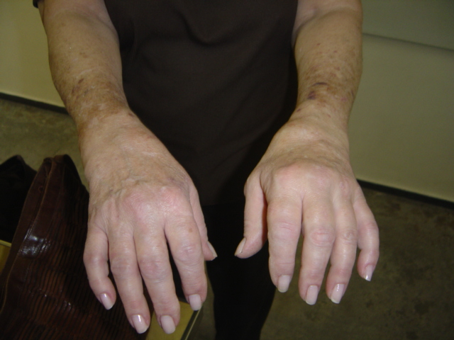
Notes:
BOTH WRIST MCP SYMMETRICAL

Slide 6
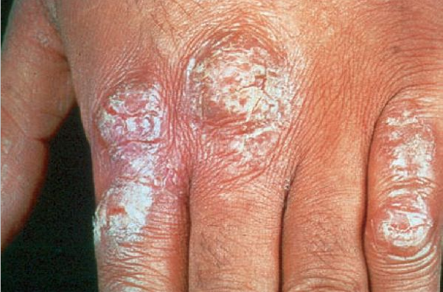
PSORIASIS RASH

Slide 7
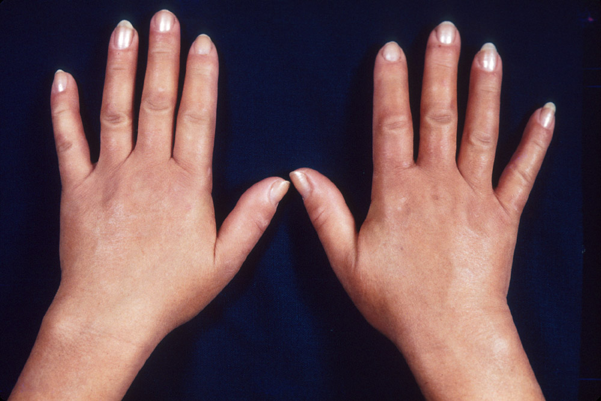

Slide 8
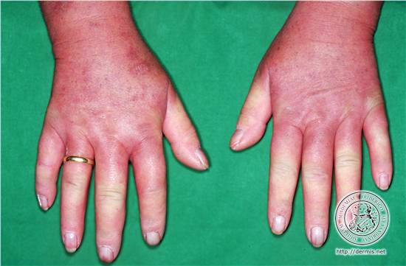

Slide 9
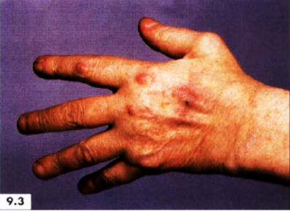
Notes:
Sub cutenoud nodules

Slide 10
periungual erythema

Slide 11
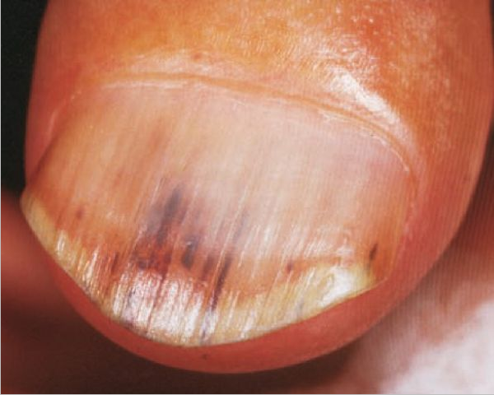
SPLINTER HEMOORRAGE

Slide 12
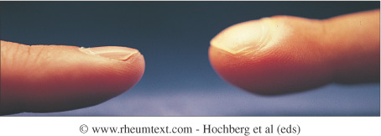
CLUBBING

Slide 13
CLUBBING

Slide 14
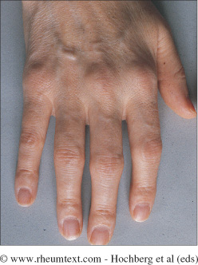
Early swelling

Slide 15
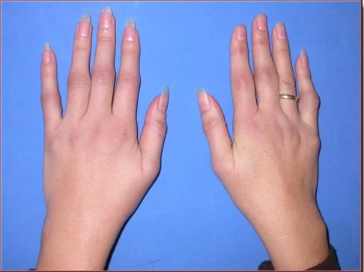
Notes:
MULTIPLE REDNESS SWELLING MCP PIP

Slide 16
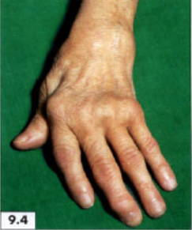
Notes:
Swelling wrist –MCPS PIP23-HEBREDEN ON MIDDLE ULNAR DEVIATION WASTING OF MYSCLES EARLY Z DEF THUMB

Slide 17
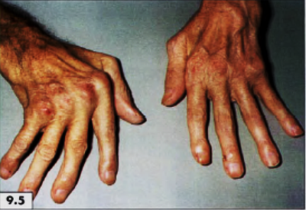

Slide 18
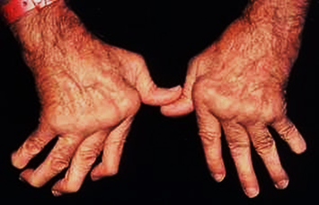

Slide 19
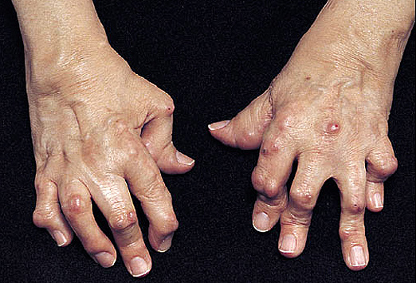

Slide 20
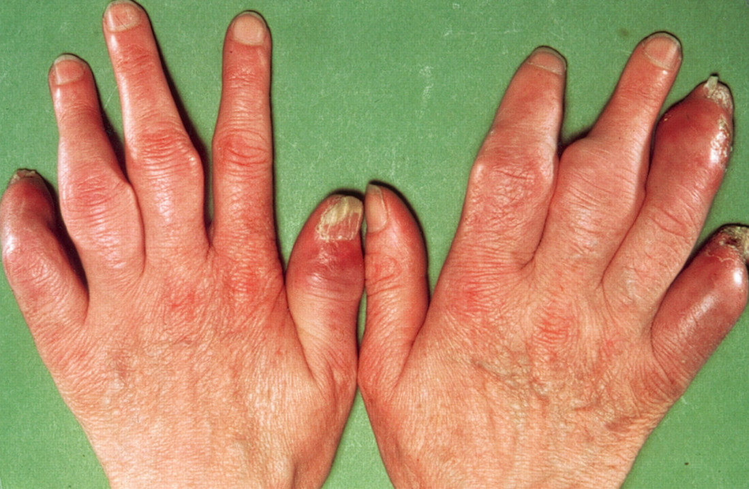
Notes:
FINGERS NAIL DYSTROPHY PIP SYNOVITIS ERYTHEMA ASYMMETRICAL

Slide 21
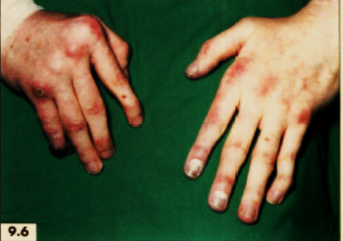
Notes:
MCP SWELING SWAN NECK

Slide 22
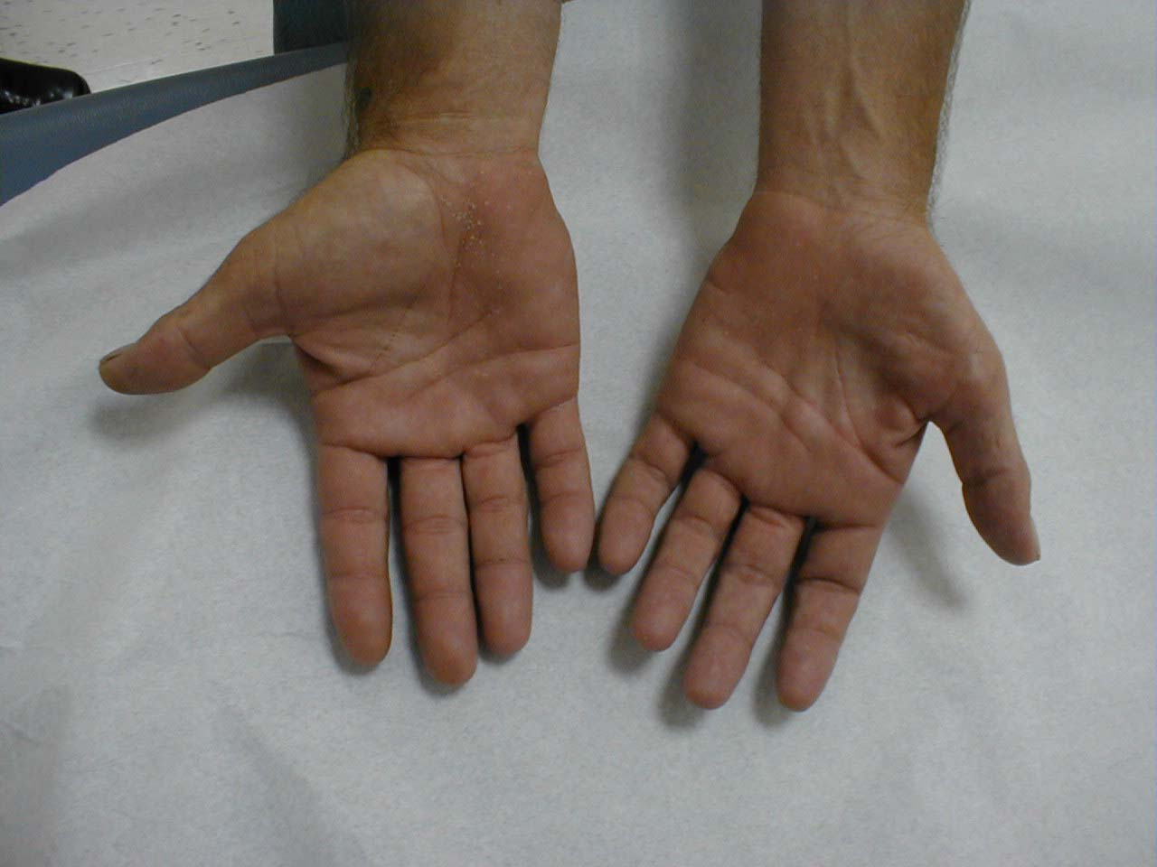
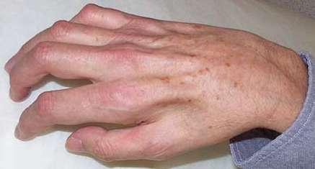
Muscle wasting
Muscle wasting

Slide 23
Notes:
PA;MAR ERYTHEMA ULNAR DEVIATION

Slide 24
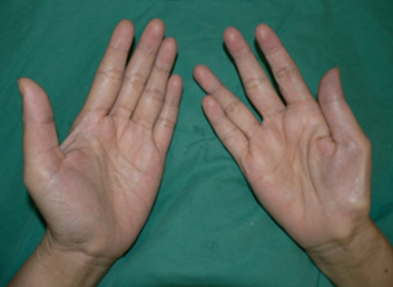
Notes:
THENAR M WASTING RT

Slide 25
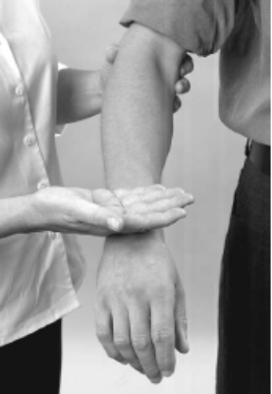
Palpation
Compare temperature
Examine each major joint.
a- Palpate for looking for changes in temperature using the back of the hand over the joints and compare with opposite side and dorsum of the fore arm.

Slide 26
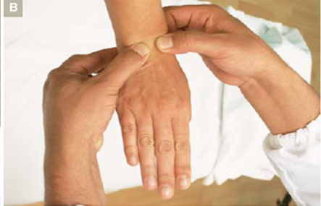
PALPATION OF WRIST JOINT
PALPATION OF WRIST JOINT
b-Encircle patient wrist using both hands support the patient wrist with finger pads of both your index fingers and use your thumb pads to palpate tenderness and fluctuating swelling over wrist .

Slide 27
PALPATION OF MCP JOINTS
C- Use finger pads of both your index fingers and use your thumb pads to palpate tenderness and fluctuating swelling over metacarpophalangeal joints.

Slide 28
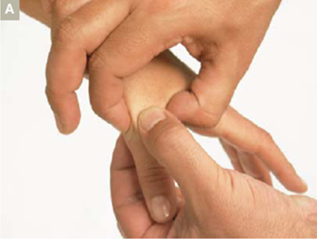
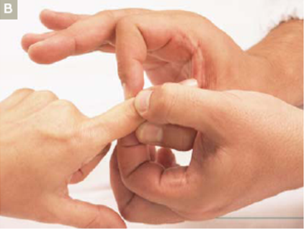
4-palpate for tenderness and fluctuation in PIP and DIP joints by using your left thumb and index fingers in a vertical plane and your right index and thumb in horizontal plane .

Slide 29
Active range of Motion
Compare both sides.
Ask the patient to move each joint through a full range of motion and note the degree and type (pain, weakness) of any limitations or any increased range of motion .
a- Fingers: flexion/extension; abduction/adduction .
b-metacarpophalangeal joints: flexion and extension.
c-Thumb: flexion/extension; abduction/adduction; opposition
d-Wrist: flexion/extension; radial/ulnar deviation .

Slide 30
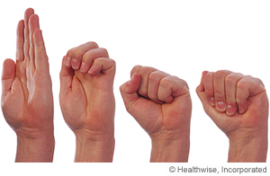
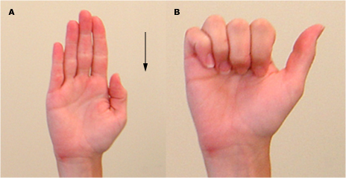
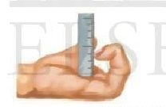
LIMITION OF FINGER FLEXION

Slide 31
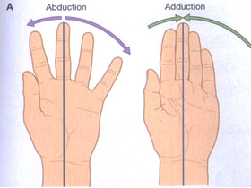
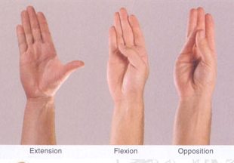
THUMB

Slide 32
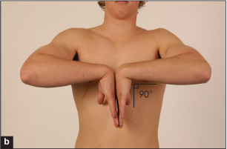
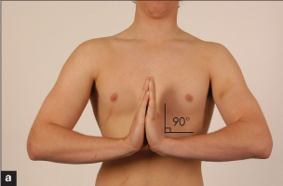

Slide 33
passive range of motion
Confirm range of movement and assess for end of movement tenderness
Fingers - flexion/extension.
Metacarpophalangeal joints flexion and extension.
Wrist - flexion/extension.

Slide 34
special tests
Phalen's Test (Median Nerve)
Ask the patient to press the back of the hands together with the wrists fully flexed.
Have the patient hold this position for 60 seconds and then ask patient to comment on how the hands feel.
(Pain, tingling, or other abnormal sensations in the thumb, index, or middle fingers strongly suggest carpal tunnel syndrome)
Tinel's Sign (Median Nerve)
Use your middle finger or a reflex hammer to tap over the carpal tunnel ask patient to comment on how the hands feel.
(Pain, tingling, or electric sensations strongly suggest carpal tunnel syndrome)

Slide 35
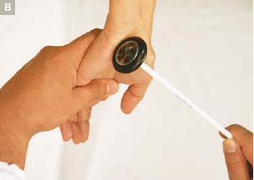

Slide 36
Median nerve distribution of paraesthesias in the right hand

Slide 37
Cover & thank the patient

Slide 38
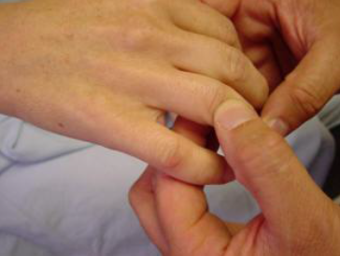
WRONG

Slide 39
