Slide 1


The effect of schizophrenia on your life
Presented by: Lamia Hani Ben ghuzzi
3004
Second year Med student
May15,2022
1

Slide 2

2

Slide 3

Define Schizophrenia
Explain the symptoms in schizophrenia
Outline cognitive problems of schizophrenia
Hospitalizations for mental illness
Management of schizophrenia
3

Slide 4
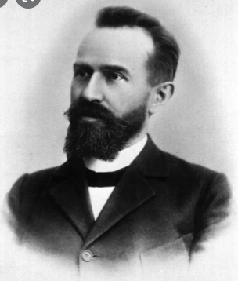
Definition of Schizophrenia
Schizophrenia is a mantel disorder also called mental illness or psychiatric disorders .
Behavioral or mental pattern that causes significant distress or impairment of personal functioning.
Paul Eugene Bleuler is a psychiatrist who coined the terms "schizophrenia“ in 1908 .
4

Slide 5

The symptoms in schizophrenia
Positive Symptoms of Schizophrenia
Negative Symptoms
of Schizophrenia
Hallucinations
Agitation
Hostility
Bizarre Behaviors
Disorganized Speech
Restricted emotion
Social withdrawal
Dependency
Over thinking
Lack of self-care
Sleep disturbance
5

Slide 6
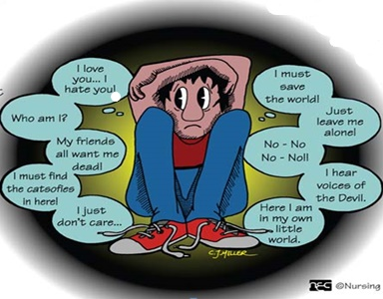
6

Slide 7
Cognitive problems of schizophrenia
Deficits processing of complex information.
Maintaining a steady focus of attention.
Working memory.
Distinguishing between relevant stimulit.
Abstract thinking.
7

Slide 8
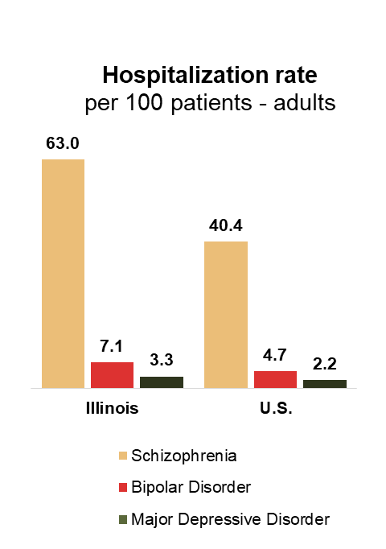
Hospitalizations for mental illness
8

Slide 9

Are patients with schizophrenia more likely to be violent ?
No, individuals with schizophrenia are more likely to be Victims of violence than perpetrators.
9

Slide 10
Course of Schizophrenia
Good
Function
Psycho-
pathology
Premorbid
Progression
Stable
Relapsing
Poor
15
20
30
40
50
60
70
Age (Years)
10

Slide 11

Management of schizophrenia
Psychological Treatments :
Social skills training
Self sufficiency
Act appropriately in public
11

Slide 12
Pharmacological Treatments :
Major drugs used in treating schizophrenia :
First-generation drugs :
Chlorpromazine.
Trifluoperazie .
Second-generation drugs :
Clozapine .
Olanzapine .
12

Slide 13
Conclusion
To sum up , nightmare schizophrenic they don’t know where the truth imagine the people , places and important moment in their life not gone , not did the worst never happened.
13

Slide 14

References
1- Sheitman BB, Lieberman JA. The natural history and pathophysiology of treatment-resistant schizophrenia.
J Psychiatr Res. 2016(May-Aug);32(3-4):143-150 .
2- Healthcare Cost and Utilization Project (HCUPnet) 2014 .
3- Freedman, R., 2018. Schizophrenia.
14

Slide 15

15

