Slide 1

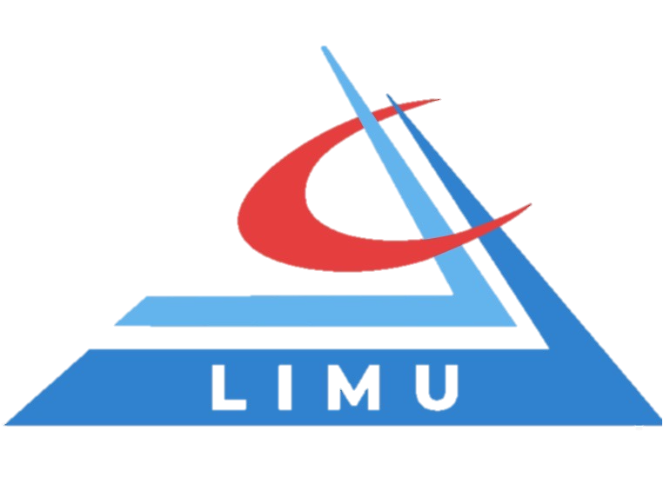
Customer-Driven Strategy
Libyan International Medical University
Faculty of Business Administration
Name: Jude Mahmoud Boughalia 3766
Email: joud_3766@limu.edu.ly

Slide 2
Table of Contents
01
02
03
04
Introduction
Definition of Customer-Driven Strategy
Example
Creating a Customer-Driven Strategy
05
Elements of Customer-Driven Strategy
06
Conclusion
02

Slide 3
Introduction
Rather than thinking about your business or your product and how you're going to market them, you start by thinking about your customers, Who are they? And How can you help solving their problems?.
03

Slide 4
Definition of Customer- Driven Strategy?
It's a strategy of marketing activities of a given company, which as its main goal is to meet the expectations and needs of customers.
04

Slide 5
—from Peter Drucker
“The aim of marketing is to know the customer so well that the product or service fits him and sells itself.”
05

Slide 6
For Example
Restaurants often use customer-driven strategies with their salad and dessert bars. Allowing customers to choose the ingredients and dressing they like.
06

Slide 7
Creating a Customer-Driven Strategy
In order to create a customer-driven marketing strategy, you must first define the exact goal that you want to achieve as an organization.
07

Slide 8
The Elements of Customer-Driven Strategy
A customer-driven marketing strategy includes elements like identifying your target market and reacting to their needs. It should also detail ways to retain customers and use them to help you gain additional business.
08

Slide 9
The 5 Elements of Customer-Driven Strategy
1. Target Your Market.
2. Meet-Customer Needs.
3. Build Customer Loyalty.
4. Use Customer Feedback.
5. Gain Customer Referrals.
09

Slide 10
In Conclusion
You have to know your customer pretty well in process to offer him a product that he can’t resist.
10

Slide 11
References
Brenner, M. (2021, October 25). How to build a customer-driven marketing strategy for 2022. Marketing Insider Group. Retrieved March 29, 2022, from https://marketinginsidergroup.com/marketing-strategy/customer-driven-marketing-strategy/amp/
Vujasin, M., & *, N. (2021, February 24). Customer-driven marketing strategy. Paldesk. Retrieved March 29, 2022, from https://www.paldesk.com/what-is-customer-driven-marketing-strategy/
Customer Driven Marketing Strategy. LiveAgent. (2021, December 7). Retrieved March 29, 2022, from https://www.liveagent.com/customer-support-glossary/customer-driven-marketing-strategy/
Suttle, R. (2017, November 21). Customer Driven Marketing Strategies. Small Business - Chron.com. Retrieved March 29, 2022, from https://smallbusiness.chron.com/customer-driven-marketing-strategies-3227.html

Slide 12
Thanks!
Any questions?

