Slide 1
E&M commerce
Amin Osman
4109

Slide 2
E-commerce and M-commerce
e-commerce: Involves the exchange of money for goods and services over electronic networks and encompasses many of an organization’s outward facing processes—such as sales, marketing, order taking, delivery, procurement of goods and services, and customer service—that touch customers, suppliers, and other business partners.
Mobile commerce (m-commerce): is the buying and selling of goods and/or services using a mobile device, such as a tablet, smartphone, or other portable device.

Slide 3
Different e-commerce and business applications
business-to-business (B2B) e-commerce: A subset of e-commerce in which all the participants are organizations, B2B e-commerce is a useful tool for connecting business partners in a virtual supply chain to cut resupply times and reduce costs.
business-to-consumer (B2C) e-commerce: A form of e-commerce in which customers deal directly with an organization and avoid intermediaries, Early B2C pioneers competed with the traditional “brick-and-mortar” retailers in an industry, selling their products directly to consumers.
consumer-to-consumer (C2C) e-commerce: A subset of e-commerce that involves electronic transactions between consumers using a third party to facilitate the process, eBay is an example of a C2C e-commerce site; customers buy and sell items to each other through the site.
E-government is the use of information and communications technology to simplify the sharing of information, speed formerly paper-based processes, and improve the relationship between citizens and government. Government-to-citizen (G2C), government-to-business (G2B), and government-to-government (G2G) are all forms of e-government, each with different applications.
Citizens can use G2C applications to submit their state and federal tax returns online, renew auto licenses, purchase postage, and apply for student loans.
G2B applications support the purchase of materials and services from private industry by government procurement offices, enable firms to bid on government contracts, and help businesses identify government contracts on which they may bid.
G2G applications support transactions between government entities, such as between the federal government and state or local governments.

Slide 4


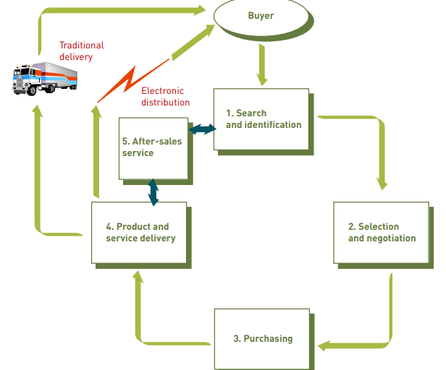
Multistage model for e-commerce
A successful e-commerce system must address the many stages that consumers experience in the sales life cycle. At the heart of any e-commerce system is the user’s ability to search for and identify items for sale; select those items and negotiate prices, terms of payment, and delivery date; send an order to the vendor to purchase the items; pay for the product or service; obtain product delivery; and receive after-sales support.
Search and Identification
Select and Negotiate
Purchase Products and Services Electronically
Deliver Products and Services
After-Sales Service

Slide 5
Challenges to convert to e-commerce
Dealing with Consumer Privacy Concerns: about one-third of all adult Internet users will not buy anything online primarily because they have privacy concerns or lack trust in online merchants. In addition to having an effective e-commerce model and strategy, companies must carefully address consumer privacy concerns and overcome consumers’ lack of trust.
Overcoming Consumers’ Lack of Trust: Lack of trust in online sellers is one of the most frequently cited reasons that some consumers give to explain why they are unwilling to purchase online. Can they be sure that the company or person with which they are dealing is legitimate and will send the item(s) they purchase? What if there is a problem with the product or service when it is received: for example, if it does not match the description on the Web site, is the wrong size or wrong color, is damaged during the delivery process, or does not work as advertised?
Overcoming Global Issues:-
Cultural challenges. Great care must be taken to ensure that a Web sites appealing, easy to use, and inoffensive to potential customers around the world.
Language challenges. Language differences can make it difficult to understand the information and directions posted on a Web site.
Time and distance challenges. Significant time differences make it difficult for some people to be able to speak to customer services representatives or to get technical support during regular waking hours.
Infrastructure challenges. The Web site must support access by customers using a wide variety of hardware and software devices.
Currency challenges. The Web site must be able to state prices and accept payment in a variety of currencies
State, regional, and national law challenges. The Web site must operate in conformance to a wide variety of laws that cover a variety of issues, including the protection of trademarks and patents, the sale of copyrighted material, the collection and safeguarding of personal or financial data, the payment of sales taxes and fees, and much more

Slide 6
Key components of technology infrastructure
Hardware: A Web server hardware platform complete with the appropriate software is a key ingredient to e-commerce infrastructure.
Web Server Software: In addition to the Web server operating system, each e-commerce Web site must have Web server software to perform fundamental services, including security and identification, retrieval and sending of Web pages, Web site tracking, Web site development, and Web page development.
E-Commerce Software: After you have located or built a host server, including the hardware, operating system, and Web server software, you can begin to investigate and install e-commerce software to support five core tasks: catalogue management to create and update the product catalogue, product configuration to help customers select the necessary components and options, shopping cart facilities to track the items selected for purchase e-commerce transaction processing, and Web traffic data analysis to provide details to adjust the operations of the Web site.
Mobile Commerce Hardware and Software: For m-commerce to work effectively, the interface between the mobile device and its user must improve to the point that it is nearly as easy to purchase an item on a wireless device as it is to purchase it on a PC. In addition, network speeds must continue to improve so that users do not become frustrated.
Electronic Payment Systems: Electronic payment systems are a key component of the e-commerce infrastructure. Current e-commerce technology relies on user identification and encryption to safeguard business transactions. Actual payments are made in a variety of ways, including electronic cash, electronic wallets, and smart, credit, charge, and debit cards.

Slide 7
Advantages and disadvantages of e-commerce
Advantages :
Reduce Costs: By eliminating or reducing time-consuming and labour-intensive steps throughout the order and delivery process, more sales can be completed in the same period and with increased accuracy. With increased speed and accuracy of customer order information, companies can reduce the need for inventory—from raw materials to safety stocks and finished goods—at all the intermediate manufacturing, storage, and transportation points.
Speed the Flow of Goods and Information: When organizations are connected via e-commerce, the flow of information is accelerated because electronic connections and communications are already established. As a result, information can flow easily, directly, and rapidly from buyer to seller.
Increase Accuracy: By enabling buyers to enter their own product specifications and order information directly, human data-entry error on the part of the supplier is eliminated.
Improve Customer Service: Increased and more detailed information about delivery dates and current status can increase customer loyalty. In addition, the ability to consistently meet customers’ desired delivery dates with high-quality goods and services eliminates any incentive for customers to seek other sources of supply.
Disadvantages :
Lack of Privacy. To some extent, the privacy of a customer is compromised in eCommerce.
Fear.
Product Suitability.
Cultural Obstacles.
Technical Limitations.
Huge Technological Cost.

Slide 8
Resources
principles-of-information-systems 9th edition.pdf
principles-information-systems-13th.pdf
https://www.shiprocket.in/blog/ecommerce-limitations/

