Slide 1


Electron - cigarettes
Ibrahim saad
3381
First year – PTS
2022 \ 6 \4

Slide 2
Objectives
Definition of E-cigarettes
Outline the components of E-cigarettes
List the Advantages & Disadvantages of E-cigarettes
Comparative between E-cigarette and normal cigarettes
Vaping safer than smoking
1

Slide 3
Introduction
The e-cigarette was invented in 2003 by Chinese pharmacist Hon Lik, who initially developed the device to serve as an alternative to conventional smoking
2

Slide 4

What are the e-cigarettes ?
3

Slide 5
Why do teenagers use E-cigarettes ?
4

Slide 6
2,000,060
5

Slide 7
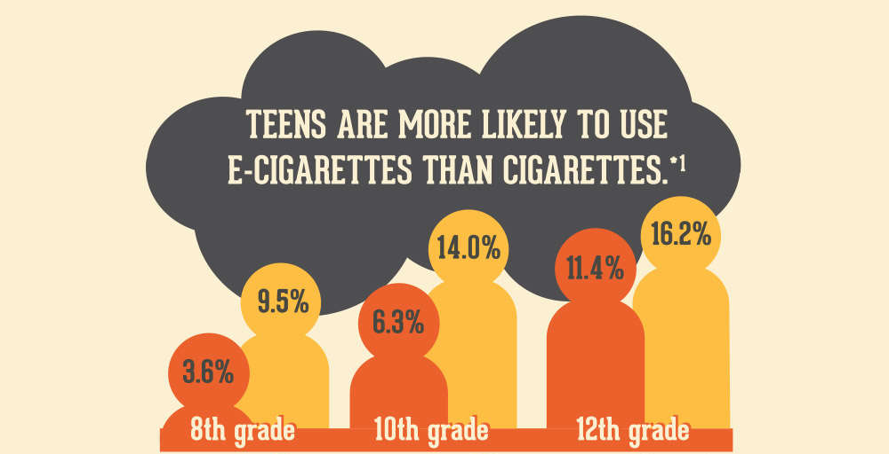
Continuous…
6

Slide 8
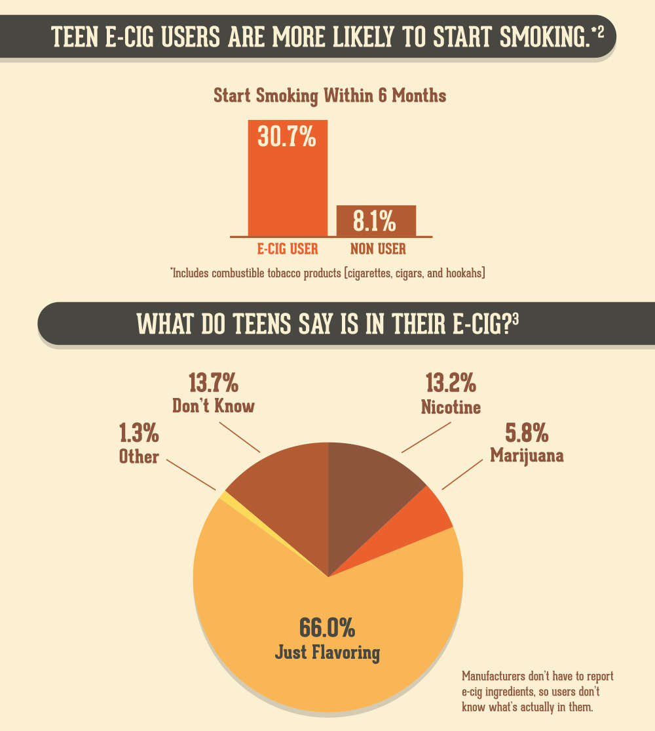
Continuous…
7

Slide 9
Continuous…
8

Slide 10
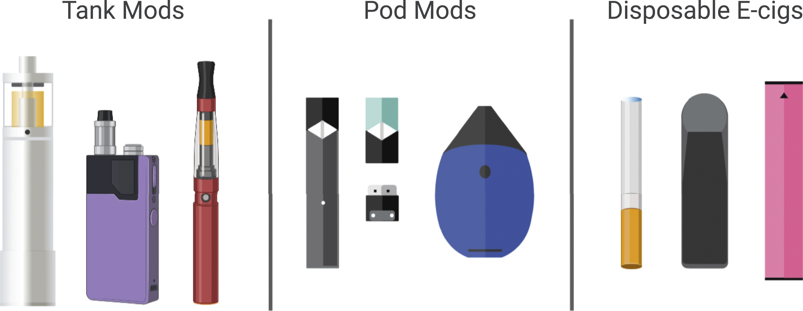
Components of E-cigarettes
9

Slide 11
Continuous
Pod, which holds a liquid solution (e-liquid or e-juice) containing varying amounts of nicotine, flavorings, and other chemicals.
Heating element (atomizer)
Power source (usually a battery)
Mouthpiece that the person uses to inhale.
10

Slide 12
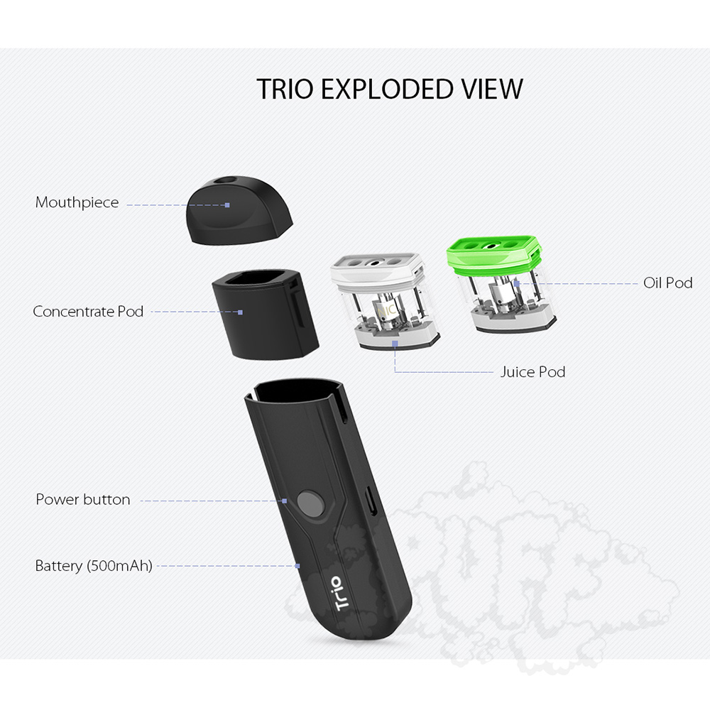
Continuous…
11

Slide 13
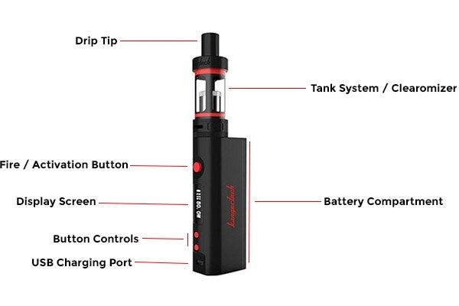
Continuous…
12

Slide 14
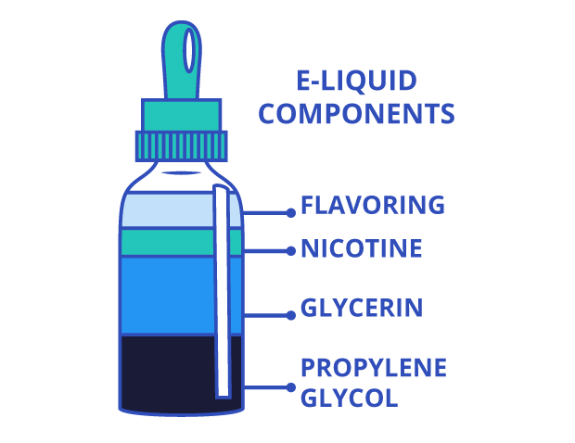
Continuous…
13

Slide 15

Advantages & Disadvantages of E-cigarettes
14

Slide 16
Advantages
Can help some people quit smoking
Usually cheaper than smoking.
It is much less harmful than smoking
Less harmful to those around you than smoking
15

Slide 17
Disadvantages
Coughing.
Dry mouth and throat.
Shortness of breath.
Mouth and throat irritation.
Headache
16

Slide 18
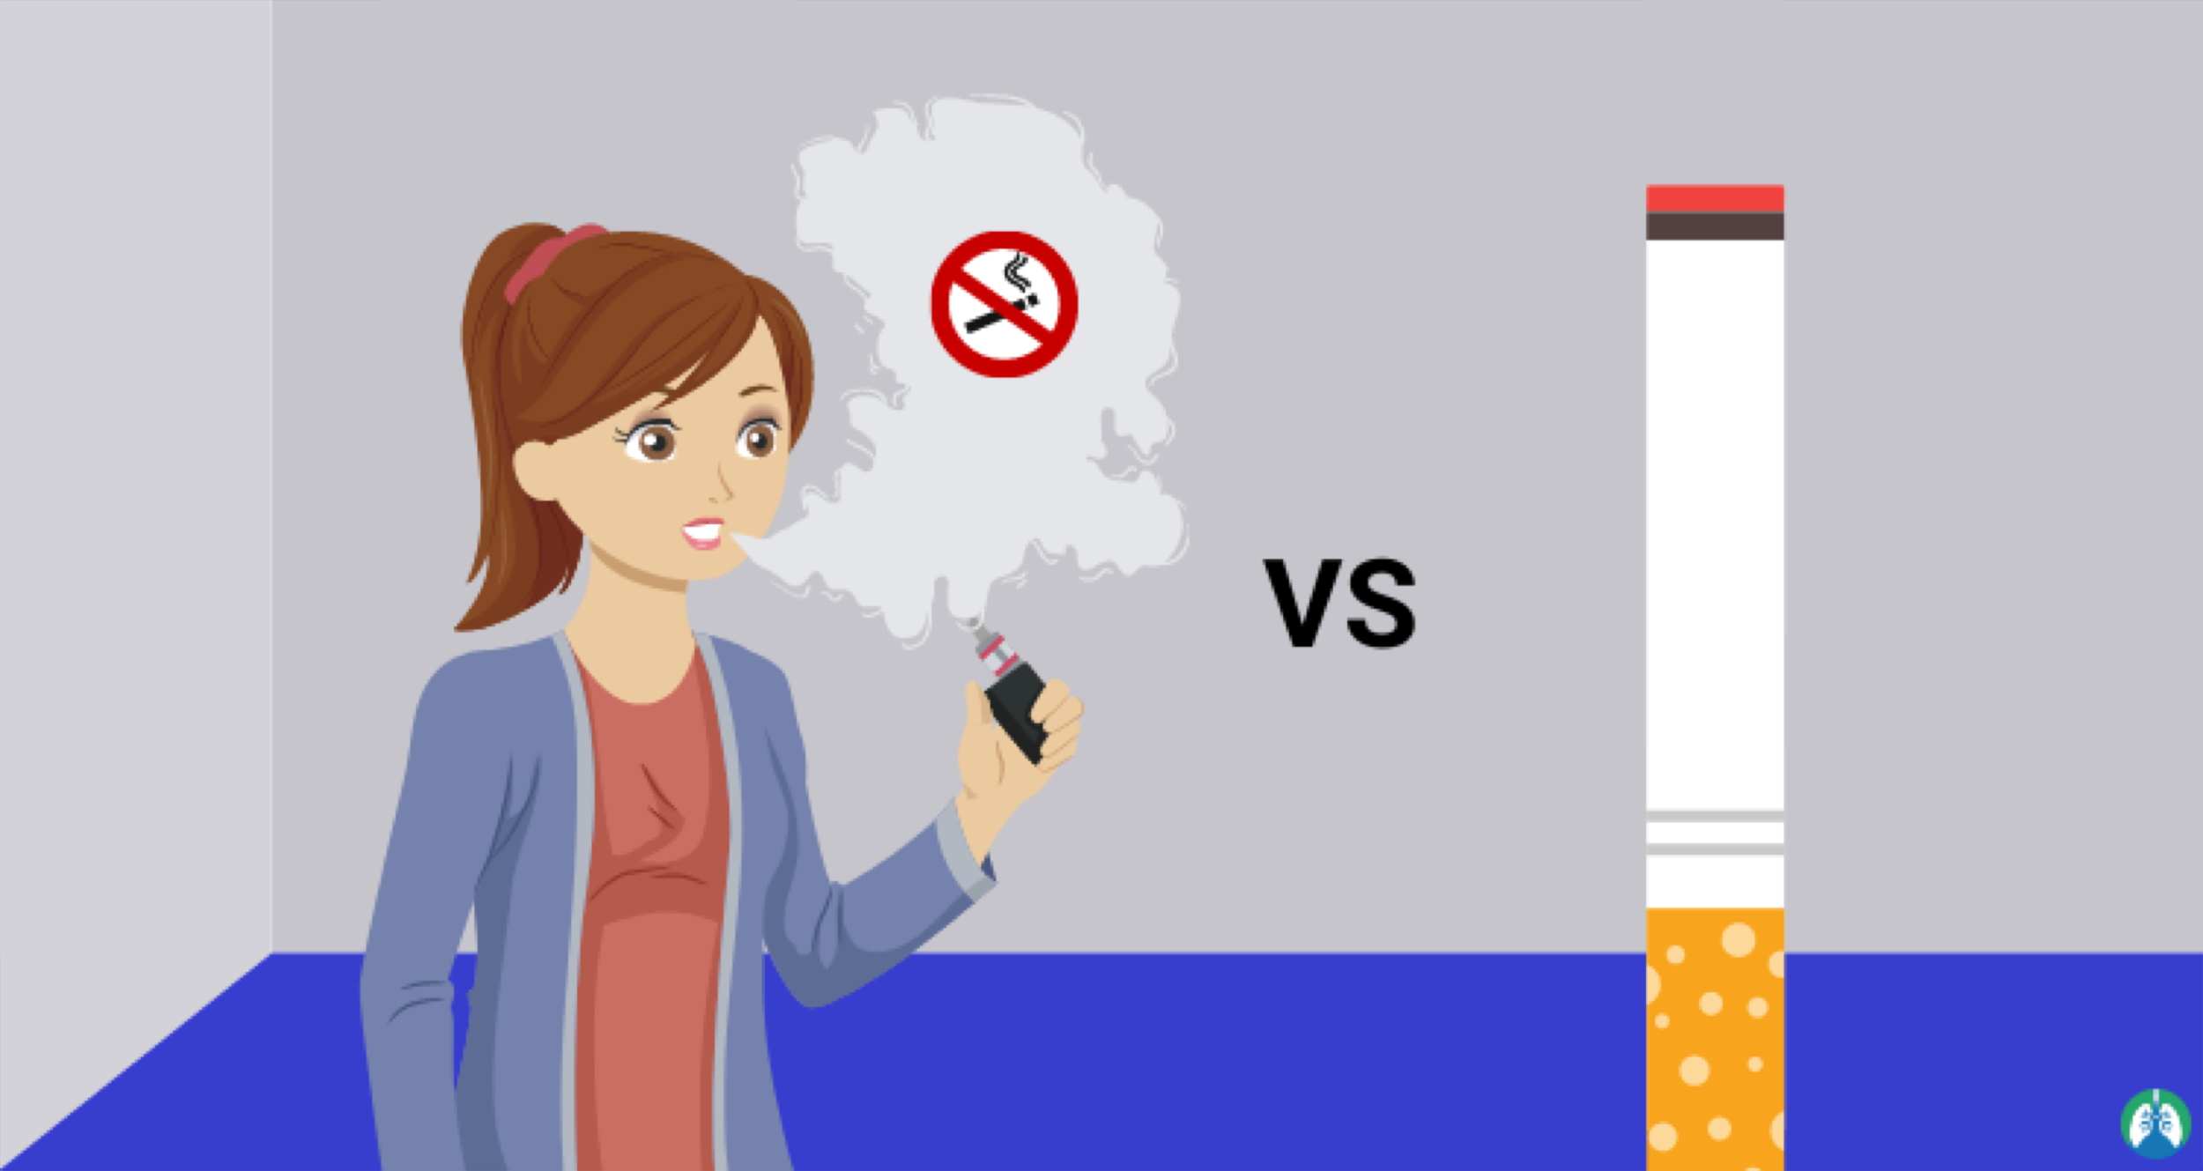
Comparative between
E- cigarettes and normal cigarettes
17

Slide 19
Continuous…
The difference between smoking and vaping is that smoking delivers nicotine by burning tobacco, which can cause smoking-related illnesses, and vaping can deliver nicotine by heating a liquid in a much less harmful way.
17

Slide 20
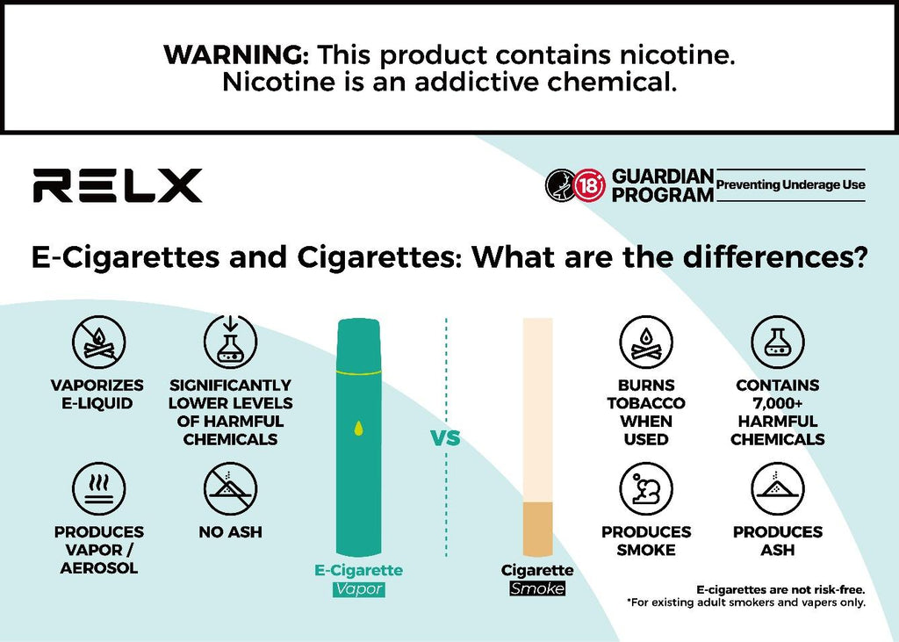
Continuous…
18

Slide 21

Vaping safer than smoking
19

Slide 22
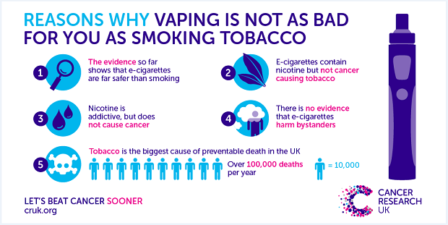
Continuous…
20

Slide 23
Conclusion
The electron cigarettes are not harmless but they are much less harmful than normal cigarettes , cheaper and healthier , and does not cuase cancer and does not lead to death
22

Slide 24
Reference
https://nida.nih.gov/publications/drugfacts/vaping-devices-electronic-cigarettes#:~:text=Most%20e-cigarettes%20consist%20of,power%20source%20(usually%
https://www.lung.org/quit-smoking/e-cigarettes-vaping/impact-of-e-cigarettes-on-lung
https://www.cdc.gov/tobacco/basic_information/e-cigarettes/about-e-cigarettes.html
Gentzke AS, Wang TW, Cornelius M, Park-Lee E, Ren C, Sawdey MD, Cullen KA, Loretan C, Jamal A, Homa DM. Tobacco Product Use and Associated Factors Among Middle and High School Students – National Youth Tobacco Survey, United States, 2021. Morbidity and Mortality Weekly Report, 2022; 71(No. SS-5):1–29.
https://www.fda.gov/tobacco-products/products-ingredients-components/e-cigarettes-vapes-and-other-electronic-nicotine-delivery-systems-ends
23

Slide 25
Thank you

