Slide 1
Introduction to Toxicology
د. سمير المرغني- دكتوراة في البصمة الوراثية-بريطانيا
استاذ مساعد-كلية الطب -جامعة بنغازي
رئيس قسم الطب الشرعي والسموم-كلية الطب-جامعة اجدابيا
والجامعة الدولية الليبية للعلوم الطبية

Slide 2
Toxicology
The study of poisons
Poisons are chemical/physical agents that produce adverse responses in biological organisms
Any substance can be toxic if introduced in a dose capable of disturbing the normal physiological homeostasis of the exposed body.

Slide 3
OTHER TERMS
Toxicants: are toxic substances from chemicals
Toxins: are poisonous substance produced within living cells or organisms
  Venom

Slide 4
Toxicology
The science of poisons that studies toxic substances with respect to their:
Sources
Properties
Mechanism of toxicity
Toxic effects
Detection
Clinical manifestations
Management

Slide 5
Sources
Chemical Source: the commonest source e.g. drugs, corrosives
Plant Source: e.g. hashish, cocaine
Animal Source: the least but most serious source. Venomous animals such as scorpions, spiders, snakes, wasps.

Slide 6
Venomous & Poisonous Animals
  Venomous animals deliver or inject venom into other organisms, using a specialized apparatus of some kind (usually fangs or a stinger). The venom is produced in a gland attached to this apparatus.
  Poisonous animals do not deliver their toxins directly. The entire body, or large parts of it, may contain the poisonous substance. These organisms may be harmful when eaten or touched.

Slide 7
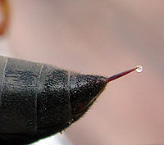
Wasp sting (VENOM)

Slide 8
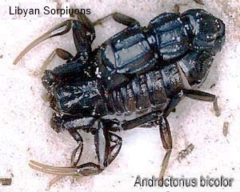
Androctonus bicolor

Slide 9
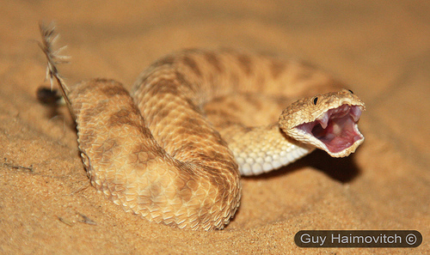
Cerastes vipera

Slide 10
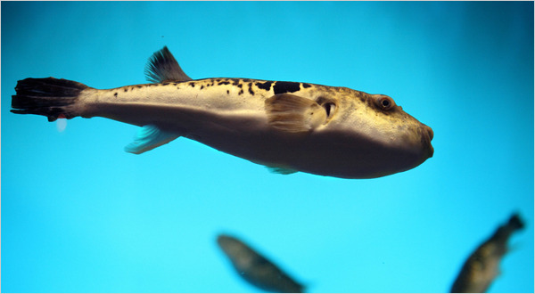
Tetradotoxin in Puffer Fish

Slide 11
Sites of Toxic Actions
Local (non-specific):
Wherever the poison contacts the biological system it starts its harmful effects. It does not require specific site or receptor to elicit its effects such as toxicity by acids or alkalis.
Remote (systemic):
The poison affects a system far from its portal of entry.
Local & Remote:
The poison has the capacity of acting locally and systematically.
Oxalic acid is an example of these poisons.

Slide 12
Types of Toxic Mechanisms
Direct: the poison itself can cause toxic effects as in corrosives.
Indirect: toxicity results from the interaction of the poison with the biological activity within biological system.
  Binding to cell membrane to change in their function or structure thus affecting their normality.
  Interference with enzymatic actions.
  Formation of metabolites which are more toxic than the parent poison.
  Effects on DNA

Slide 13
Classification of toxic agents
According to the Target organ they are acting on it (hepatotoxic, Nephrotoxic)
According to their Use (food additive, drug, pesticide)
According to their Source (animal or plant)
According to their Effects (carcinogen, mutagen)

Slide 14
According to their Physical state (gas, liquid)
According to their Chemistry (Amine, hydrocarbon)
According to their Poisoning potentiality (extremely toxic, slight toxic, etc)
According to their Biochemical mechanism of action (alkylating agent, AchE inhibitor)

Slide 15
Factors Affecting Action of Poison
A) Factors related to the poison:
Dose: a basic principle in toxicology.
  Dose is the amount of chemical that comes into contact with the body or gets inside the body.
  The increase of dose will increase the severity of toxicity.
Physical status: gaseous state is more toxic than liquid state than the solid state.
Purity: this depends on the impurity of the poison; if the impurities are more toxic than the poison, the toxicity will be more and vice versa.

Slide 16
B) Factors related to the individual:
  Age
  Health
  Sensitivity
  Sex
C) Factors related to mode of exposure:
  Inhalation > IM > ingestion > Skin contact
D) Factors related to environment:
  Temperature, pressure, humidity, radiation can cause alterations on poisons status.

Slide 17
Forensic Toxicology
Forensic toxicologist is concerned with the detection and estimation of poisons for legal purposes:
  Tissues and body fluids obtained at autopsy
  Blood, urine, or gastric material obtained from a living person

Slide 18
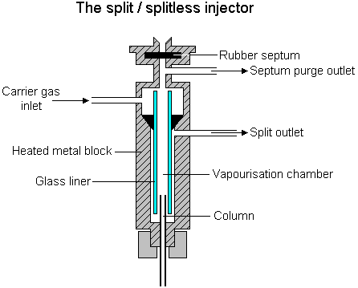
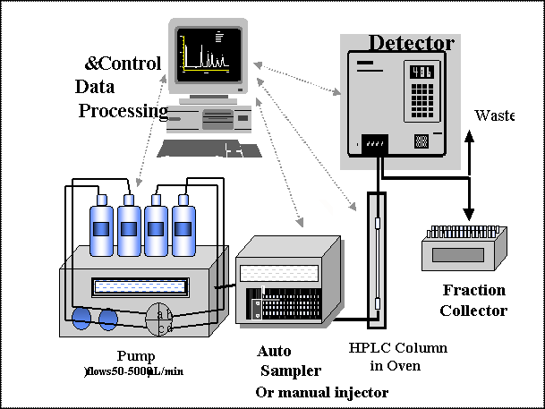
HPLC
System
Column

