Slide 1


Principles of Marketing Research about a Promotion
Libyan International University Faculty Of Business Administration
BY : Esraa Elkhoja

Slide 2
Objective :
The meaning of promotion
The meaning of ( IMC)
The difference between the promotion & ( IMC)
Promotion of campaign
Promotion of tools
Factors affect the choice of promotion tools

Slide 3
The meaning of promotion
. The act or fact of being raised in position or rank : preferment
. The act of furthering the growth or development of something
Especially :the furtherance of the acceptance and sale of merchandise through advertising , publicity ,or discounting (Merrian-webster,18.dec.2018)
The meaning of ( IMC)
. Modern marketing calls for more than developing a good product , pricing it attractively, and making it accessible. Companies must also communicate with their present and potential stakeholders and the general public. For most marketers.(KOTLER& KELLER, 2012, p:475)
The difference between the promotion & ( IMC)
. the difference is promotion have one element but the (imc) have more elements .
.and the old books use promotion word but the new books use integrated marketing communications .

Slide 4

Promotion of campaign
Promotion is one of the key areas of the marketing mix . It is the process of engaging and communicating with the target audience . Sending timely , relevant and contemporary messages through appropriate media is very critical for this communication . ( https://www.mabskool.com/business-concepts/marketing-and-strategy-terms/11925-promotional-compaign.html )

Slide 5
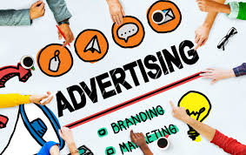
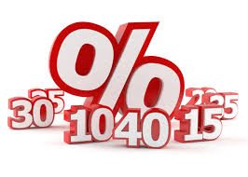
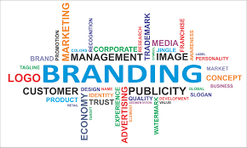
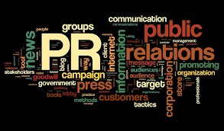
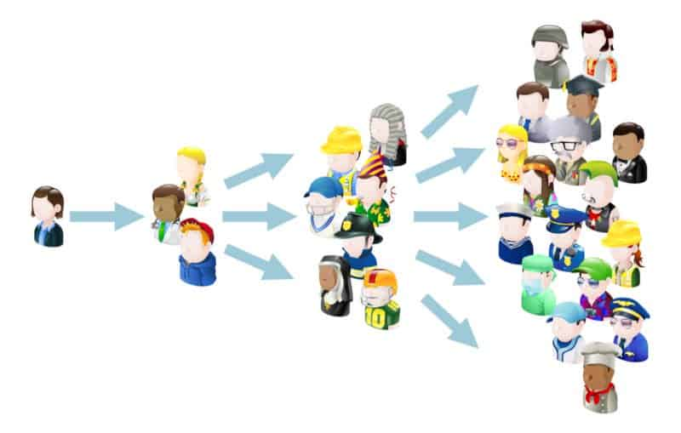
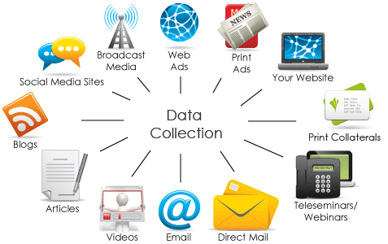

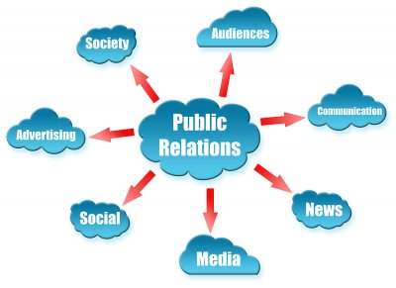
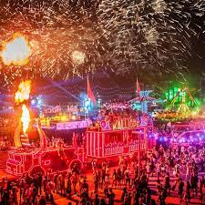
Promotion of tools
* Advertising
* Sales Promotion * Events and Experiences * Public Relations and Publicity * Direct and Interactive Marketing * Word-of-Mouth Marketing * Personal Selling .(KOTLER& KELLER, 2012, p:479)

Slide 6
Factors affect the choice of promotion tools
Factors for testing media tools are variables according to each product or service and each according to each company it’s capabilities .

Slide 7
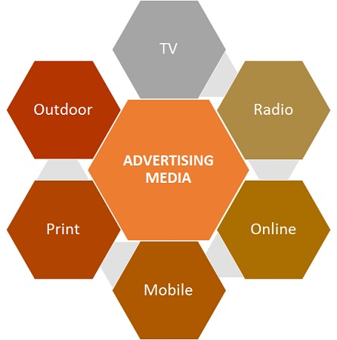
The difference between advertising and media ??
Advertising
Intended efforts to influence others to convince him of an idea , a good or an opinion , in order to change his behavior and deliberately influence , and included information that is not honest , accuracy or honesty in some kinds.
Gray propaganda to it some facts , adding to it some lies and not revealing the source, direction , goals (secret radio). (weziwezi-wepside ,2018)
The importance of advertising Advertising is a portal to identify the company's
products and services. The ad addresses each segment of consumers
with a targeted message. Advertising is widely spread. Advertising is a way that can reduce long-term
Expenses.

Slide 8

Media
Media is a communication between the sender (media) and the future (the public) through a media, through which the media message is transmitted from one party to another. The importance of the media Increase awareness among followers Education solving problems Ability to participate
https://weziwezi.com/

Slide 9
References :
1- https://www.merriam-webster.com/dictionary/promotion
2- (Marketing Management : PHILIP KOTLER & KEVIN LANE KELLER, Library of Congress Cataloging-in-Publication Data Kotler, Philip. Marketing management/Philip Kotler, Kevin Lane Keller. — 14th ed. p. cm. Includes bibliographical references and index. ISBN 978-0-13-210292-6 1. Marketing—Management. I. Keller, Kevin Lane, 1956- II. Title. HF5415.13.K64 2012 658.8—dc22 2010046655
3- ( https://www.mabskool.com/business-concepts/marketing-and-strategy-terms/11925-promotional-compaign.html )
4- https://weziwezi.com/

Slide 10
Any Questions ?
Thanks ….

