Slide 1




CANCER
BREAST CANCER
ST. Name: Amira Ajaj Mansour
ST.NO: 3378
Year 1: GBMS2
Supervisor: Fatma Elsaity
Date: 2022/05/12

Slide 2

OBJECTIVES:
Discuss types of breast cancer.
Outline symptoms of breast cancer.
List treatment of breast cancer.
List preventing breast of cancer.

Slide 3
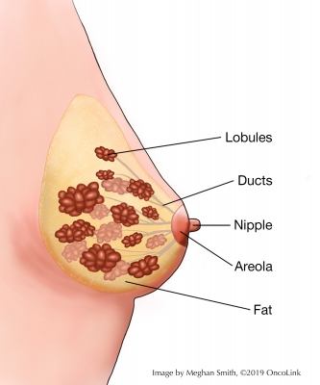
INTRONDUCTIO:
Cancer: a disease that is characterized by uncontrolled cell growth in an organ, ie the site the cells originate from.
Breast cancer: is caused by breast cells growing out of control.
As the number of cells grows, they form a mass (tumor).

Slide 4
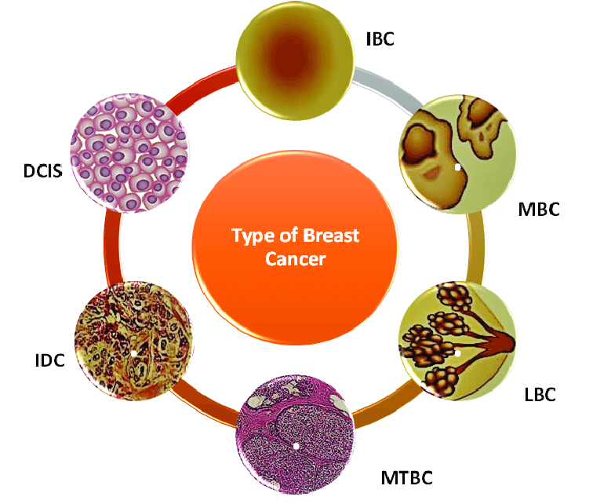
Type of Breast Cancer:
Ductal carcinoma in situ (DCIS).
Lobular carcinoma in situ (LCIS).
Inflammatory breast cancer.
Male breast cancer.
Recurrent breast cancer.

Slide 5
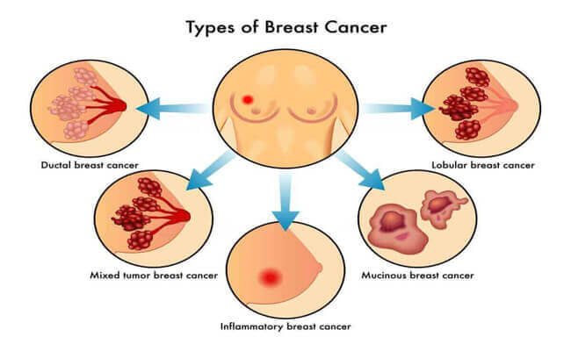

Slide 6
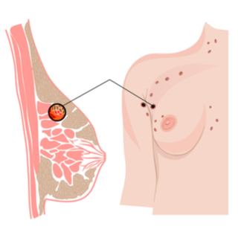
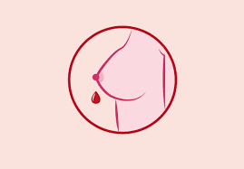
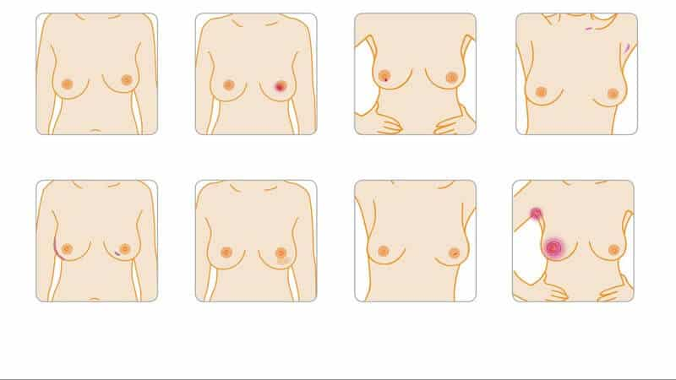
Symptoms of breast cancer:
Nipple turning inward.
Nipple discharge.
Lump in the underarm area.
Swelling of part of the breast.
Swelling of all the breasts.
Skin dimpling.
Breast or nipple pain.
Skin irritations.

Slide 7
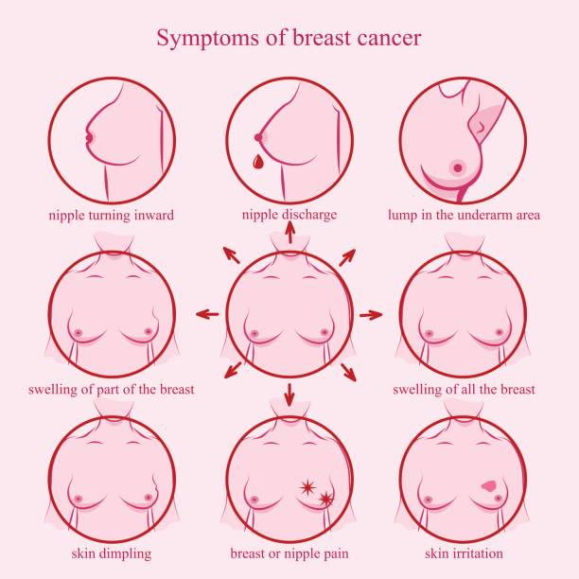

Slide 8
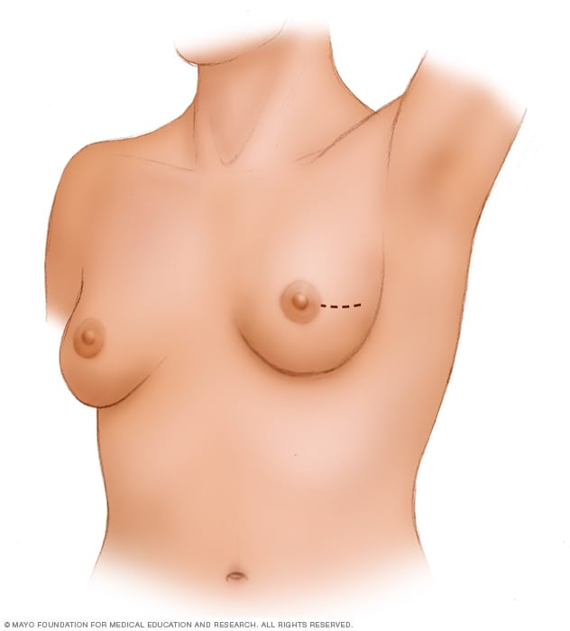
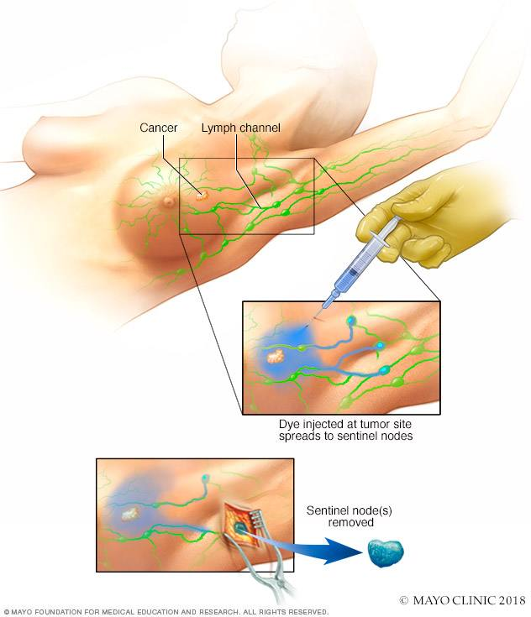
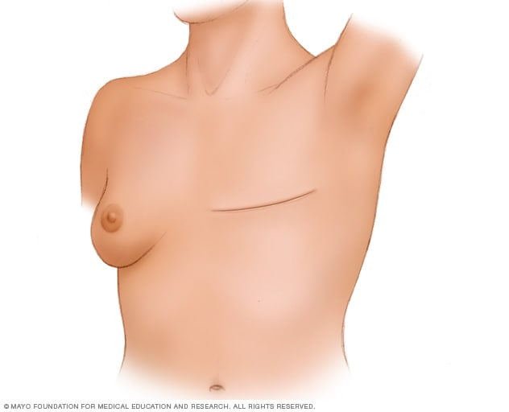
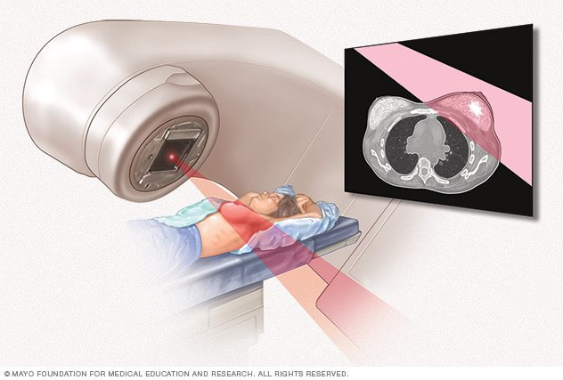
Treatment of breast cancer:
1. Lumpectomy
3. Sentinel node biopsy
2. mastectomy
4. Radiation therapy

Slide 9

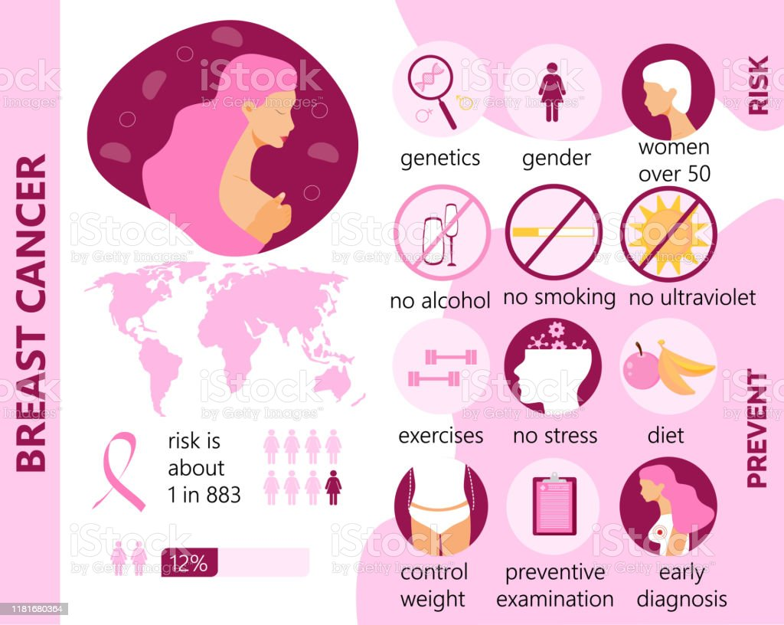
Preventing Breast Cancer:
Check your breast.
Don’t smoke 🚭.
Exercise most days of the week.
Be a healthy weight.
Breastfeed your baby🤱.

Slide 10
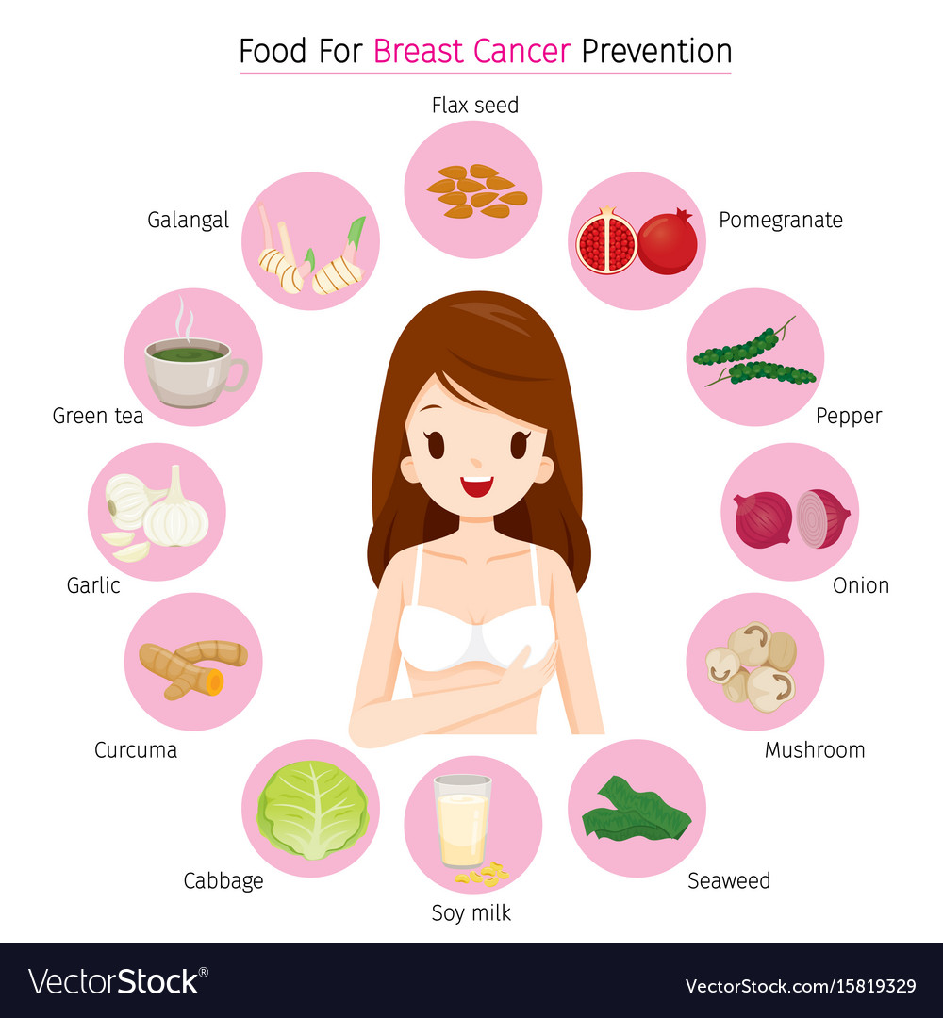

Slide 11
Conclusion
Breast cancer is the most common type of cancer among women, the risk of breast cancer increases with age, it is most common after the age of 50.
The most frequent type of breast cancer is that starting in the ducts (ductal cancer).
The less common is Inflammatory breast cancer which causes the breast to be red, and swollen.

Slide 12
REFERENCES:
Mayo Clinic. 2022. Breast cancer - Symptoms and causes. [online] Available at: <https://www.mayoclinic.org/diseases-conditions/breast-cancer/symptoms-causes/syc-20352470> [Accessed 30 May 2022].
Mayoclinic.org. 2022. Breast cancer - Diagnosis and treatment - Mayo Clinic. [online] Available at: <https://www.mayoclinic.org/diseases-conditions/breast-cancer/diagnosis-treatment/drc-20352475> [Accessed 30 May 2022].

Slide 13
Oncolink.org. 2022. Breast Cancer: The Basics | Oncolink. [online] Available at: <https://www.oncolink.org/cancers/breast/breast-cancer-the-basics> [Accessed 31 May 2022].
Cancer.org. 2022. Types of Breast Cancer | About Breast Cancer. [online] Available at: <https://www.cancer.org/cancer/breast-cancer/about/types-of-breast-cancer.html> [Accessed 31 May 2022].

Slide 14

Thank You

