Slide 1

Common Surgical Operation
Haitham R. Elmehdawi

Slide 2
APPENDECTOMY

Slide 3
APPENDECTOMY
DEFINATION
INDICATIONS
TYPES
ANAESTHESIA
POSITION
EXPOSURE AND PROCEDURE
COMPLICATIONS

Slide 4
APPENDECTOMY
DEFINITION
An appendectomy is the surgical removal of the appendix.

Slide 5
APPENDECTOMY
INDICATIONS
Acute appendicitis
As Interval appendectomy
  after drainage of abscess
  Appendicular mass
Carcinoid tumour : at the tip. <2cm
Mucocele of the appendix
As part of other operation
  On table colonic lavage.

Slide 6
APPENDECTOMY
TYPES
OPEN
LAPAROSCOPIC

Slide 7
APPENDECTOMY
ANAESTHESIA
General anesthesia with endotracheal intubation and muscle relaxation
Spinal or Local anesthesia may be indicated in the very ill patient.

Slide 8
APPENDECTOMY
POSITION
Patient is placed in supine position.
Routine scrubbing and gowning
The skin is cleaned from the nipple line to the mid thigh and draped exposing the operation field.

Slide 9
APPENDECTOMY
PROCEDURE
INCISION
  Mc Burney’s/Grid iron
  Lanz
  Rutherford Morison’s

Slide 10
APPENDECTOMY
POST-OP COMPLICATION
Wound infection
    Most common
    5-10% of patient
    4-5th day
Intra- abdominal abscess -8%
Ileus
Portal pyemia
Faecal fistula
Adhesive intestinal obstruction
Generalised peritonitis
Hemorrhage
Respiratory infections
UTI
Venous thrombosis and embolism

Slide 11
THYROIDECTOMY
DEFINATION
INDICATIONS
TYPES
ANAESTHESIA
POSITION
EXPOSURE AND PROCEDURE
COMPLICATIONS

Slide 12
THYROIDECTOMY
DEFINITION
Thyroidectomy is the surgical removal of all or part of the thyroid gland.

Slide 13
THYROIDECTOMY
INDICATIONS
• Toxic multinodular goiter; does not respond well to drugs.
• Toxic solitary nodule; it may be neoplastic.
• Malignant goiter
• Presence of pressure symptoms
• Failure of patient to take drugs regularly or follow-up
• Complications during drug therapy
• Relapse after previous drug therapy
• Exophthalmus
• Cosmetic

Slide 14
THYROIDECTOMY
TYPES OF THYROIDECTOMY
• Hemithyroidectomy
• Subtotal thyroidectomy
• Near total thyroidectomy
• Total thyroidectomy

Slide 15
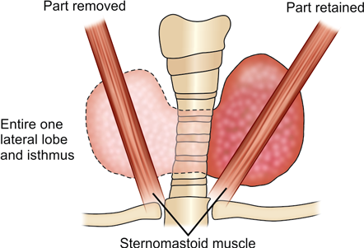
THYROIDECTOMY
• Hemithyroidectomy

Slide 16
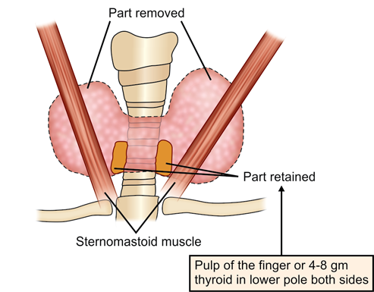
THYROIDECTOMY
• Subtotal thyroidectomy

Slide 17
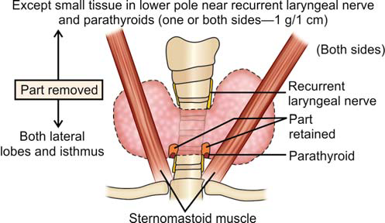
THYROIDECTOMY
• Near total thyroidectomy

Slide 18
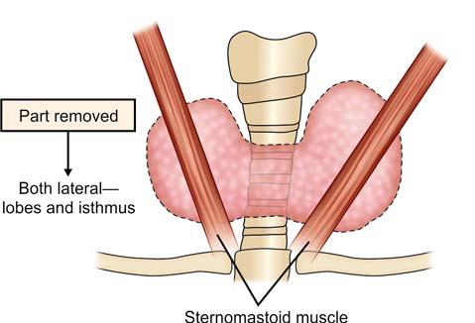
THYROIDECTOMY
• Total thyroidectomy

Slide 19
THYROIDECTOMY
ANAESTHESIA
• Anaesthesia is general

Slide 20
THYROIDECTOMY
POSITION
• patient is placed in a supine position initially with the neck extended by placing a ring beneath the head and a sandbag roll beneath the shoulder.
• The table is tilted 20–30 degrees “head up” to aid in emptying the neck veins.
• The skin is prepped from the chin to the upper thorax

Slide 21
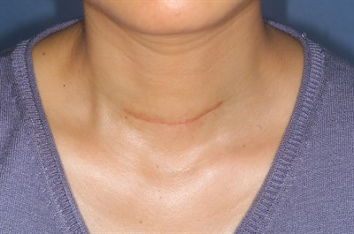
THYROIDECTOMY
PROCEDURE
INCISION
  Kocher’s low collar incision

Slide 22
THYROIDECTOMY
POST-OP COMPLICATION
EARLY
  • Haemorrhage
  • hypoparathyroidism
  • Recurrent laryngeal nerve palsy
    • 95% neurapraxia and resolves
    • If bilateral, cord adduct to midline so needs immediate reintubation
  • Thyroid crisis
LATE
  • Hypothroidism
  • Recurrence
  • Keloid

Slide 23
Cholecystectomy
DEFINATION
INDICATIONS
TYPES
ANAESTHESIA
POSITION
EXPOSURE AND PROCEDURE
COMPLICATIONS

Slide 24
Cholecystectomy
DEFINITION
It is the surgical removal of the gall bladder .

Slide 25
Cholecystectomy
INDICATIONS
Cholelithiasis
Acute cholecystitis
Chronic cholecystitis
Acalculous cholecystitis
Gallstone pancreatitis
Gallbladder polyps
Porcelain gallbladder

Slide 26
Cholecystectomy
TYPES
OPEN
LAPAROSCOPIC

Slide 27
Cholecystectomy
LAPAROSCOPIC CHOLECYSTECTOMY
STANDARD
MODIFIED
    Reduce port size
    Reduce port number
    NOTES

Slide 28
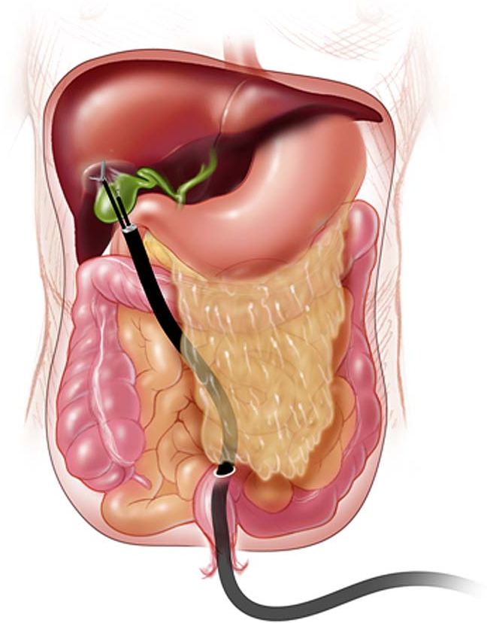
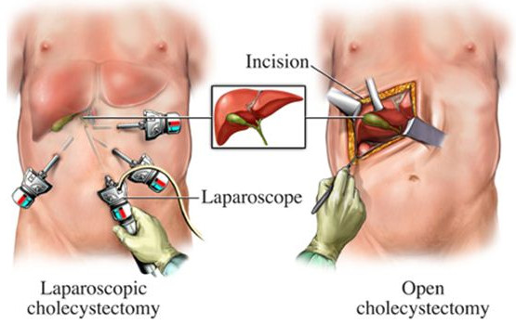
Cholecystectomy
LAPAROSCOPIC CHOLECYSTECTOMY
NOTES

Slide 29
Cholecystectomy
ANAESTHESIA
General anesthesia with endotracheal intubation and muscle relaxation.

Slide 30
Cholecystectomy
POSITION
Patient is placed in supine position.
Routine scrubbing and gowning
The skin is cleaned from the nipple line to the mid thigh and draped exposing the operation field.

Slide 31
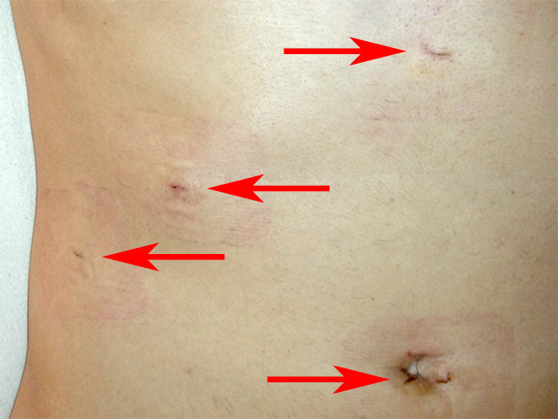
Cholecystectomy
PROCEDURE
INCISION
  4 small incisions

Slide 32
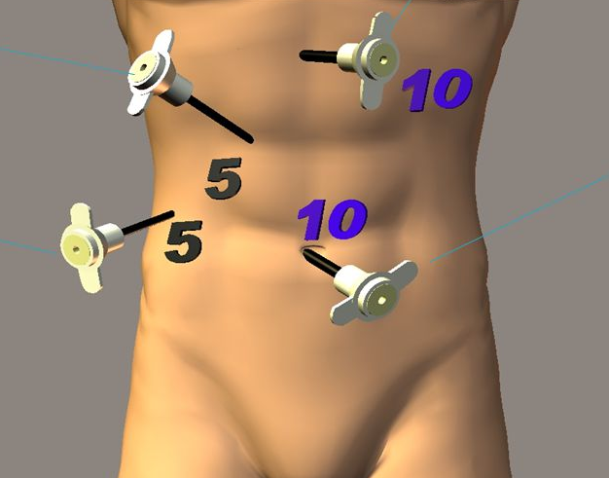
Cholecystectomy

Slide 33
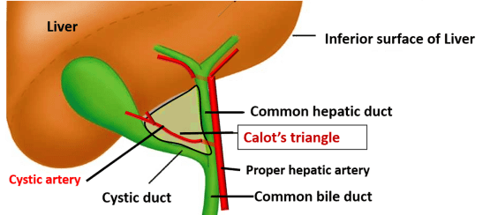
Cholecystectomy

Slide 34
Cholecystectomy
POST-OP COMPLICATION
Haemorrhage
Bile leak
Bile duct injury
Wound infection
Intra- abdominal abscess
Ileus
Adhesive intestinal obstruction
Generalised peritonitis

Slide 35


