Slide 1



Childhood obesity
By:
Alsaedi Muammar
ID 2801
Block :PTS

Slide 2
Objectives
Definition of obesity
Epidemiology obesity in children
Outline Risk factors of obesity in children
List complication of obesity in children
Outline prevention of obesity

Slide 3
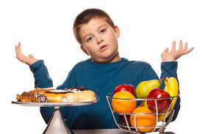
introduction
Is that you have a high amount of fat in your body
and from that definition you can not that
obesity is not about more weight its about more fat

Slide 4
definition
Obesity is the imbalance between coloric intake and energy expenditure.
Obesity is detemined using the body mass index ( BMI ).

Slide 5
Overweight or obese
BMI between 85th and 94th percentiles overweight
BMI 95th percentile or above obesity
BMI 99th percentile or higher severe obesity

Slide 6
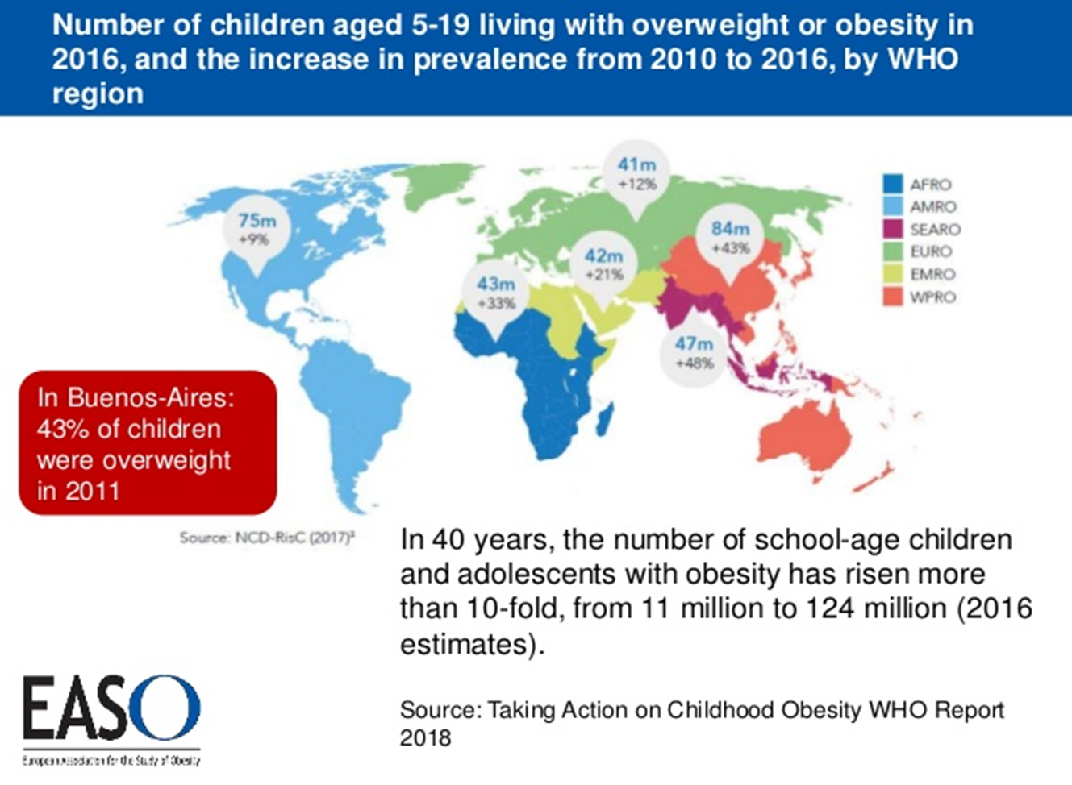

Slide 7
Risk factors:
1-Diet. Regularly eating high-calorie foods, such as fast food.
2-Lack of exercise. Children who don't exercise much are more likely to gain weight because they don't burn as many calories.
3-Family factors
4- Psychological factors. Personal, parental and family stress can increase a child's risk of obesity.
5-Socioeconomic factors.
6- Certain medications
. paroxetine (Paxil).

Slide 8
Complications
Type 2 diabetes.
High cholesterol and high blood pressure
Joint pain.
Breathing problems. Asthma is more common in children who are overweight.
Non alcoholic fatty liver disease (NAFLD).

Slide 9

Prevention
The most important strategies for preventing obesity are healthy eating behaviors, regular physical activity, and reduced sedentary activity (such as watching television and videotapes, and playing computer games).

Slide 10
Conclusion
Childhood obesity is a condition that is more cost-effective to prevent than to treat. Few medications are approved for treatment and then only for specific indications and with close follow-up. Accept that obesity is a family condition influenced equally by genetics and the food and activity environment.
Obesity is very danger disease and it should be prevent before it goes really bad
Obesity is the imbalance between coloric intake and energy expenditure

Slide 11
References:
Hedley AA, Ogden CL, Johnson CL, Carroll MD, Curtin LR, Flegal KM. Prevalence of overweight and obesity among US children, adolescents, and adults, 1999−2002. JAMA. 2004;291:2847–2850. - PubMed
Freedman DS, Khan LK, Serdula MK, Dietz WH, Srinivasan SR, Berenson GS. The relation of childhood BMI to adult adiposity: the Bogalusa Heart Study. Pediatrics. 2005;115:22–27. – PubMed
https://www.medicinenet.com/obesity_weight_loss/article.htm

Slide 12


