Slide 1
Clinical disorders of acid-base balance ( part I )
Mohamed Osama Ezwaie, MD
Associate professor of nephrology
ezwaie@yahoo.com
2019

Slide 2
Learning objectives ( part I & II)
Definitions
Human body acids
Chemical and mathematical basis for acid base disorders
Physiology of acid base balance/ homeostasis
ECF ionic composition
Clinical disorders of acid base disorders
Step-wise diagnostic approach

Slide 3
Acid- base definitions
Acid - substance that generates H⁺ in solutions, When an acid releases a proton it is converted to conjugate base.
Base - substance that generate OH⁻ in solutions, When a base binds a proton it is converted to conjugate acid.
An acid base disorder is a change in the normal value of extracellular pH that may result when renal or respiratory function is abnormal or when an acid or base load overwhelms excretory capacity.
Notes:
Acid - substance that generates H⁺ in solutions (Arrhenius definition), When an acid releases a proton it is converted to conjugate base.
Base - substance that generate OH⁻ in solutions (Arrhenius definition), When a base binds a proton it is converted to conjugate acid.

Slide 4
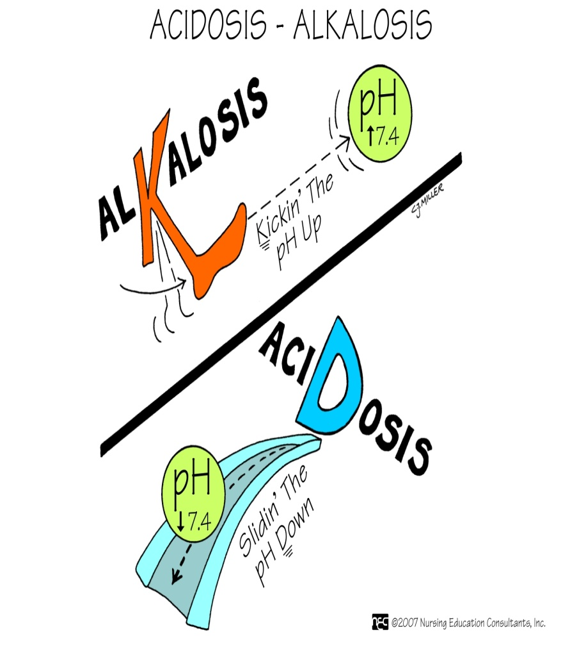
Acid- base definitions
Acidemia - Reduction in the blood pH below normal range of 7.35 -7.45
Alkalemia - Elevation in blood pH above the normal range of 7.35 – 7.45
Acidosis – process that increases [H+] by increasing PCO2 or by reducing [HCO3
Alkalosis – process that reduces [H+] by reducing PCO2 or by increasing [HCO3-]
Normal arterial acid base values
HCO3- ( mEq/L) | PaCO2 ( mmHg) | pH
22-26 | 36-44 | 7.35- 7.45 | Range
24 | 40 | 7.40 | Optimal value
Notes:
Acidemia and alkalemia from biochemical aspect, while acidosis and alkalosis is clinical aspect definition

Slide 5
Acid- base definitions
Simple acid base disorders : Disorders that are either metabolic or respiratory.
Mixed acid base disoders: More than one acid base disturbance present. pH may be normal or abnormal.
Though acidosis and alkalosis usually leads to acidemia and alkalemia respectively, the exception occurs when there is a mixed acid base disorder.

Slide 6
Acid- base disorders; definitions
Though acidosis and alkalosis usually leads to acidemia and alkalemia respectively, the exception occurs when there is a mixed acid base disorder.
In that situation, multiple acid base processes coexisting may lead to a normal pH or a mixed picture.
Clinical disturbances of acid base metabolism classically are defined in terms of the HCO3- /CO2 buffer system.

Slide 7
Human body acids
The human body generates acids continuously. A normal subject produces daily ;
  20 mmol of "volatile" acid (carbonic acid) and
  80 mmol of "nonvolatile" acids.
Most of the volatile acid is produced as CO₂ as result of cell respiration/ metabolism and is subject to the reaction:
CO₂ + H₂O ↔ H₂CO₃ ↔ H⁺ + HCO₃⁻
Occurs at pulmonary cap. level
Occurs at tissue cap. level
Notes:
Nonvolatile acid originates very largely from the metabolic transformation of proteins contained in food, primarily from the aminoacids methionine and cysteine. More acidic radicals come from the metabolism of carbohydrate and fat as a result of incomplete combustion, from nucleoprotein uric acid and from inorganic phosphorus compounds

Slide 8
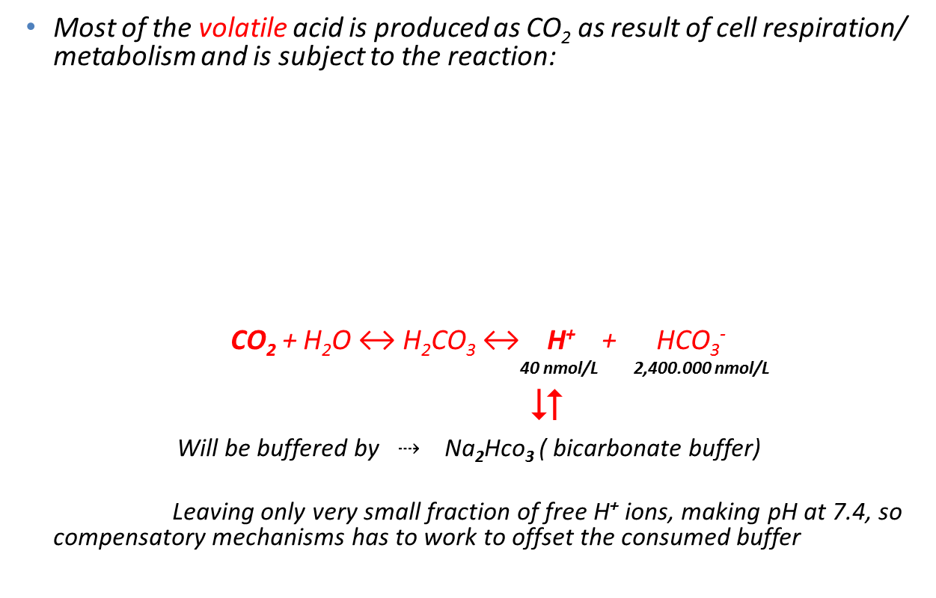
Human body acids
Most of the volatile acid is produced as CO₂ as result of cell respiration/ metabolism and is subject to the reaction:
CO₂ + H₂O ↔ H₂CO₃ ↔ H⁺ + HCO₃⁻
40 nmol/L 2,400.000 nmol/L

Will be buffered by $⇢$ Na₂Hco₃ ( bicarbonate buffer)
Leaving only very small fraction of free H⁺ ions, making pH at 7.4, so compensatory mechanisms has to work to offset the consumed buffer
Occurs at pulmonary cap. level
Occurs at tissue cap. level
Notes:
Nonvolatile acid originates very largely from the metabolic transformation of proteins contained in food, primarily from the aminoacids methionine and cysteine. More acidic radicals come from the metabolism of carbohydrate and fat as a result of incomplete combustion, from nucleoprotein uric acid and from inorganic phosphorus compounds

Slide 9
Human body acids
The non-volatile acids generated during metabolic processes dissociate and produce hydrogen ions:
  Part of these ions is used in metabolism ( enzyme function)
  Some fraction binds to oxygen in water to form hydronium ions ( hydrated protons H₃O⁺, H₅O₂⁺ )
  While rest remains free in plasma water, contributing to plasma pH
Notes:
There is not enough available oxygen in every moment to bind unused hydrogen ions in body fluids but there are several mechanisms that regulate hydrogen ions concentration.

Slide 10
Human body acids
Because [H⁺] is so critical to enzyme function yet the absolute concentration is small
The hydrogen ion is kept in the body under rigorous control, its concentration is maintained within very narrow range:
  [ H+]= 35 - 45 nanomols per liter of body fluid
Notes:
There is not enough available oxygen in every moment to bind unused hydrogen ions in body fluids but there are several mechanisms that regulate hydrogen ions concentration.

Slide 11
Human body acids
The pH of the body must be maintained within a narrow range
Most body systems function optimally at a pH of near 7.4
As the pH changes (either higher or lower);
  Enzymes may cease to function
  Nerve and muscle activity weakens
  Finally all metabolic activity becomes deranged
Notes:
Acids are substances that can provide a hydrogen ion. Strong acids hold their H+ ion weakly, so it’s free to dissociate and act on other substances. Weak acids hold the hydrogen more tightly, so it doesn’t contribute as greatly to free hydrogen ion concentration — and thus the solution has a higher (less acidic) pH.

Slide 12
[Plasma ion] Vs. [hydrogen ion]
Ion* | nmoles/L
H⁺ | 40
K⁺ | 4,000,000
Ca⁺⁺ | 2,500,000
Mg⁺⁺ | 1,000,000
Na⁺ | 140,000,000
*K⁺, Potassium ion; Ca⁺⁺, calcium ion; Mg⁺⁺, magnesium ion; Na⁺, sodium ion.
Notes:
One ampoule 50 ml of bicarbonate 8.4% = 50 mEq of bicarbonate with osmolality of 800 mOsm/L
One tablet of KCL 600 mg= 20 mEq of KCL

Slide 13
Concept of pH; logarithmic scale
The pH is a method of expressing extremely small concentrations (of acid in solution) in numbers, and has no unit
To understand logarithm, think of "power." Thus 10³ = 1000 and
log (1000) = 3
pH is defined as the negative logarithm of the hydrogen ion (H+) concentration or activity
            pH = - log [H+]
The scale is exponential — a change of one unit is actually a ten-fold change in[ H + ], a solution with pH of 7 has ten times as much acid as a solution with pH of 8.
Notes:
To understand logarithm, think of "power." Thus 10³ = 1000 and log (1000) = 3. When the pH changes by 0.3 units, e.g., from 7.4 to 7.1 the hydrogen ion concentration doubles (from 40 to 80 nMol/1). Wouldn't [H⁺] be so much easier to understand?

Slide 14
Concept of pH; logarithmic scale
The intracellular pH is about 7.0 at body temperature - fairly close to neutral and tightly maintained; it is where most of the body's chemistry occurs
The body maintains the blood at pH 7.4, which is about 0.4 pH units more alkaline than the intracellular pH
This is equivalent to a 2.5-fold difference in concentration: extracellular 40 nMol/L; intracellular 100 nMol/L
Converting chemical formula to logarithmic formula ( scale/ equation), which is the standard equation used in acid-base clinical chemistry
Notes:
In the interests of clear thinking remember that, at body temperature, true neutral is pH 6.8. So, nearly all acid-base results deal with a patient whose plasma is actually on the alkaline side of neutral (see Acidosis and Alkalosis). Nevertheless, "Acidemia"is a useful shorthand for "...more acid than the normal pH of 7.4".

Slide 15
Equations of acid –base chemistry
The conversion of chemical equation of carbonic acid system to mathematical equation
CO₂ + H₂O ↔ H₂CO₃ ↔ H⁺ + HCO₃⁻
^{( chemical equation)}
[H+] x [HCO3-] = K x [CO2] x [H2O]
(Henderson mathematical / equilibrium equation)
“ K ” is equilibrium constant

Slide 16
Equations of acid –base chemistry
The next step is to write Henderson's equation in the right order with the water concentration omitted as a constant.
[H⁺] = K x [CO₂] / [HCO₃⁻]
Hasselbalch modified Henderson's elegant idea by regarding the water concentration as constant and taking logarithms of the remaining components (pK is the negative logarithm of "K"). This resulted in the
Henderson-Hasselbalch Equation- primary form:
pH = pK + log ( [HCO₃⁻] / [CO₂] )
Notes:
The "K" is still "K" and the equation is still recognizable. Why, then, have generations of medical students been taught the Henderson-Hasselbalch version? Why, in fact, were we taught it at all? Were our teachers so mathematically naive that they failed to recognize that the two equations were mathematically equivalent. If so, did they succumb to the temptation to teach us - and therefore test us - using the more complex version?
Part of the reason lies outside medicine; chemists find knowing the negative logarithm of "K" (pK) is a useful shorthand way of writing a long number. In addition, the same logarithmic version is in widespread use, although it is known by other names in other places. At the Royal Veterinary and Agricultural University of Copenhagen it is known as the "Bjerrum equation" in honor of Professor Bjerrum who worked there; and, in the chemical world it is generally known as the buffer equation. (Astrup and Severinghaus, 1986), p 194. There is no need in physiology for us to use this equation. It is part of history's legacy. The Modified Henderson Equation is recommended

Slide 17
Henderson-Hasselbach logarithmic equation
The value of pK in the bicarbonate buffer system (pK = 6.1)
The constant 0.03 converts PaCO₂ from mm Hg to mmoles/L.
may be substituted to come up with this final equation
Henderson-Hasselbalch Equation-final form:
pH = 6.1 +log HCO3-/ (0.03 x PCO2)
Notes:
The Henderson-Hasselbalch equation demonstrates the key players in acid-base regulation and their relationship with each other. Furthermore, it gives an idea about how pH is regulated in the extracellular fluid. It is advisable to use the inverse of the numerator and the denominator, because in this way, dealing with negatives can be avoided

Slide 18

Chemical to logarithmic equation
CO₂ + H₂O ↔ H₂CO₃ ↔ H⁺ + HCO₃⁻
^{( chemical equation)}
Henderson-Hasselbalch Equation:
pH = 6.1 +log HCO3-/ (0.03 x PCO2)
Notes:
The pH of the blood is equal to the pK of the bicarbonate buffer system plus the logarithm of the following ratio bicarbonate concentration ([HCO₃⁻]) over 0.03 times the arterial partial pressure of carbon dioxide (PaCO₂).

Slide 19


Henderson-Hasselbach logarithmic equation
Henderson-Hasselbalch Equation:
Notes:
It is not necessary to memorize the full Henderson­Hasselbalch equation to intelligently manage acid­base disorders. It is important to understand that pH reflects a ratio of HCO₃⁻ to PaCO₂.

Slide 20
Acid-Base clinical physiology
Body defenses against acid-base disturbances:
  The chemical buffer systems ( ECF, and intracellular); acts immediately, first line of defense, but can not remove hydrogen ions from body
  Renal system regulation; acts hours to days, eliminates excess acids or alkali from body
    Bicarbonate reclammation; where 80-90% reabsorbed by ( PCT )
    Net acid excretion ( NAE );
      Titrable acids ( H₂Po₄⁻ ) by DCT
      Non-titrable acids; ammniogensis ( NH₄⁺) by PCT
  Respiratory system regulation; acts within minutes to eliminate CO2 from lungs
Notes:
According to Henderson - Hasselbalch equation the smallest possible changes of pH upon treatment with acid or base will be seen when pH equals pK_{a}.
Buffer systems are abundantly present in the human body either inside cells and in extracellular fluids. Body buffers work as weak acids with pKa in the region of physiological pH, namely 7.4.

Slide 21
Acid-Base clinical physiology
Body defenses against acid-base disturbances:
  The chemical buffer systems ( ECF, and intracellular); acts immediately, can not remove hydrogen ions from body.
  Renal system regulation; acts hours to days, eliminates excess acids or alkali from body
  Respiratory system regulation; acts within minutes to eliminate CO2 from lungs
Notes:
According to Henderson - Hasselbalch equation the smallest possible changes of pH upon treatment with acid or base will be seen when pH equals pK_{a}.
Buffer systems are abundantly present in the human body either inside cells and in extracellular fluids. Body buffers work as weak acids with pKa in the region of physiological pH, namely 7.4.

Slide 22
Acid-Base clinical physiology
Body buffers:
  First line of defense against acute changes in [ H ]
  [ H ] ions are bufferred by both intracellular and extracellular buffers
  The efficiency of a buffer system depends on;
    Its buffering capacity ( molar concentration of both components )
    Direct connection to the respiratory system
Notes:
The capacity of a buffer solution depends on:
1- molar concentrations of both buffer components → buffer capacity
2- the ratio of the concentration of the conjugate base to the concentration of the weak acid → equal concentrations of both components provide maximum buffering capacity

Slide 23
Acid-Base clinical physiology
Body buffers:
  The total buffering capacity of body fluids (15 mmol/kg of body weight), which is not enough to compensate the whole production of nonvolatile acids in the body ( 80 mmol/day)
  Buffer systems in body fluids:
  Blood contains two basic buffer systems:
  Bicarbonate and nonbicarbonate.
  Each consists of a weak acid or and their conjugate base.
Notes:
The bicarbonate and nonbicarbonate buffer systems are in equilibrium with each other. Measuring the components of either system will give the hydrogen ion concentration ([H⁺]) or the pH of the blood. However, since the nonbicarbonate system is a heterogeneous group of molecules, it is easier to measure the bicarbonate buffer components in order to determine pH.

Slide 24
Acid-Base clinical physiology
Body buffers:
Nonbicarbonate | Bicarbonate
Diaphasic phosphate/ monophasic phosphate pK_{a}= 6.7 Proteinate/ protein pK_{a} = 5.4 - 9.4 Hemoglobinate/ hemoglobin pK_{a} = 5.4 - 9.4 | Bicarbonate/ carbonic acid pK_{a} = 6.12
Notes:
A buffer is a substance that resists changes in pH (acid concentration) by undergoing a reversible reaction — in other words, you add a bunch of acid, the buffer undergoes a reaction so that only a small change in pH occurs. Add a bunch of alkali, the buffer changes back to its original state.

Slide 25
Acid-Base clinical physiology
Body buffers ( ECF):
Nonbicarbonate | Bicarbonate
Diaphasic phosphate/ monophasic phosphate pK_{a}= 6.7 Proteinate/ protein pK_{a} = 5.4 - 9.4 Hemoglobinate/ hemoglobin pK_{a} = 5.4 - 9.4 ( intracellular ) | Bicarbonate/ carbonic acid pK_{a} = 6.12
Notes:
Intracellular buffers include; organic phosphates ( 2,3 DPG, ATP) and hemoglobin. A buffer is a substance that resists changes in pH (acid concentration) by undergoing a reversible reaction — in other words, you add a bunch of acid, the buffer undergoes a reaction so that only a small change in pH occurs. Add a bunch of alkali, the buffer changes back to its original state.

Slide 26
Acid-Base clinical physiology
Carbonic acid-Bicarbonate buffering:
  This buffering system is very effective because;
    Most abundant buffer system in the body
    Its the ability to convert carbonic acid to carbon dioxide (through the enzyme carbonic anhydrase) then remove CO2 from the body through respiration
    Since carbon dioxide is readily diffusible across all cell membranes, the results of buffering can be reflected quickly in intracellular compartments
Notes:
adding enough acid to lower the serum bicarbonate by half would normally drop the pH from 7.4 to 6.0 — but instead all the extra H2CO3 is removed by conversion to CO2. The drop in pH stimulates extra respirations so CO2 (and subsequently more H2CO3) is removed. The pH therefore falls only to 7.3 or 7.2.

Slide 27
Intracellular buffers
Intracellular buffers include phosphates and cytosolic proteins ( hemoglobin)
Hemoglobin is one of the most important buffering agents. Its buffering capacity is due to the imidazole chain of the hemoglobin molecule, which contains histadines.
Imidazole can accept an extra proton or donate it back at the normal body pH.
Notes:
One ampoule 50 ml of bicarbonate 8.4% = 50 mEq of bicarbonate
One tablet of KCL 600 mg= 20 mEq of KCL

Slide 28
Intracellular buffers
Hemoglobin has an additional property that enables it to maintain pH within the capillaries, known as the Bohr effect. When combined with oxygen in pulmonary capillaries, hemoglobin tends to release hydrogen ions that have attached to the imidazole chain (it becomes a stronger acid). At site of Co2 washout
Notes:
According to Henderson - Hasselbalch equation the smallest possible changes of pH upon treatment with acid or base will be seen when pH equals pK_{a}.
Buffer systems are abundantly present in the human body either inside cells and in extracellular fluids. Body buffers work as weak acids with pKa in the region of physiological pH, namely 7.4.

Slide 29
Intracellular buffers
When hemoglobin is exposed to acid and lower oxygen concentrations in the capillaries, it gives up the oxygen. It then becomes a weaker acid, taking up extra hydrogen ion. This change maintains the pH in the capillaries essentially the same despite the higher CO2 concentration.
An opposite change occurs when hemoglobin is exposed to the higher oxygen concentration in the lung. As it takes up oxygen, it becomes more acidic (more prone to release the hydrogen ion).
The hydrogen ions react with bicarbonate to form carbonic acid, which in turn is converted to carbon dioxide and released into the alveoli. Hemoglobin is therefore not only an oxygen-transporting molecule, but is also an acid-transporting system.
Notes:
adding enough acid to lower the serum bicarbonate by half would normally drop the pH from 7.4 to 6.0 — but instead all the extra H2CO3 is removed by conversion to CO2. The drop in pH stimulates extra respirations so CO2 (and subsequently more H2CO3) is removed. The pH therefore falls only to 7.3 or 7.2.

Slide 30
Renal system regulation
Reabsorption of filtered HCO3 by PCT ( HCO3 reclamation):
    Huge amount of bicarbonate filtered by kidneys each day
      180 L/ day ( GFR) X 25 mEq/ L ( filtered conc.)
    = 4500 mEq/ day of HCO3 that must be reclaimed

Slide 31
Renal system regulation
Reabsorption of filtered HCO3 by PCT ( HCO3 reclamation):
  This process simply keeps HCO3 from being lost in the urine and therefore prevents metabolic acidosis
  This process dose not add net HCO3 to ECF, nor secrets net hydrogen ion into urine, dose not change hydrogen status of the body
  This process has transport maximum (>26 mEq/L)

Slide 32
Renal system regulation
Renal excretion of hydrogen ions:
  Elimination of enough hydrogen ions to equal the fixed acid produced each day, maintaining HCO3 from being consumed and maintained as ECF buffer.
  The removal of hydrogen ion from the body by kidney results in generation of new HCO3 to replace the 50-100 mEq/ day of HCO3 that was used to buffer the daily production of fixed acids.

Slide 33
Renal system regulation
Renal excretion of hydrogen ions: this done by two mechanisms;
  Active secretion hydrogen ion by an ATP-utilizing proton “ pump “ in the collecting tubule. One HCO3 is produced for every hydrogen ion excreted, titratable acids.
  Hydrolysis of glutamine in the proximal tubule generates NH4 ( which excreted in urine) and HCO3 ( which is returned to ECF), through process of ammoniogenesis.
  The latter process is major way of generating HCO3 than excretion of hydrogen ion in generating HCO3
Notes:
The main way the kidneys responds to acidosis ( excess hydrogen ions) is by increasing the production and excretion of NH4.

Slide 34
Renal system regulation
Renal excretion of hydrogen ions: renal acidification
              = + -
Net urinary acid excretion
Titratable acid excretion ( H2PO4)
Ammonium ( NH4) excretion
Residual base excretion ( adds net H ion to ECF)
Notes:
The main way the kidneys responds to acidosis ( excess hydrogen ions) is by increasing the production and excretion of NH4.

Slide 35
Respiratory system regulation
Respiratory / ventilatory compensation:
  Changes in minute ventilation, through stimulation of respiratory center, by altered PaCO2 ( >45 mmHg ) and PaO2 ( <70 mmHg )
  Hypercapnic response is mediated by neurons located at floor of fourth ventricle of brain ( centrally)
  Hypoxemic response mediated by chemoreceptors of the carotid bodies ( peripherally)
  It requires 6-12 hours for this response to be complete

Slide 36
Total CO2 ( venous blood )
Defined as the sum of the carbonic acid and the bicarbonate, or
TCO2 = [H2CO3] + [HCO3-]
As the normal ratio of bicarbonate to carbonic acid at physiologic pH is around 20:1, total CO2 will therefore be about 5% higher than serum bicarbonate.
When you observe a difference between total CO2 and bicarbonate that is larger than 5%, the patient is having acidosis
Notes:
“Total CO2" is a value often reported on blood gas slips
Crude method of detecting abnormal acid base status ( CKD clinincs).

Slide 37
Clinical disorders of acid-base balance ( part II )
Mohamed Osama Ezwaie, MD
Associate professor of nephrology
ezwaie@yahoo.com
2019

Slide 38
ECF Ionic composition
Anion composition
  80% bicarbonate + chloride = 'measured anions'
  20% protein (albumin), phosphate, sulphate, lactate, urate, organic anions etc = 'unmeasured anions‘
Cation composition
  90% sodium and potassium
  10% calcium, magnesium , Ig = unmeasured cations

Slide 39
Anion gap ( ECF )
ECF is electro-neutral with regard to charges
  Sum of positively charged ions = sum of negatively charged ions
  Na⁺+ K ⁺ +Unmeasured cations= Cl ⁻+HCO3 ⁻ + unmeasured anions
  AG defined as quantity of umeasured anions (20%) not balanced by unmeasured cations (10%)
Notes:
Normally amount of unmeasured anions is larger than unmeasured cations. Because, negatively charged plasma proteins account for the normal anion gap, the normal values should be adjusted downward for patients with hypoalbuminemia.
The approximate correction is a reduction in the normal anion gap of 2.5 meq/l for every 1g/dl decline in the plasma albumin concentration (normal value = 4 g/dl).

Slide 40
Anion gap ( ECF )
  AG defined as quantity of umeasured anions not balanced by unmeasured cations
  AG = UA – UC
  = Na – Cl + HCO3
  ( normally 12 ±4 mEq/L)
Notes:
Normally amount of unmeasured anions is larger than unmeasured cations. Because, negatively charged plasma proteins account for the normal anion gap, the normal values should be adjusted downward for patients with hypoalbuminemia.
The approximate correction is a reduction in the normal anion gap of 2.5 meq/l for every 1g/dl decline in the plasma albumin concentration (normal value = 4 g/dl).

Slide 41
ECF anion gap
[ Cations ] = [ Anions ]
Normal acid base status (AG 12±4 mEq/l)
Unmeasured cations
Unmeasured anions
K
(Anion gap)
Hco3
Cl
Notes:
Unmeasured anions ; phospahtes, sulphates, negatively charged proteins ( albumin)
Unmeasured cations; calcium, magnesium, positively charged proteins ( immunoglobulins)

Slide 42
Anion gap ( ECF )
If the anion of the acid added to plasma is Cl- , the anion gap will be normal (i.e., the decrease in [HCO3-] is matched by an increase in [Cl-]). For example:
HCl + NaHCO3 → NaCl + H2CO3 → CO2 + H2O
Clinically known as normal anion gap metabolic acidosis , NAGMA ( hyperchloremic acidosis)
Notes:
In this setting, there is a meq. for meq. replacement of extracellular HCO3- by Cl- ; thus, there is no change in the anion gap, since the sum of Cl-] + [HCO3-] remains constant. This disorder is called a hyperchloremic acidosis, because of the associated increase in the Cl- concentration. GI or renal loss of HCO3- produces the same effect as adding HCl as the kidney in its effort to preserve the ECV will retain NaCl leading to a net exchange of lost HCO3- for Cl-.

Slide 43
Normal anion gap acidosis
Hypercholermic acidosis ( AG 12±4 mEq/l)
Unmeasured cations
Unmeasured anions
(Anion gap)
K
Hco3
Na
Cl

Slide 44
Anion gap ( ECF )
In contrast, if the anion of the acid is not Cl- (e.g. lactate, β-hydroxybutyrate), the anion gap will increase (i.e. the decrease in [HCO3-] is not matched by an increase in the [Cl-] but rather by an increase in the [unmeasured anion]:
HA + NaHCO3 → NaA + H2CO3 → CO2 + H2O
( A- is the unmeasured anion )
Results in high anion gap metabolic acidosis, AGMA

Slide 45
High anion gap acidosis
AG > 16 mEq/l
Unmeasured cations
Unmeasured anions
(Anion gap)
K
Hco3
Na
Cl

Slide 46
Clinical significance of Serum AG
High SAG;
  D.D of metabolic acidosis;
    AGMA
    NAGMA
Low SAG;
  Paraproteinemia, Immunoglobulins in multiple myeloma
  Sever hyperkalemia
  Sever hypercalcemia
  Hypoalbuminemia
  (Mask underlying AGMA)

Slide 47
Clinical disorders of acid base balance
Acid Base Disorder | Initial Chemical Change | Compensatory Response
Respiratory Acidosis | ↑ PCO2 | ↑HCO3-
Respiratory Alkalosis | ↓ PCO2 | ↓ HCO3-
Metabolic Acidosis | ↓ HCO3- | ↓ PCO2
Metabolic Alkalosis | ↑ HCO3- | ↑ PCO2

Slide 48
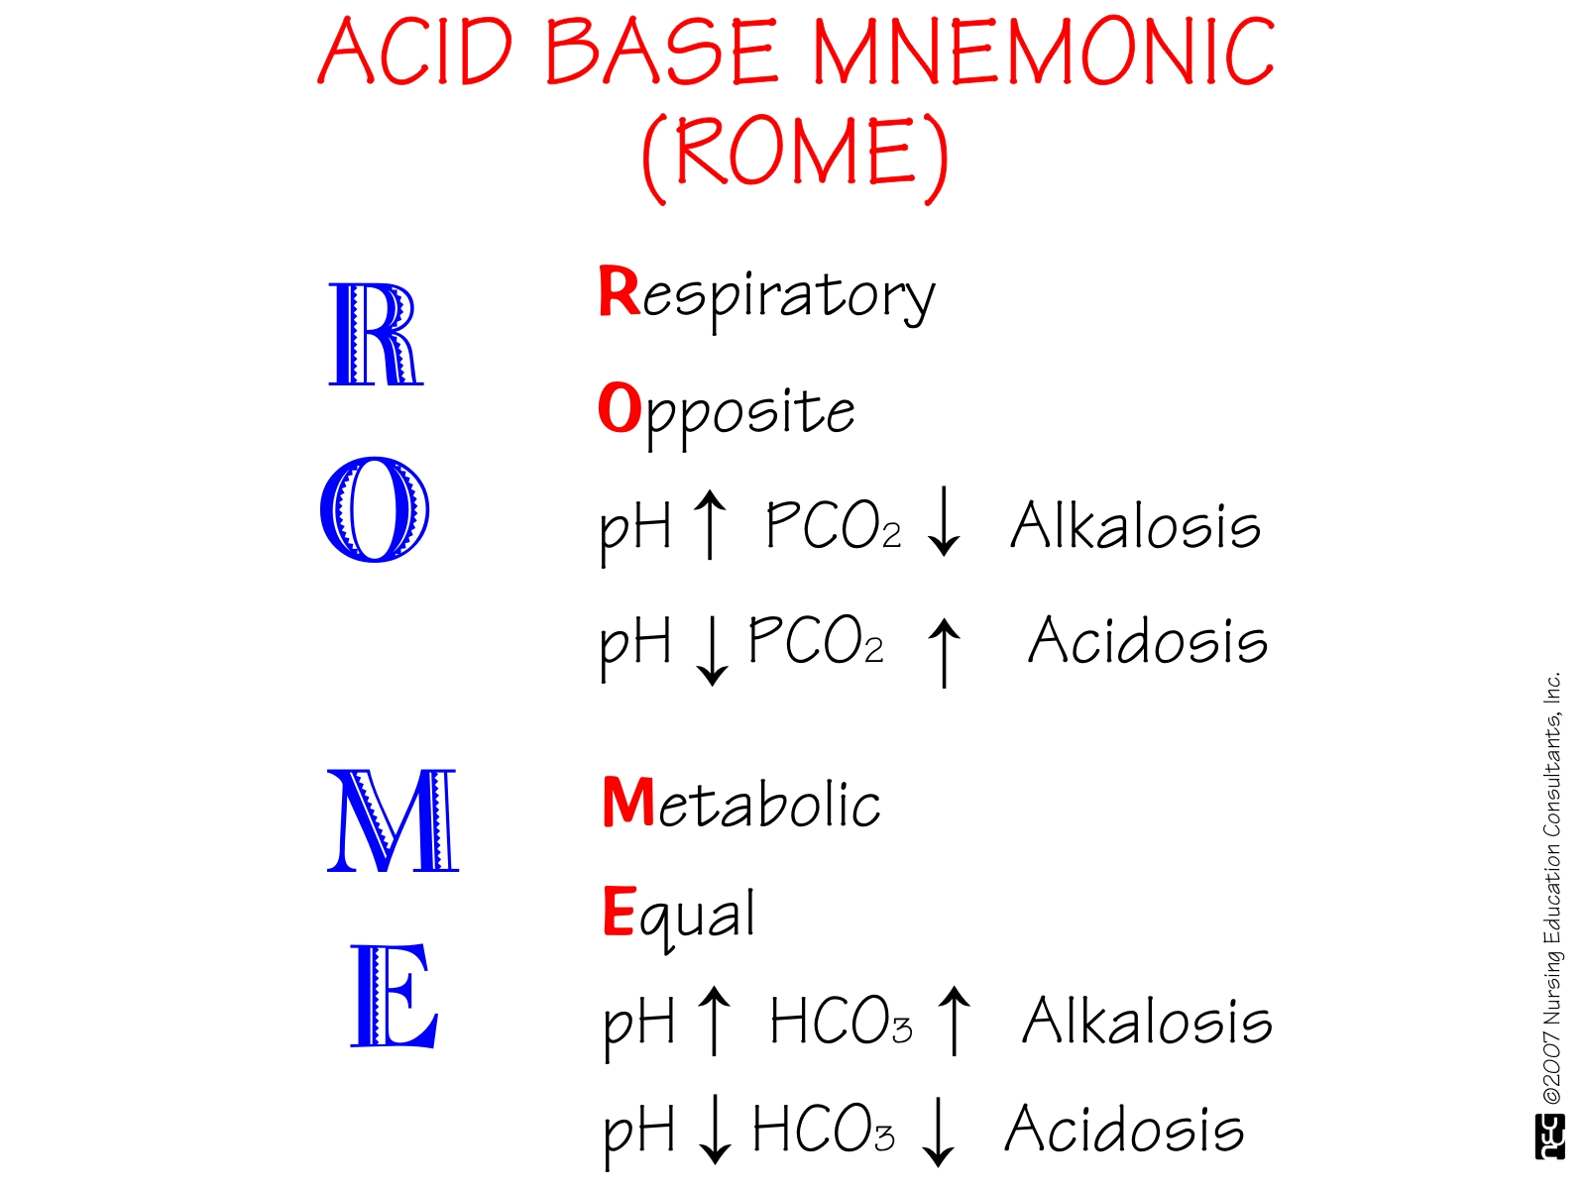

Slide 49
High anion gap metabolic acidosis
Uremia
Diabetic ketoacidosis
Lactic acidosis
salisylates
Methanol
Ethylene Glycol
Paraldehyde

Slide 50
Non-Anion gap metabolic acidosis
Renal tubular acidosis
  Type 1 ( failure of hydrogen ion excretion, DCT)
  Type 2 ( loss of HCO3, PCT)
Diarrhea
Uretrosigmoidostomy diversion
Acetazolamide
Spironolactone

Slide 51
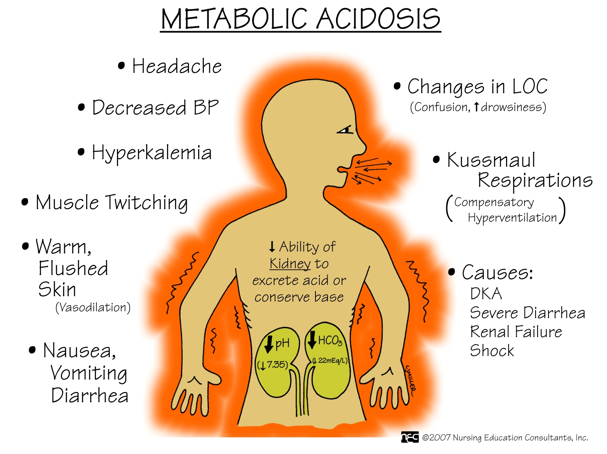

Slide 52
Principles of correction of metabolic acidosis
Calculating dose of hypertonic NaHco3 ( 892 mOsm/L );
  We assume bicarbonate distributes in 50% of body wt. ( volume of distribution, vd ), and to raise pH > 7.2, and Hco3 > 12
  One vial of 8.4% hypertonic NaHco3; 5o ml contains 44.6 mEq
  Hco3 deficit ( mEq/L ) = 0.5 X body wt. ( kg) X ( desired – measured )
  50% of the required dose given at start slowly bolus infusion over 1-2 hours, then monitor pH, Hco3 and Pco2 to give the remaining amount
  70 kg patient whose arterial pH 7.0 and Hco₃ 6 mEq/L, Pco2 34, calculate the Hco3 deficit ? ( 210 mEq/L, require 4.7 vials of bicarbonate )
Notes:
Lactic acidosis two types; type A hypoxia-related , type B due to increased production or reduced metabolism of lactic acid ( metformin ).
Type B has better prognosis than type A
Bicarbonate administration is not recommended in lactic acidosis, particularly in type A, unless there is associated hyperkalemia. Since acidemia reduces lactic acidosis, while alkalemia enhances lactic acid production. Bicarbonate therapy will reduce ionised calcium and this has negative inotropic effect on the heart. Also risk of intracellular acidosis is increased in hypoxic lactic acidosis state. Some trials use thiamine i.v for treating type B lactic acidosis.

Slide 53
Metabolic alkalosis
Contraction alkalosis
Vomiting, NGT suction
Endocrine; conn’s syndrome, Bartter’s syndrome, cushing’s syndrome
Loop and thiazide diuretics
Excess alkali
Post-hypercapnia

Slide 54
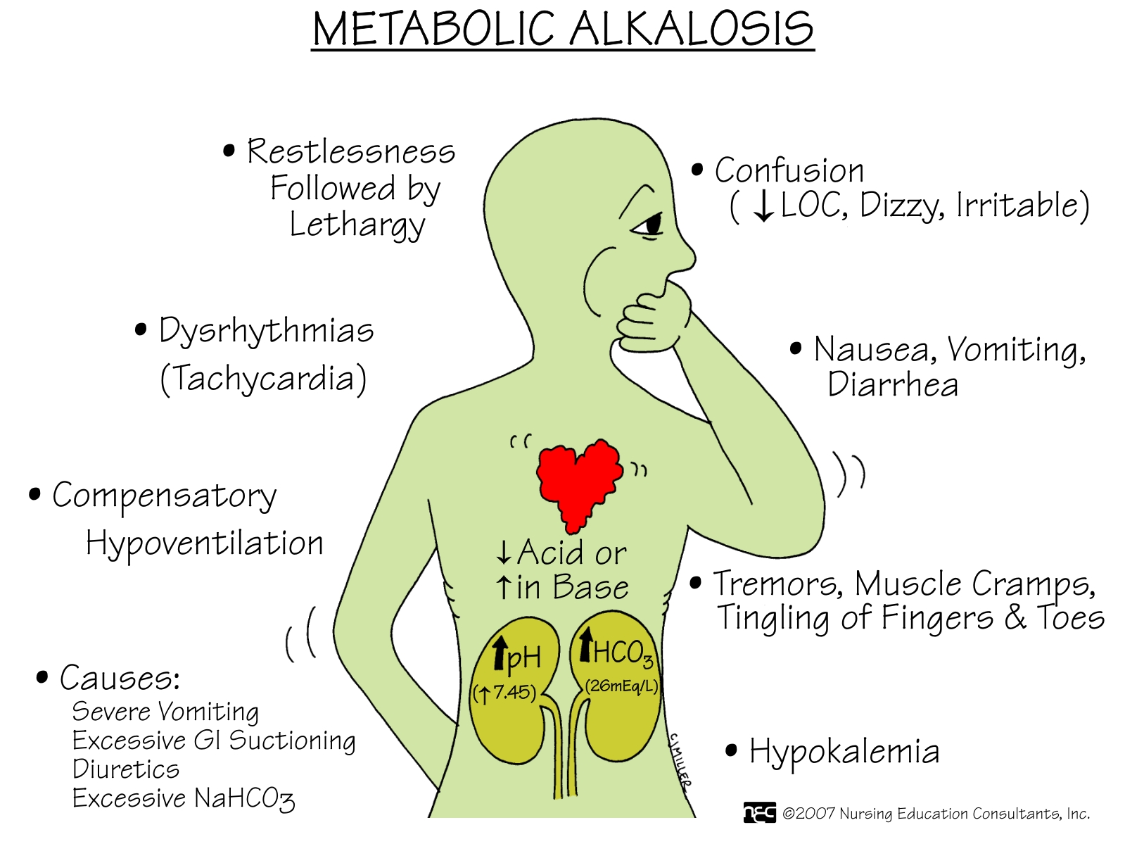

Slide 55
Respiratory acidosis
Acute ( hypoventilation):
  CNS depression ( drugs/ CVA)
  Airway obstruction
  Pneumonia
  Pulmonary edema
  Pneumothorax
  Myopathy
Chronic :
  COPD
  Restrictive lung disease

Slide 56
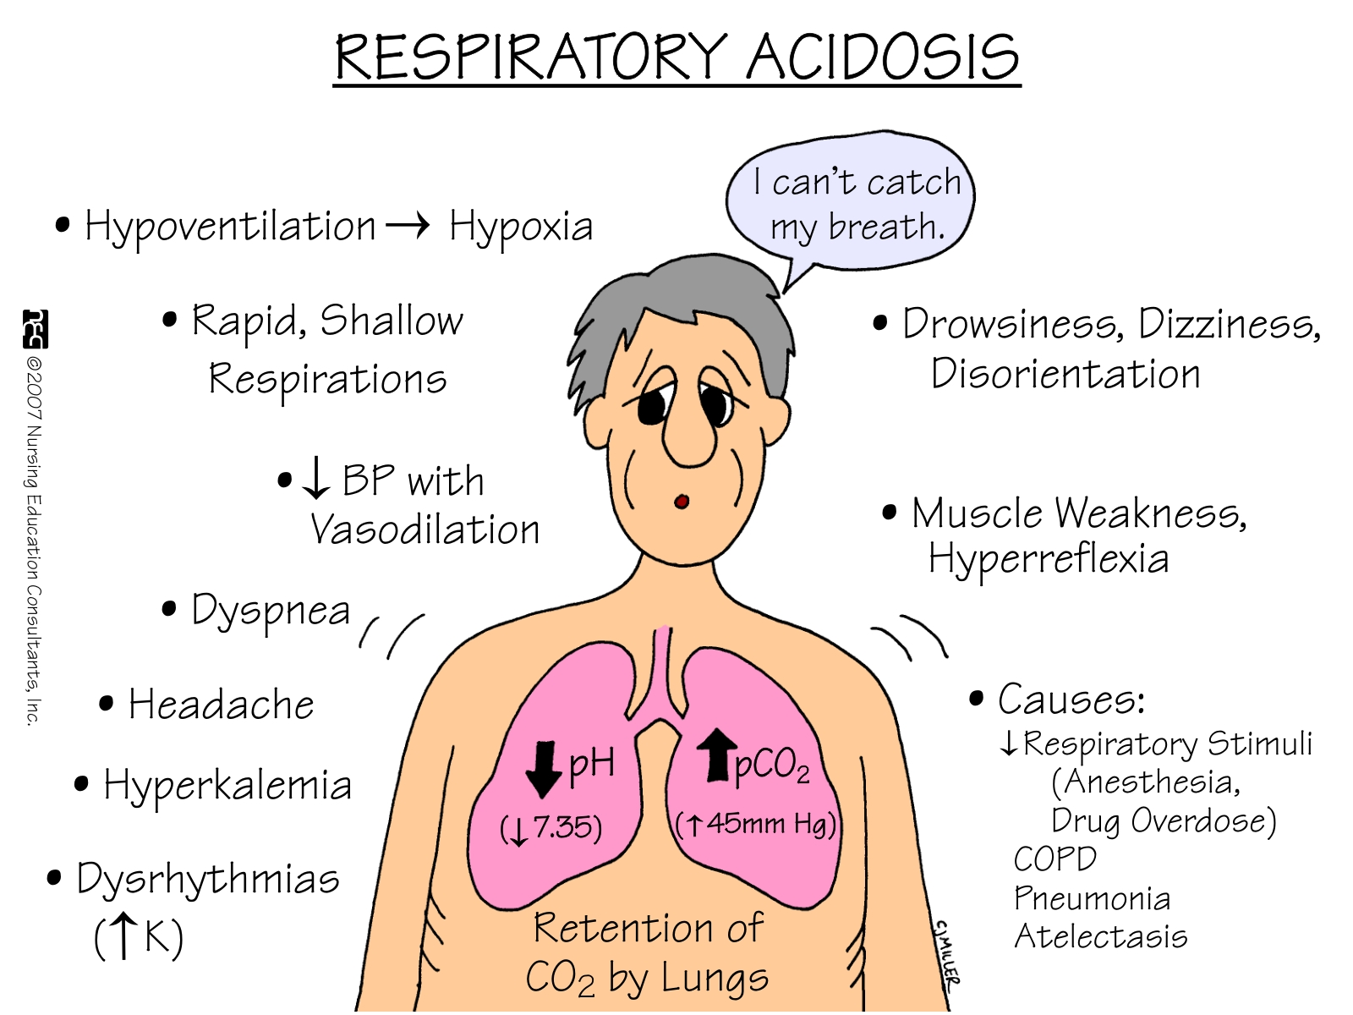
CO2 retention

Slide 57
Respiratory alkalosis
Conditions associated with hyperventilation:
  Hypoxia
  Anxiety
  CNS disease
  Mechanical ventilators
  Progesterone
  Salisylates/ sepsis

Slide 58
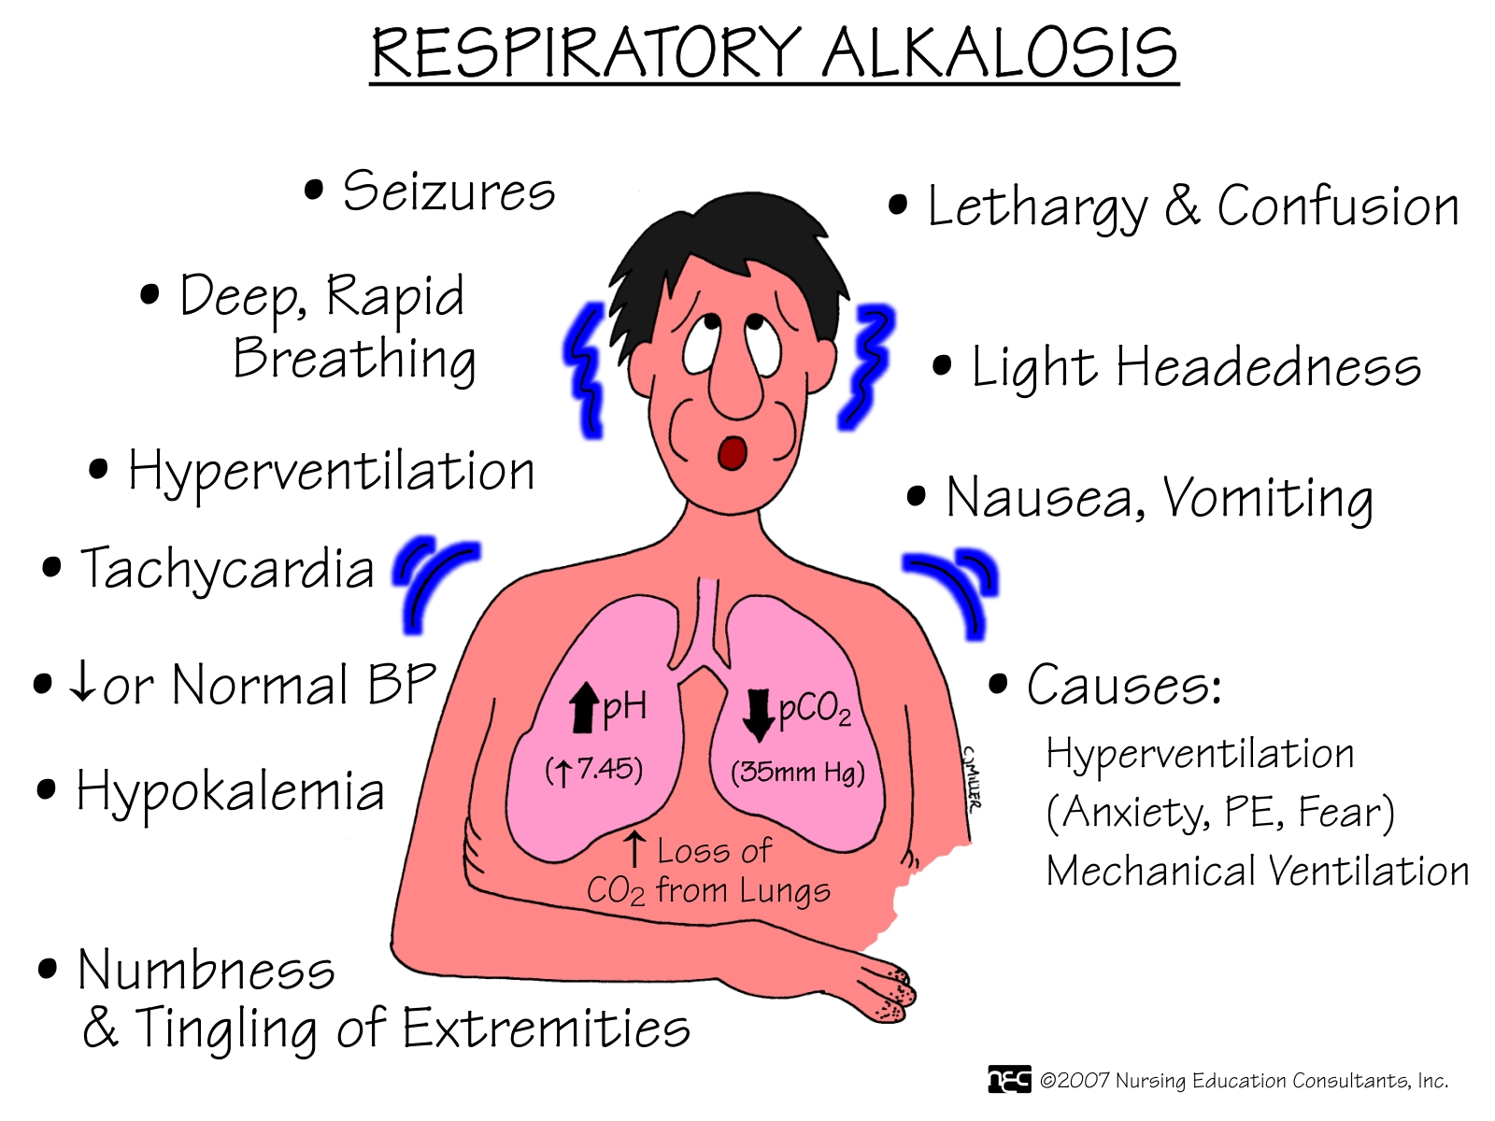

Slide 59
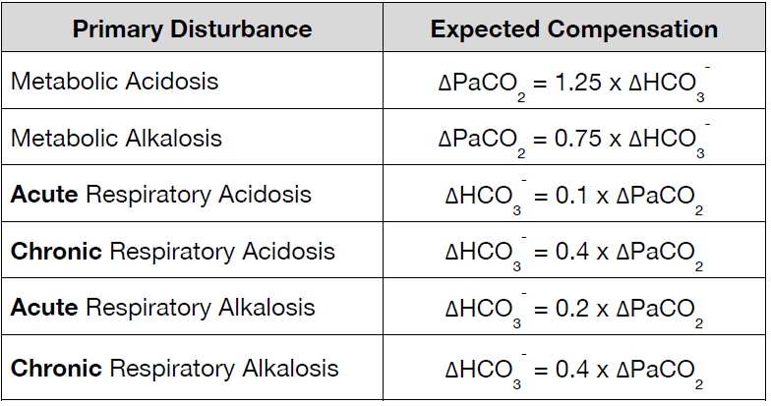
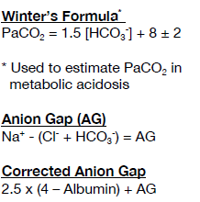
Compensatory responses
- AG
Notes:
Prediction of compensation is more accurate in metabolic distrubances than in respiratory disturbances; owing to slower renal compenations ( may take 4-5 days to be complete ) in respiratory ABB disorders.

Slide 60
Step-wise diagnostic approach
1. History and physical examination ( clinical clues to dx. )
2 . Look at the pH
3. Determine primary problem by comparing direction of change of pCO 2 and pH.
Opposite directions (i.e. a falling pH with a rising pCO 2 ) indicates primary respiratory problem.
Same direction indicates primary metabolic problem.
4. Assess compensation by comparing direction of change of pCO 2 and bicarbonate and applying a compensation rule. If no rule fits, then two problems are probably occurring simultaneously
5. Anion gap
6. AGMA; calculate delta ration ( ∆∕ ∆ )
7. NAGMA; calculate urine anion gap
8. Additional investigation; to find a cause

Slide 61
Case # 1
pH 7,32
PaCo2 28 mmHg
HCO3 14 mEq/ L
Renal function and glucose normal
  What is acid base status of this patient?
Notes:
Simple metabolic acidosis, partially compensated

Slide 62
Case #2
Patient his ABGs paper showed the following; pH 7.15, PaCo2 26, Hco3 12 mmHg, his blood chemistry; sodium 136 mEq/dL, chloride 114 mEq/L, potassium 4.5 mEq/dL
Questions;
  What ABB disorder patient is suffering from ?
  What is d.d diagnosis of his ABB disorder ?
Notes:
Patient has simple NAGMA
d.d; RTA, chronic diarrhea, early CKD

Slide 63
Case # 3
58 years lean man with diabetes mellitus, and chronic kidney disease, presents with abrupt dyspnea, and right sided chest pain for 2 hours.
pO2 sat. 84%
pH 7,48
PaCo2 20 mmHg
HCO3 10 mEq/ L
Creatinine 2.8 mg/ dl
Blood glucose 223 mg/ dl
  What is acid base status of this patient?
Notes:
Mixed respiratory alkalosis with metabolic acidosis

