Slide 1
NOSOCOMIAL(HEALTH CARE ASSOCIATED) INFECTIONS
CONTROL & PREVENTATION

Slide 2
Definition: Healthcare-Associated Infections (HAIs)
Infections that patients acquire during the course of receiving treatment for other conditions within a healthcare setting (and not present or incubating on admission).
*inpatient day care long erm placment.

Slide 3
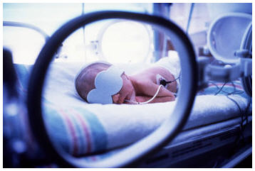
A baby was born prematurely.
She was progressing in the neonatal intensive care unit until she developed a bloodstream infection related to her umbilical catheter.

Slide 4
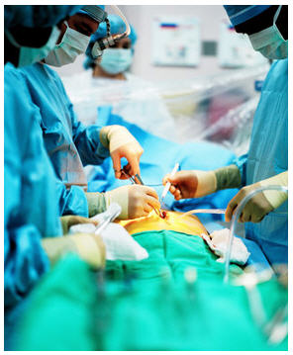
A man has open heart surgery.
The surgery goes well but he later dies of a MRSA wound infection that developed after surgery.

Slide 5

lady contracts Clostridium difficile after giving birth.
She has lived with this unbearable infection through 6 months of relapses.

Slide 6
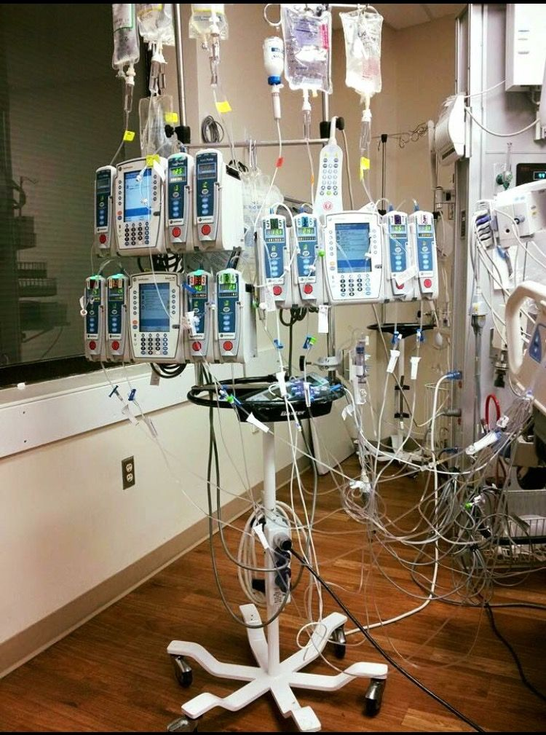

Slide 8
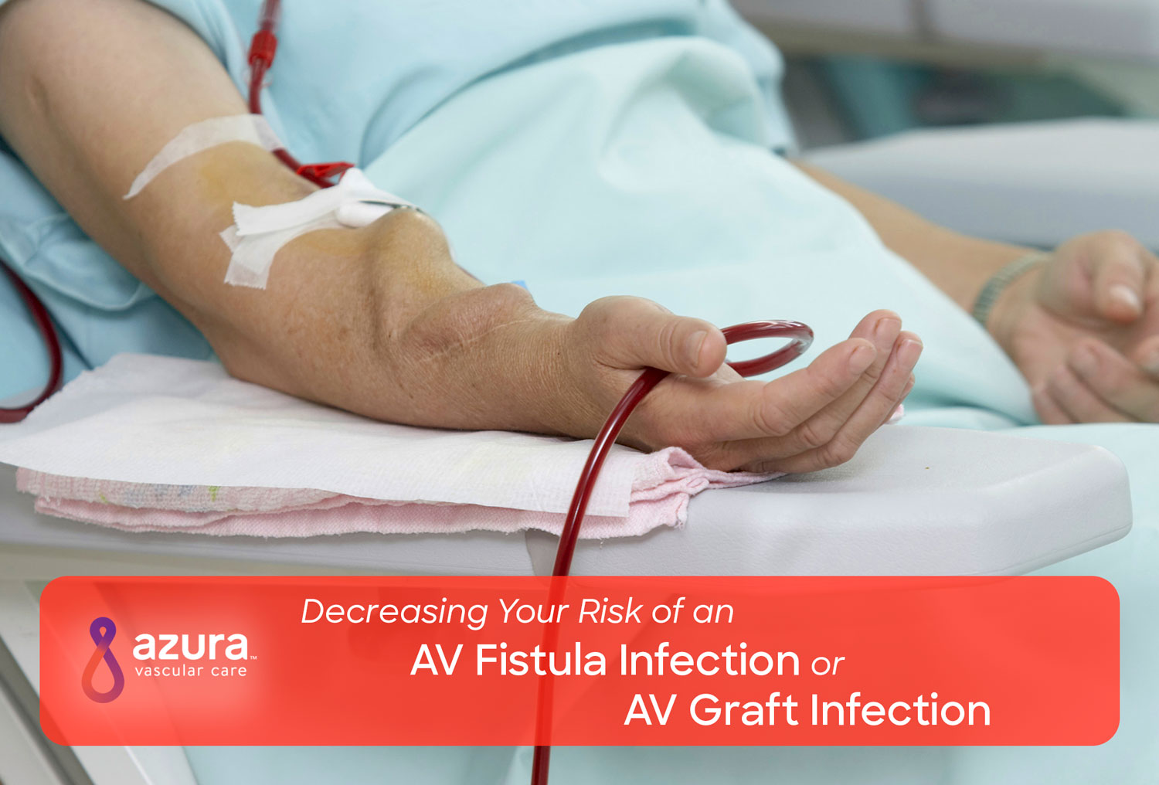

Slide 9
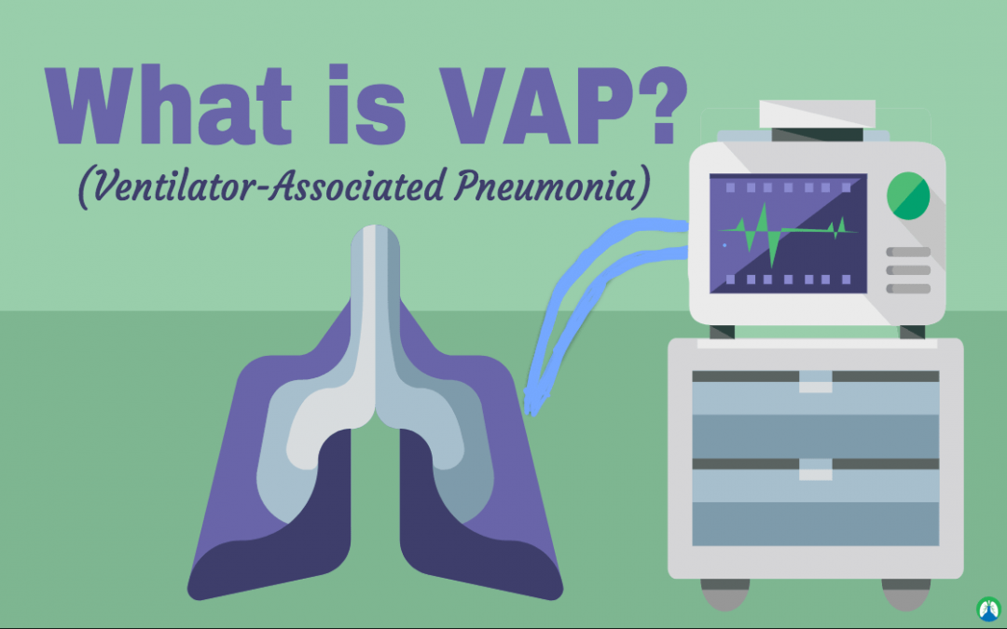
VAP

Slide 10
Infection Control—The process by which health care facilities develop and implement specific policies and procedures to prevent the spread of infections among health care staff and patients

Slide 11
Epidemiology of Nosocomial Infections
Most common sites for nosocomial infections
Surgical incisions
Urinary tract (i.e., catheter-related)
Lower respiratory tract
Bloodstream (i.e., catheter-related)
Notes:
Infection rates approach 8–10% in many developing countries
Most common organisms
Gram negative aerobes (kleb, Pseudo, Enterobacter, Serratia, E.Coli.
Staph Aureus (frequently methacillin resistant)
Enterococcus
M. tuberculosis
Clostridium Dif
Salmonella
Many others (see Goldmann, 2001, unpublished)

Slide 12
Epidemiology of Nosocomial Infections
Common microorganisms??
Aerobic gram-positive cocci (Staphylococcus aureas [MRSA], enterococci [vancomycin-resistant]),
Aerobic gram-negative bacilli (Escherichia coli, P. aeruginosa, Enterobacter spp., and Klebsiella pneumoniae)
Notes:
Infection rates approach 8–10% in many developing countries
Most common organisms
Gram negative aerobes (kleb, Pseudo, Enterobacter, Serratia, E.Coli.
Staph Aureus (frequently methacillin resistant)
Enterococcus
M. tuberculosis
Clostridium Dif
Salmonella
Many others (see Goldmann, 2001, unpublished)

Slide 13
Epidemiology of Nosocomial Infections
Nosocomial transmission of community
acquired, multidrug-resistant organisms
M. tuberculosis
Salmonella spp.
Shigella spp.
V. cholerae
Notes:
Infection rates approach 8–10% in many developing countries.
Most common organisms are—
Gram negative aerobes (kleb, Pseudo, Enterobacter, Serratia, E. coli)
Staph Aureus (frequently methacillin resistant)
Enterococcus
M. tuberculosis
Clostridium Dif
Salmonella
Many others (see Goldmann, 2001, unpublished)

Slide 14
1st principle of infection prevention
at least 35-50% of all healthcare-associated infections are associated with only 5 patient care practices:
Use and care of urinary catheters
Use and care of vascular access lines
Therapy and support of pulmonary functions
Surveillance of surgical procedures
Hand hygiene and standard precautions

Slide 15
Healthcare-Associated Urinary Tract Infection
Urinary tract infection (UTI) causes ~ 40% of hospital-acquired infections
Most infections due to urinary catheters
25% of inpatients are catheterized
Leads to increased morbidity and costs

Slide 16
Prevention of Catheter-Associated Urinary Tract Infection (CA-UTI)
Two main principles
Avoid unnecessary catheterization
Limit the duration of catheterization

Slide 17
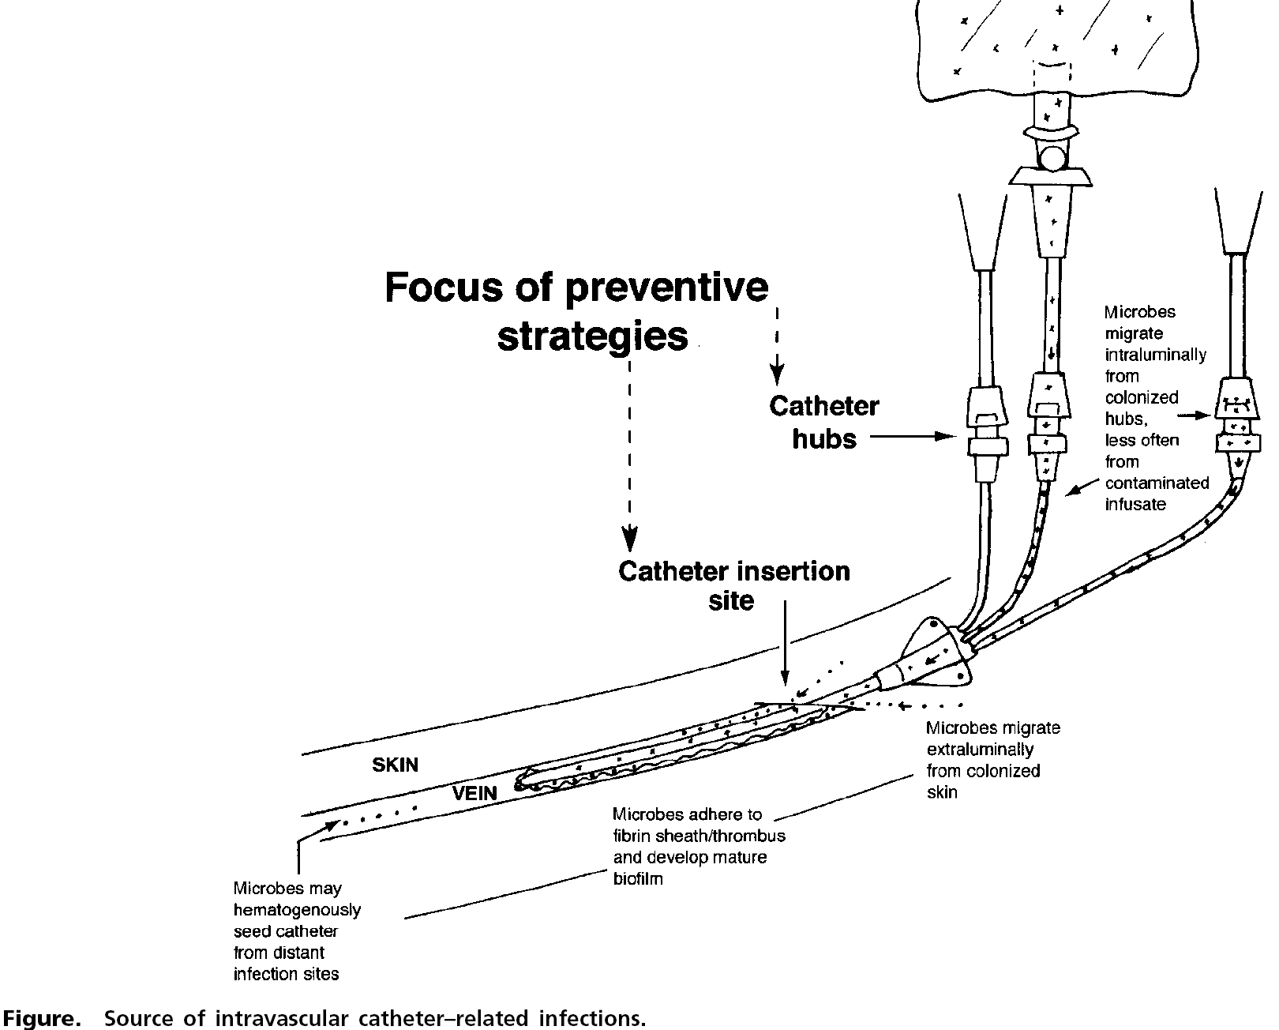
Sources of the catheter-associated bloodstream infection
Intraluminal from tubes and hubs
Hematogenous from distant sites
Skin
Vein
Extraluminal from skin

Slide 18
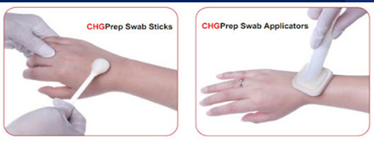
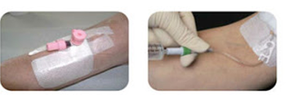
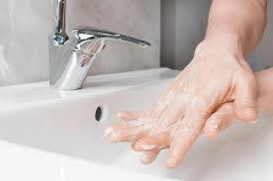
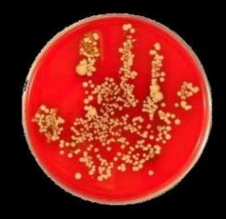
Intervention strategies to reduce catheter-associated bloodstream infections:
Hand hygiene
Maximal sterile barrier precaution at insertion
Skin antisepsis with alcohol-based chlorhexidine-
containing products
Notes:
18

Slide 19
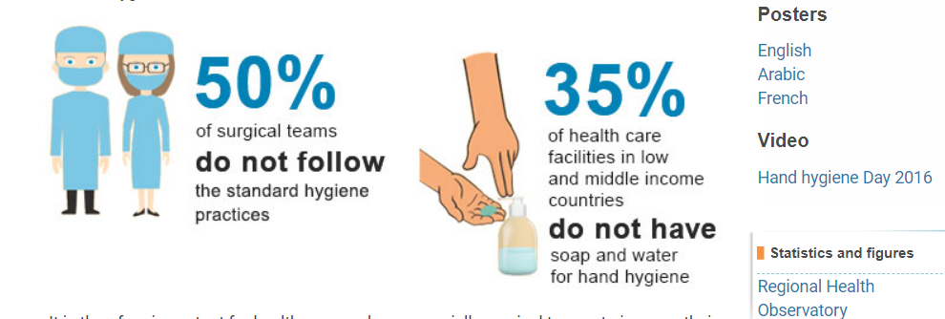

Slide 20
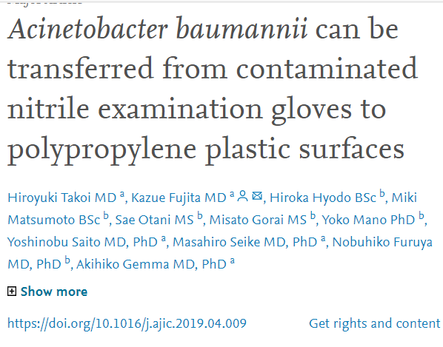
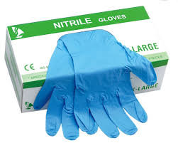
Improper use
lead to problems

Slide 21
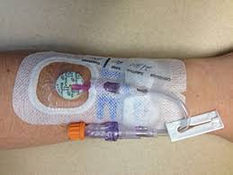
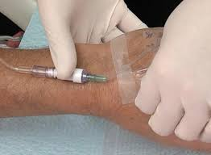
Daily review of line necessity
Standardized catheter care using a non-touch technique
Respecting the recommendations for dressing change

Slide 22
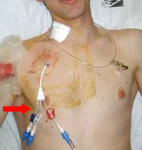
Subclavian access as the preferred insertion site

Slide 23
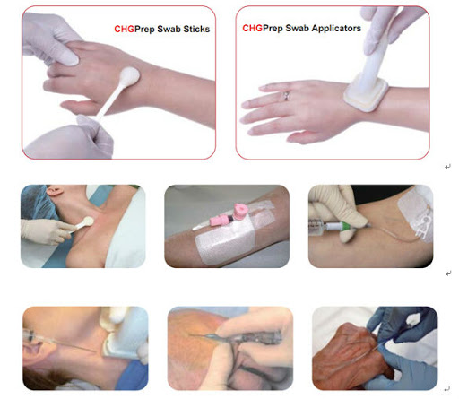

Slide 24
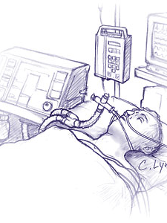
Risk factors for Ventilator-Associated Pneumonia (VAP)
Patient
Age
Coma
Lung disease
Immunosuppression
Malnutrition
Devices
Duration of invasive ventilation
Reintubation

Slide 25
VAP Prevention
- Hand hygiene before and after patient contact, preferably using alcohol-based handrubbing
- Avoid endotracheal intubation if possible
- Minimize the duration of mechanical ventilation
- Promote tracheostomy when ventilation is needed for a longer term
- Glove and gown use for endotracheal tube manip

Slide 26
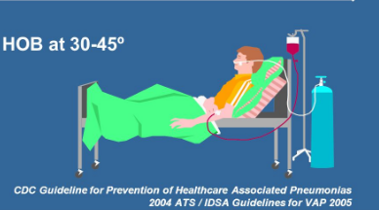
VAP Prevention (con’t)
- Oral hygiene with chlorhexidine
- Backrest elevation 30-45º
- Promote enteral feeding
Elevation of the head of bed (HOB
)

Slide 27
Healthcare-associated Infections
Impact
HAIs rank among the most important causes of death in the developing world
High cost of healthcare
Length of stay, increased use of antibiotics,
Need for isolation, additional laboratory investigations
Organisms may be transmitted to the community
(patients, staff, visitors)
Increase in antimicrobial resistance.

Slide 28
Transmission of Healthcare- associated Infections
Healthcare worker to patient
Patient to healthcare worker
Patient to patient

Slide 29
Standard precautions
Routine infection control precautions that should apply to ALL patients, in ALL healthcare settings.
Designed to facilitate SAFE medical procedures.
Protect patients as well as the healthcare workers.

Slide 30
Standard Precautions
Hand hygiene.
Use of personal protective equipments.
Instrument reprocessing .
Aseptic techniques.
Environmental cleaning and disinfection.
Waste management.

Slide 31
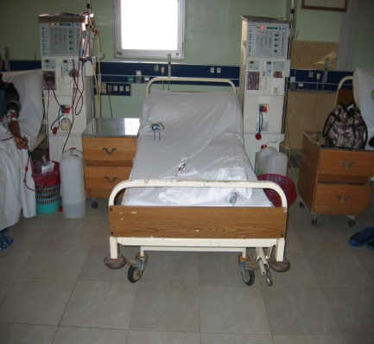
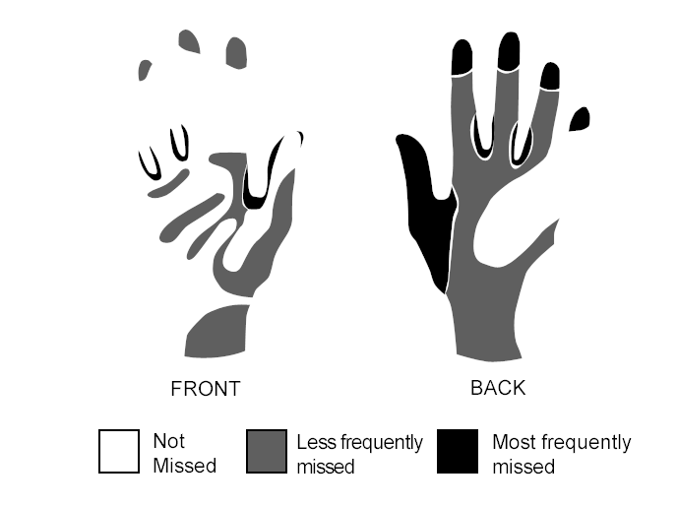
Why hand hygiene?
Most common modes of transmission of pathogens in the hospitals are via hands of health care workers!
Patient Object HCW Hands Patient
Notes:
What is the goal of handwashing? Prevent infections caused by organisms transferred on hands.
To be successful you have to understand all the factors that increase the number of organisms on hands and what can reduce them. Never limit your flocus to just how to wash hands.
Ten things that will reduce the number of organisms reaching patient A
Reduce the number of organisms on the patient;
Showering patients
Disinfect patient items when contaminating by blood or body fluids and between
patients
2. Have patients wash their hands frequently and before using shared items
Minimize the number of objects patients share
Clean, or decontaminate or sterile objects as needed
Don’t touch items in patient rooms when avoidable.
4. Don’t put uncleanable items in patient rooms.
Wash hands after touching items and patients, wear gloves
5. Clean objects between use and/or use covers
6. Wash hands before touching the patient.
What do these have to do with handwashing? Remember our ultimate goal is not handwashing, our goal is to prevent the spread of disease. To reach our goal handwashing is one of a series of things we do that have a common aim. No single action in infection control will be successful. Try to understand what the practice is trying to accomplish and then use common sense (and research when available) to make practices effect.

Slide 32
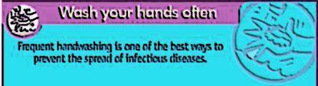
Goal of hand hygiene
Decrease the portion of Nosocomial infections spread by hand contact
Notes:
Note the goal is not to learn to wash hands exactly using the steps we recommend.
Washing hands a particular way is a means to an end.
Goal: is what we are trying to accomplish
Objective: measurable, specific observable time limited outcome
Objective and strategies change overtime with re-assessment. Flexibility is essential.
Infection control rules including handwashing techniques are not written in stone.

Slide 33
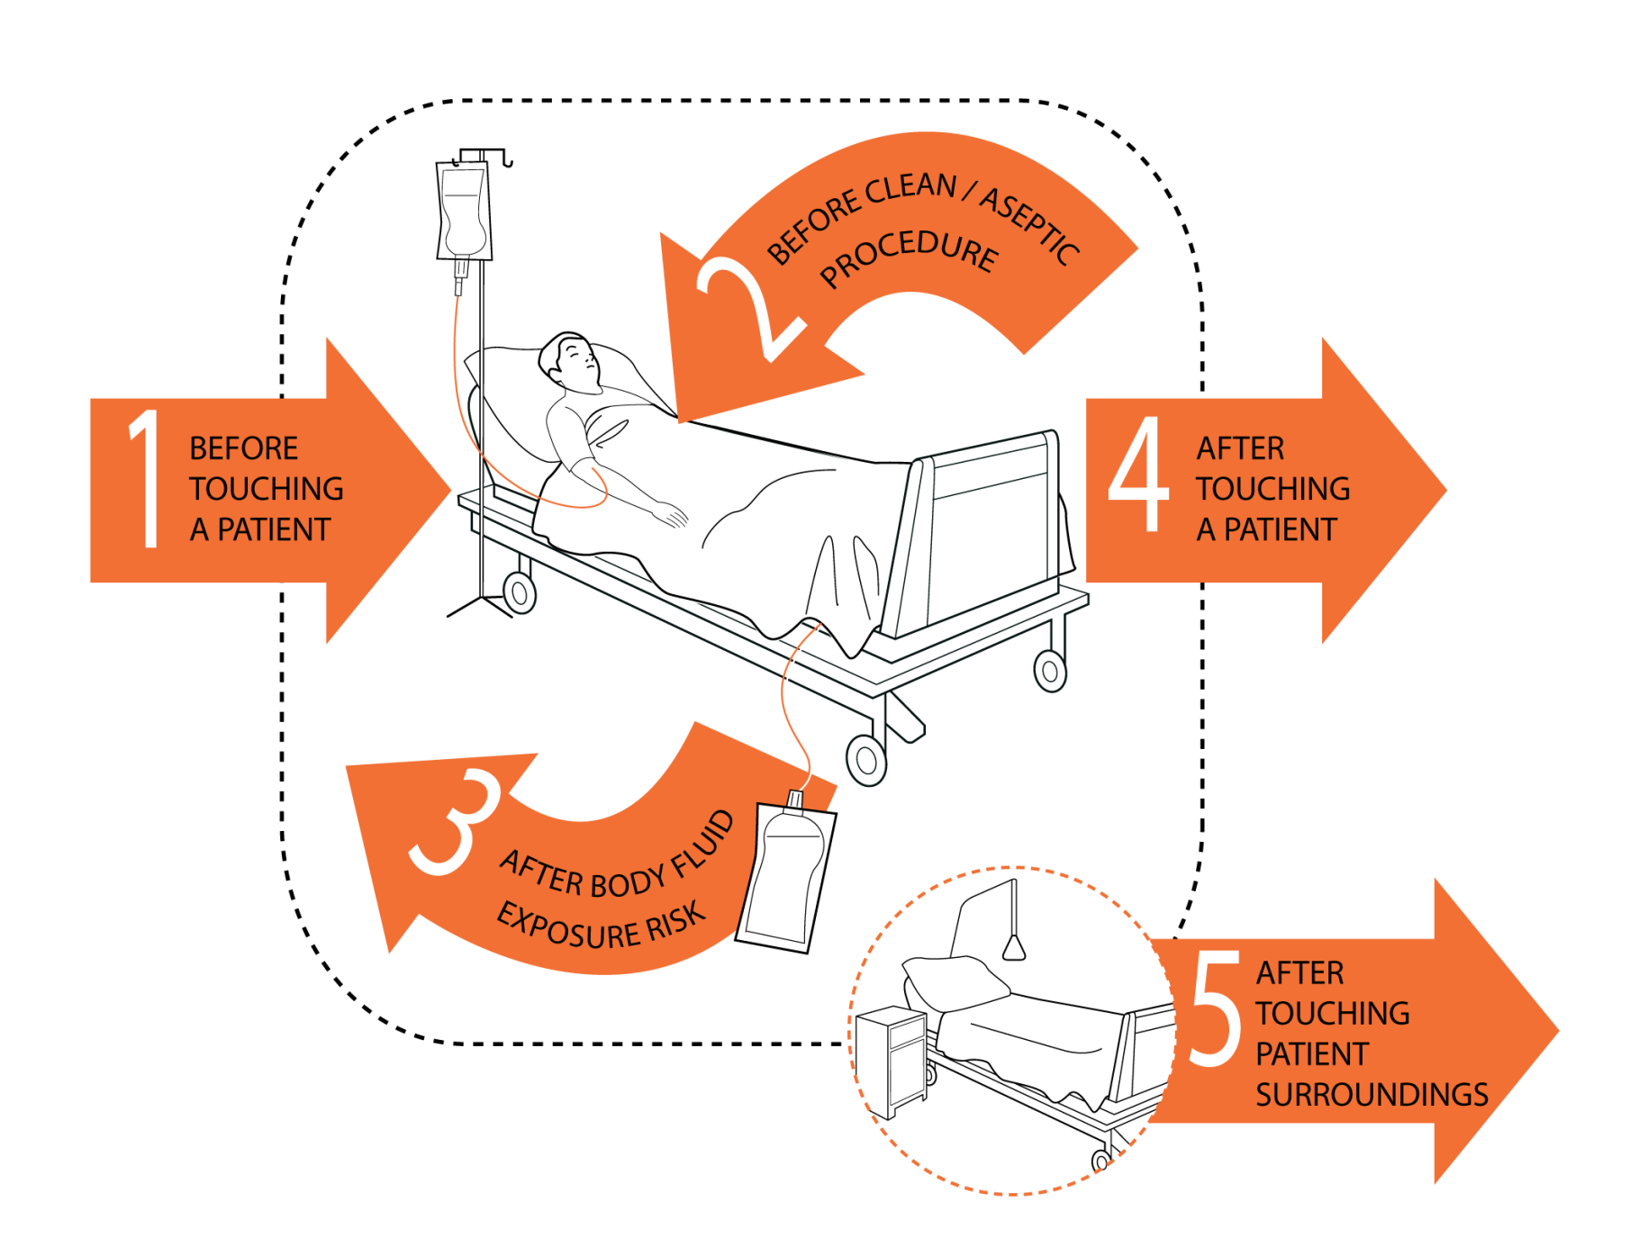
“My 5 Moments for Hand Hygiene”

Slide 34
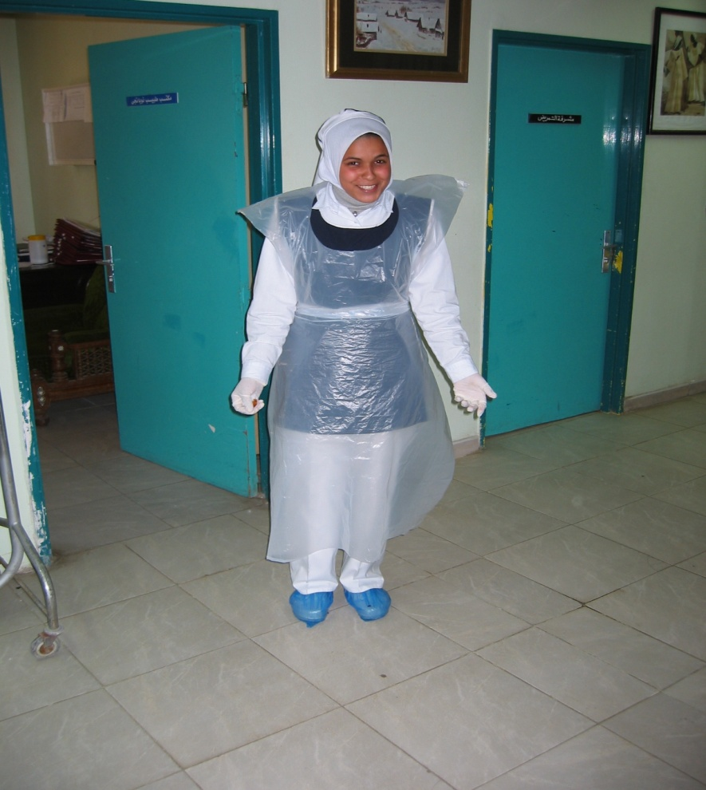
PPE Use in Healthcare Settings Goal
Improve personnel safety in the healthcare environment through appropriate use of PPE
Notes:
Personal = each person has it rather than protective equipment; mask is a personal protective equipment. A high efficiency ventilation systems is protective equipment that protects more than one person at once.
Protective - to protect you
Equipment - disposable supplies and

Slide 35
What is Personal Protective Equipment (PPE)?
Specialized clothing or equipment worn by an employee for protection against infectious diseases
Notes:
Personal = each person has it rather than protective equipment; mask is a personal protective equipment. A high efficiency ventilation systems is protective equipment that protects more than one person at once.
Protective - to protect you
Equipment - disposable supplies and

Slide 36
Personal Protective Equipment
Gloves – protect hands
Gowns – protect skin and/or clothing
Masks and respirators – protect mouth/nose
Goggles – protect eyes
Face shields – protect face, mouth, nose and eyes
Notes:
We now want to discuss five types of PPE, one at a time. We will consider: gloves, gowns, masks, boots, and eye protection.

Slide 37
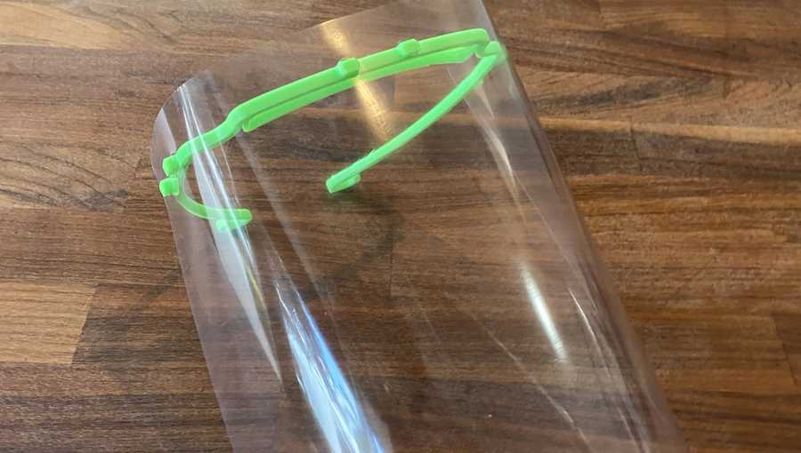
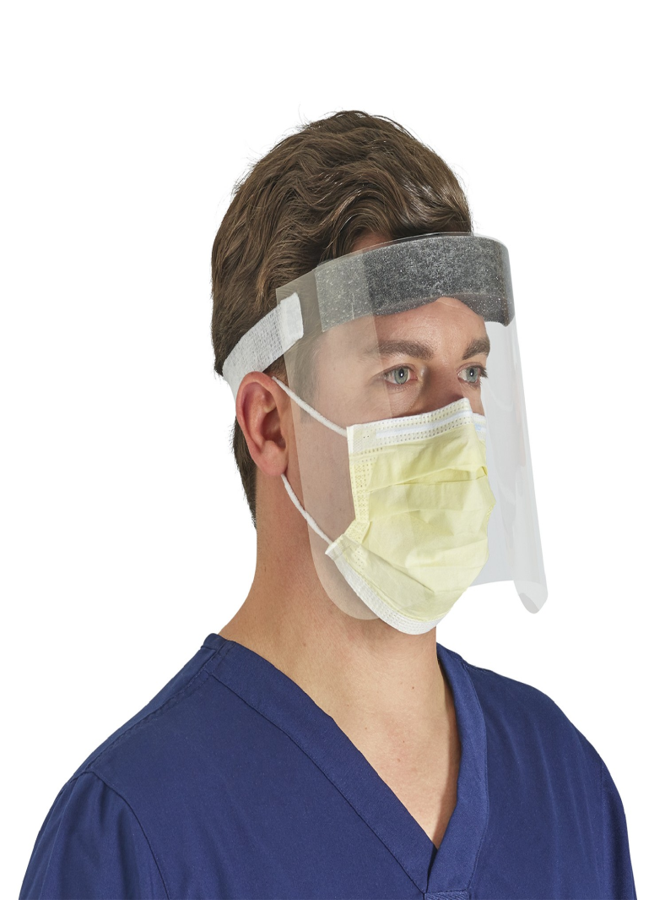
FACE SHIELD

Slide 38
Aseptic techniques
Aseptic means "without microorganisms."
Aseptic technique refers to practices that help reduce the risk of post procedure infections in clients by decreasing the likelihood that microorganisms will enter the body during clinical procedures.
Some of these practices are also designed to reduce service providers' risk of exposure to potentially infectious blood and tissues during clinical procedures

Slide 39

Instrument Reprocessing
Processing instruments used in healthcare make them safe for reuse
Single use items should be disposed off
Never reprocess single use items

Slide 40
Make sure that you understand and can help the patient follow their healthcare provider’s instructions for medication(s) and care.
support for getting groceries, prescriptions, and other personal needs.

Slide 41
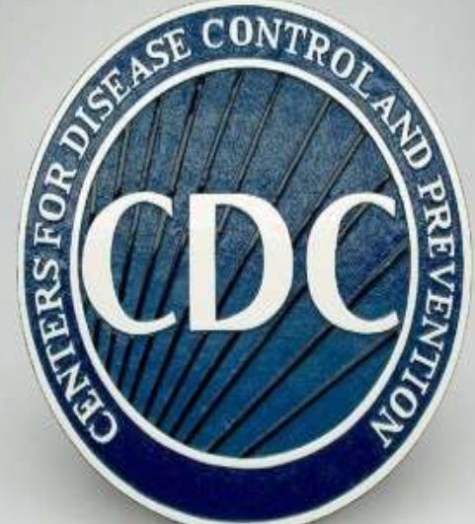
Monitor the patient’s symptoms. If the patient is getting sicker, call his or her healthcare provider and tell them that the patient laboratory result .
Household members should use a separate bedroom and bathroom.
Prohibit visitors.
Pets??.

Slide 42
Hand washing repeat as necessary .
Pt should have mask .
U should wear it if dealing with fluids or pt is not wearing it because of dyspnea.
Dont reuse .
Use a cleaning spray or wipe for surfaces.
Wear disposable gloves while handling soiled item.then remove gloves and wash hands remove mask.wash hand .remove gown wash hands wear new items.

Slide 43
Thank u

