Slide 1
CASE SCENARIO
ALI MOUSA FARAG
1303

Slide 2
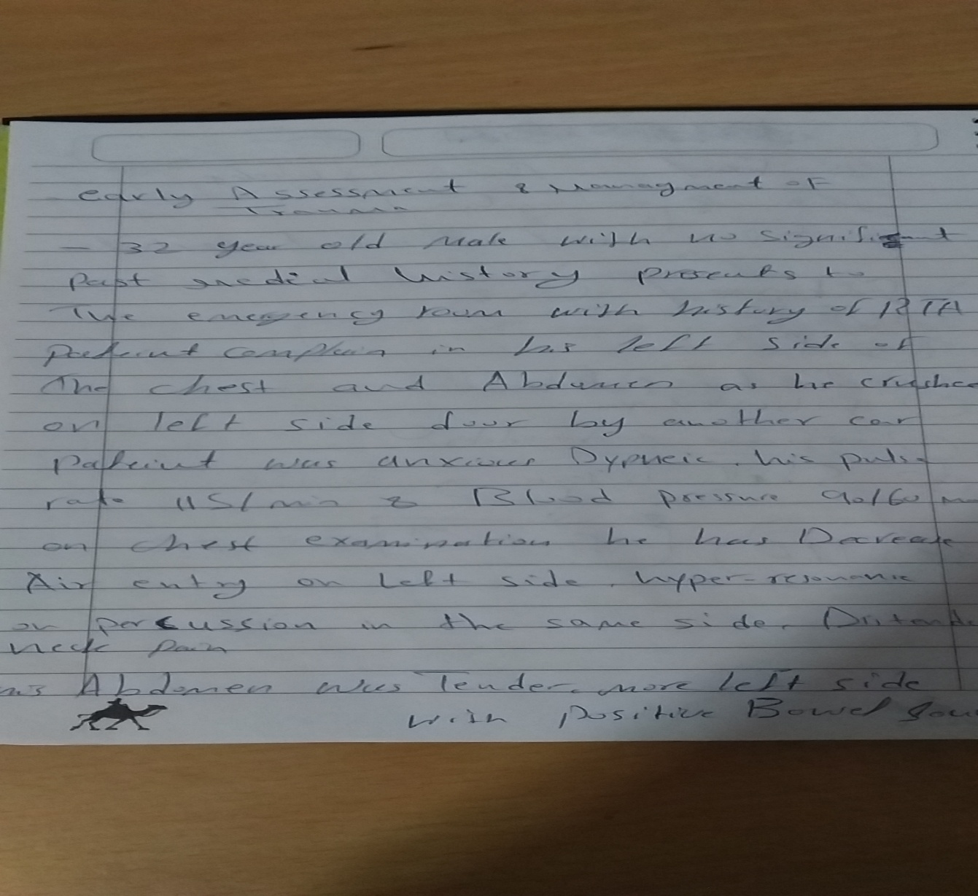

Slide 3
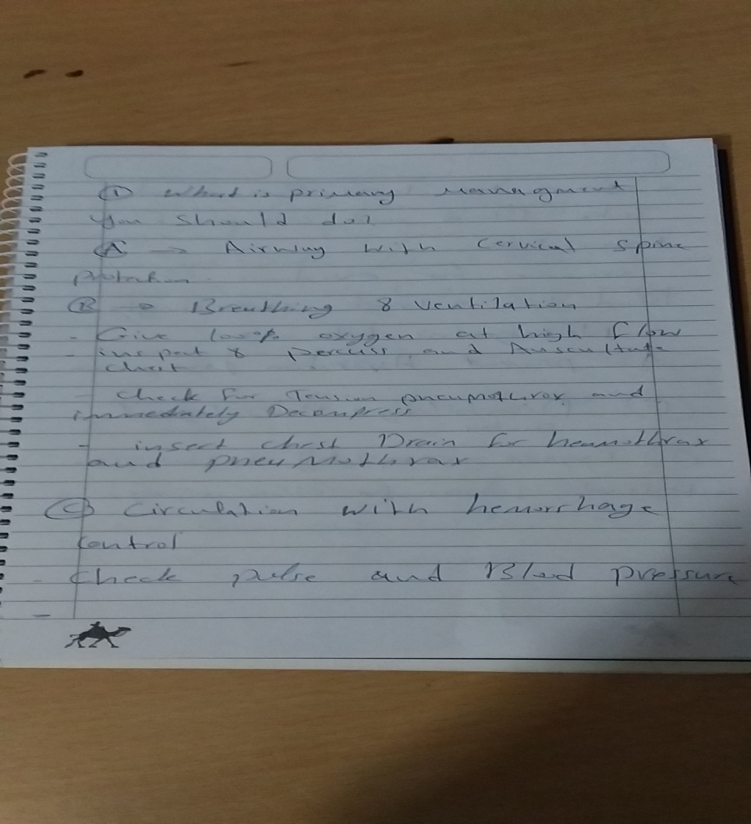

Slide 4
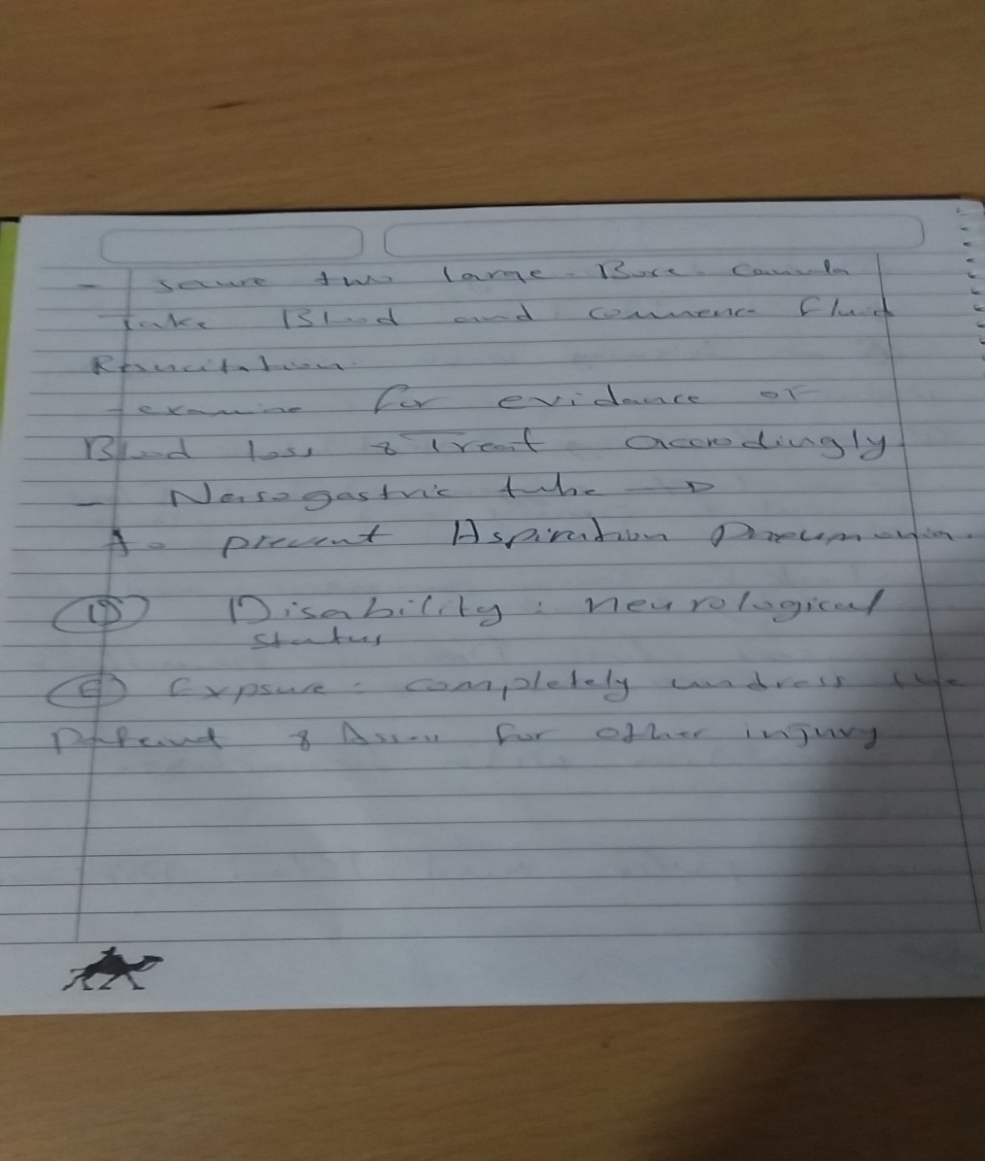

Slide 5
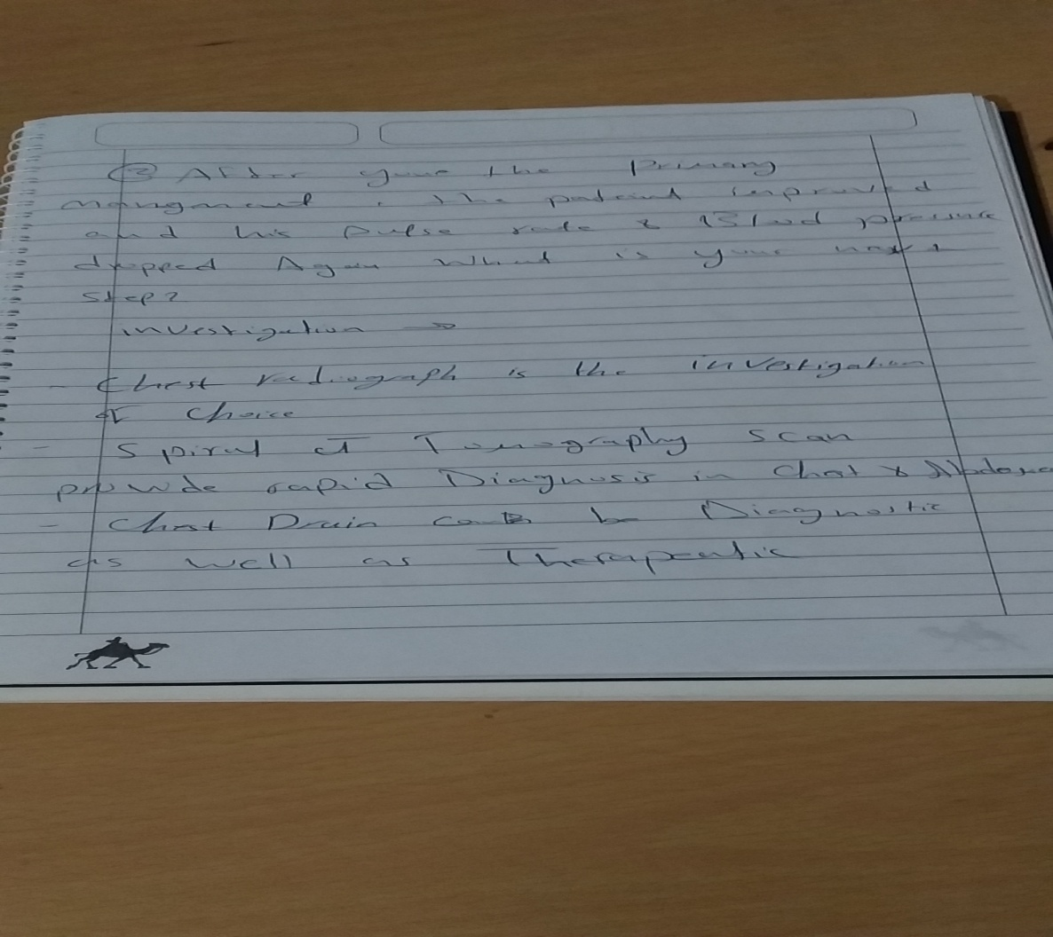

Slide 6
