Slide 1


Healthy heart with nutrition and exercise
Libyan International Medical University
Faculty Of AMS
Rana Almansouri
2865
May,15, 2022
2nd year medical student

Slide 2
Objectives:
Overview the normal component of cardiovascular system ((CVS))
Aging process of cardiovascular system in brief
The effect of some heathy nutrient on cardiovascular system
Exercise in heart disease

Slide 3
Introduction
‘Cardiovascular disease “CVD” remains one of the leading cause of morbidity and mortality in world wide
In this update ,we are focusing on the scientific evidence in support of both dietary and physical activity recommendation for CVD prevention

Slide 4
Overview
  The cardiovascular system is made up by : heart ,blood vessel ,capillary and blood that support our organs and tissue
  Every minute , our heart pumps out about 5litters of blood that supply the body with O2
  Maintaining this complex system ,and delivery anormal and healthy blood flow , is critical to our overall health and well being

Slide 5
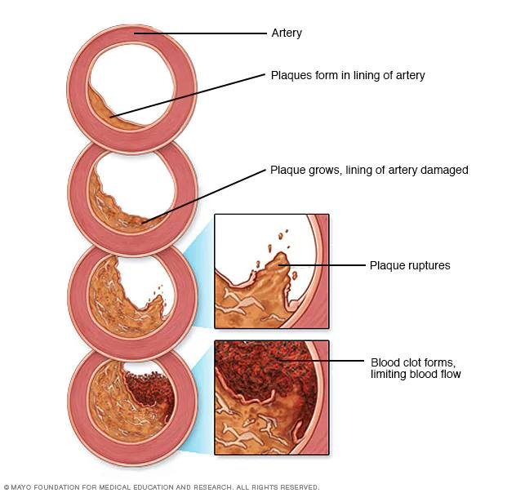
Hallmarks of aging processes in CVS
Loss of elasticity and flexibility of blood vessel
atherosclerosis
Plaque formation
Enlargement and stiffness of the heart
Reduced blood volume

Slide 6
Hallmarks of Aging in CVS
Loss of elasticity and flexibility of blood vessel
For healthy function of our blood vessel and their blood flow.
Stiffness formation and distraction valves
Harden from the build up of fat ,cholesterol ,and other substances on artery wall .
Plaque formation
This plaque build up narrows the arteries and makes it harder for blood to flow through.

Slide 7
Enlarged heart and dysfunctioning valves
our heart and it is valves can also stiffen and enlarged and restrict blood flow ,valve problems, and abnormal heart rhythms
Decrease blood volume
Even the amount of blood can decrease as we age because red and white blood cell are also reduce

Slide 8
the effect of some healthy nutrients on cvs
A lot of researches showing the benefits of some healthy compounds like
1-flavanols
2-fiber and sterols
Fish oil
Antioxidant
Lycopene

Slide 9
Flavanols
Flavanols are bioactive found in such food as cocoa ,beans ,grapes ,tea ,and blueberries
Coca flavanols
1-healthy CVS and heathy blood flow
2-increase nitric oxide (NO) in the wall of blood vessels

Slide 10
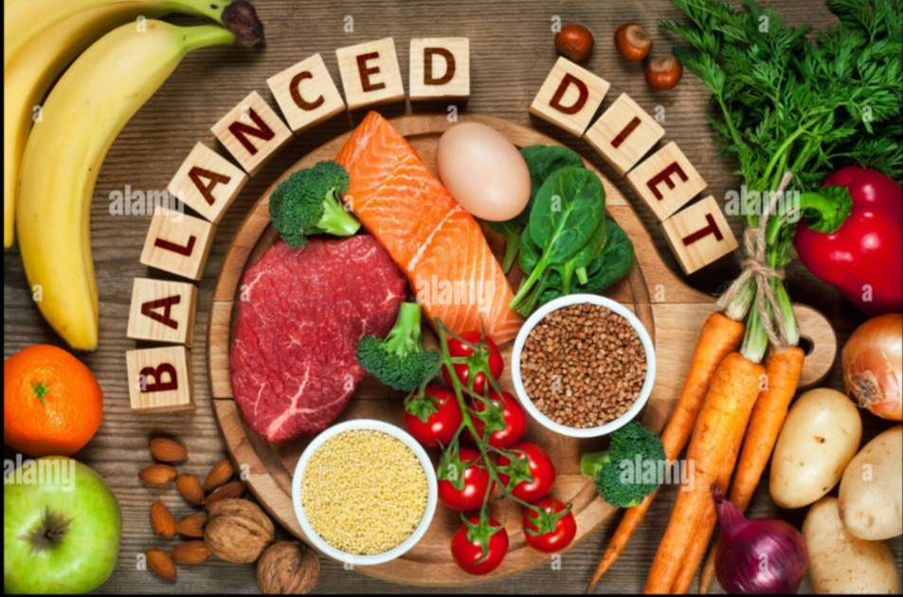
Fiber and plant sterols (((phytosterol)))
fruit
grains
vegetables
seeds
nuts

Slide 11
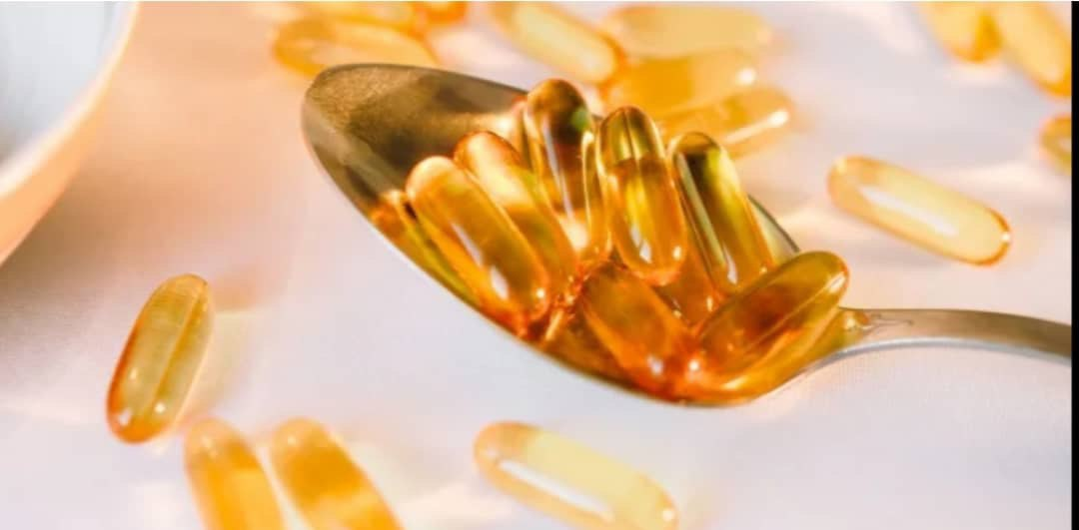
Fiber and plant sterol
reduce amount of cholesterol absorbed from food which can help in reducing blood LDL AND CHOLESTEROL
Fish oil ((omega-3))and fatty acids
1-Reduse the unhealthy fat in blood
2-Improve BP

Slide 12

Antioxidant nutrients
1-slow progression of atherosclerosis B/C of their ability to inhibit the damaging oxidative processes also antioxidant intervention may affect long term lesion progression but not necessarily modulate the properties of preexisting advanced atherosclerosis lesions

Slide 13
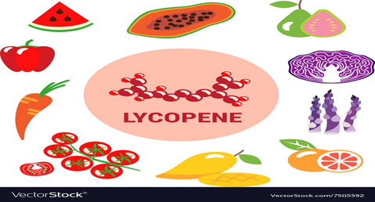
Lycopene
year((naturally present carotenoid ))
tomato and tomato products
Increase lycopene decrease heart disease
A lot of studies have shown an inverse relationship between the intake of lycopene and the incidence of heart disease
Unfortunately more than two third of heart disease –related death world wide can be linked two food choice , and 6 million death could have been avoided through better diet , according to study published last year .

Slide 14

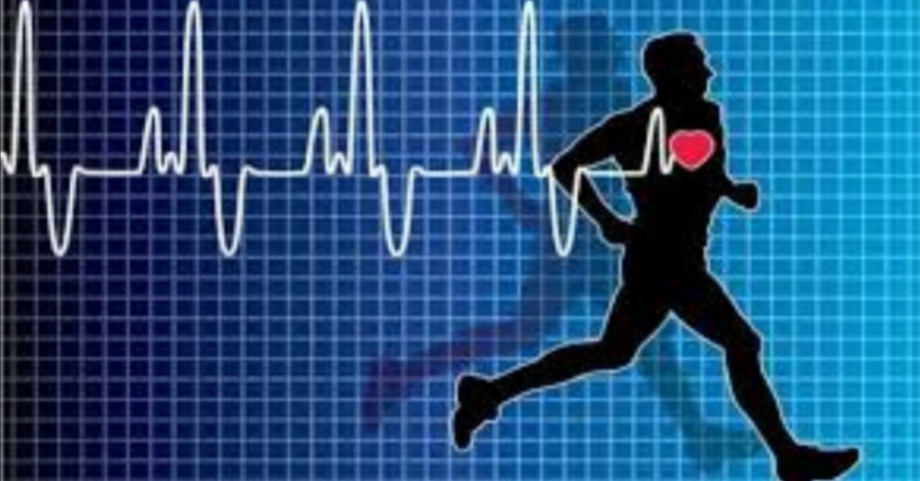
Exercise in cardiovascular disease
At least 30 min /day of regular mild to moderate physical activity can reduce risk of :
CVD
Hypertension
DM
Obesity
osteoporosis

Slide 15
Conclusion
The high CVD prevalence is largely attributed to the sedentary life style and nutritional behavior
And in combition with drug treatment intervention in the area of nutrition ant physical activity is the recommended management for p.t at a high risk of CVD

Slide 16
REFRENCES
Wu L, Ashraf MH, Facci M, Wang R, Paterson PG, Ferrie A, Juurlink BH. Dietary approach to attenuate oxidative stress, hypertension, and inflammation in the cardiovascular system. Proceedings of the National Academy of Sciences. 2004 May 4;101(18):7094-9.
Steptoe A, Kivimäki M. Stress and cardiovascular disease. Nature Reviews Cardiology. 2012 Jun;9(6):360-70
Hong YM. Atherosclerotic cardiovascular disease beginning in childhood. Korean circulation journal. 2010 Jan 1;40(1):1-9

Slide 17

Thank you

