Slide 1
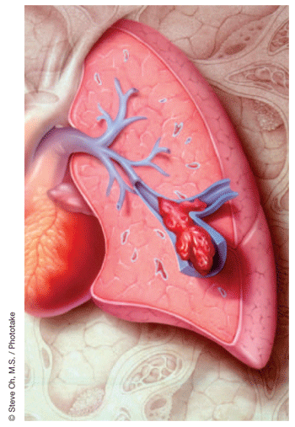
pulmonary embolism
Dr. Zaki Bettamer
Zikoecho@yahoo.com
Saturday, June 20, 2020

Slide 2
67 years Old male presented with acute dyspnea, Pleuritic Right side chest pain and hemoptysis , with history of recent pelvic fracture post RTA one week back.
On examination : Left leg swelling and tender, BP: 90/60, pulse : 140 beat / minute, regular.
Chest examination: normal
The commonest arrhythmia expected in this patient

Slide 3
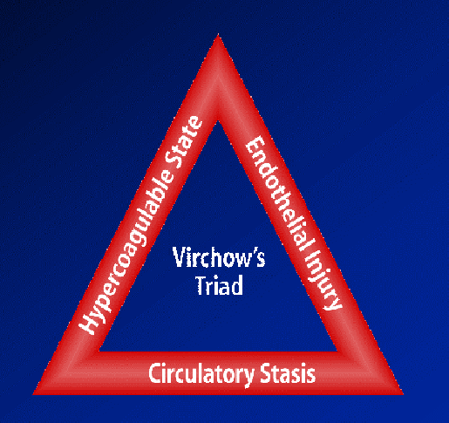

Slide 4
Definition:
It is an obstructive lesion in the pulmonary vascular tree.
It is usually caused by a insoluble thrombus that has travelled from a distant site.
A blood clot that forms and remain in a vein is called thrombus, a clot that travels to another part is called embolus.

Slide 5
Incidence:
The majority (80%) of pulmonary emboli arise from the propagation of lower limb DVT
The annual incidence is about 60-70 per 100 000 population.
Rare causes include septic emboli (from endocarditis affecting the tricuspid or pulmonary valves), tumour (especially choriocarcinoma), fat, air, amniotic fluid and placenta.
It is a common mode of death in patients with cancer, stroke and pregnancy.

Slide 6
Correct diagnosis is made only in 10-30 %.
60 % of autopsies showed some evidence of post PE.
15 % of postoperative deaths are related to PE or its sequels.
PE is a commonest cause of maternal death in the UK.

Slide 7
Predisposing factors
Recent surgery especially pelvic, large
joint and extensive abdominal .
Following pelvic and leg fractures.
Pregnancy and child birth.
Old age: > 70 years.
Smoking .
Inherited clotting disorders:
a. Hypercoagulable state.
b. Platelets abnormalities.
c. Protein S & C deficiency.

Slide 8
Long periods of immobility:
a. Prolonged hospitalization.
b. Long plane or car trips.
c. Prolonged bed rest.
Severe debilitating illness:
a. Severe injures.
b. Cardiac diseases.
c. Malignancies.

Slide 9
Increased estrogen level:
a. Contraceptive pills.
b. Hormonal therapy.
Increased levels of clotting factors:
a. pancreatic, lung and ovarian malignancies
(increased procoagulant).
b. Female hormones.

Slide 10
Family history.
Pace makers or venous catheterization either central or peripheral.
Being overweight:
There is a link between the formation of clots
formation to leptin ( hormone produced by fat cells).
Previous proved history of venous thromboembolism.

Slide 11
Cardiac problems:
a. Congenital.
b. Congestive.
c. Hypertensive.
Others:
a. Nephrotic syndrome.
b. Thrombotic and myeloproliferative disorders.
c. Inflammatory bowel diseases.

Slide 12
Sources and origin of PE
The source can be indentified in only 50 – 70 % of cases.
70 – 90 % of the identified cases, clots come from IVC.
10 – 20 % of the identified cases, clotscome from SVC.

Slide 13
Pathological leading causes
Deep vein thrombosis.
Air embolism.
Amniotic fluid embolism.
Fat embolism.
Rare : Tumor emboli & Bacterial clumps.

Slide 14
Progression of pulmonary embolism.
The course of events depend on the size of the clot causing PE.
A. Small to medium sized PE.
Cut off the circulation to a part of the lung.
It heals with fibrous scar.
Can travel more distally infracting the lung.

Slide 15
B. Massive pulmonary embolism.
Embolize the main pulmonary artery Blocking off almost blood flow to lungs.
The emboli may happen suddenly causing Massive PE or gradual causing recurrent PE state.
Lodge at the bifurcation of the main pulmonary artery causing hemodynamic collapse or death.

Slide 16
Probable outcome of PE.
10 % of clinically presented PE are fatal.
30 % of patients with PE will suffer a second attack.
70 % will had PE complications.

Slide 17
Differential diagnosis of PE
Myocardial infarction.
Pneumonia.
Congestive heart failure.
Asthma.
COPD.
Intrathoracic neoplasm.
Rib fractures.
Pneumothorax.
Musculoskeletal pains.

Slide 18
Presentations of PE.
According to the size of venous emboli:
Acute
Large sized.
Massive PE.
It involves > 50 % of the main PA
Sudden death.
Chronic
Small sized.
Pulmonary infarction with episodes of pleuritic chest pain And haemoptysis.

Slide 19
Postoperative presentations.
Classical time: 2nd postoperative week !
Sudden death
Cyanosis
Dysponea
Tackyponea
Cough
Hemoptysis
Chest pains
Low EtCO2

Slide 20
Symptoms More clear in patient with pre-existing lung diseases.
Possible presentations:
Completely normal.
Chest pain
Pleuritic pain
Dysponea
Apprehension
Cough
Hemoptysis
Diaphoresis

Slide 21
Syncope
Tachyponea
Rales
Tachycardia
Fever > 37.8
Phlebitis
Cyanosis
Leg swelling
Leg pain
Wheezing
Angina pain.
AF
Coma
Pul.infection
Sweating

Slide 22
Chronic effects of PE
1. Increased PVR.
2. Decrease gasexchange.
3. Alveolar hyperventilation.
4. Increased AWP.
5. Decreased lung compliance.
6. Right side ventricular dysfunction & failure.

Slide 23
Screening and Diagnosis.
PE is difficult to diagnose especially with underlying lung or cardiac diseases.
More than one test should be done to increase the efficacy of correct diagnosis.

Slide 24
1st line of investigations.
ECG.
Nonspecific changes are common.
Sinus tachycardia is the commonest among changes.
Possible changes: AF, RBBB, T wave inversion &
P pulmonale.
S1 , Q3, T3

Slide 25
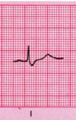


ECG
Signs of right ventricular strain
(S1, Q3, T3)
S wave in lead 1
Q wave in III
inverted T in III

Slide 26
Chest X ray.
Possible findings
normal.
Atelectasis or density.
Pleural effusion.
Pleural opacity.
Elevated diaphragm.
Prominent PA.
Cardiomegally.
Pulmonary edema.

Slide 27
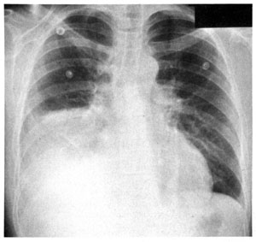
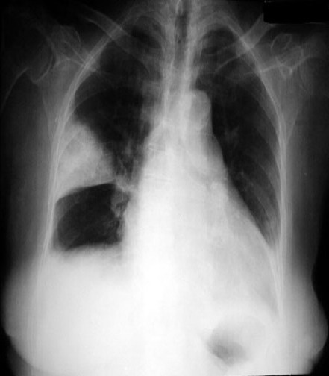
Pleural effusion
Wedge shaped density.

Slide 28
ABGs
May be normal !
Hypoxia.
Respiratory hypocarbia.
Increased A-a gradient.
* Gradient > 15-20 is considered abnormal.

Slide 29
D – dimer test.
D – dimer are released as a result of fibrinolysis & indicate the presence of intravascular thrombus. It reflects the breakdown of plasmin.
Useful, to exclude the PE.
Has > 99% sensitivity in acute PE or DVT.
.

Slide 30
Negative D – dimer Test.
Exclude PE in Patient with low pre-test Probability.
Helpful in patient with a high clinical Probability.
Positive D – dimer test.
Needs further investigations to confirm the diagnosis
Less useful in patients with longer hospitalization.
False positive can result from the clot formation at venepuncture sites.

Slide 31
False positive d – dimer test
Malignant Patient.
Recent Surgery.
Chronic Inflammatory Process
Sepsis
Venepuncture Due to clot formation

Slide 32
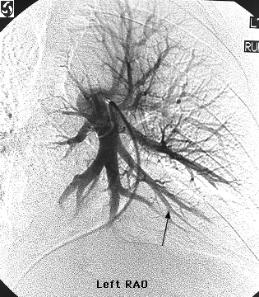
Pulmonary angiography
Shows pulmonary vascular obstruction
Gold standard of diagnosis of PE,
Thrombolytic therapy can be given through the catheter afterwards.

Slide 33
Computed tomographic pulmonary angiogram
Has sensitivity > 90 %
Dilatation of pulmonary vessels proximal to the embolus with collapse of distal vessels.

Slide 34
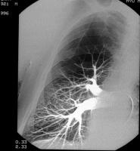
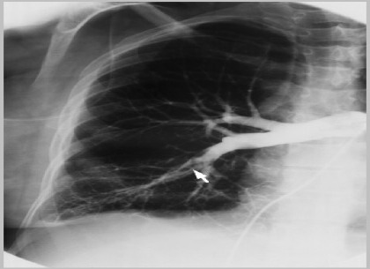

Slide 35
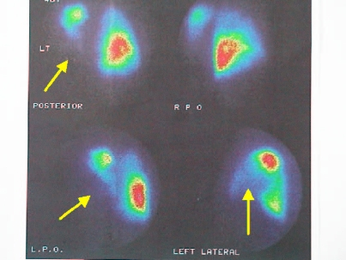
Isotope lung scan.
( ventilation/perfusion scan)
Use of radioactive tracers to study
air flow( ventilation ) and
blood flow (perfusion).

Slide 36
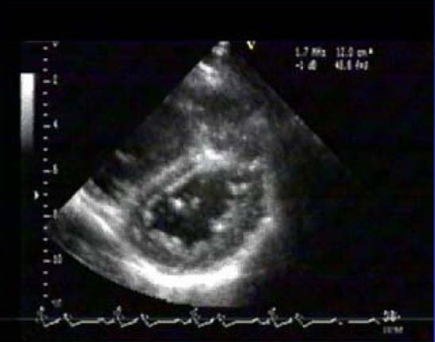
2nd line of investigations.
Leg ultrasound scan doppler for detection of DVT.
Around 70 % of patient proved PE will have a proximal DVT.
. Echocardiogram.
Diagnostic only in the massive PE.
Of prognostic information's.
The findings may be:
* RV overload & dysfunction.
* Dilatation of IVC.
* Dilated pulmonary arties.
* Disturbed flow velocity.
* Direct visualization of clots in the prox. PA, RV, or RA.

Slide 37
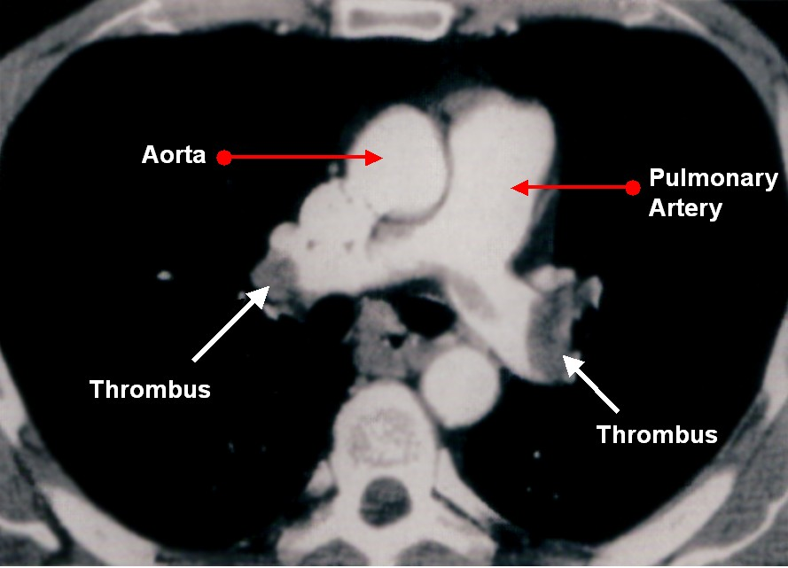
Spiral “ Helical “ computerized tomography.
Three dimensional series of very thin x ray beams using contrast dye.

Slide 38
Lung ultrasound.
1. It is noninvasive sonar.
2. Uses high frequency sound waves to check for blood clots.
3. It is cheaper than V/Q scan
Venography.
Invasive procedure to reveal clot blockage at any point of the vein course using contrast.

Slide 39
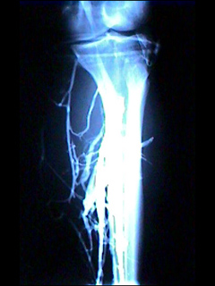


Slide 40
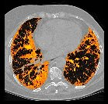
Magnetic resonance ( MRI ).
Expensive.
Reserved for pregnant woman and renal patient.
TEE.
Intraoperative diagnosis of PE.

Slide 41

c. Intraoperative prophylaxis
Decrease venousstasis:
1. Raising legs.
2. Avoid leg trauma.
3. Use of pneumatic leg compression.
4. Use of electrical calf muscle stimulation.

Slide 42
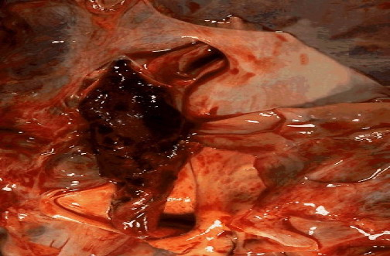
When pulmonary embolism is life threatening ?
Massive PE.
Worsening the cardiopulmonary underlying diseases.
Treatment plan are not effective.

Slide 43
Treatment overview of PE
1. Preventive strategies plan:
A. Preventive steps in the hospital:
1. Correction of the risk factors.
2. Adequate hydration.
3. Graduated compression stockings.
4. Use of pneumatic compression.
5. Early physical activity.

Slide 44
6. Anticoagulant therapy.
a. Heparin: 5000 iu, 8-12 hˉ1 , 2h before operation.
b. Ultra low dose heparin: 1 unit.kg.hˉ1 infusion.
c. Adjusted heparin dose: start 3500 iu subcut. Every 8 hˉ1 to keep ATT 1.5 X normal.
d. Low molecular heparin: one dose, 12hˉ1 subcut.untill patient ambulate.

Slide 45


B. Preventive steps while travelling.
Take a walk.
Exercise while you set.
Wear support stockings.
Drink plenty of fluids.
Ask for medical advise:
* If you had DVT before.
* If the travelling time is more than 6 hours.
* If you at any risk.

Slide 46
II. Active strategies plans.
A. Treatment of DVT:
1. Heparin.
* 5000 IU bolus, followed by
40000 IU over 24 h for 7 days.
* adjust the dose: APTT 1.5-2
2. Oral anticoagulants:
* Warfarin for 3 – 6 month.
* Keep PT 1.2-1.5 ( INR : 2 – 3 )

Slide 47
B. Thrombolytic therapy.
indicated for acute massive PE causing collapse or arrest.
1. Streptokinase:
250000 U IV over 30 min, then
100000 U hˉ1 for 24 hours.
2. Tissue type plasmogen activator
100 mg IV over 2 hours.
3. Urokinase:
4400 IU Kgˉ1 over 10 min. followed by
4400 IU Kgˉ1.hˉ1 for 12 -24 hours.

Slide 48
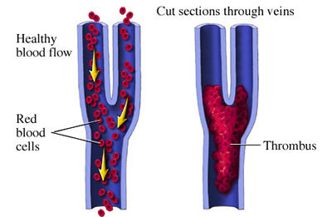
Actilyse ” Alteplase”
* Action:
It is an enzyme that increase plasmin that break down clots.
Recommendations
a. Should be given as soon as possible.
b. Given as infusion over 2-3 hours.
c. 10 mg bolus over one or two minutes
followed by 90 mg.

Slide 49
C. Surgical pulmonary embolectomy.
* Under CP bypass.
* Postoperative & operative mortality is 20 – 50 %
* Long term survival is 71 % after 5 years.
* Indicated in acute massive PE with life
D. I.V.C umbrella filter:
* Placed percutaneously under local analgesia.
* Aim: to avoid recurrence of more emboli.

Slide 50
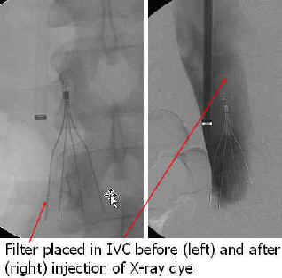
D. I.V.C umbrella filter:
* Indications:
a. Contraindication to anticoagulant.
b. Failure of anticoagulant therapy.
c. Chronic recurrent PE
d. Emergency treatment following massive PE.

Slide 51
E. Cather throbectomy.
* Indications:
A. Contraindication for frinolysis.
B. Surgical embolectomy is not available.

Slide 52

Please don’t forget
Patients at risk of DVT should be encouraged to keep mobile.

Slide 53
Regarding the D – dimer test in diagnosis of Pulmonary Embolism :
Presence of D – Dimer is not indicate the presence of intravascular thrombus.
Has <2 % sensitivity in acute Pulmonary Embolism or DVT.
Useful to exclude the Pulmonary Embolism.
Negative D – dimer Needs further investigations to confirm the diagnosis.
Positive D – dimer test Exclude Pulmonary Embolism in Patient with high pretest Probability.

Slide 54
One of the following is Chronic effects of Pulmonary Embolism :
Decrease Pulmonary Vascular Resistant .
Increase gas exchange.
Decrease A Wedge Pressure .
Increase lung compliance.
Right side ventricular dysfunction & failure.

Slide 55

THANK YOU

