Slide 1


Effect of climate change on the world economy
Student name: Mohamed Ramadan Alzayani
Student number: 2712
Block: PTS
Date: 3rd/April/2022
1

Slide 2
The Objectives:
Define what will happen during the climate change.
Effect of the climate change in the world economy.
Outline the major non-renewable and renewable energy sources.
List the appropriate steps to preserve the climate.
2

Slide 3

The Introduction
3

Slide 4
1- Define what will happen during the climate change
TEMPERATURE
Ice
Has risen about 1.8°F.
has decreased more than 60 feet since 1980.
SEA LEVEL
VEGETATION
has risen from 1.7mm/year to 3.2mm/year.
Extreme precipitation events can disturb plant growth.
Population
Animals
severe extreme weather events.
More animal species are becoming extinct.
4

Slide 5
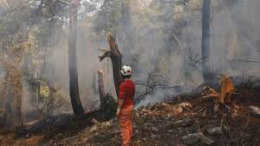
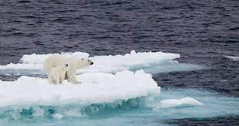
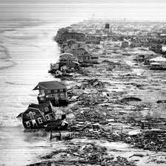
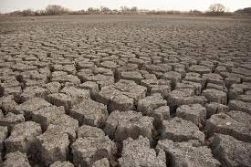
5

Slide 6
2- Effect of the climate change in world economy:
Global growth will be obstructed by rising operational costs as global temperatures rise, with studies suggesting that a worst-case impact of a 1% reduction in gross domestic product growth per year could be realized.
6
Notes:
You know guys there is studies shows that a worse case impact 1% reduction in the gross domastic product grouth every year.
And the impact will be damaging to the develobing economies.
And onlly through serios effort can the long-term financial reflection be improve

Slide 7
The effect on growth and inflation:
Despite there being winners and losers, increasing temperatures will be negative for global activity overall.
7

Slide 8
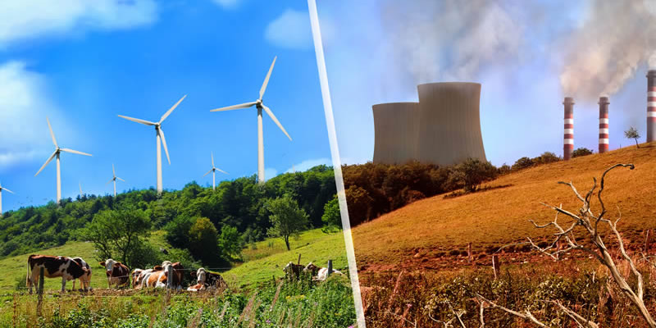
3- Outline the sources of non-renewable
and renewable energy:
8

Slide 9
The non-renewable sources:
Petroleum
Hydrocarbon gas liquids
Nuclear energy
9

Slide 10
The renewable sources:
Solar energy
Hydropower
Wind energy
Biomass
10

Slide 11
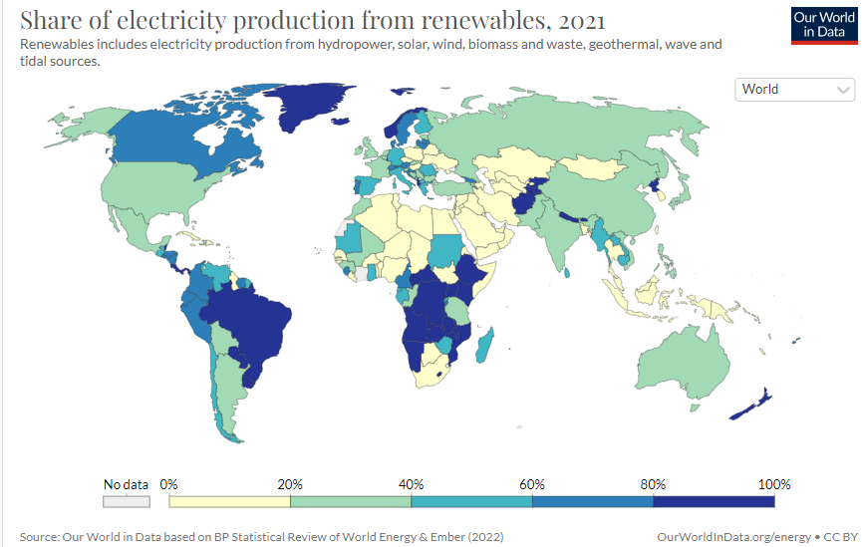
11

Slide 12
4- List the steps to preserve the climate:
Keep petroleum in the ground.
Invest in renewable energy.
Improve farming and encourage vegan diets.
Protect forests like the Amazon.
Protect the oceans.
Reduce plastic.
12

Slide 13
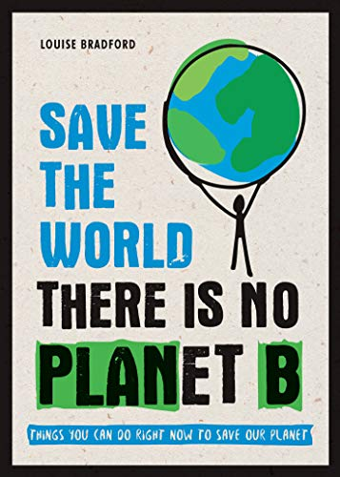
In the conclusion:
Our planet is literally dying and that’s because of our recklessness and selfishness, and we need to take a serious position about that.
13

Slide 14
References:
Covington. H and Thamotheram. R (2015), “The Case for Forceful Stewardship (Part 1): The Financial Risk from Global Warming”, Available at SSRN: http:// ssrn.com/abstract=2551478 or http://dx.doi.org/10.2139/ssrn.2551478
Covington.H and Thamotheram.R (2015), “The Case for Forceful Stewardship (Part 2): Managing Climate Risk (January 19, 2015), Available at SSRN: http:// ssrn.com/abstract=2551485 and http://dx.doi.org/10.2139/ssrn.2551485
Dietz.S & Stern.N (2014), “Endogenous growth, convexity of damages and climate risk: how Nordhaus’ framework supports deep cuts in carbon emissions”, Centre for Climate Change Economics and Policy, Working Paper No.180
International Monetary Fund, Fiscal Affairs Department (2008), “The Fiscal Implications of Climate Change”, Available at SSRN: http://www.imf.org/external/ np/pp/eng/2008/022208.pdf
Hallegatte.S, Dumas.P and Hourcade.J.C (2010), “A Note on the Economic Cost of Climate Change and the Rationale to Limit it Below 2°C”, World Bank Policy Research Working Paper 5179
https://www.eia.gov/energyexplained/what-is-energy/sources-of-energy.php
https://www.greenpeace.org.uk/challenges/climate-change/solutions-climate-change/ agreement).
14

Slide 15
THANKS FOR YOUR ATTENTION

